Slide 1


CV32E40P* Verification Schedule Status Sprint #6
Mike Thompson
www.openhwgroup.org
© OpenHW Group
November 23, 2020
1

Slide 2
Administravia
Attendance is now being tracked for all OpenHW Task Group meetings:
This meeting qualifies as an OpenHW Group Task Group meeting.
Eligibility to vote in each committee depends on meeting attendance, as described in the OpenHW bylaws.
CVA6 and FORCE-RISCV projects working towards formal Project Launch:
Reach out to Jérôme Quevremont (CVA6) or Jingliang (Leo) Wang (FORCE) to get involved.
“RTL Freeze” for CV32E40P:
If you haven’t already, please review the Checklist at: https://github.com/openhwgroup/core-v-docs/blob/master/program/milestones/Functional_RTL_Freeze_Criteria.xlsx

Slide 3
Verification Plans
Current status of simulation and Formal Vplans is provided at https://github.com/openhwgroup/core-v-docs/tree/master/verif/CV32E40P/
Current “holes” in the simulation Vplans:
Simulation Vplans:
Cross-referencing of interrupt Vplan is still “todo”.
Sleep Unit and Pipelines Vplans are complete and review (discussed later in this presentation).
Formal Vplans up to date.

Slide 4
Issues
CORE-V-DOCS:
#261 “Add description about Core Versions and RTL Freeze”
What are doing about #259? Is it an issue for the ISA?
Others are related to PULP or FP ISA or the FPGA project and therefore not gating CV32E40P.
CORE-V-VERIF:
2 related to use of Questa simulation
#253 (Compliance) is resolved
#84 (timescale) slipped through the cracks!
#50 (ISA Verification) is “done enough” and I will be formally requesting a waiver for it.
10 are “waived” (5 of these are labeled as “improvement” for future core-v-verif projects.
CV32E40P:
Mike is recommending that #270 (common manifest) should gate RTL Freeze.

Slide 5
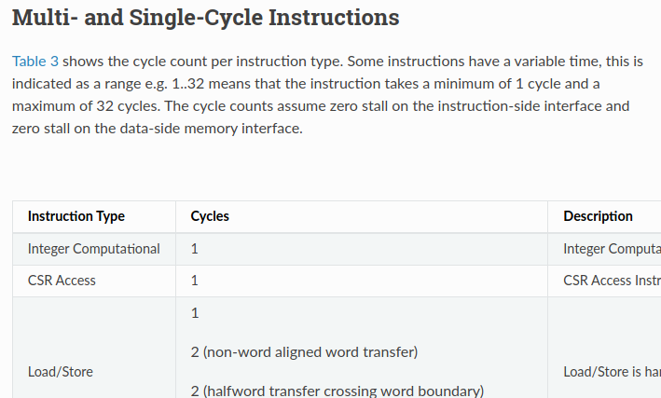
Waivers
CV32E40P:
None! (assuming issue #261 is the actual gating mechanism)
CORE-V-DOCS:
Issue #259.
CORE-V-VERIF:
Cross coverage of instructions, see issue #50 (and next slide).
Cycle counts as per Table 3 of the User Manual.

Slide 6
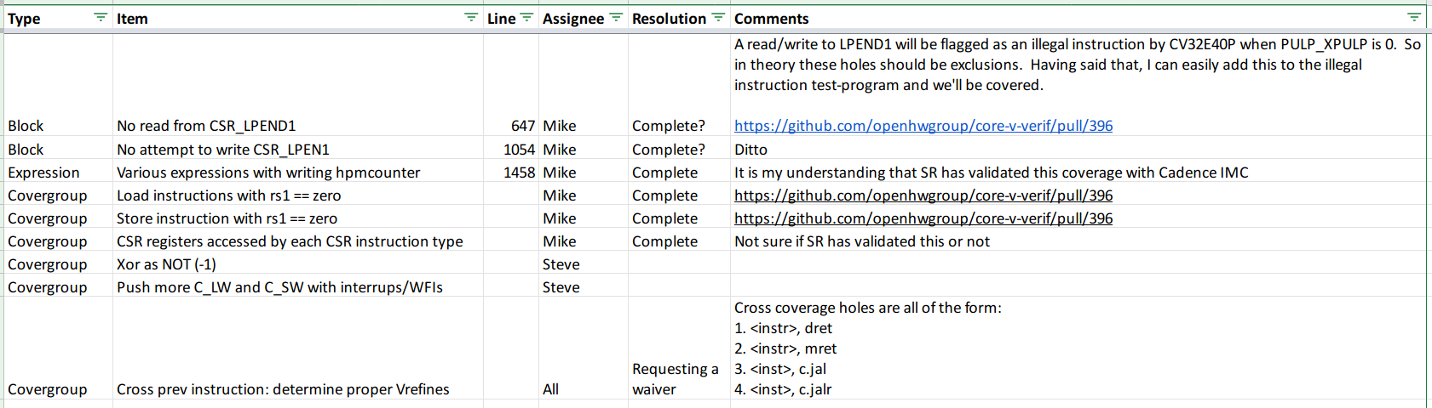
Simulation Coverage Holes

Slide 7
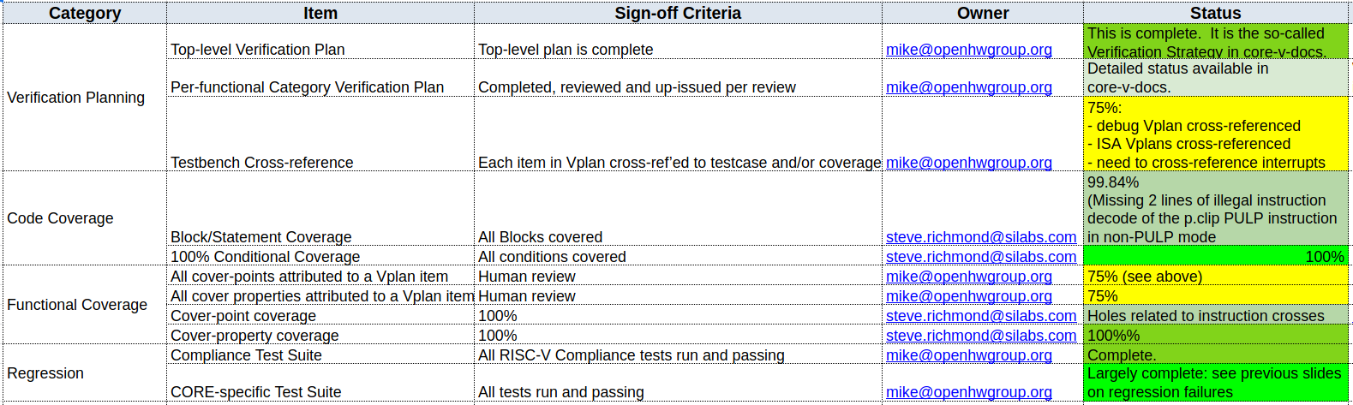
Simulation Verification Checklist
Latest: all code covered. For single instr ISA Fcov we are still missing LUI with 0 immediate, but that's it.

Slide 8
Recommendation
CV32E40P is ready for “Functional RTL Freeze”.
Still a few loose end to clean off:
Mostly checklist items.
Need to create GitHub tags, run regressions and publish results.
Can we get this done in time for a formal review on 2020-12-01?
Keep in mind that American Thanksgiving is this weekend and the SiLabs team have earned a break!
Mike should not lead this review.

Slide 9
Thank You

