Slide 1


Verification Task Group March 4, 2021
Steve Richmond steve.richmond@silabs.com
Robert Chu robertchu@futurewei.com
Mike Thompson mike@openhwgroup.org

Slide 2
Outline
Administration
RVFI/RVVI
Meeting Schedule Proposal
Project Tasks Organization
Open Issues

Slide 3
Administration
Reminder that attendance will be taken at all meetings
Attendance ensures voting eligibility per OpenHW bylaws
Active project engagement – please reach out to get involved
CVA6 (Jerome Quevremont/Mike Thompson)
Force ISG (Robert Chu)
CV32E40P_v2 (John Martin/Greg Tumbush)
CV32E40X/CV32E40S (Steve Richmond)

Slide 4
Core-V Checker Environment
Proposal created with fork to create a scoreboard with RVFI+RVVI
RVFI -> Processor Monitor
https://github.com/SymbioticEDA/riscv-formal/blob/master/docs/rvfi.md
RVVI -> Control/State interface for the ISS
https://github.com/openhwgroup/core-v-docs/blob/master/verif/MeetingPresentations/Verif-TG-01.21.2021-RVVI.pdf

Slide 5
Core-V Checker Environment
UVM infrastructure to integrate RVFI/RVVI into a comprehensive UVM-capable solution
Reusable UVM agents across cores
uvma_rvfi_agent
uvma_rvvi_agent

Slide 6
Core-V Checker Environment
Goals:
Works with abstracted interfaces to processor/ISS
Monitored interfaces with logs
Synchronous interface to processor
Checks PC, GPRs, CSRs
Signals async events to the ISS
Immune to processor stalls

Slide 7
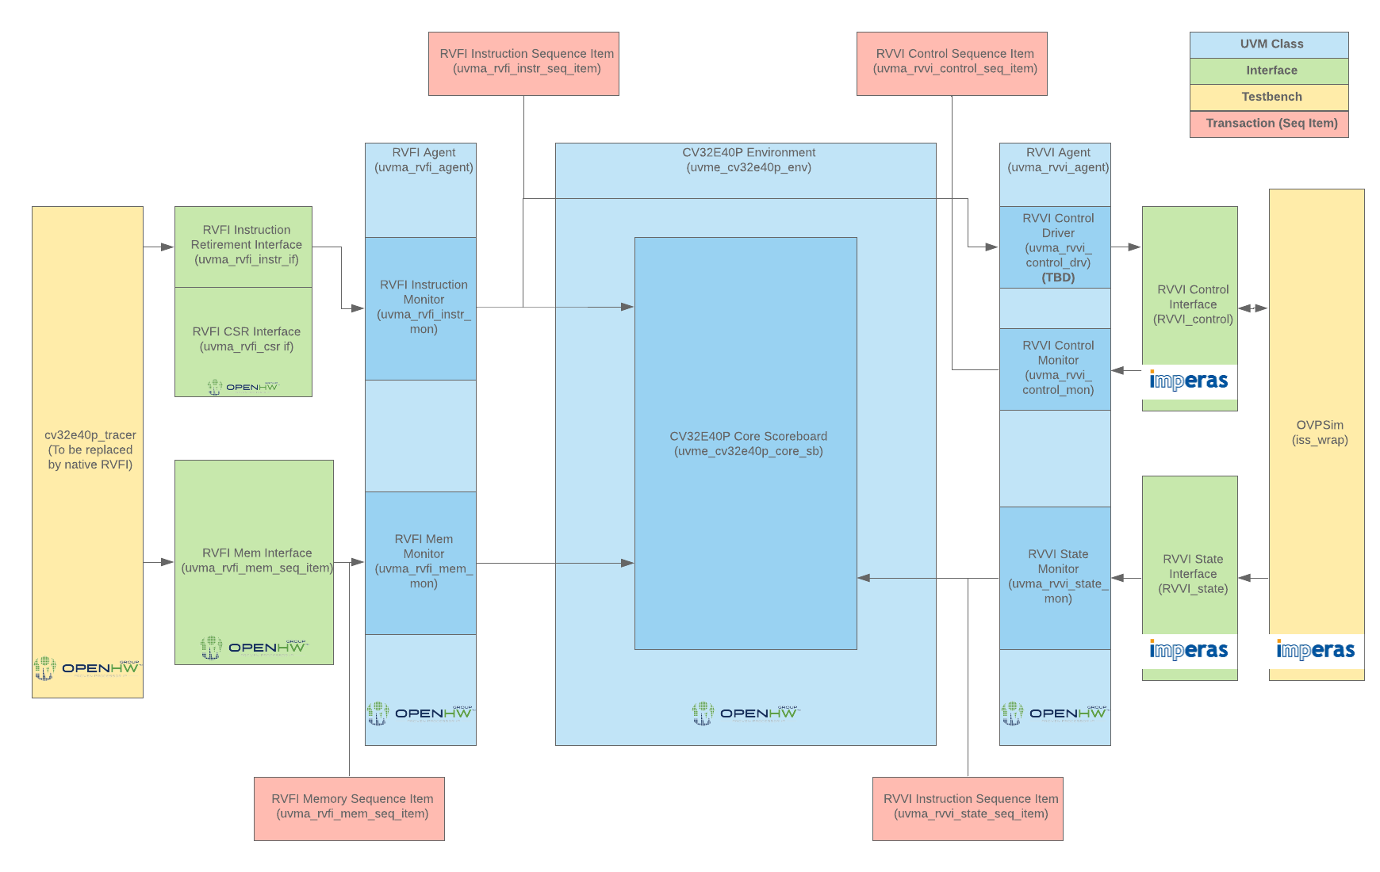
CVCE Block Diagram

Slide 8
RVFI Instruction Interface
Core-V cores must implement an RVFI instruction interface:
Deterministically increment an integer to resolve program order (order)
Report the opcode executed (insn)
Report whether a trap was taken for this instruction (trap)
Report whether this instruction was first for handler (intr)
Extension: when intr == 1, the ID of the interrupt (intr_id)
Report whether this instruction is from a debug request (halt)
Report mode of the core (mode)
Report current XL (64-bit cores) (ixl)
Report PC before and after instruction execution (pc_rdata, pc_wdata)
Report any GPR updates during that instruction
Note that this requires pipeline architectural modeling, not just sampling of wires

Slide 9
RVFI Instruction Interface
The interface should be synchronous to the core
The interface should be posedge logic only
It is an implementation choice as to whether the
There is no handshake (as in the current tracer)-this is just a monitor interface

Slide 10
RVFI Memory Interface
The RVFI Memory Interface reports memory reads and writes (D-OBI) from the processor
Read address
Read mask
Write address
Write mask
Currently designed as a separate monitor interface not connected to instruction interface

Slide 11
RVFI CSR Interface
For each CSR in a core, the following interface should be implemented
csr_<csrname>_mask
csr_<csrname>_data
csr_<csrname>_mask can be used to signal significant bits
Separate interface for scalability but sampled at instruction retirement
data should be value of CSR based on ISA implementation for this instruction

Slide 12
Scoreboard
Monitors broadcast the following via analysis ports
uvma_rvfi_instr_seq_item
Contains all information on instruction interface
GPRs
CSRs
uvma_rvvi_state_seq_item
Contains all items from RVVI_state interface
Scoreboard implemented within the core environment
PCs, GPRs checked directly as simple in-order checks

Slide 13
Scoreboard
CSRs
Anticipate that custom checking will be required on many/most CSRs
Will implement an abstract base class that enables user to override checks

Slide 14
Risks
Processor monitors are complicated
CSR checking with h/w update ports

Slide 15
Rollout
RVFI + RVVI Agents
PC + GPR checking <- Here
CSR checker
RVVI control tied to RVFI instruction retirement
RVVI control for interrupts
RVFI instruction monitor on the CV32E40P
Memory monitor integration to scoreboard
Stall testing
CSR checker integraton

Slide 16
CVCE Today
Ongoing fork of core-v-verif with CVCE is here:
https://github.com/strichmo/core-v-verif/tree/strichmo/pr%2Frvfi_rvvi_sb
Branch: rvfi_rvvi_sb
Since tracer updates are needed (CSR monitoring) the cv32e40p is also forked (above branch points to fork via Common.mk)
https://github.com/strichmo/cv32e40p/tree/strichmo/temp/tracer_for_rvfi_rvvi_test
Branch: tracer_for_rvfi_rvvi_test

Slide 17
Meeting Schedule Proposal
Multiple cores are now in development
cv32e40x
cv32e40s
cva6
In PPL
cv32e40p_v2
Sprint meetings for the cv32e40p were effective in driving focus to short-term tactical issues in execution
VTG meetings should be focused on strategic directives and discussion
Fewer meetings-more content

Slide 18
Meeting Schedule Proposal
Monthly VTG meeting
First Thursday of every month @0930 US Central
Focused on strategic initiatives, general direction
Examples
RVVI/RVFI
Next-gen ISA coverage model

Slide 19
Meeting Schedule Proposal
CV32E40X/S Status
Second Thursday of every month @0930 US Central
Review status of project, regressions, coverage
Discuss common issues, infrastructure, assigned tasks
CVA6
Third Thursday of every month @0930 US Central
Review status of project, regressions, coverage
Discuss common issues, infrastructure, assigned tasks

Slide 20
Project Tasks
cv32e40x/s will be executed via Agile development
Silicon Labs maintains detailed task backlog
To enable collaboration, project boards on Github will enable visibility tracking of active tasks and collaborative tasks
Core-v-verif common infrastructure
https://github.com/openhwgroup/core-v-verif/projects/9
CV32E40S
https://github.com/openhwgroup/core-v-verif/projects/10
CV32E40X
https://github.com/openhwgroup/core-v-verif/projects/11
For core testbench development general tasks will be tracked on the projects page

Slide 21
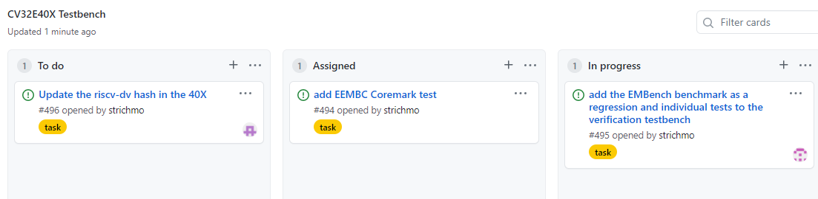
Project Tasks
For core testbench development general tasks will be tracked on the projects page
Examples
Develop Vplan for feature <x>
Develop assertions for vplan
Close coverage on feature <y>

Slide 22
Improvements
https://github.com/openhwgroup/core-v-verif/labels/improvement
We are implementing some enhancements

Slide 23
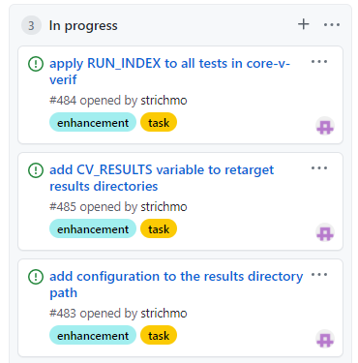
Test Control
Apply RUN_INDEX to all test
All tests will now be randomly regressable
Enable results/ directory to be retargeted
No change by default
Add configuration (default, no_pulp, etc.) to results path
Enables multiple configurations to be regressable
Implemented by Silicon Labs

Slide 24
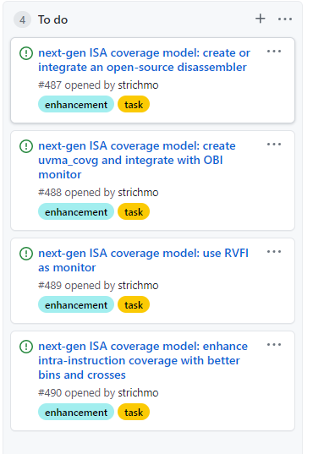
Next-Generation ISA Coverage Model
Driven by monitors
OBI first, then RVFI when available
UVM Agent structure
No dependency on the ISS
Extensible by RV extension
I,M,C,B,P,xPULP
Requires on-demand disassembler/decoder

Slide 25
Benchmarks
Silicon Labs is adding EEMBC Coremark and EMBench to core-v-verif for the 40X and 40S
Should be easily extensible to the 40P

Slide 26
Open Issues

