Slide 1
Code For Good – Best Buddies
Team 5
Jose, Corey, Thai and Satish

Slide 2
Background
Match Adult Participants (Age 18 & Older) with a Volunteer in the Community In Hopes of Starting a Friendship Between Them

Slide 3
Recommendations
Create a Database of Volunteers and Buddies
Match Buddies with Volunteers based on location, age and hobbies (extensible)
Provide a recommendation of Volunteers from the best match to the worst

Slide 4
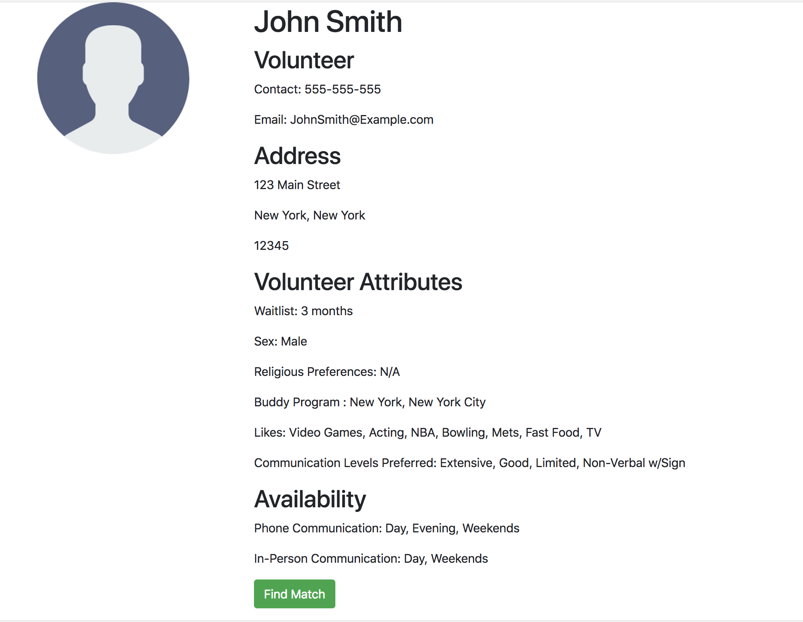
Best Buddy UI

Slide 5
Next Steps
Recommend group activity
Generate alerts about wait lists for buddies and volunteers – browser dashboard on login, email, social media
Recommend other volunteers based on the match percentage
Extend the experience to mobile devices

