Slide 1
Green city force
Presented by Team-6

Slide 2
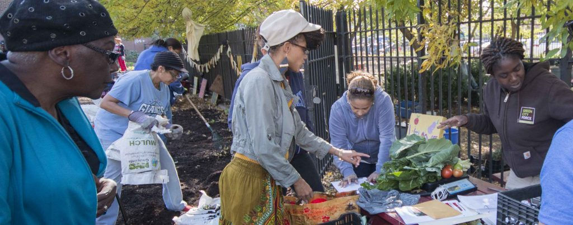
Objective
To increase NYCHA resident engagement in the organization’s initiatives
To amplify resident-to-resident outreach
To get more residents out to the Farms at NYCHA
To pick up more compost and distribute more produce

Slide 3
Total weight of produce distributed (lbs)

Slide 4
Total weight of compost collected (lb)

Slide 5
New vs returning visitors
10% Unique Visitors
Total 3000 Visitors
90% Returning Visitors

Slide 6
Number of farm stand visits

Slide 7
Ideal solutions
Situation
5,000 residents 3,000 visits > 150-300 unique visitors year round
Complication
Most residents are not active in online social medial to share with the community
Resolution
Share information with people
Example
Increase NYCHA resident engagement in the organization’s initiatives
Get more residents out to the Farms at NYCHA
Pick up more compost and distribute more produce
Amplify resident-to-resident outreach

Slide 8
Two Content Layout with Table
Class | Group A | Group B
Class 1 | 82 | 85
Class 2 | 76 | 88
Class 3 | 84 | 90
First bullet point here
Second bullet point here
Third bullet point here

Slide 9
Two Content Layout with SmartArt
First bullet point here
Second bullet point here
Third bullet point here
Group A
Task 1
Task 2
Group B
Task 1
Task 2
Group C
Task 1
Task 2

