Slide 1
Digital Library: Week 2
Camron Mellott
Josh Watson
Luke Joseph

Slide 2
Status
The group has completed the UI for the project
Baseline work has begun for the book API.
The team is ahead of schedule according to our Gantt chart

Slide 3
Challenges
Problems with local development server
GitHub pull issues

Slide 4
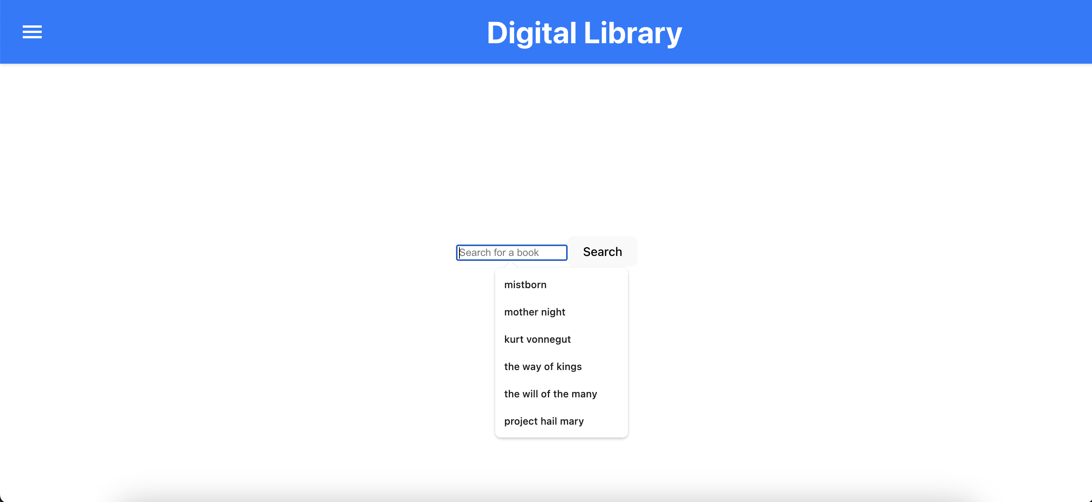
UI Showcase : Home Page

Slide 5
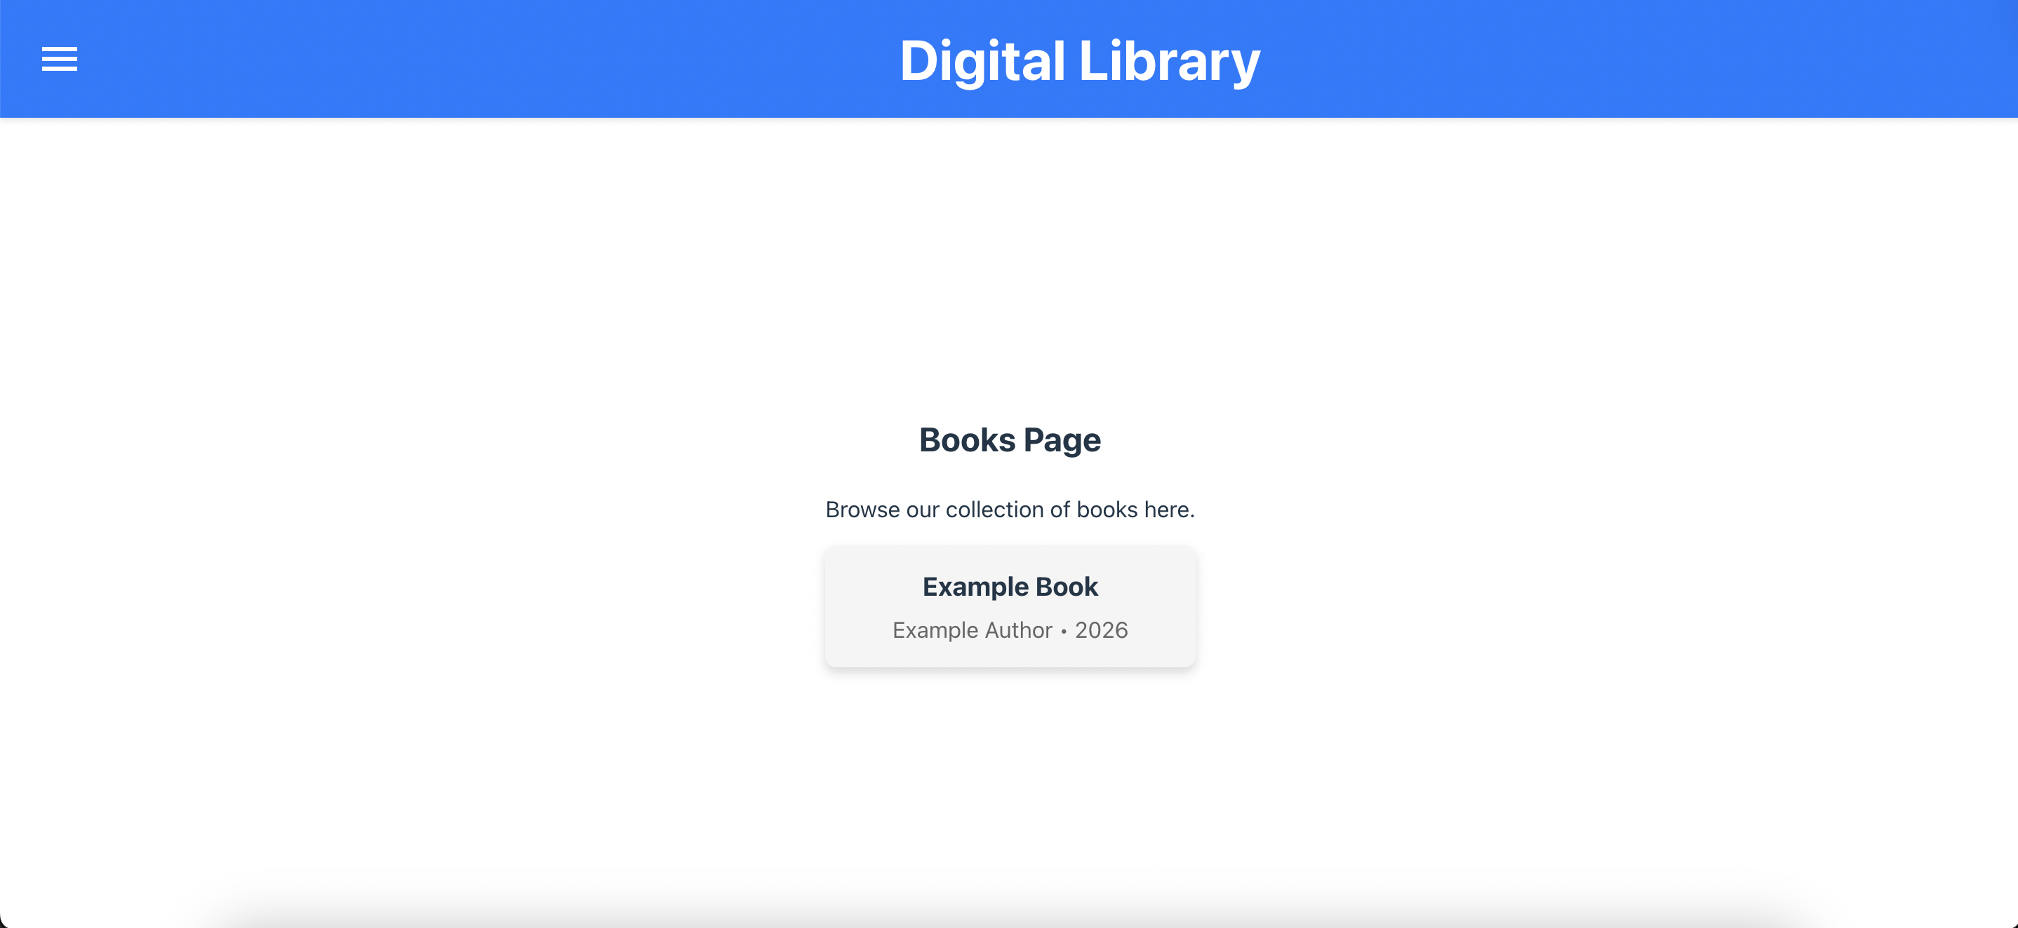
UI Showcase: Books Page

Slide 6
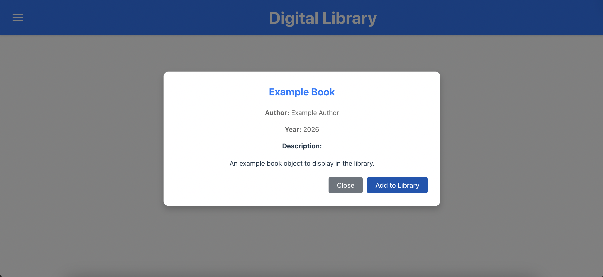
UI Showcase: Book Descriptions

Slide 7
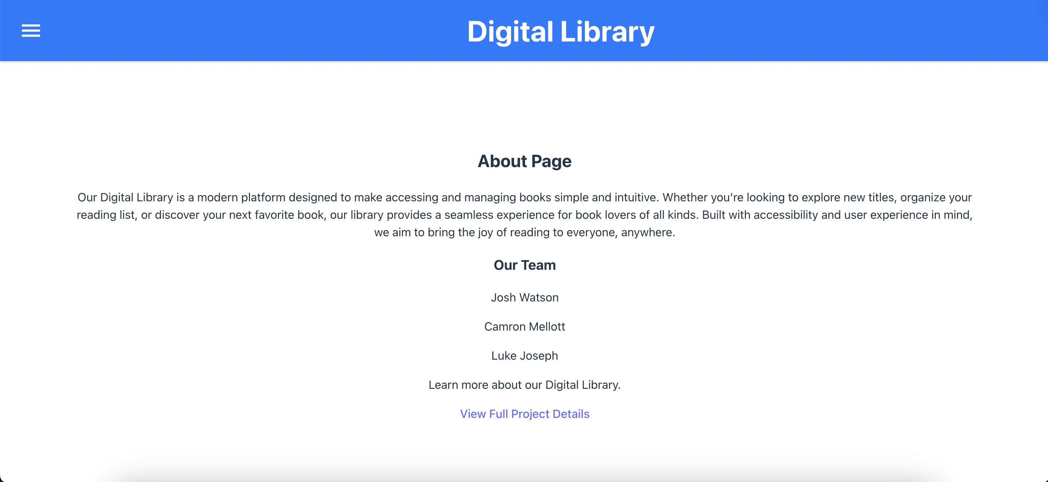
UI Showcase: About Page

