Slide 1
Digital Library Week 11
Camron Mellott
Josh Watson
Luke Joseph

Slide 2
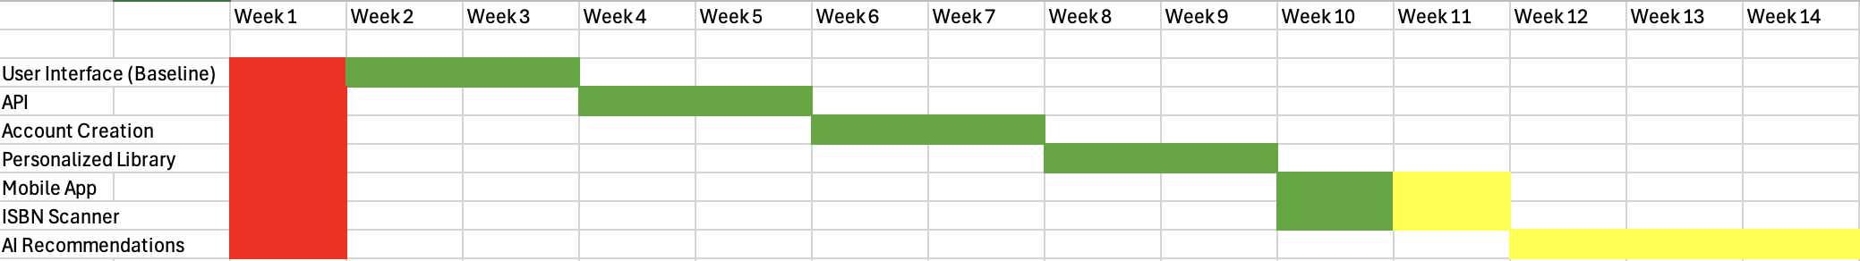
Gantt Chart
We are slightly behind on our gantt chart plan. ISBN scanner not implemented yet.
Needed to have the app version working before development could be started.

Slide 3
This Week
Deployed our website.
Got the email verification working
Utilized capacitor to wrap our application to work natively on mobile devices.

Slide 4


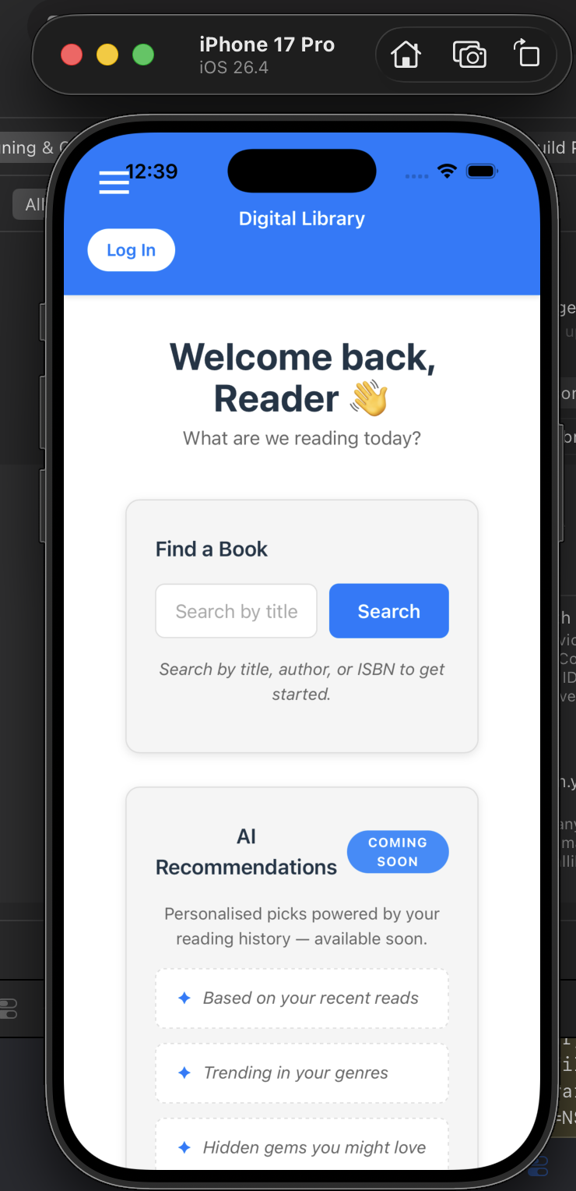

Mobile View
Running in Xcode simulator

Slide 5
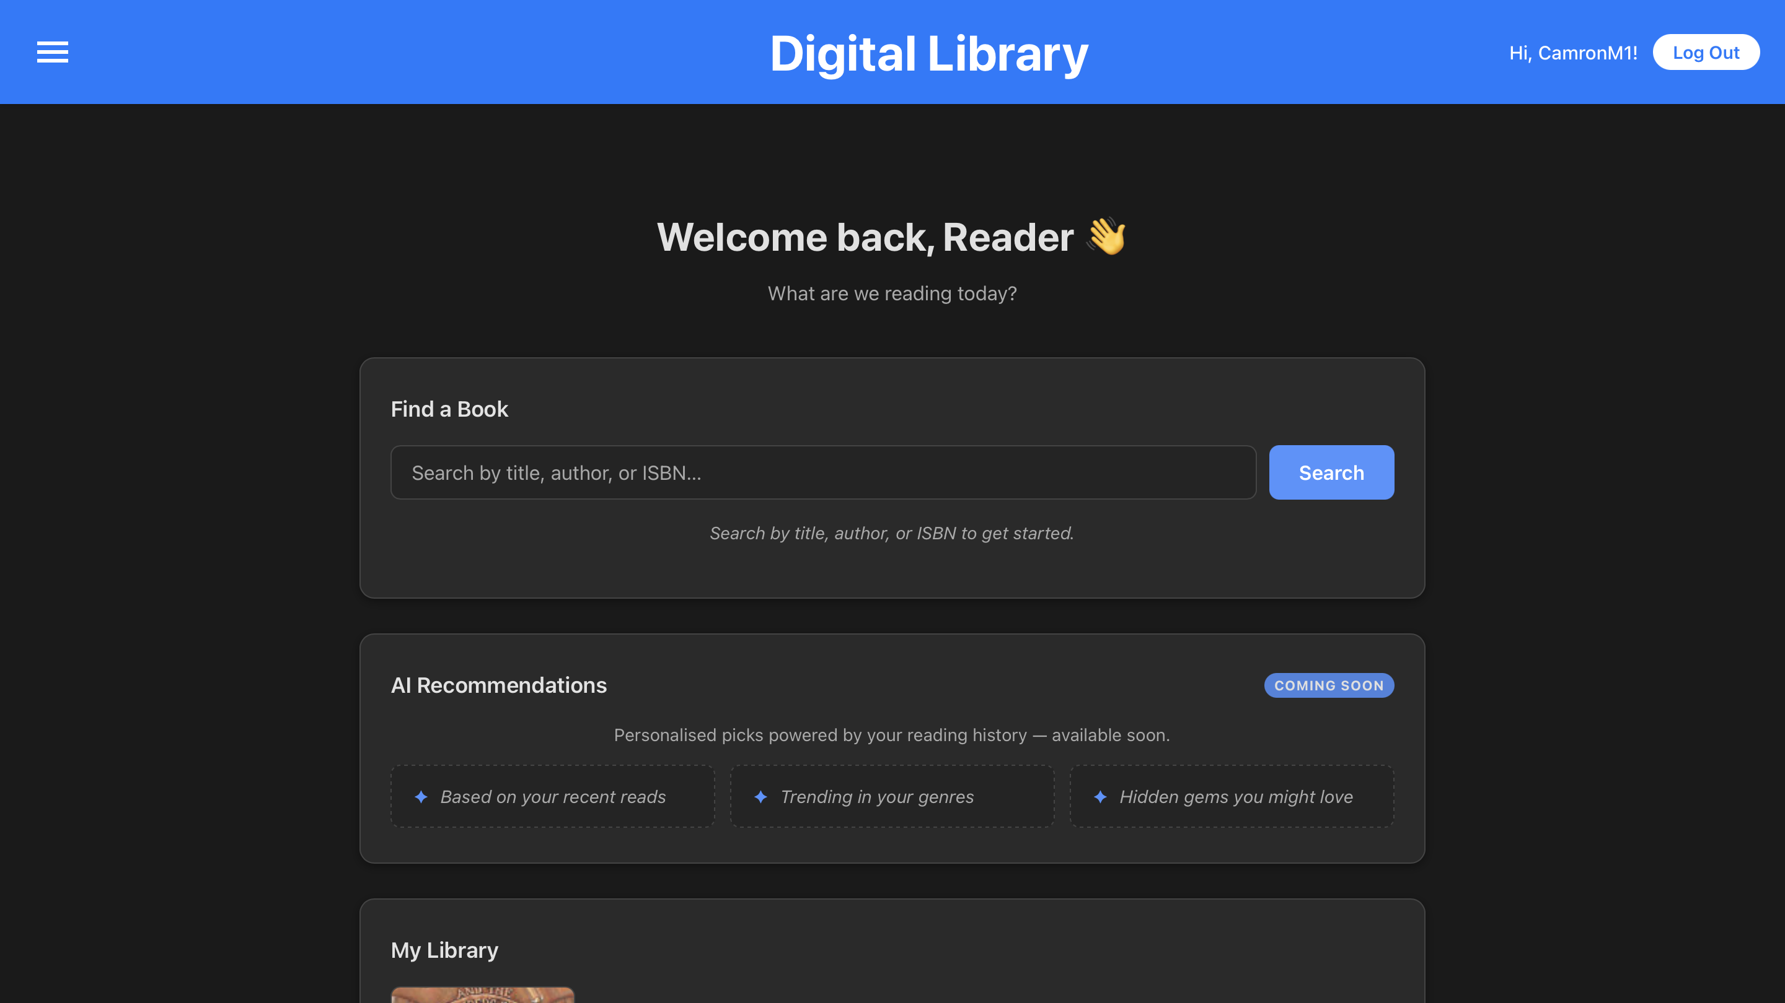
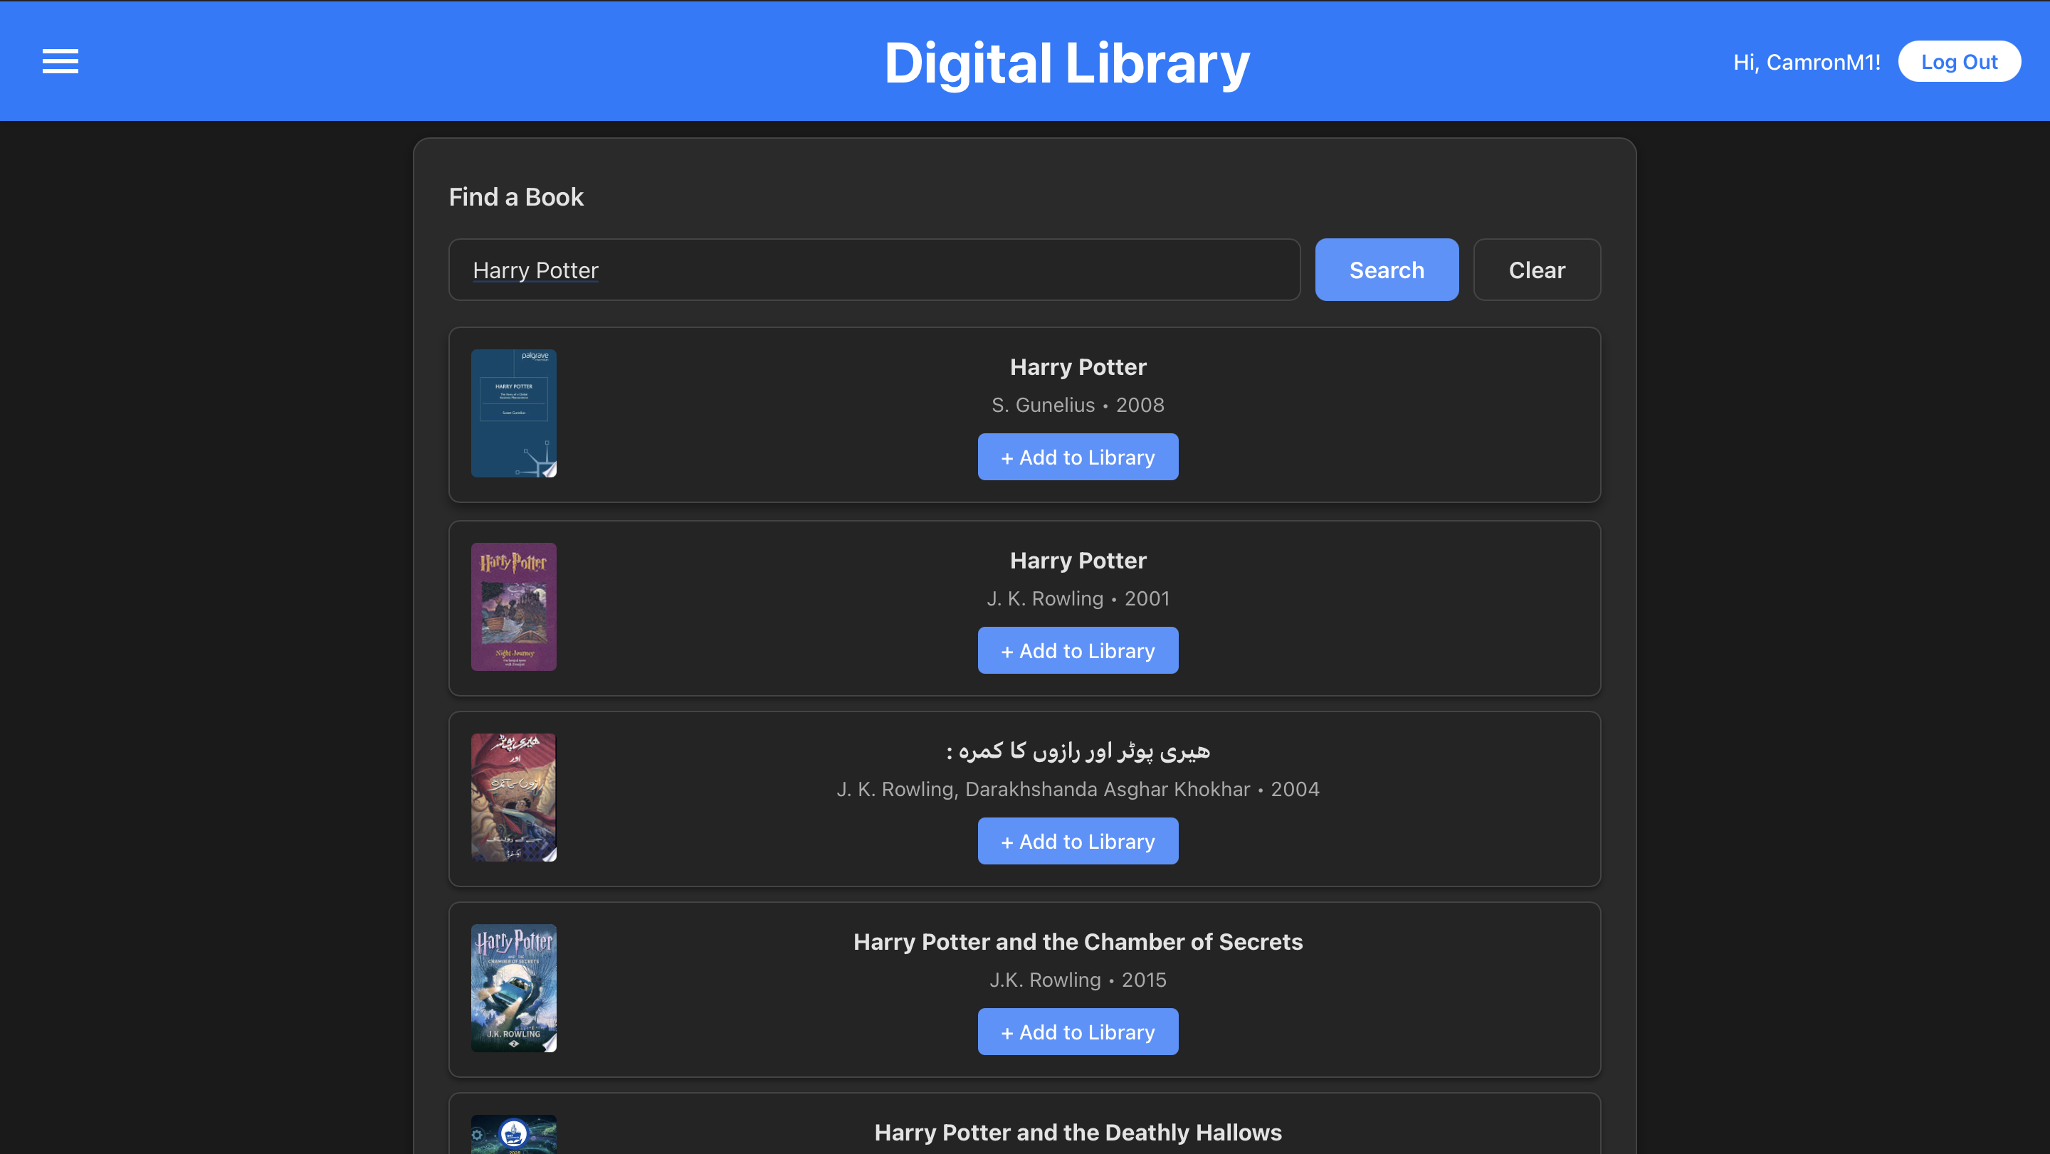
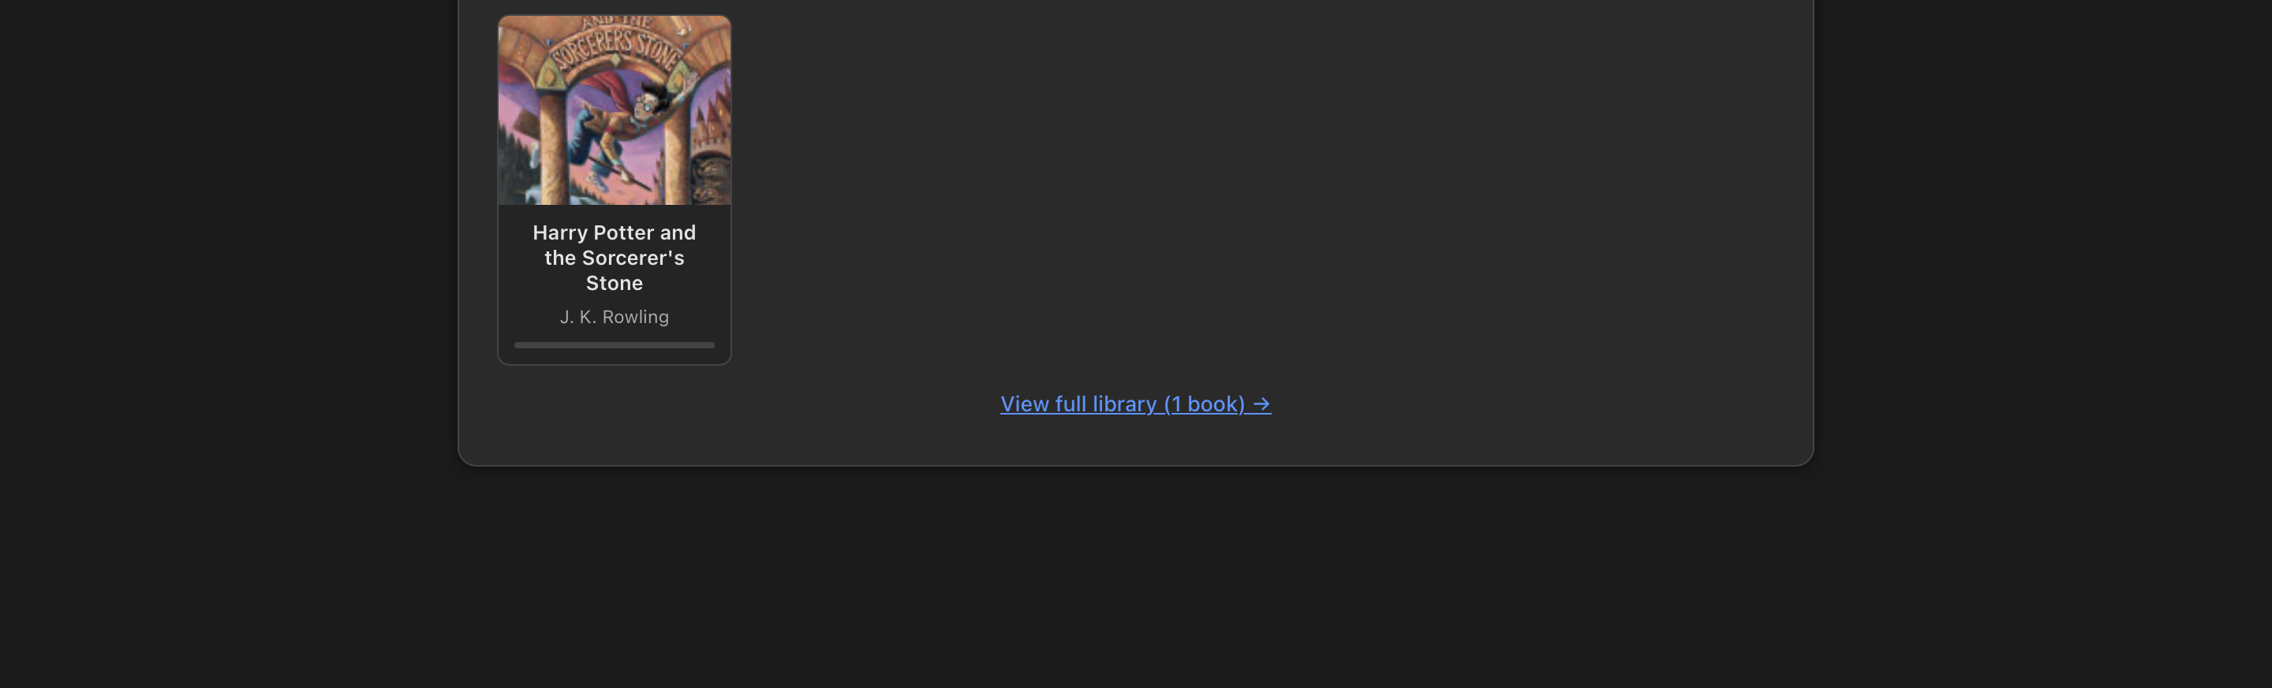
Home page
z

Slide 6
Challenges
Finding the right ISBN Scanner
Refactoring the Home page
Installing all necessary dependencies for a seamless mobile experience
Email Verification

