Slide 1
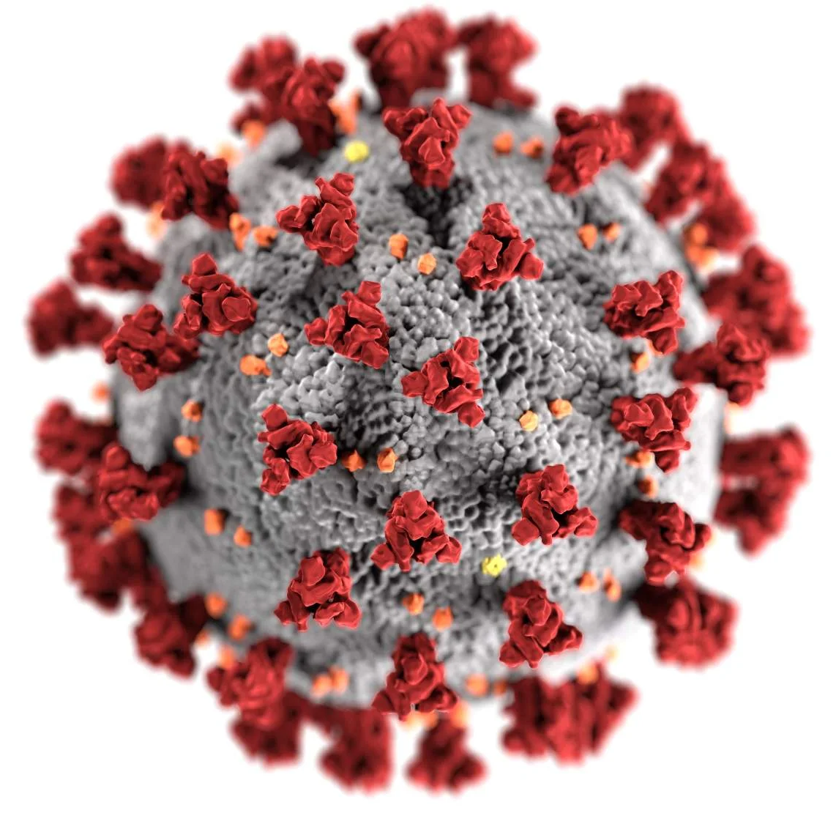
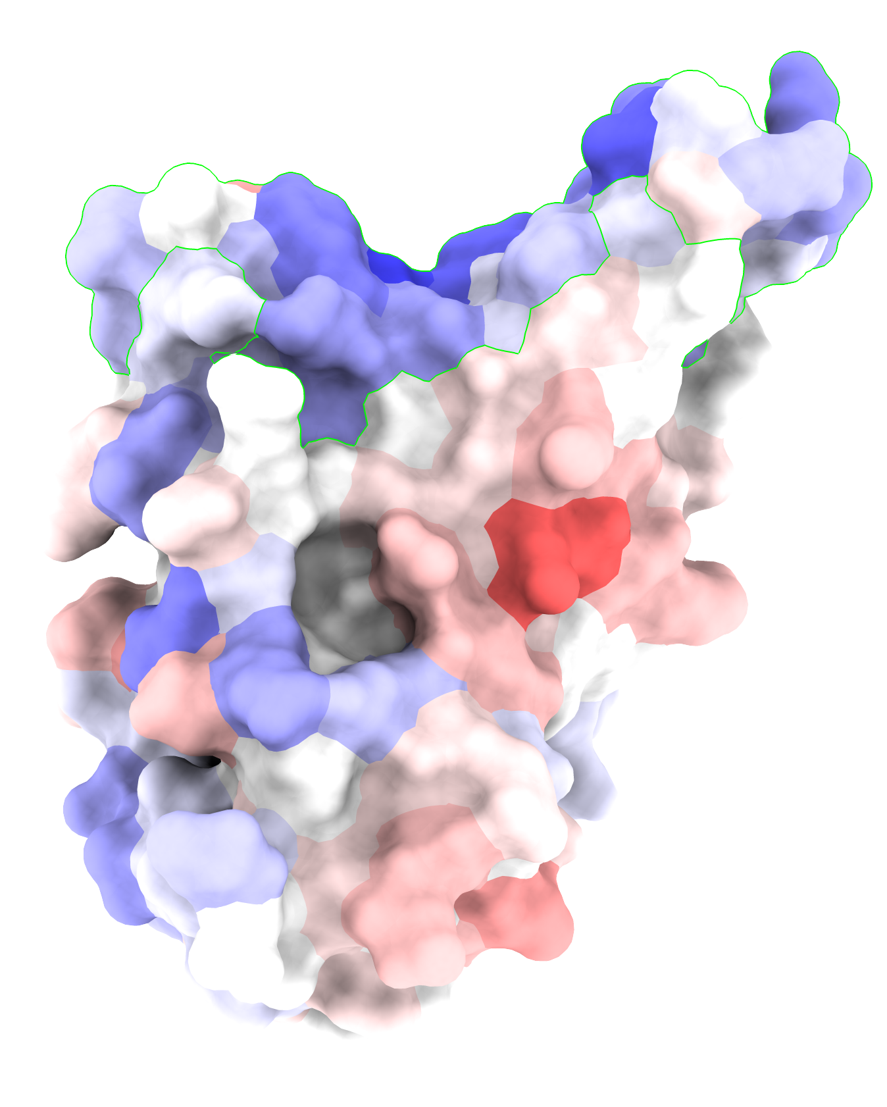
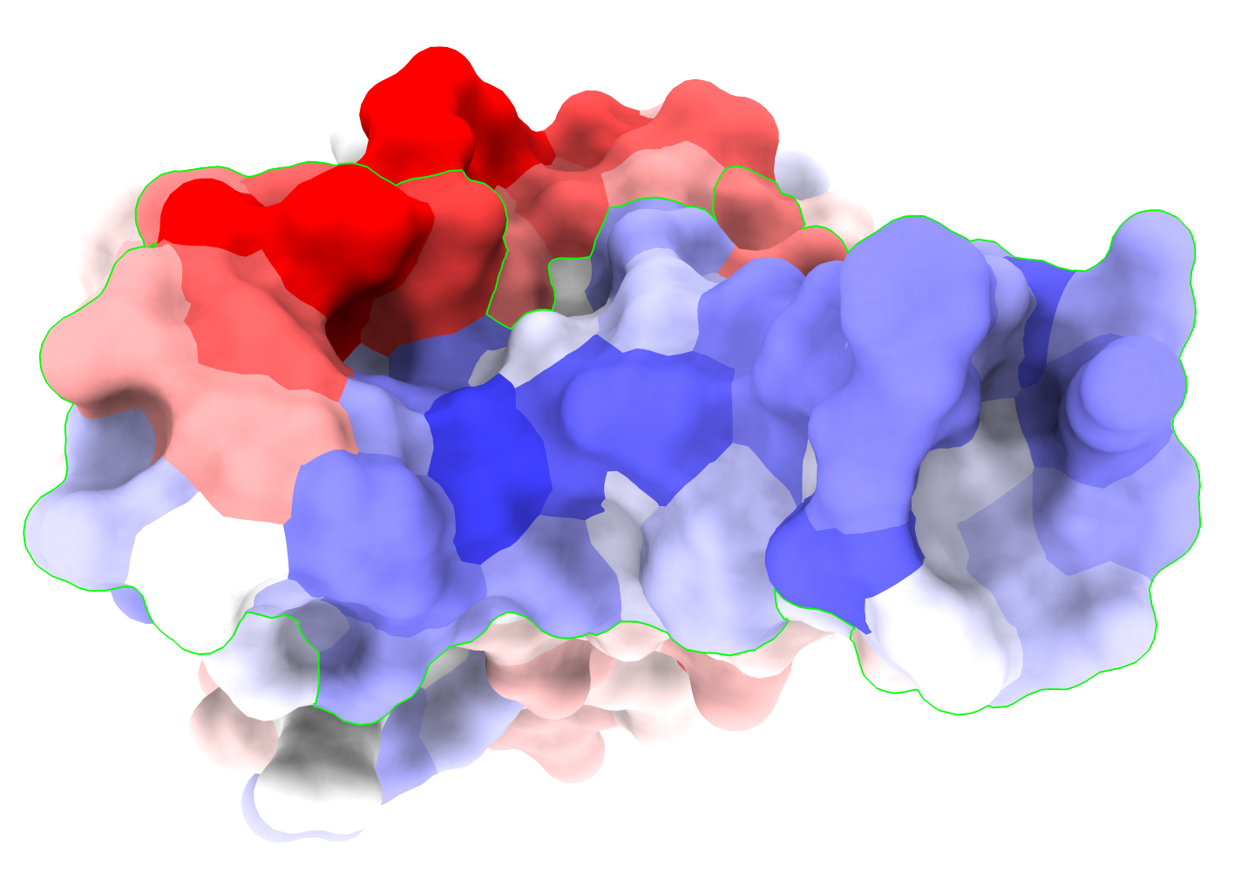
Y505H
K417N
90°
N501Y
S477N
Q498R
Q493R
G496S
E484A
< WT > WT
The viral envelope
of SARS-CoV-2 coronavirus
Change in antibody binding propensity of the
Receptor Binding Domain of the Omicron variant

