Slide 1
Survey of dimensionality reduction and models on MNIST-like datasets
ECE 271B project presentation
Jerry Yan, Shifeng Cheng

Slide 2
Overall project goal
We want to compare various dimensionality reduction techniques on different classification models vs CNNs (accuracies and runtimes).
The task we perform for these comparisons is single character recognition from images.
We combine multiple single character datasets in an attempt to have a singular, more general model.

Slide 3




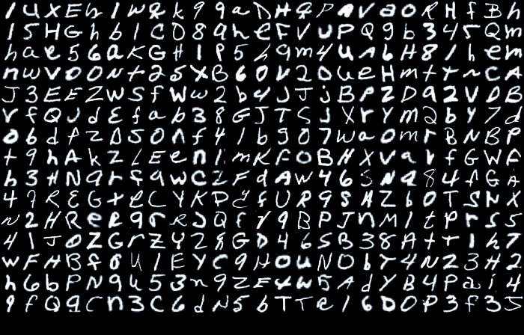










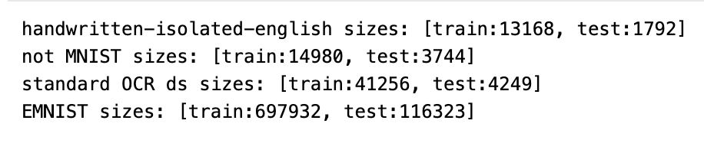
Datasets used
handwritten-isolated-english
(26 letter classes)
notMNIST (10 letter classes)
EMNIST (36 letter/digit classes)
standard-ocr-dataset (36 letter/digit classes)

Slide 4

The plan
handwritten-isolated-english
standard-ocr-dataset
notMNIST
EMNIST
the model

Slide 5
Non-convolutional models
Linear logistic regression
K-nearest neighbors (KNN)
Multi-layer perceptron (MLP)
Support vector machine (SVM)

Slide 6
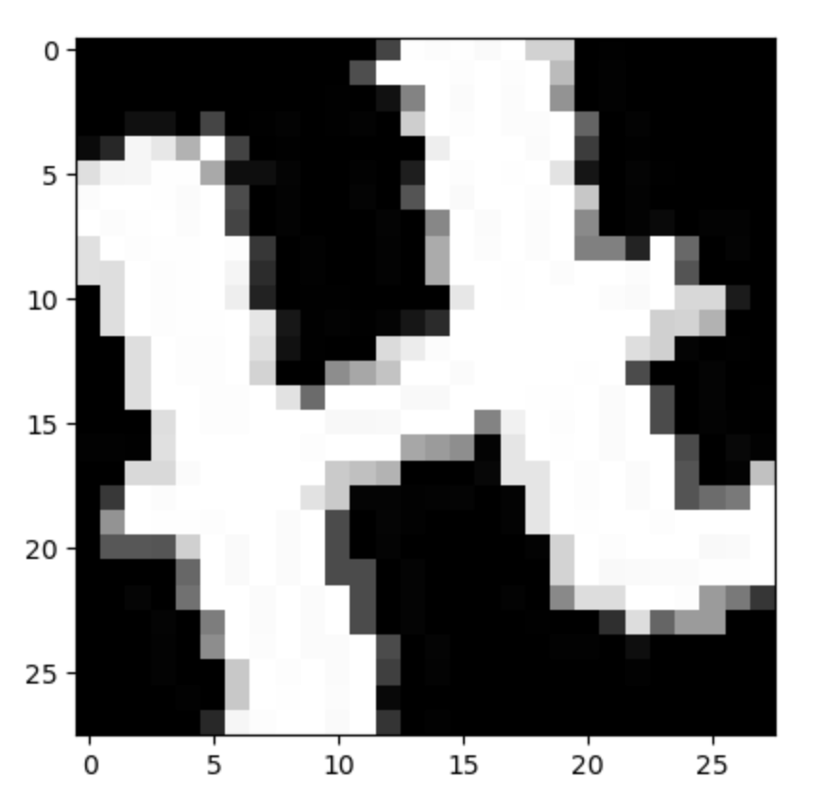
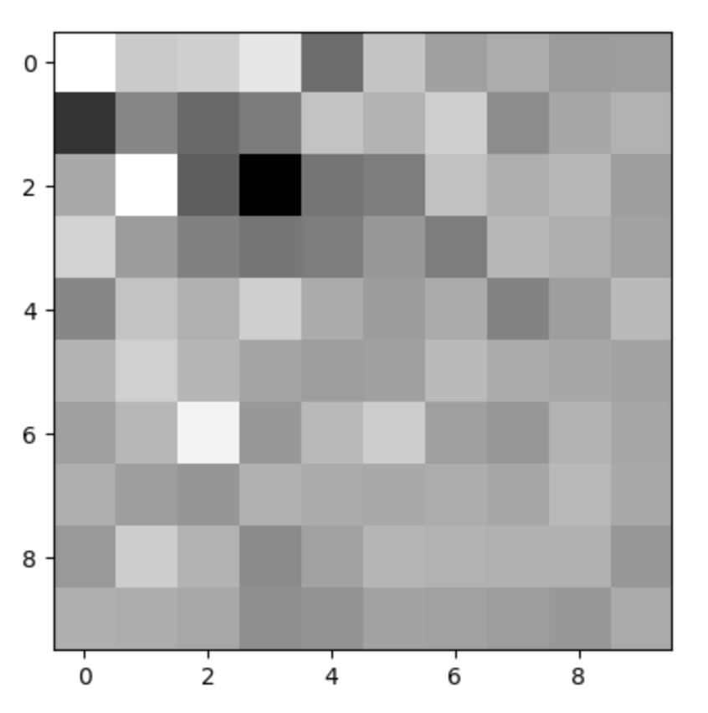
Chosen dimensionality reduction techniques
Principal component analysis (PCA)
Linear discriminant analysis (LDA)
Random Gaussian projection (RGP)
Multilinear PCA (MPCA)

Slide 7
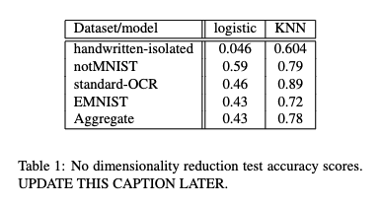
Some preliminary results

Slide 8
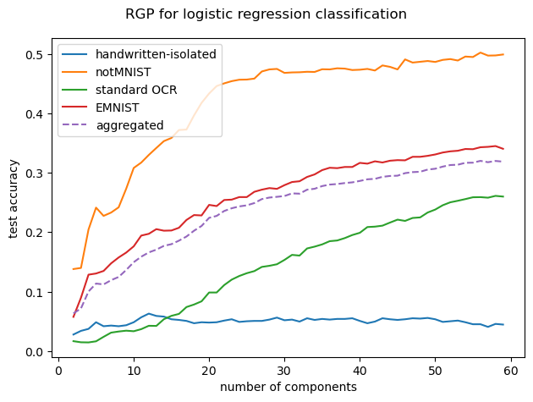
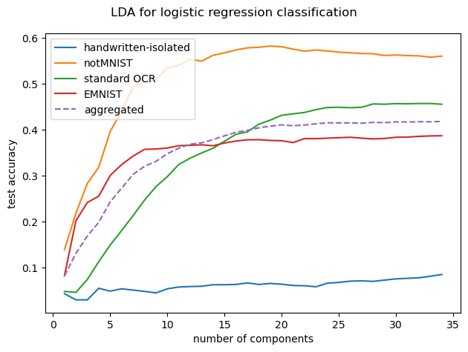
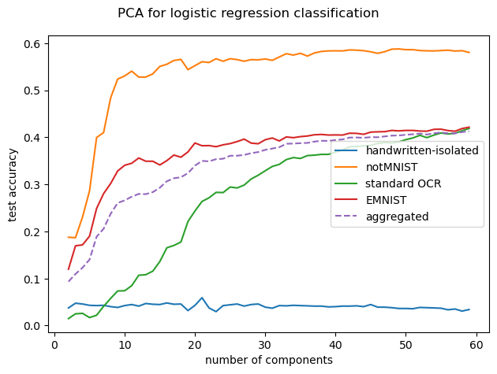
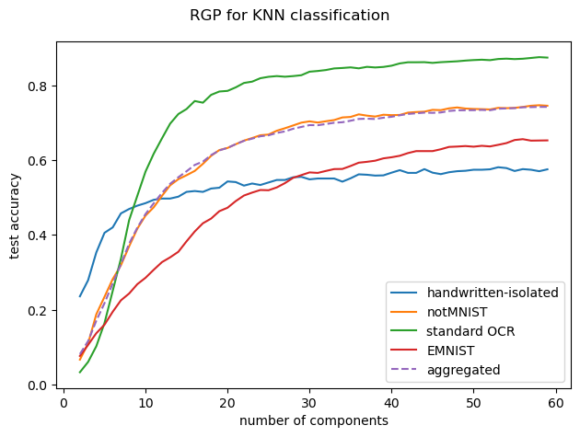
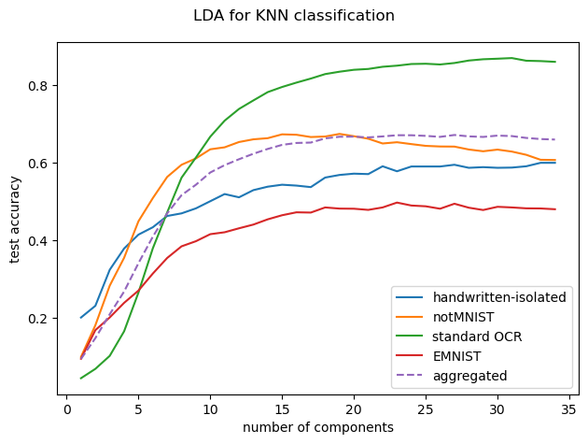
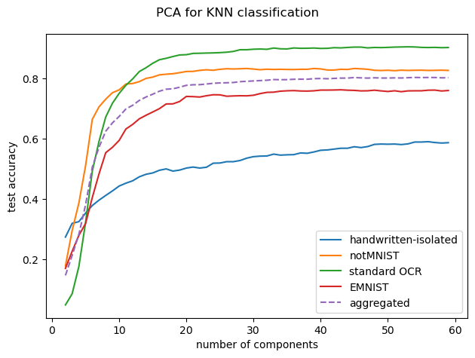
RGP
LDA
PCA
logistic
KNN

Slide 9
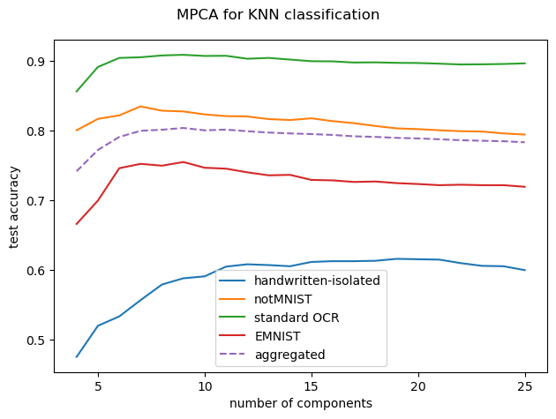
MPCA

Slide 10
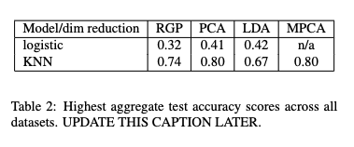
Highest aggregate test scores

Slide 11
CNN plans
Generic CNN
Some transfer learning with
ResNet
VGG
Test if MPCA on the images for training actually does anything

Slide 12
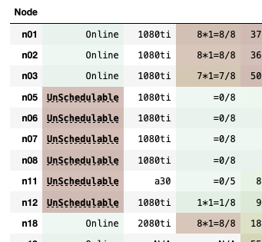

Datahub problems :(
Basic CNN (2 conv layers)

