Slide 1
Beating the S&P500
Guilherme Augusto Zagatti, Ronald Wihal Oei, Po-Kai Peng, Vincent Yong, Jervis Chan
Team Markov
QG5210 Project
Semester 1 AY 2020/21
National University of Singapore

Slide 2
Outline
Background
Investment scenario
Data
The S&P500 Index
Modern portfolio theory (MPT)
Minimum variance portfolio
Forecasting models
ARMA
GARCH(1,1)
MSGARCH
Portfolio performance

Slide 3
Background
Financial portfolio allocation is an important challenge faced by investors.
DeMiguel (2007) explores different portfolio diversification strategies and concludes that there is no single portfolio allocation method that consistently performs better than the equal-weighted portfolio. He believes that better allocation methods could be discovered by improving the estimation of the moments of asset returns.
Notes:
DeMiguel, Victor, Lorenzo Garlappi, and Raman Uppal. “Optimal Versus Naive Diversification: How Inefficient Is the 1/N Portfolio Strategy?” The Review of Financial Studies 22, no. 5 (May 1, 2009): 1915–53. https://doi.org/10.1093/rfs/hhm075.

Slide 4
Investment scenario
Investor would like to invest in the stocks listed in S&P500, which are large cap stocks spanning a large range of industries representative of the US economy.
There are an infinite number of strategies to invest in the S&P500
If we had perfect foresight and could pick the best performing stock at the end of each month with zero drawdown, the mean annualized return of this strategy over the past 25 years would be equal to 930%.

Slide 5
Data
All S&P500 securities (except for Voltier which was only recently added as the result of a corporate spin off) and the S&P500 index itself.
Historic closing prices and log monthly returns (end of month only) from 1995-01-01 to 2020-10-01.
Data was downloaded from Yahoo!Finance using R package quantmod.

Slide 6
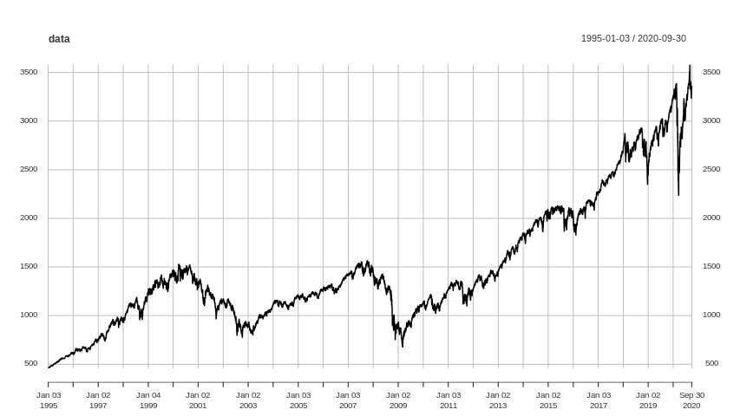
Baseline strategy: S&P500 index
This is the same as investing a weighted proportion in each stock where the weight is equal to the market capitalization of each stock.
This is a very popular strategy easily replicated with exchange traded funds (ETF).

Slide 7
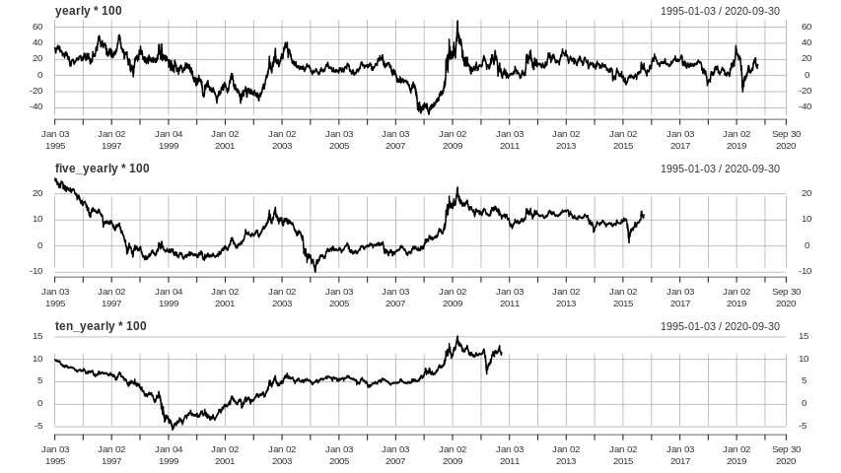
Timing is important
Annualized returns will vary significantly depending on the time one enters the market.
The plots on the right show the annualized return one would have obtained after 1, 5 or 10 years of entering the market on the date shown in the x-axis.

Slide 8
Timing is important
In 1 of every 4 days we entered the S&P500 from 1995 to 2015 for a period of 5 years, we would have lost 1.4% of our initial investment on an annualized base.
If we held the S&P500 for 10 years, we would only have beaten the 10-year US treasury yield 60 percent of the days.
 | daily | weekly | monthly | yearly | 5-yearly | 10-yearly
min | -100% | -100% | -99% | -48.8% | -10.2% | -5.8%
25 perc. | -69% | -39.4% | -17.8% | 2% | -1.4% | 2.2%
50 perc. | 190% | 19.7% | 17.1% | 11.4% | 6.3% | 5.3%
75 perc. | 341% | 311% | 51.9% | 19.2% | 11.7% | 7%
max | 9.8e13 % | 112% | 1328.1% | 68.6 | 26.1% | 15.3%
n | 6,483 | 6,478 | 6,463 | 6,231 | 5,223 | 3,963

Slide 9
Modern Portfolio Theory (MPT)
A portfolio should not be evaluated only according to its expected return, but risk should be also taken into account.
The mean-variance analysis consists of optimizing a portfolio given the trade-off between expected return and risk.
Markowitz (1952) noticed that an asset’s risk contribution to a portfolio is not only dependent on its own risk but also on its correlation with other assets in the portfolio.

Slide 10
Modern Portfolio Theory (MPT)
The main challenge is that risk and return are unobservable.
Traditionally MPT describes the conditional distribution of asset returns using very simplistic statistical models that only rely on estimating conditional expectations and covariance using historical data.
These models do not fully capture features of risk and return observed in the real world.

Slide 11
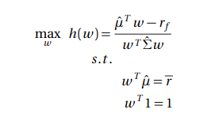
Strategies: Minimum variance portfolio
Our portfolio consists of choosing the weights that maximizes the Sharpe ratio, this is the portfolio that lies on the efficient frontier and is tangent to the capital market line.
To find the optimal portfolio, we need estimates for the expected return and the covariance matrix.

Slide 12
Rolling forecast
estimation window: 10 years (120 months)
Investor is unwilling to invest in stocks that have not withstood the test of time, ie. which have not traded for a period of at least 10 years.
Investor uses only the most up-to-date information to build his estimator, ie. the last 10 years of data.
1-month ahead forecast
estimation window: 10 years (120 months)
1-month ahead forecast
estimation window: 10 years (120 months)
1-month ahead forecast

Slide 13
Covariance estimator
We estimate each stock independently, meaning that we do not get estimates for the cross-correlation terms.
As a work around, we estimate the off-diagonal terms as following:
compute the forecast error: ε_{i} = y_{i,true} - y_{i,pred}
compute the covariance between errors as our off-diagonal estimator: cov(εᵢ, εⱼ)

Slide 14
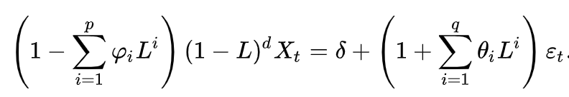
Forecasting models: ARIMA(p,d,q)
‘auto.arima’ was used to determine the optimal parameters (p, d, q) of ARIMA model
We assumed stationarity of returns and allowed for seasonal variations
Notes:
ARIMA model was fitted, accounting for the order of the autoregressive model (p), degree of differencing (d) and order of the moving-average model (q)

Slide 15

Forecasting models: GARCH(1,1)
Uses lag 1 residual errors and lag 1 variances to predict the conditional variance at the next time step (σ_{t})
Return is given by σ_{t} times a randomly generated number (ϵ_{t}) from a specified distribution

Slide 16
Forecasting models: MSGARCH
2 state volatility regime
1 regime with normally distributed volatility
1 regime with Student-t distributed volatility
In each regime, volatility follows GARCH(1,1)
Notes:
https://www.jstatsoft.org/article/view/v091i04

Slide 17
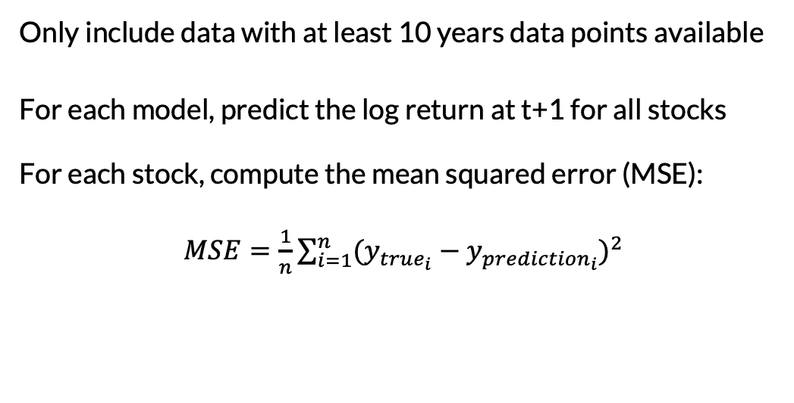
Comparison Between the Three Models

Slide 18
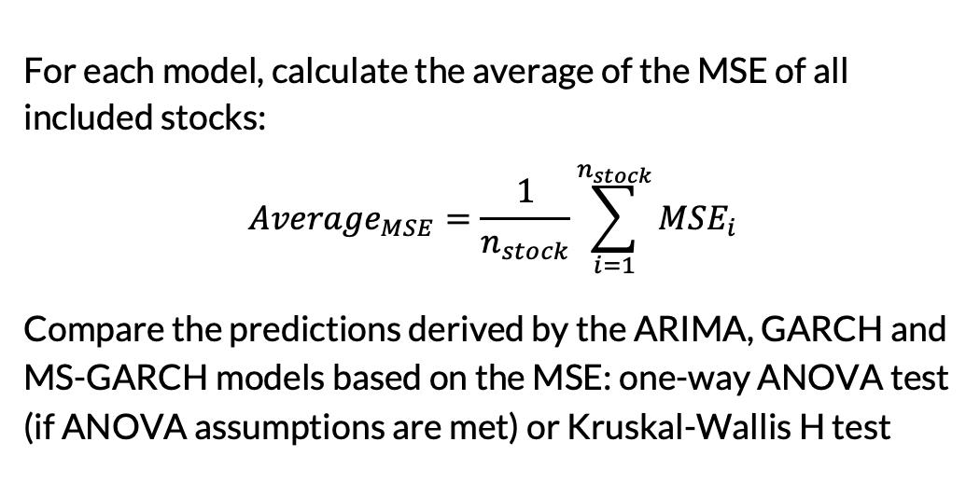
Comparison Between the Three Models

Slide 19
Summary of the MSE
Model | Number of stocks | Average period length | Average absolute log-return | Average of MSE | Standard deviation of MSE
ARIMA | 452 | 286 months | 0.06030038 | 0.008068208 | 0.006007860
GARCH |  |  |  | 0.007740972 | 0.005576524
MS-GARCH |  |  |  | 0.007740557 | 0.005508433

Slide 20
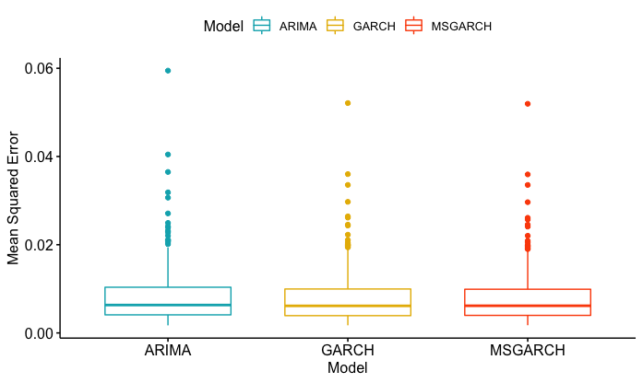
Summary of the MSE

Slide 21
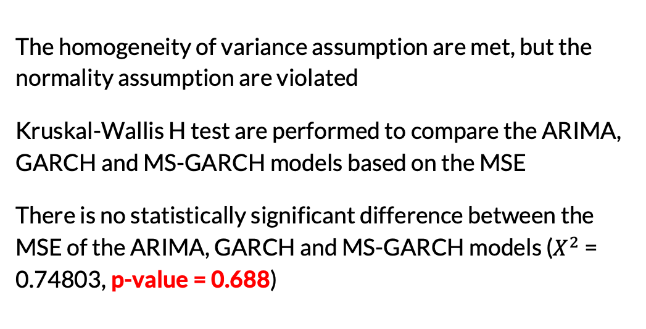
Kruskal-Wallis H Test

Slide 22
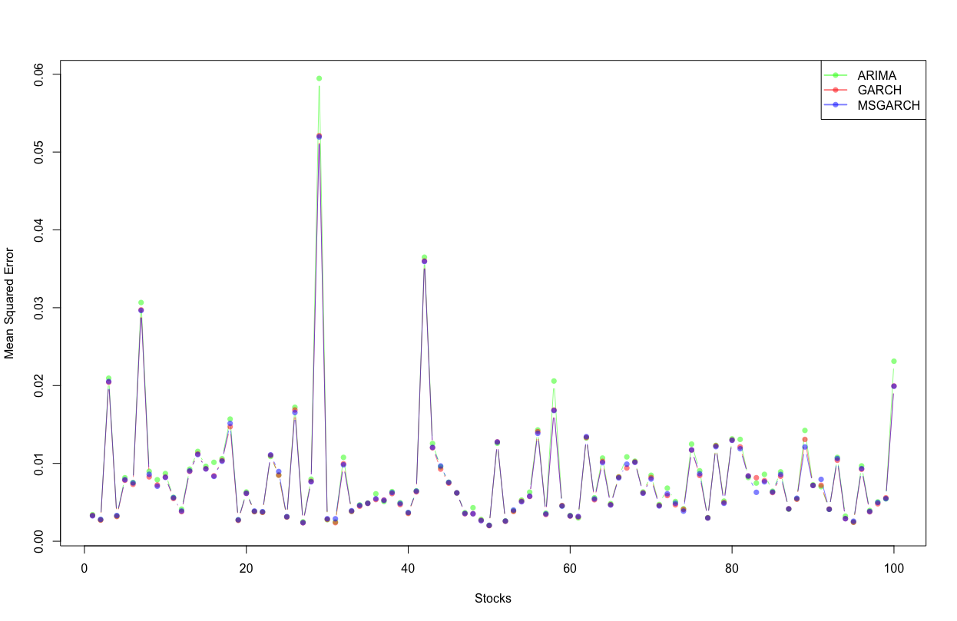
Visualization of the MSE for 100 Stocks

Slide 23
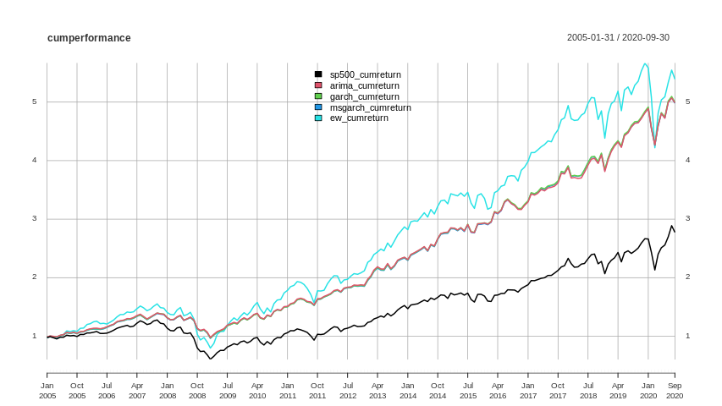
Portfolio performance: Cumulative Returns
Our proposed portfolios would have outperform S&P500 in the last 15 years equally well.
Following DeMiguel (2009) we see that the equal weight portfolio has a slightly higher return but is much more volatile.

Slide 24
Rolling returns
 | yearly |  |  | 5-yearly |  |  | 10-yearly
 | S&P500 | Sharpe | EW | S&P500 | Sharpe | EW | S&P500 | Sharpe | EW
min | -44.7% | -23.6% | -41.8% | -3.3% | 4.7% | 4.2% | 4.2% | 9.6% | 10.17%
25 perc. | 2.6% | 8.5% | 3.8% | 0.7% | 7.3% | 8.5% | 5.2% | 10.5% | 11.36%
50 perc. | 11.2% | 13.2% | 15.7% | 9.1% | 11.9% | 11.8% | 6.1% | 11% | 12.6%
75 perc. | 15.5% | 17.3% | 22% | 12.2% | 14.7% | 16.7% | 10.9% | 13.8% | 14.6%
max | 50.3% | 34.8% | 77.7% | 20.4% | 19.6% | 29.9% | 14.2% | 15.5% | 20%
n | 933 | 933 | 933 | 885 | 885 | 885 | 825 | 825 | 825

Slide 25
Thank you

