Slide 1

ANZ Virtual Internship Task 2
Jervis Chan jun yong

Slide 2
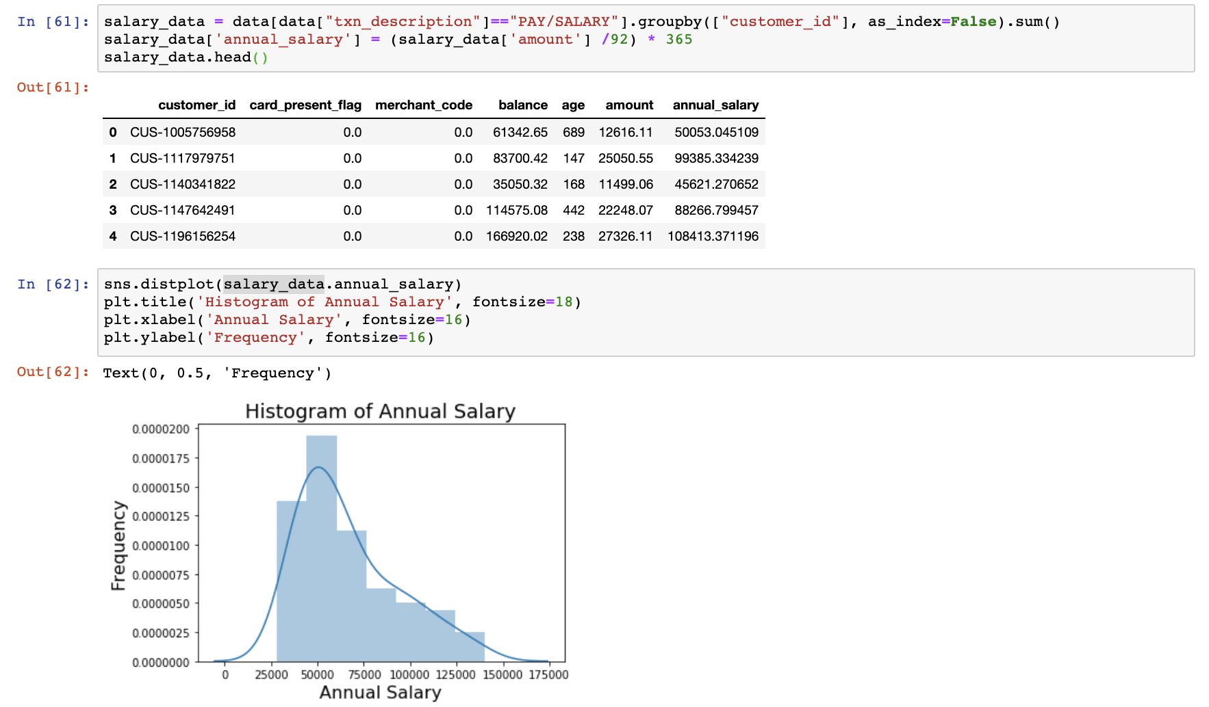

Slide 4
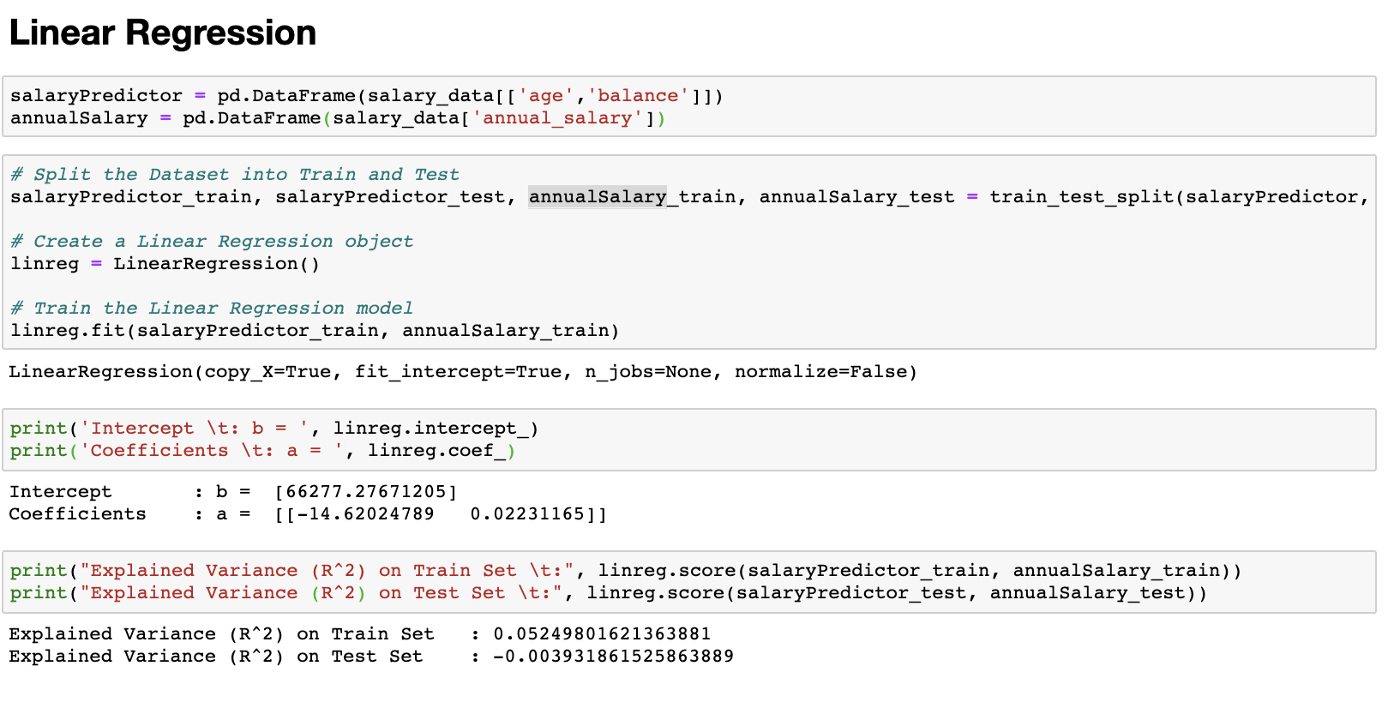

Slide 5
