Slide 1
Credit Card Fraud Detection
Jervis Chan
Jovan Chan
Vincent Yong

Slide 2
Dataset: Credit Card Fraud (Kaggle)
Transactions made by credit cards in September 2013 by European cardholders that occurred in two days
284,807 transactions
492 frauds (0.172% of all transactions)
Classification Problem:
Identify fraudulent credit card transactions

Slide 3
Practical Motivation
Despite the introduction of EMV chip technology, credit card fraud remains a concern for both banks and customers.
In 2016, global card fraud losses equaled $22.8 billion, with 15.4 million consumers becoming victims of identity theft or fraud.

Slide 4
Practical Motivation
Loss to customers
Customers lose money as a result from credit card frauds. The average U.S. consumer lost a median of $429 from credit card fraud in 2017.
Customers also experience identity theft which can result in inconveniences such as account seizures.

Slide 5
Practical Motivation
Loss to banks
Most of the financial loss is not attributed to the customers but to the financial institutions (79% of credit card fraud losses are paid by the financial institutions).
Banks may also face penalties if they fail to curb the high frequencies of credit card fraud. This is practiced in Australia where the new Australia Payments Network sets a minimum loss thresholds and intervention trigger points for financial institutions and imposes penalties if they fail to meet these thresholds.

Slide 6
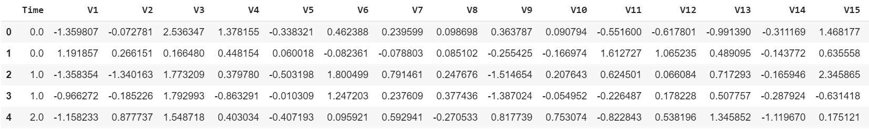
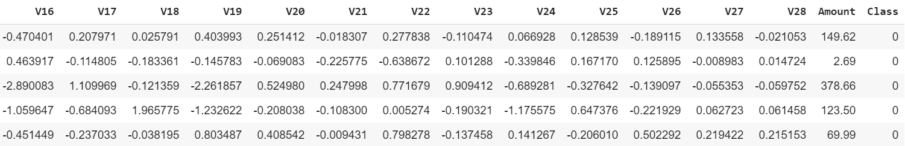
Problem Formulation
Dataset consists of continuous variables V1-V28, transaction amount, transaction time and the class

Slide 7
Problem Formulation
‘Class’ is a binary of 0 or 1
0 - Not Fraudulent, 1 - Fraudulent

Slide 8
Problem Formulation
Binary Classification on Transactions
Determine if that particular transaction is fraudulent given a test dataset without the Class column

Slide 9
Statistical Description
Check for Null Values
Check Data Types
Statistical Summary
Mean
Standard Deviation
Interquartile Values

Slide 10
Pattern Recognition
Countplot of Class variable
Boxplot of V1-V28 against Class
Correlation Heatmap

Slide 11
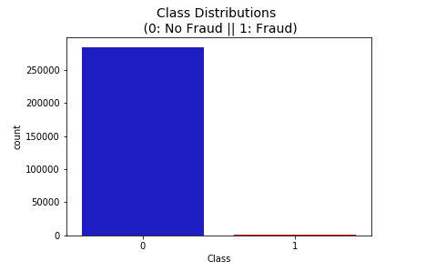
Countplot
No Frauds: 99.83%
Frauds: 0.17%
Due to the highly imbalanced dataset, we can choose to either undersample or oversample the train_df.

Slide 12
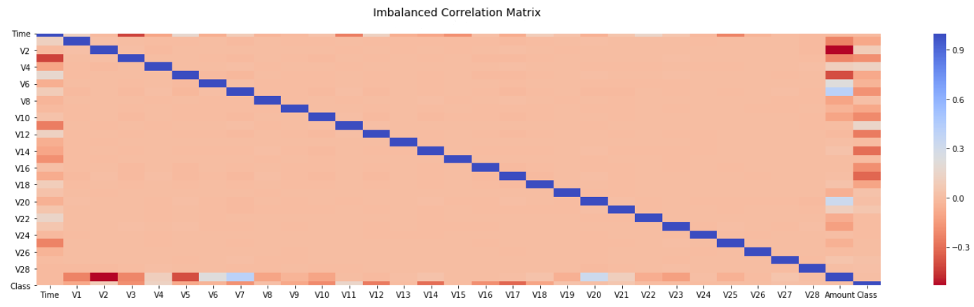
Imbalanced correlation matrix
Correlation matrix using the existing dataframe is unreflective of any correlations between the variables (Time, V1-V28, Amount) and our target (Class)

Slide 13
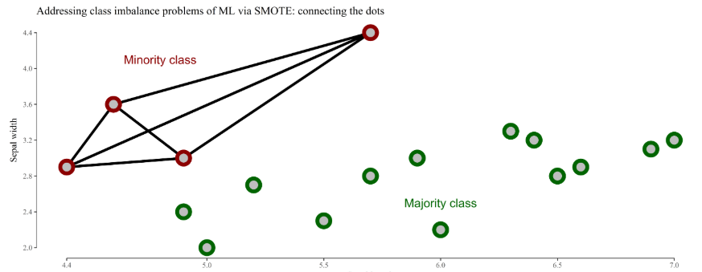
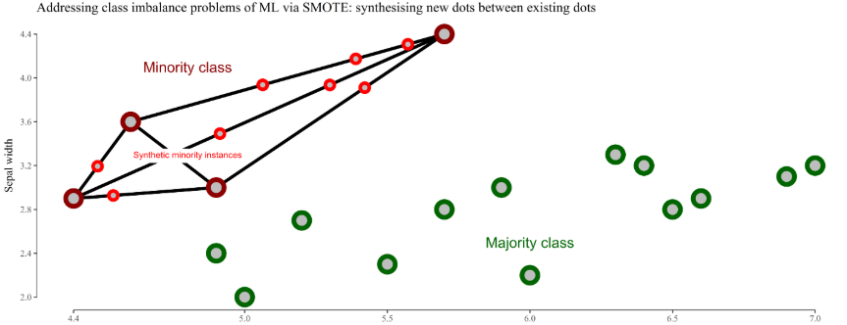
Sampling
We performed sampling to create dataframes with equal values of fraudulent and non-fraudulent transactions.
Undersampling
Extracted all of the fraudulent transactions and randomly extracted an equal number of non-fraudulent transaction.
Oversampling
SMOTE generates new instances of fraud cases from our existing fraud cases

Slide 14
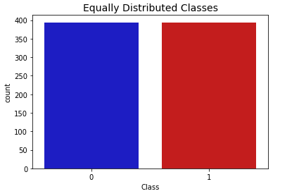
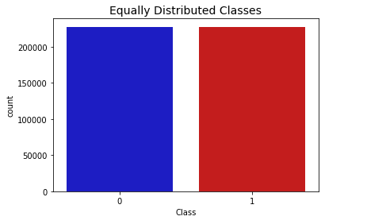
Count Plots
Undersampled
Oversampled

Slide 15
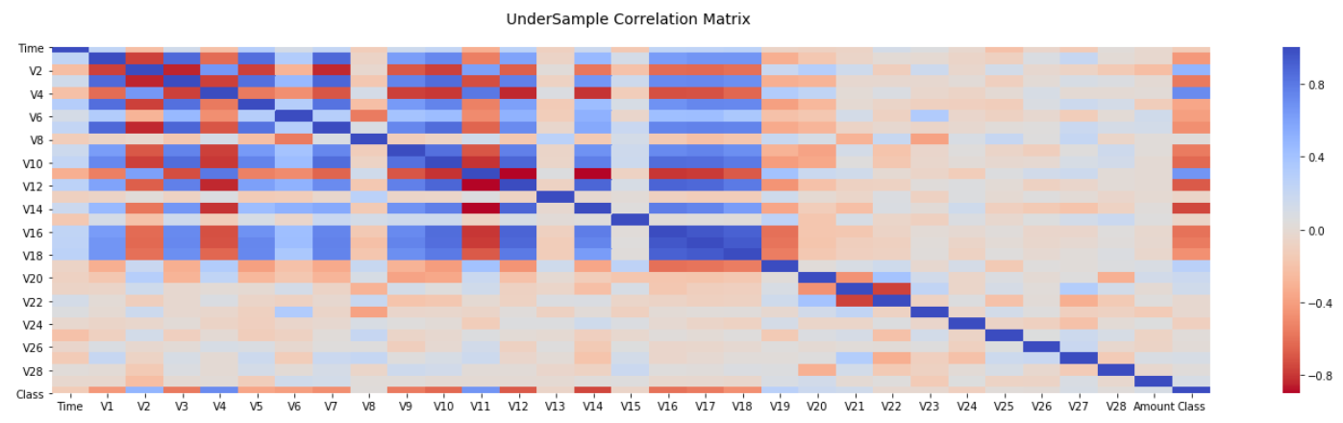
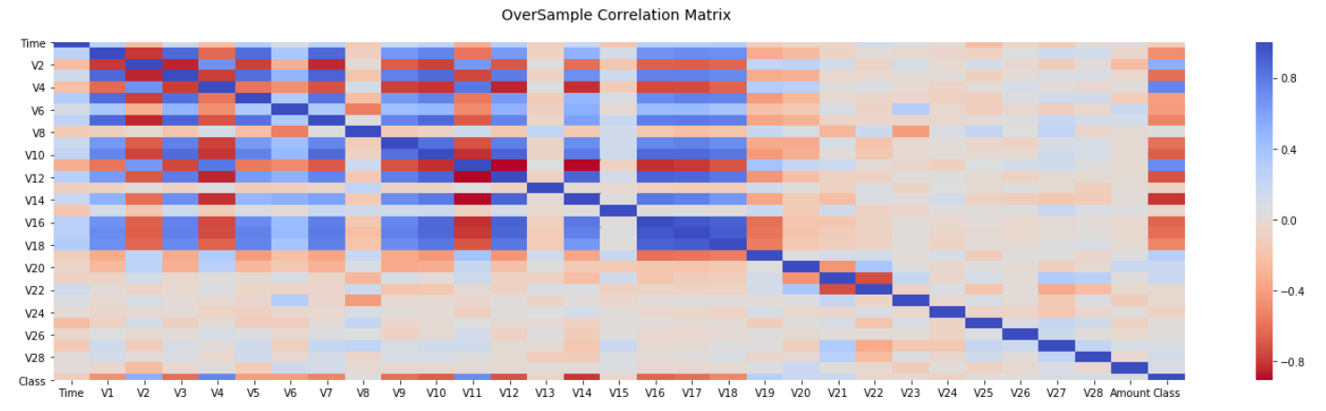
Correlation matrix

Slide 16
Correlation matrix

Slide 17
Correlation Matrix - Results
Variable | Correlation
V3 | -0.563363
V4 | 0.711425
V10 | -0.625112
V11 | 0.669724
V12 | -0.679374
V14 | -0.749900
V16 | -0.590220
Variable | Correlation
V3 | -0.608970
V4 | 0.742052
V9 | -0.601215
V10 | -0.670195
V11 | 0.716714
V12 | -0.713727
V14 | -0.801103
V16 | -0.644581
V17 | -0.611864
Undersampled
Oversampled
Notes:
We can see that oversampled data provides higher correlation
Other variables do not exhibit strong correlation

Slide 18
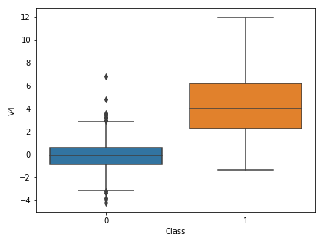
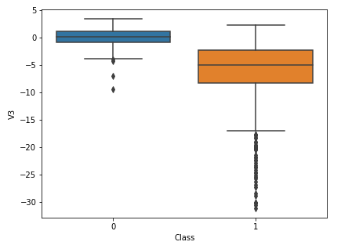
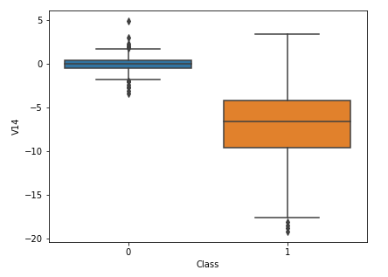
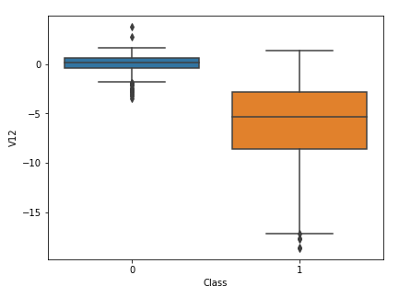
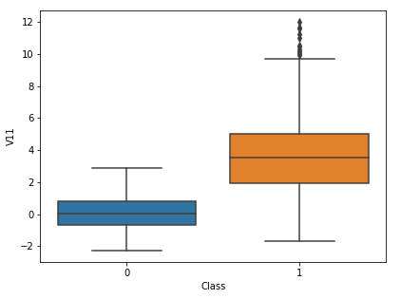
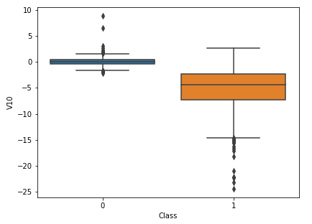
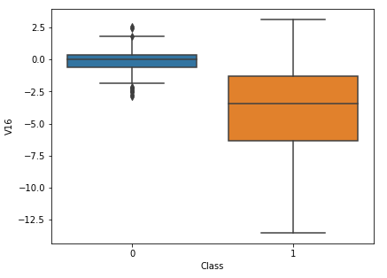
Box Plots - Undersampled data
High positive correlations:
High negative correlations:

Slide 19
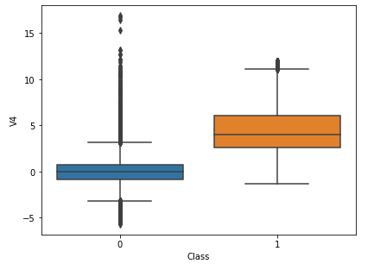
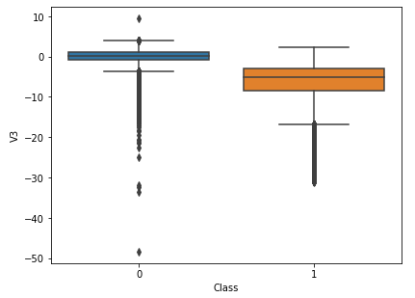
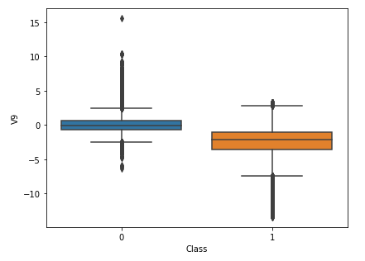
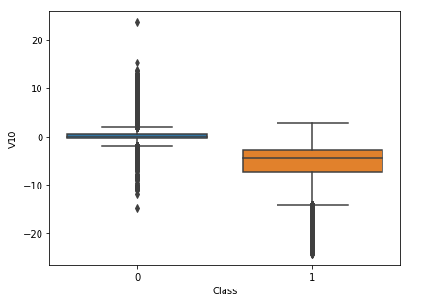
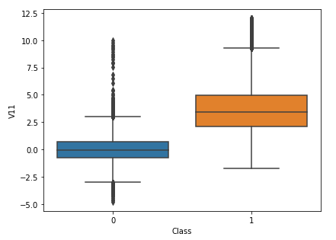
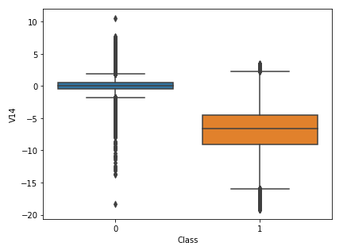
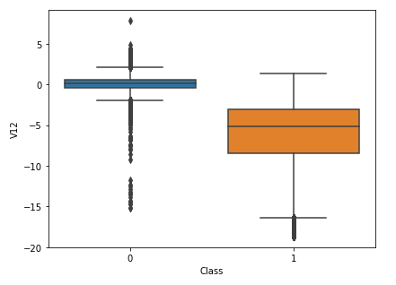
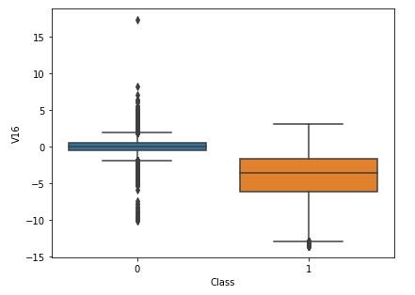
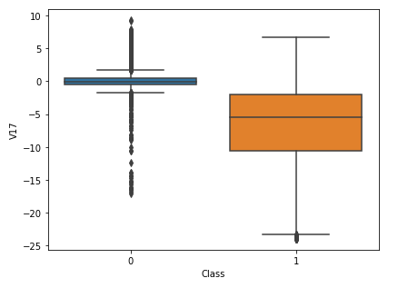
Box Plots - Oversampled data
High positive correlations:
High negative correlations:

Slide 20
Data Preparation: Train/Test Split
Split the data into 80% for train and 20% for test, using stratified sampling
Ensures test dataset has the correct ratio of fraudulent to non-fraudulent transactions

Slide 21
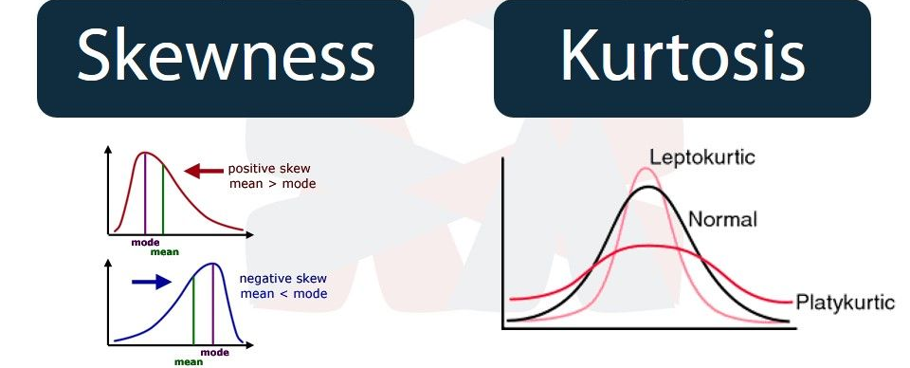
Data Preparation: Feature Engineering
Normalisation
Created new features:
time_between_transactions
For each V1 - V28:
Mean
Standard Deviation
Skew
Kurtosis

Slide 22
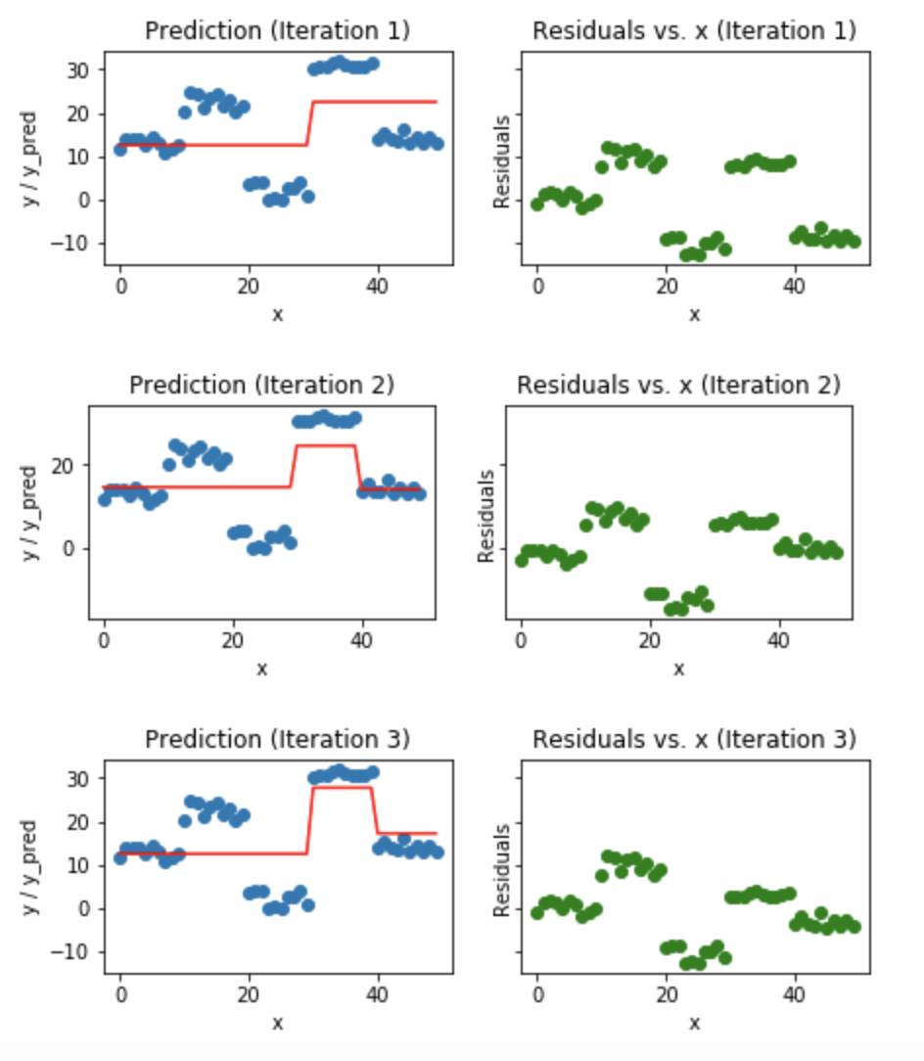
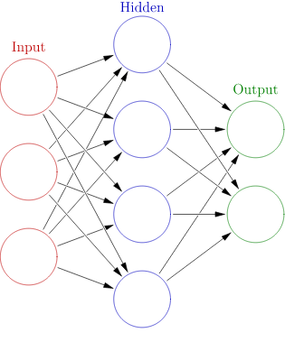
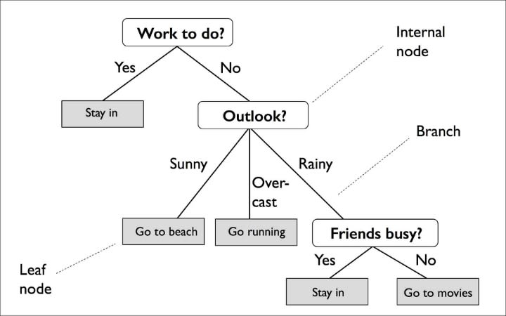
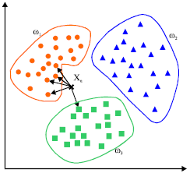
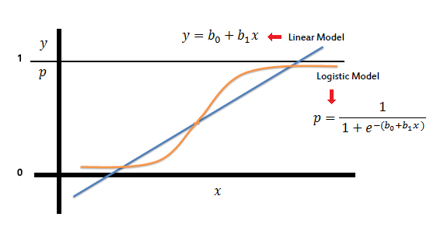
Machine Learning
We experiment with various supervised learning algorithms and compare results.
Logistic Regression
K Nearest Neighbours
Decision Tree
Random Forest
LightGBM
Neural Network

Slide 23
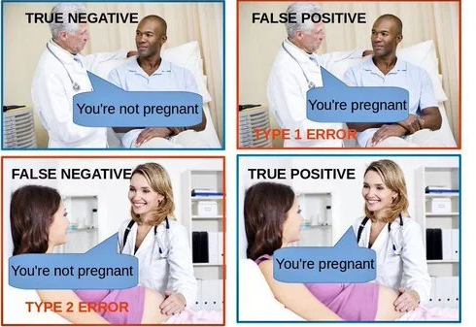
Metrics For Evaluation

Slide 24
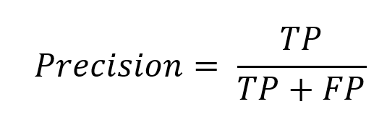
Metrics For Evaluation
Precision tells us out of all the transactions we predicted as fraudulent, what percentage was actually fraudulent.

Slide 25
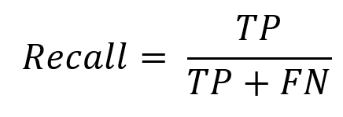
Metrics For Evaluation
Recall tells us out of all the fraudulent transactions, what percentage was correctly identified by our model.
This metric is more important than precision, as it is more crucial to detect fraudulent transactions and not let them slip by, than reducing the number of false positives detected.

Slide 26
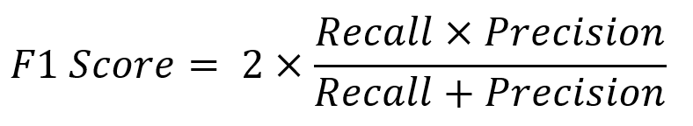
Metrics For Evaluation
F1 Score considers both recall and precision.
This takes both false positives and false negatives into consideration, and is much more useful as an indicator of the model's performance than accuracy, especially because of the highly skewed data.
Notes:
To elaborate, if our model guessed that none of the transactions were fraudulent, we would still achieve a 99.83% accuracy, as such using accuracy would not be useful in such a skewed data.

Slide 27

Metrics For Evaluation
Weighted average takes the average of F1 scores for both classes with respect to their support.
This gives a greater importance to the higher represented class.

Slide 28

Metrics For Evaluation
Macro average takes the average of F1 scores for both classes.

Slide 29
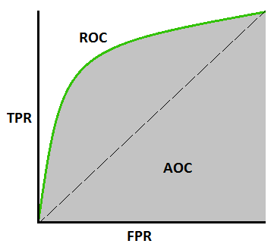
Metrics For Evaluation
AUC - ROC (Receiver Operating characteristic) curve
Performance measurement for binary classification at different thresholds
Plots False Positive Rate against True Positive Rate
Performance of the model is indicated by the area under the curve

Slide 30
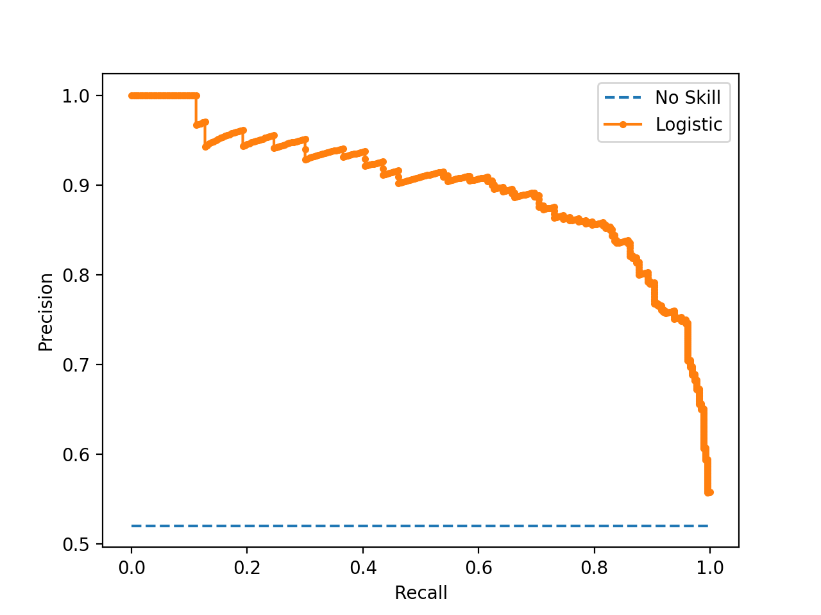
Metrics For Evaluation
AUC - Precision Recall curve
Plots Precision against Recall
Trade off between the two; Eg. if we predict all transactions to be fraudulent, recall will be high but precision will be low.
Performance of the model is indicated by the area under the curve

Slide 31
Results
 | Logistic Regression | K Nearest Neighbours | Decision Tree | LightGBM | Random Forest | Neural Networks
Undersampled | 0.49 | 0.56 | 0.48 | 0.52 | 0.53
Oversampled | 0.50 | 0.89 | 0.74 | 0.80 | 0.94 | 0.88
Table of Macro Average of F1 scores

Slide 32
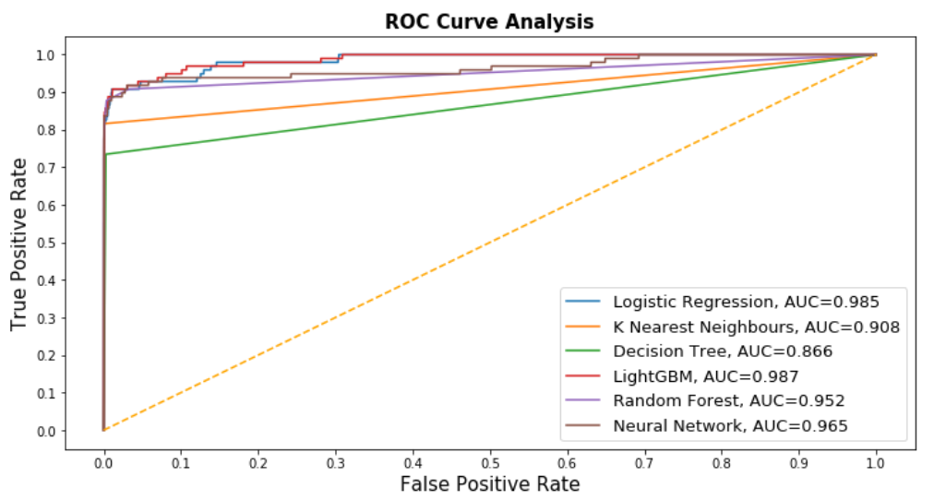
ROC Curves

Slide 33
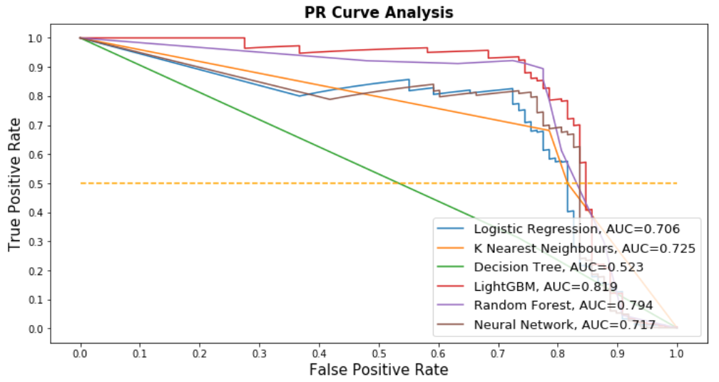
Precision-Recall Curves

Slide 34
Discussion Of Results
ROC Curve
Number of true negatives are extremely large and would cause the FPR to become very small
Not useful when comparing between different models all with very small FPRs
FPR is also less important as we want to focus more on the fraudulent transactions, rather than the non-fraudulent ones
Precision-Recall curve
Precision, on the other hand, highlights how correct our fraudulent predictions are. This is a more useful metric than false positive rate
Hence, PR curve will be better suited to evaluate our model than ROC curve

Slide 35
Conclusion
Sampling was helpful in dealing with the highly unbalanced dataset
Oversampling was able to produce better results
Random forest produced the best results

Slide 36



Team Members
Jervis Chan
Vincent Yong
Jovan Chan

