Slide 1



MIKROTIK
December 2025
MIKROTIK
Unified Threat Management (UTM)
Presented by Mark Jeryl H. Omandam BSIT-4

Slide 2

Introduction.
MikroTik is an affordable and flexible networking platform powered by RouterOS, offering enterprise-level features such as routing, firewalling, NAT, VPN, bandwidth control, and hotspot services. It is widely used across homes, schools, businesses, and ISP networks, with configuration options suitable for both beginners and professionals. As a UTM solution, MikroTik integrates security and traffic management features into a single device, enabling it to function as both a router and a security gateway that protects, controls, and optimizes network performance in physical and virtual environments.
MikroTik UTM provides essential network security by integrating firewalling, traffic control, VPN, content filtering, and access management into a single RouterOS-based device.

Slide 3

FEATURES
OF MIKROTIK

Slide 4

DHCP
Automatically assigns IP addresses to devices
Reduces manual network configuration
Prevents IP address conflicts
Makes network management easier

Slide 5
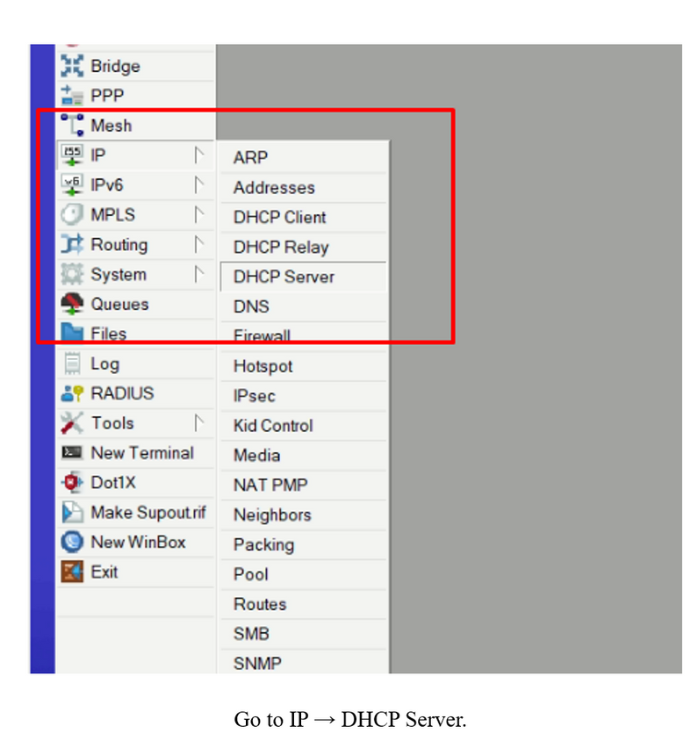
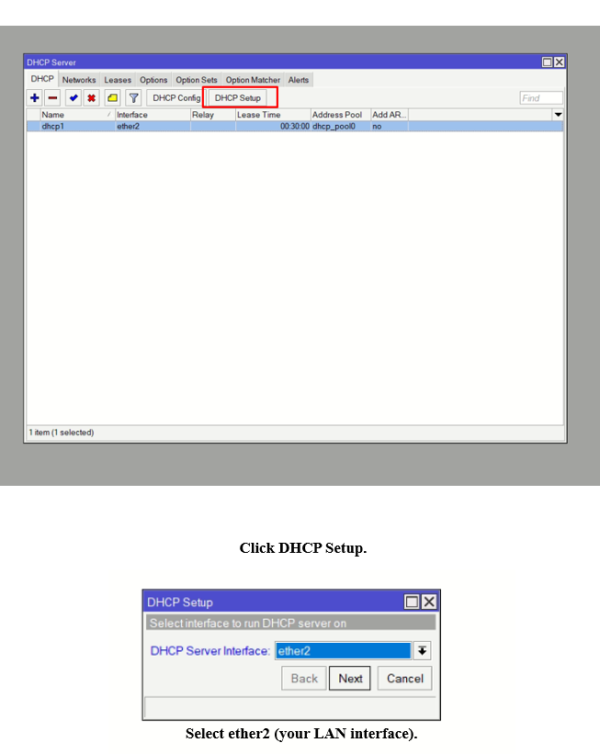
Steps
Go to IP → DHCP Server
Click DHCP Setup
Select the LAN interface (ether2)
Set gateway, address pool, and DNS
Finish the setup

Slide 6
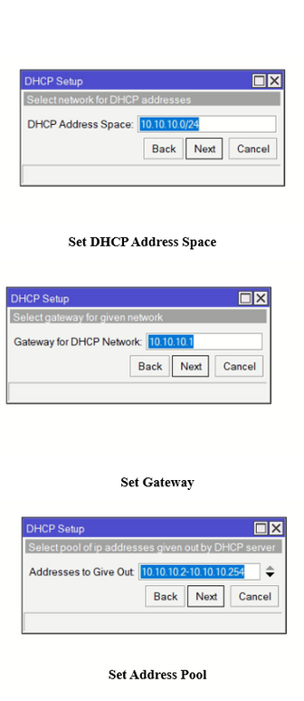
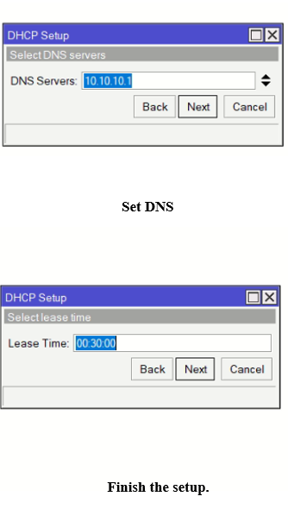
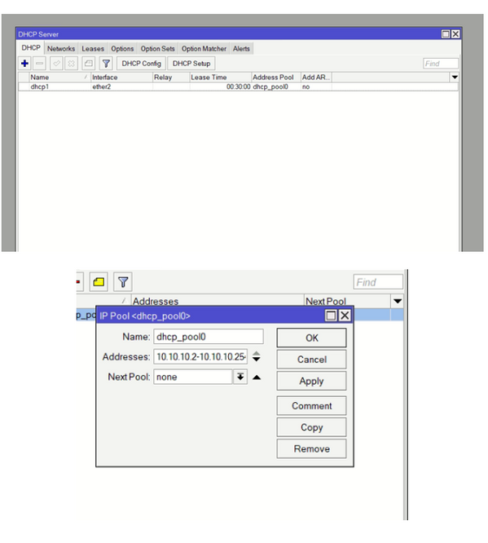
Steps
Go to IP → DHCP Server
Click DHCP Setup
Select the LAN interface (ether2)
Set gateway, address pool, and DNS
Finish the setup

Slide 7
2. NTP (Network Time Protocol)
Synchronizes device clocks across the network
Ensures accurate logs and scheduled tasks
Functions as a local time server for LAN clients
Uses router's internal clock for reliability

Slide 8
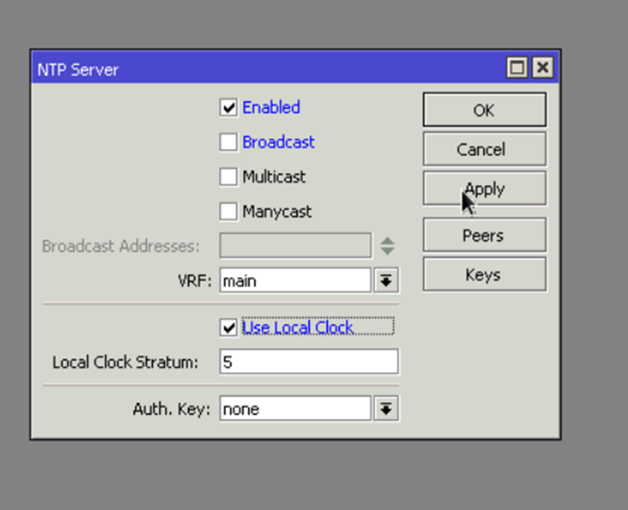
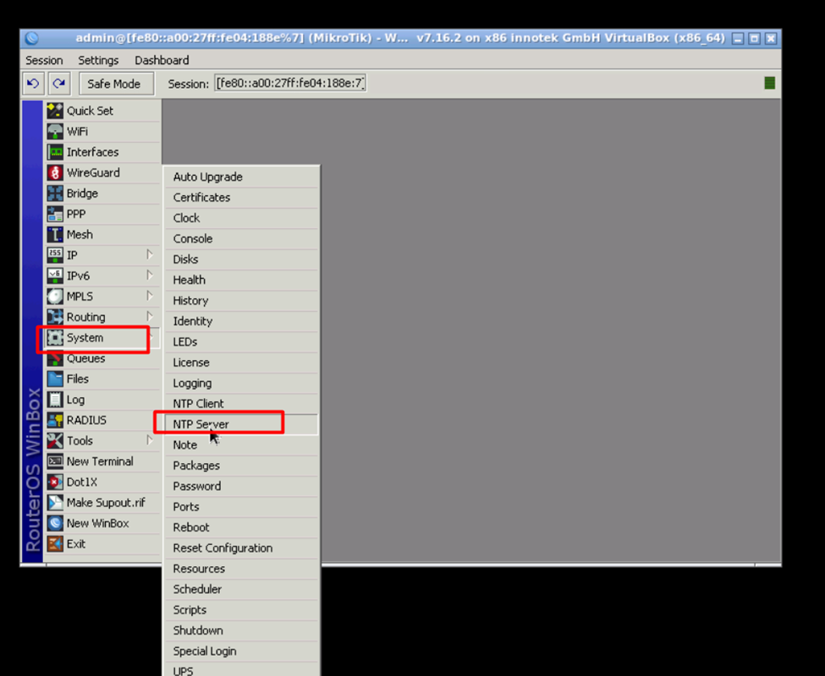
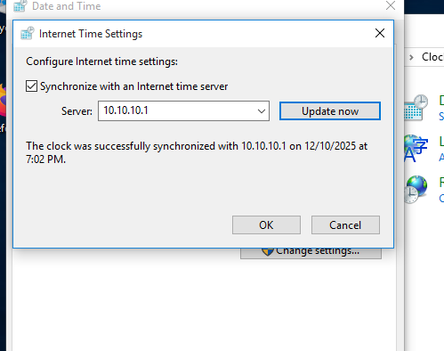
Steps
Go to System → NTP Server
Check "Enabled" and "Use Local Clock"
Set Local Clock Stratum to 5 and click Apply
On client PC, go to Internet Time Settings
Enter Server IP (10.10.10.1) and click Update now

Slide 9
3.Specific Device Ping Banned
Blocks ICMP (ping) traffic
Prevents network scanning
Increases device-level security
Allows selective device control

Slide 10
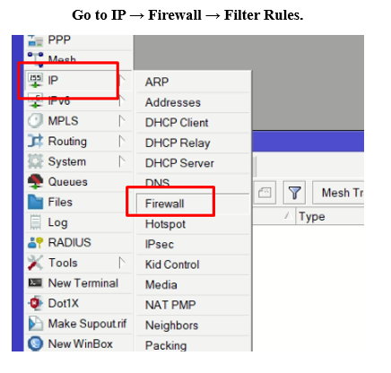
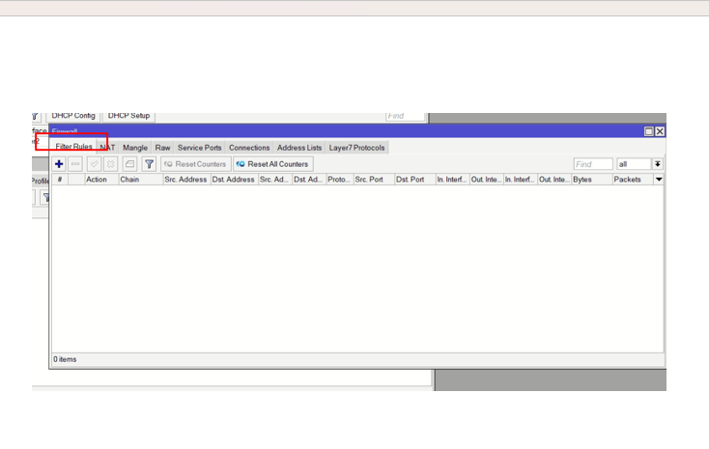
Steps
Go to IP → Firewall → Filter Rules
Click +
Set Chain: forward
Enter source IP address of device
Set Protocol: icmp
Set Action: drop
Save

Slide 11
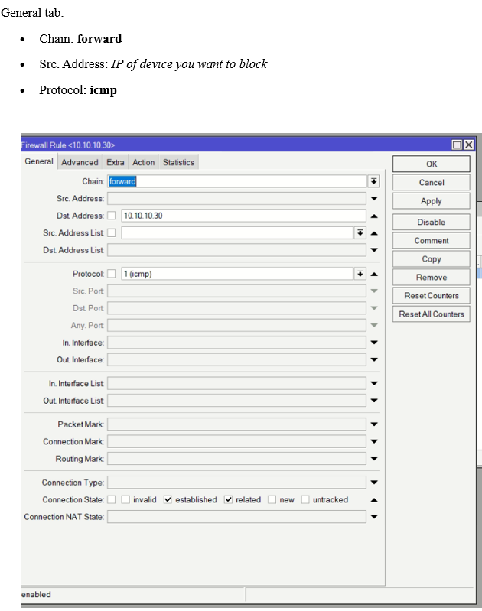
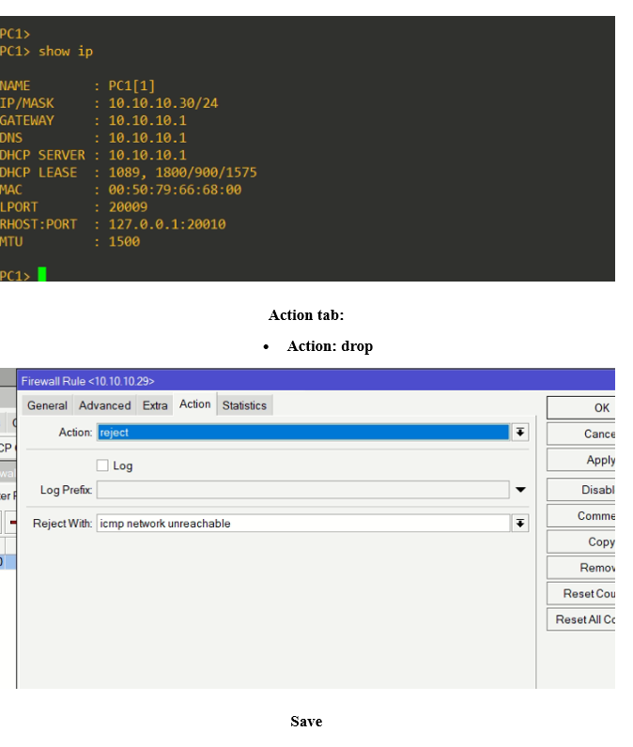
Steps
Go to IP → Firewall → Filter Rules
Click +
Set Chain: forward
Enter source IP address of device
Set Protocol: icmp
Set Action: drop
Save

Slide 12
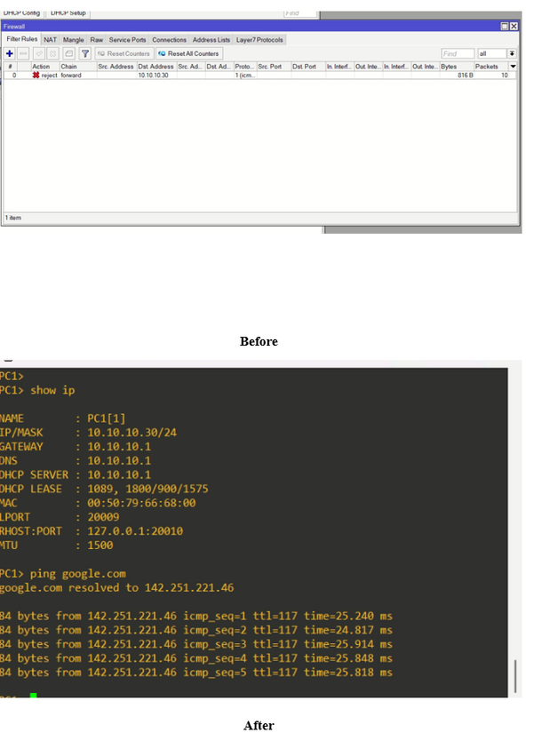
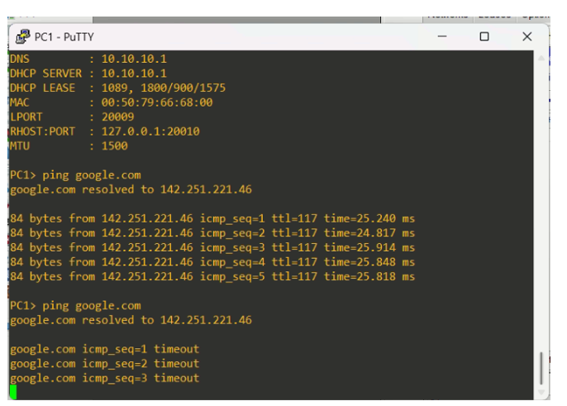
Steps
Go to IP → Firewall → Filter Rules
Click +
Set Chain: forward
Enter source IP address of device
Set Protocol: icmp
Set Action: drop
Save

Slide 13
4.IP Reservation
Assigns permanent IP addresses to devices
Uses MAC address binding
Ensures consistent IP usage
Useful for servers and important devices

Slide 14
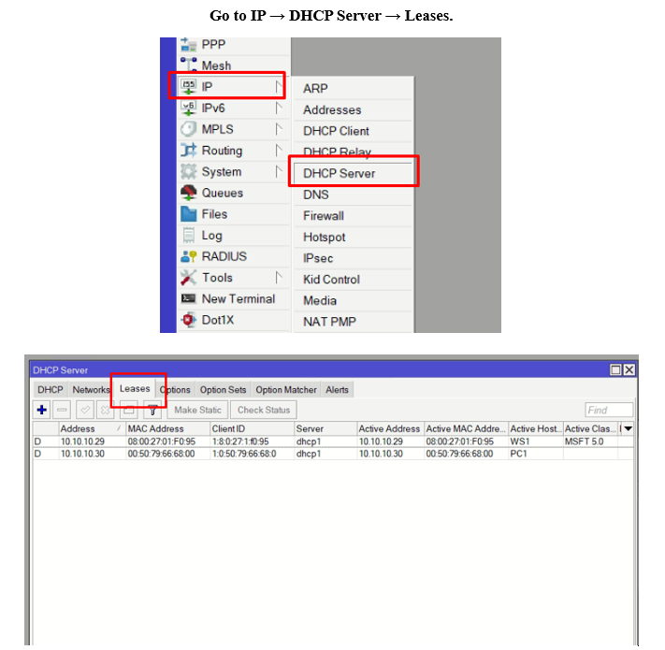
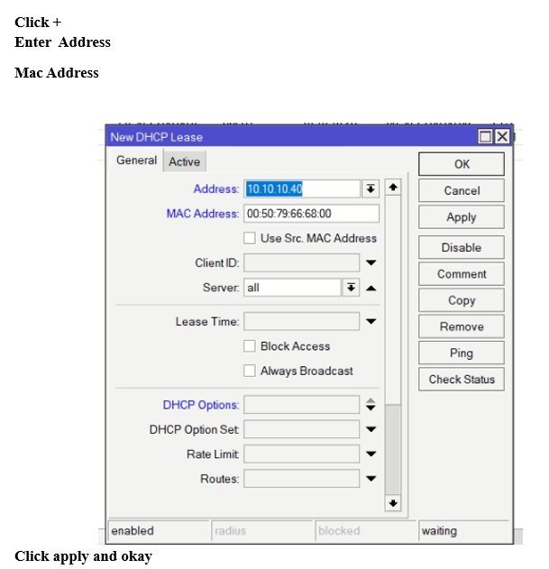
Steps
Go to IP → DHCP Server → Leases
Click +
Enter IP Address
Enter MAC Address
Apply and OK

Slide 15
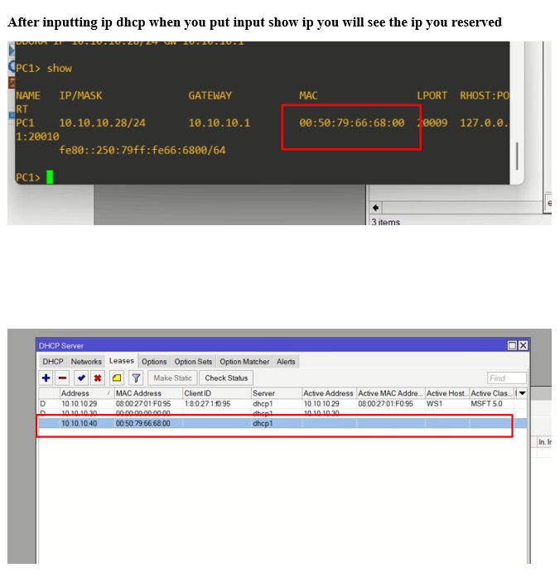
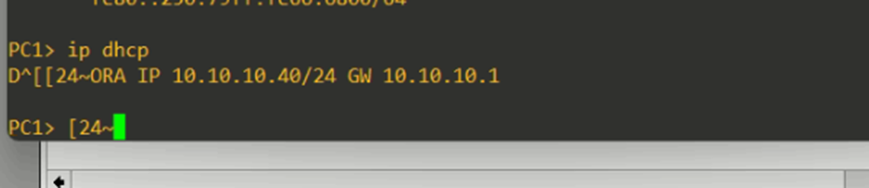
Steps
Go to IP → DHCP Server → Leases
Click +
Enter IP Address
Enter MAC Address
Apply and OK

Slide 16
5.Limit Bandwidth
Controls internet speed per device
Prevents bandwidth abuse
Ensures fair network usage
Improves overall performance

Slide 17
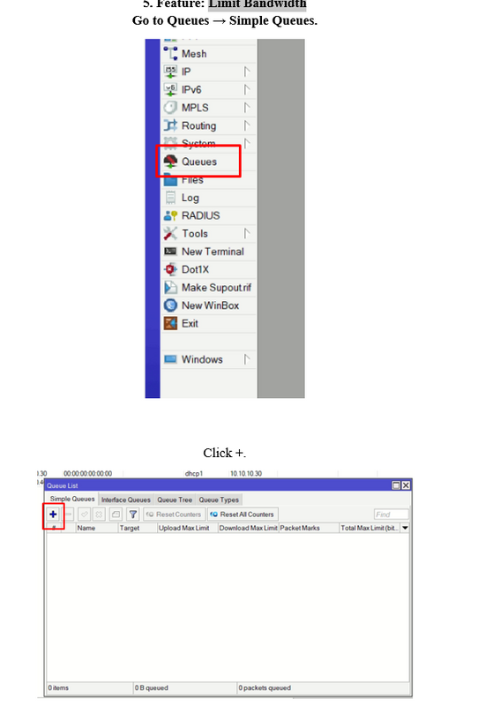
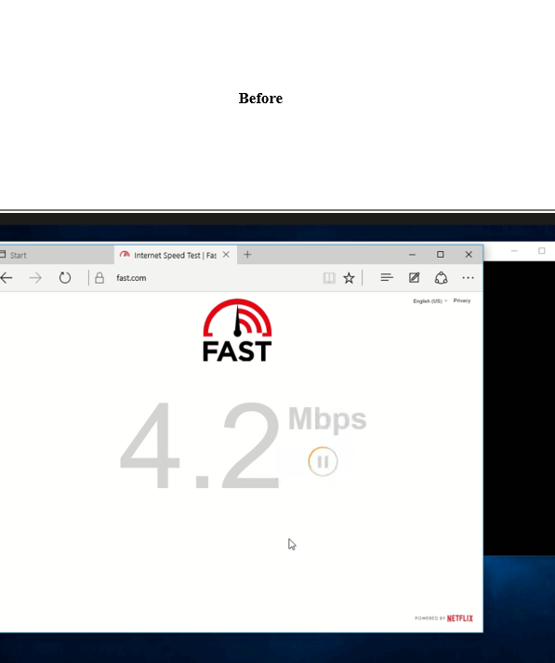
Steps
Go to Queues → Simple Queues
Click +
Set target IP address
Set maximum upload and download speed
Save

Slide 18
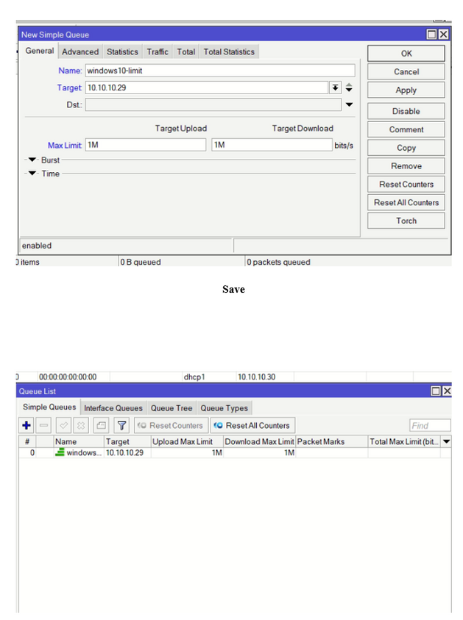
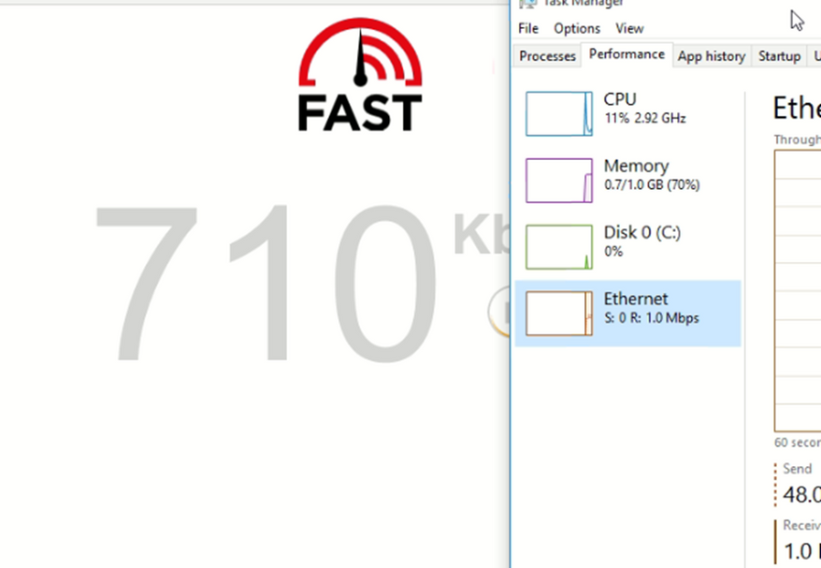
Steps
Go to Queues → Simple Queues
Click +
Set target IP address
Set maximum upload and download speed
Save

Slide 19
6.DNS Hostname Resolver
Converts domain names to IP addresses
Speeds up browsing
Allows local hostname resolution
Improves network reliability

Slide 20
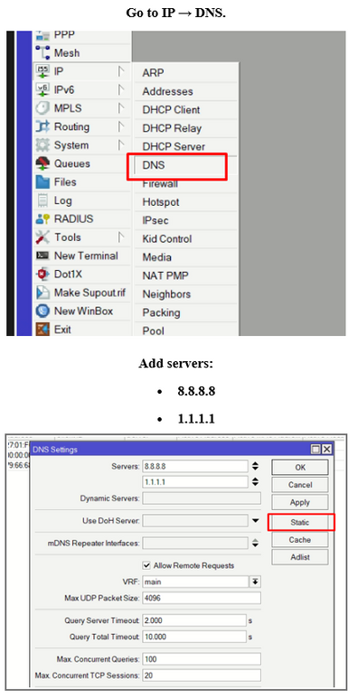
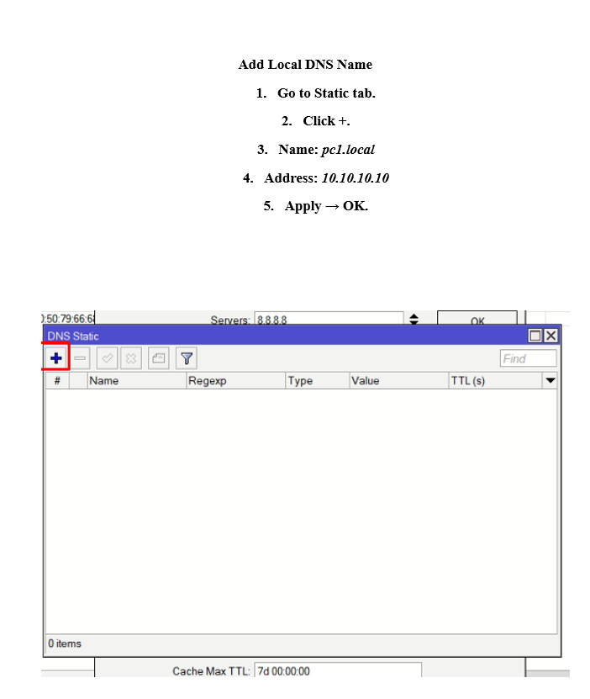
Steps
Go to IP → DNS
Add DNS servers (8.8.8.8, 1.1.1.1)
Go to Static tab
Click +
Enter domain name and IP address
Apply and OK

Slide 21
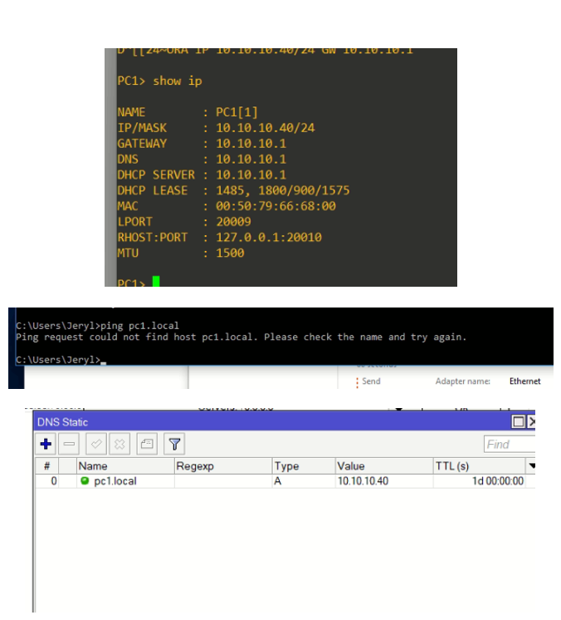
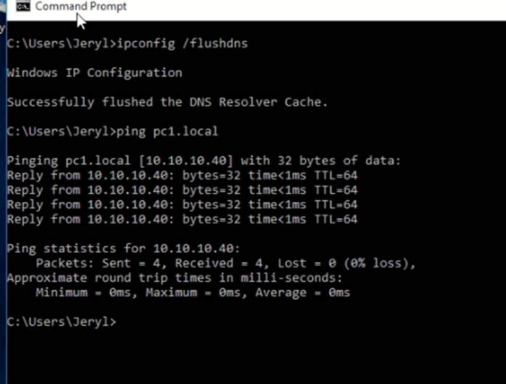
Steps
Go to IP → DNS
Add DNS servers (8.8.8.8, 1.1.1.1)
Go to Static tab
Click +
Enter domain name and IP address
Apply and OK

Slide 22
7.Kid Control
Kid Control is a feature that allows you to manage internet access for specific devices on your network, such as restricting access for children's devices during certain times. It allows you to create profiles that block internet connectivity based on a schedule (e.g., blocking access on specific days or hours).

Slide 23
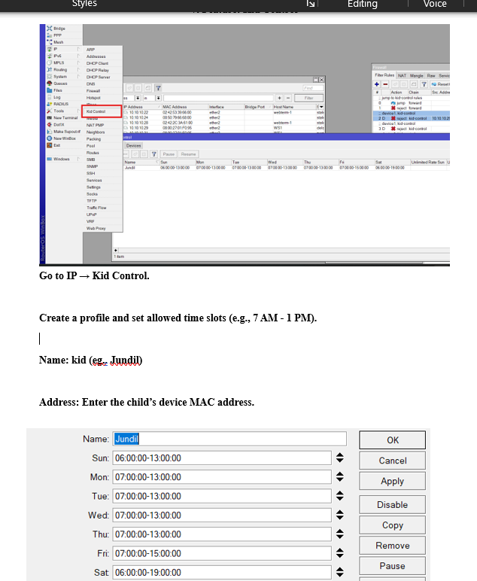
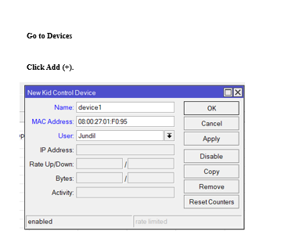
Steps
Go to IP → Kid Control.
Create a profile and set allowed time slots (e.g., 7 AM - 1 PM).
Go to Devices tab and click +.
Enter the child's device MAC Address.
Select the User Profile created earlier.
Click OK to activate.

Slide 24
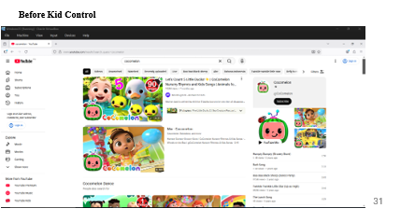
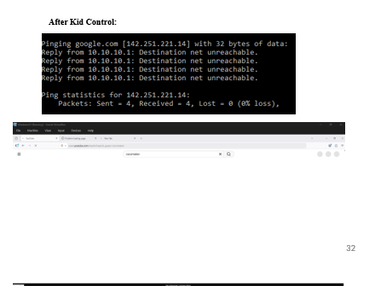
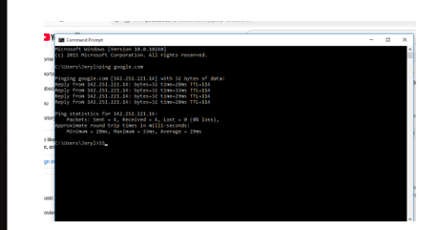
Steps
Go to IP → Kid Control.
Create a profile and set allowed time slots (e.g., 7 AM - 1 PM).
Go to Devices tab and click +.
Enter the child's device MAC Address.
Select the User Profile created earlier.
Click OK to activate.

Slide 25

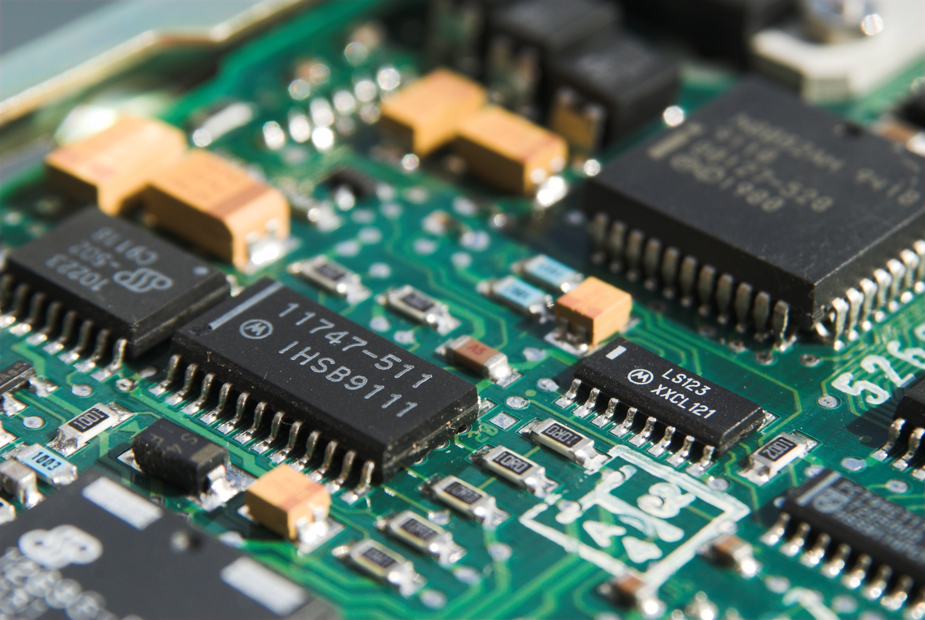
Conclusion
MikroTik is a powerful and cost-effective networking solution that combines routing, security, and traffic management features into a single platform. Through its RouterOS, it provides essential UTM functions such as DHCP, NAT, firewall filtering, bandwidth control, DNS management, and Kid Control. These features allow MikroTik to function not only as a router, but also as a security gateway that improves network stability, protects connected devices, and optimizes internet usage. Because of its flexibility and ease of configuration, MikroTik is well suited for laboratories, schools, small businesses, and real-world production networks.

Slide 26
MIKROTIK
December 2025
THANK YOU

