Slide 1
Finding the students who will leave, while there is still time to help
An early warning on day one. And one decision only the school can make.
Jeryl Donato Estopace
PGD AI/ML capstone, Pillar 5
Built on 4,424 student records from Instituto Politecnico de Portalegre

Slide 2
391 students in every 1,000 leave before they finish
Each dot is ten students, and the filled ones are the ones who do not graduate. The rate is 391 in every 1,000 among the 3,630 whose outcome is settled, once the 794 still enrolled are set aside.
Every dropout costs three parties at once, because the student loses years and fees while the school loses tuition and the country loses a graduate it had already half paid for.
The school knows this is happening, and what it cannot see is which students, because that only becomes clear when the first exams come back, by which time half the year is gone and so, usually, is the student.
2,100 EUR
the tuition that one saved student pays back over a three-year degree, which is a deliberately low estimate because the real loss is larger.
The question is not whether to help, but who to help first, and when.

Slide 3
What the tool does, on the day a student enrolls
It reads the enrollment form, and nothing else.
It knows the student's age and course, whether they hold a scholarship, whether the fees are paid, and what a parent does, and all of it is known before the first class.
It does not look at grades, attendance, or coursework.
That was on purpose and it costs some accuracy, because a tool that waited for first-term results would be more certain and also useless, since by then the student has already decided.
It hands the tutoring team a ranked list.
The students most at risk sit at the top, and it is a starting point for a conversation twelve months early rather than a number ever shown to a student.
12 months
of warning, instead of none
8 in 10
of the students who go on to leave are on the list
1 in 2
students are flagged, sized against what the tutoring team can handle
The tool does not decide anything, and all it does is decide what a person looks at first.

Slide 4
Out of every 1,000 students
Scaled from 726 real students the tool had never seen. It was tested once, on data held back from the start.
311
80
172
437
caught
leavers the team reaches in time
missed
leavers the tool does not find
contacted for nothing
graduates who were never leaving
correctly left alone
the team never hears about them
Of the 391 who leave, the tool finds 311.
Eighty are missed, which is the honest number and will never be zero, because no tool that runs on an enrollment form finds everyone.
The 172 contacted for nothing is the cost worth arguing about, and slide 6 does.
483
students flagged, about one in two, which is more than the team can staff, and the fairness fix on slide 8 is what brings the list back within reach.
Every number on this slide came from students the tool had never seen.

Slide 5
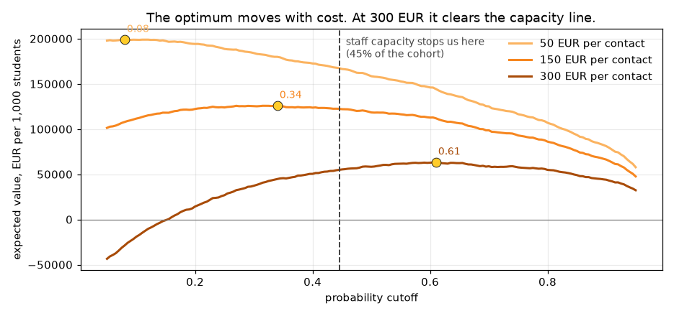
The return
Three assumptions, all stated, all careful. Change any one and the answer moves. That is why the curve is here, not just the number.
A saved student is worth about 2,100 EUR.
Three years of public tuition, and nothing else counted.
Reaching out works about three times in ten.
So a student the tool finds is worth about 630 EUR on average rather than 2,100.
A conversation costs somewhere between 50 and 300 EUR.
The school knows this number and I do not, so all three are shown.
A conversation costs | Best case | At 1 in 2
50 EUR | 199,022 EUR | 171,942 EUR
150 EUR | 125,289 EUR | 123,595 EUR
300 EUR | 58,967 EUR | 51,074 EUR
Value per 1,000 students. Aiming at the team's capacity instead of the most profitable cutoff costs only about 1,700 EUR at a 150 EUR contact, so it is nearly free, and slide 8 is the thing that is not.
At 150 EUR a conversation, a save returns about four times what a contact costs, so the money says reach out broadly and there is barely any sorting left to do.

Slide 6
The price, and who pays it
172 in every 1,000 are contacted who were never going to leave.
The cost is not paid in euros but in a student pulled into a conversation they did not need, and told in effect that a system thinks they are failing.
If the tool flags fewer students then fewer graduates get bothered, but every student it cuts is also a leaver the team never reaches, so the 80 missed today becomes 120.
not flagged flagged
437
172
correctly left alone
contacted for nothing
80
311
missed
caught
This is the trade, and it does not go away.
Finding more leavers always means bothering more graduates, and bothering fewer always means finding fewer, so where the school sits is a judgement about students rather than a calculation.
That is why the list goes to a person, and the person decides who to call.

Slide 7
The tool is worse at its job for women
The tool was checked across gender, age, scholarship, and debt, and gender is the one that fails on fairness, because the other three flag groups that really do drop out more.
3 in 10
of the women who go on to drop out are never on the list at all, and for men it is closer to one in eight.
This shows up in no count of who gets flagged.
The tool flags men about twice as often as women, so a check on flagging rates says men are over-contacted and stops there, which answers a different question from the one that matters.
The harm only appears when you count who gets missed rather than who gets contacted.
men who leave
88%
women who leave
70%
Share of the students who go on to leave that the tool actually finds.
The students this tool exists to reach are being missed, and they are being missed unevenly.

Slide 8
Closing that gap costs about 30 students
There is a way to correct it. It works. It is not free, and the school should see the bill before it decides.
as it stands
311
The option the school should not take
A second fix closes the same gap and looks better on paper, but it gets there by contacting fewer students of every kind, so it costs seventy leavers instead of thirty.
Fixing a gap by helping fewer people is not a fix.
with the gap closed
281
Leavers found, per 1,000 students.
Thirty fewer students are reached in every thousand.
That is about 8,000 EUR per 1,000 students at a 150 EUR contact, and the catch rate falls from about 8 in 10 to 7 in 10.
What it buys is that those thirty are not loaded onto women.
It does not make the tool better but it makes it evenly bad, and the list of about 410 still fits what the team can reach.
This is the school's decision, not the tool's.
Thirty students is the price of the tool finding women as well as it finds men, and only the school can say whether that is worth paying.
The recommendation is to pay it, but the number is on the table rather than hidden.

Slide 9
How to put it in, without betting the school on it
Nothing here asks anyone to trust the tool on day one. Each phase earns the next.
ONE TERM
ONE YEAR
ONGOING
1. Watch it, do not act on it
2. One department, real contact
3. Full rollout, with a standing check
The tool produces its list and nobody is contacted, and at the end of term the school compares who it flagged against who actually left, and against who the tutors would have worried about anyway. If it does not beat the tutors then it does not deploy.
A single department runs it for real, and the list goes to a tutor who decides who to call. This finally tests the thing slide 5 rests on, which is whether reaching out actually keeps anyone, since that was only ever an assumption of three in ten.
The tool runs school-wide, with the gender gap re-measured at every intake and reported to whoever owns the decision. It was measured on a single group of 130 women, and it will not stay fixed on its own.
The tool is cheap to run and expensive to trust, so the school buys that trust in stages.

Slide 10
Three conditions, and the ask
1. A student never sees their score.
It appears on no portal and in no letter, and no tutor reads it out, because a prediction handed to a person is not help.
2. Fix what the school can actually change.
The strongest signals, a student's course and a parent's job, are not things they can change, so the one that can be is unpaid fees, and a payment plan is cheaper than a tutor and treats the cause.
3. Re-measure the gap every intake.
It was measured only once, on a single group, so it belongs in the annual reporting line with a named owner.
THE ASK
Approve phase one.
For one term the tool runs and nobody is contacted, so that by the end we know whether it beats a tutor's judgement.
It costs a term of nobody's time, and it buys the one thing worth buying at this stage, which is evidence.
And approve the shape of the thing.
It should be a ranked list that a person reads and acts on, rather than a label stuck on a student's record that follows them around.
The tool works, and it should not be trusted blindly, but it does not need to be, because it only has to point a tutor at the right student early enough to matter.

