Slide 1
Predicting Student Dropout, with a Fairness Audit
Four mistakes. Each one changed an answer.
Jeryl Donato Estopace
PGD AI/ML capstone, Pillar 5
UCI, Predict Students' Dropout and Academic Success. 4,424 students, Instituto Politecnico de Portalegre

Slide 2
The frame
3,630
39.1%
12
students, after 794 with no settled outcome removed
drop out. Mildly uneven, handled with class weights
curricular columns dropped, they leak
The task is a yes-or-no call between Dropout and Graduate, and the Enrolled rows have no settled outcome, so they cannot teach the model.
The twelve curricular columns predict dropout almost perfectly, because a failing student is already leaving. So the model sees only what is known at enrollment.
PR AUC and ROC AUC choose the model, two scores that hold at every cutoff.
Recall judges the deployed system, once a cutoff exists. Recall is the share of real dropouts caught, set by the model and the cutoff together.
Accuracy is reported and not trusted. Call everyone a graduate and you are right 61 percent of the time and catch nobody.

Slide 3
The gaps were there before the model
Dropout rate by group, against an overall 39.1 percent. Notebook 02.
Group | Dropout rate | n
Men | 56.1% | 1,249
Women | 30.2% | 2,381
No scholarship | 48.4% | 2,661
Scholarship holder | 13.8% | 969
Debtor | 75.5% | 413
Not a debtor | 34.5% | 3,217
Age 24 to 30 | 66.5% | 499
Age 17 to 20 | 26.1% | 2,080
94.0%
Dropout rate for the 486 students not up to date on tuition, against 30.7 percent for those who are.
A student who has stopped paying is often already leaving, so this feature nearly is the outcome, and it is kept but watched, because removing it costs about five points of PR-AUC.
These group rates come back on slide 10, and they are the reason the fairness audit had to be rewritten.

Slide 4
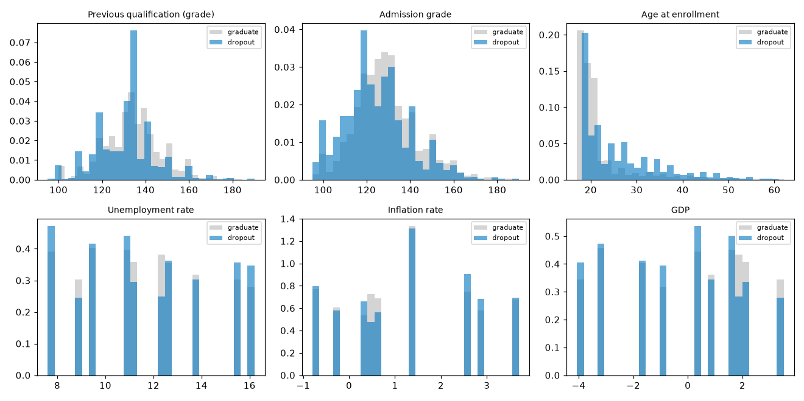
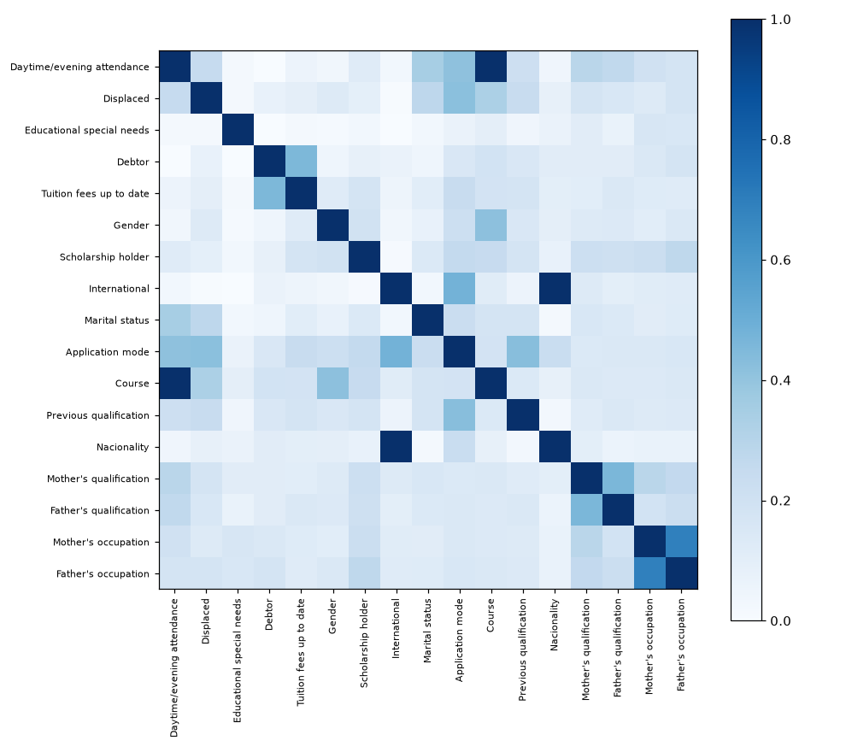
What predicts dropout
The right test for each feature type. Mann-Whitney U on the numbers, chi-square and Cramer's V on the categories.
Age has the strongest link at p = 9.2e-65, because older entrants drop out more, and admission grade and previous qualification grade follow, while unemployment and inflation show no real difference at p = 0.75 and 0.21.
Tuition 0.437, Course 0.346, application mode 0.330 lead on Cramer's V.
Every VIF is under 2. VIF spots overlap in the six numbers only.
The matrix shows two pairs sitting at a perfect V = 1.000. I noted that and moved on.

Slide 5
1
The feature that broke the coefficients
I built a socioeconomic pressure score, one point each for owing money, falling behind on tuition, and holding no scholarship, and it ranked first on mutual information ahead of every raw column in the file.
Then the model turned around and said that owing the school money makes a student less likely to drop out.
The model and the data are the same, and the only change is whether the score sits in the matrix.
Coefficient | Score in | Score out | Real rate
Debtor | −0.465 | +1.006 | 76% vs 34%
Scholarship holder | +0.138 | −1.344 | 14% vs 49%
Tuition fees up to date | −1.480 | −2.913 | 31% vs 94%
pressure − Debtor + Tuition + Scholarship = [2]
It takes one value, exactly 2, on all 2,904 training rows, because the score was three columns the matrix already held.
Two signs flip, because the model reads owing money as protective and a scholarship as a risk, when the data says the opposite.
Accuracy never moved, because the score carried no new information. It only made the model unreadable, and every Step 5 explanation is read off these coefficients.
Design matrix | Old | Fixed
Columns | 216 | 84
One-hot blocks | 9 | 6
Exact linear dependencies | 19 | 6
Slide 4 said overlap was fine because VIF said so. But VIF only reads the six numbers, so it never saw the category columns and never saw a feature built after it ran.
A feature that adds no information cannot help a model, but it can destroy its ability to explain itself.

Slide 6
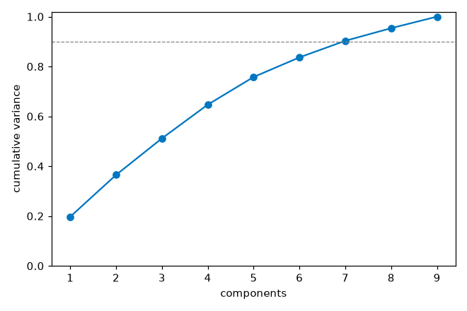
Features that replace, instead of repeat
A feature built from columns that stay in the matrix adds nothing to a linear model, so it earns its place only by replacing its sources.
The same rank check caught two more repeats, both already flagged at V = 1.000 and both waved past.
International equals (Nacionality != 1) on 100 percent of rows, which is the same column twice.
Daytime attendance is decided entirely by Course, because zero of the 17 courses run both a day and an evening class.
Five engineered features replace their sources and four weak columns come out, and then the cost is measured on training slices rather than assumed.
mature entry lands sixth at 0.0534, below the raw age column it bends, because it reads the whole age signal, so a cutoff drawn from it ranks lower, as it should.
Feature set | CV PR-AUC | Columns
Every raw feature | 0.817 | 215
Engineered and selected | 0.819 | 84
PCA needs seven of its nine parts to reach 90 percent of the variance, so there is nothing to compress, which matches the low VIF, and it rides into Step 4 as a seventh model rather than a chart nobody uses.
215, not the 216 on the last slide. The difference is the pressure score, now gone.
Sixty percent of the columns are gone and the score went slightly up, so the result is 131 columns cut for free.

Slide 7
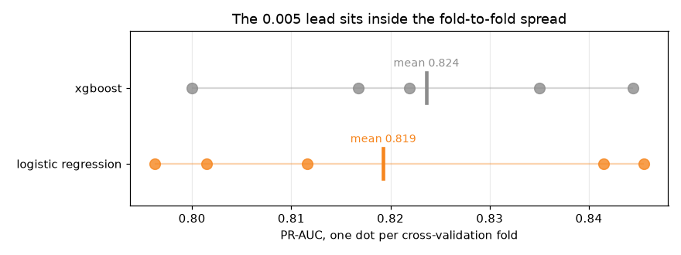
Seven models, and whether the lead is real
Tuned by cross-validation on five held-out slices of the training set, with the test set scored once.
Model | CV PR-AUC | Test PR-AUC | ROC-AUC
XGBoost | 0.824 | 0.828 | 0.857
Random forest | 0.820 | 0.823 | 0.855
Logistic regression | 0.819 | 0.822 | 0.851
Logistic regression + PCA | 0.818 | 0.821 | 0.852
SVM | 0.808 | 0.817 | 0.858
MLP (neural net) | 0.752 | 0.753 | 0.798
Decision tree | 0.723 | 0.699 | 0.762
The gap is 0.005. Slices swing by 0.020.
Each dot is one slice, and the two ranges overlap almost completely, so the gap between the means disappears inside them.
XGBoost is not better than logistic regression here but only tied with it, and it happened to land on top.
Logistic regression ships, and not because it scores highest. When two models tie, the tiebreak that matters is whether a student can be told why they were flagged.
PCA lands fourth, a thousandth behind, and a component is a blend of nine columns, so it could never explain a flag in a sentence that means anything.
A gap smaller than the measured noise is not a gap, and this deck has to keep that standard everywhere.

Slide 8
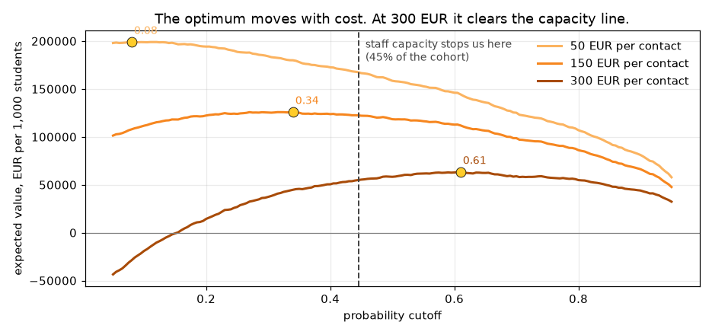
The cutoff nobody chose
Recall depends on the model and the cutoff together rather than the model alone, and the default cutoff is 0.5, which nobody chose.
Rule | Cutoff | Recall | Precision | Flagged
Default 0.5 | 0.50 | 0.750 | 0.670 | 43.8%
Capacity 50% | 0.38 | 0.838 | 0.609 | 53.9%
Capacity 45% | 0.45 | 0.796 | 0.644 | 48.3%
Capacity 40% | 0.50 | 0.750 | 0.670 | 43.8%
Capacity 35% | 0.57 | 0.697 | 0.723 | 37.7%
The default is capacity 40 percent. It is a staffing decision made by accident, by a library default, and moving it to 45 percent climbs recall to 0.796 on the same model and the same data.
The chart caught me being sloppy where the table had not. I had written that staff time runs out long before the economics do.
The 300 EUR curve peaks at 0.61, tighter than the capacity line.
Staff capacity binds at 50 and 150 EUR per contact, but at 300 EUR the money binds first, and the economics want fewer flags than the team could handle.
At the deployed 0.445 the value holds, 171,942 / 123,595 / 51,074 per 1,000. At 150 EUR that is 1,700 below the best case, so capacity is nearly free.
Outreach cost | Best cutoff | Flagged | Value per 1,000
50 EUR | 0.08 | 93.1% | 199,022 EUR
150 EUR | 0.34 | 59.4% | 125,289 EUR
300 EUR | 0.61 | 34.4% | 58,967 EUR
The ranked list is the product and the binary flag is not, and the cutoff goes at 0.445 to audit fairness and report one honest number.

Slide 9
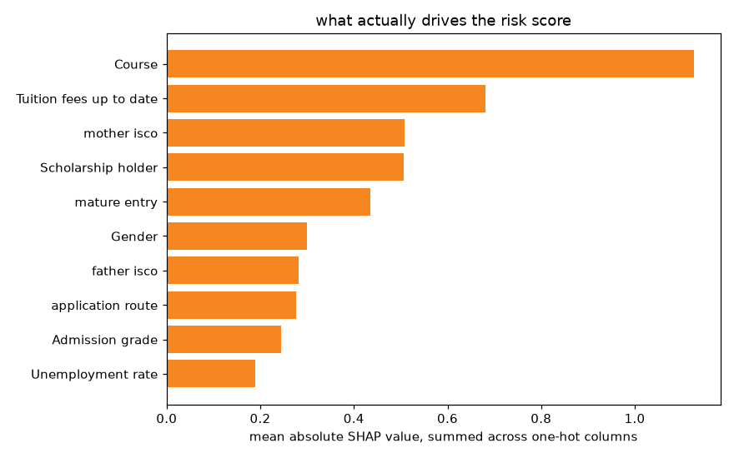
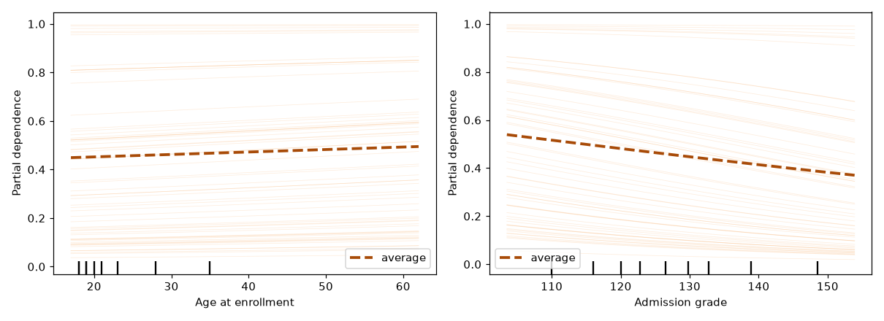
2
SHAP ranked columns, not features
The first SHAP chart plotted one bar per column of the design matrix, but Course is not one column and instead seventeen of them, so its importance split into seventeen small bars while a single flag kept all its weight in one place.
Old, per encoded column |  | Fixed, summed by feature
flag__Tuition fees up to date | 0.680 | Course | 1.126
flag__Scholarship holder | 0.507 | Tuition fees up to date | 0.680
flag__mature entry | 0.436 | mother isco | 0.509
flag__Gender | 0.301 | Scholarship holder | 0.507
cat__Course_9500 | 0.284 | mature entry | 0.436
num__Admission grade | 0.245 | Gender | 0.301
cat__Course_9500 is the proof. The largest fragment of the strongest feature sat fifth, behind four flags, and mother's occupation did not appear at all. A second bug hid here too, because unseeded 100-row sampling drifted from 0.90 to 0.68 between runs, until the fix read all 2,904.
Course sits far ahead at 1.126, and where raw association put tuition first, inside the model course leads. Neither a course nor a parent's job is something a student can act on, and the model mostly finds students who started further back.
Prediction vs one feature. The lines run parallel, a check passing rather than a finding.

Slide 10
3
Equal flagging asked the wrong question
Debtors drop out at 76 percent against 34, so demanding equal flagging is demanding the model be wrong on purpose. The real-world gap sits next to the metric, so that a flagging gap near the outcome gap reports a disparity, and a bigger one makes one.
Attribute | Real gap | Flagging gap | DI ratio | Error gap | Recall gap
Gender | 0.238 | 0.350 | 0.496 | 0.290 | 0.177
Scholarship | 0.318 | 0.500 | 0.171 | 0.385 | 0.283
Debtor | 0.392 | 0.369 | 0.545 | 0.199 | 0.199
Age band | 0.433 | 0.558 | 0.369 | 0.572 | 0.253
male
female
flagged
0.694
0.345
dropouts found
0.877
0.700
false alarms
0.485
0.195
3 in 10
Debtor. Real gap 0.392 and flagging gap 0.369, so the model's disparity is smaller than the world's. Its DI ratio of 0.545 sits below the 0.8 line the old audit called a failure, but it is not one.
Gender. Real gap 0.238 and flagging gap 0.350, so the gap the model creates is bigger than the gap in the world, and that is amplification.
of the women who go on to drop out are never flagged at all, and for men it is closer to one in eight. It appears in no flagging-rate metric, and only once you count errors instead of flags.
These gaps use the 726 test students, a little below the full-data rates on slide 3. The finding is not that every group fails the equal-rate test, which was true and useless.

Slide 11
4
Rigor does not generalize on its own
Step 4 refused to call a 0.005 lead real against a 0.020 swing, and then I quoted fairness numbers to three decimals off one 726-row split without asking what the noise was. So I went back and asked, with 2,000 seeded bootstrap resamples.
male n=288 dropouts 154
female n=438 dropouts 130
Women are the majority of the test set and the minority of its dropouts, so the recall gap rests on 130 students rather than 726.
95% intervals, 2,000 resamples. The top three are the recall gap itself, male minus female. The bottom two compare the two mitigations against each other.
Baseline
real
Threshold optimizer
spans zero
Approach | Recall | Accuracy | Recall gap (magnitude)
Baseline at 0.45 | 0.796 | 0.748 | 0.177
Threshold optimizer | 0.609 | 0.781 | 0.026
Exponentiated gradient | 0.718 | 0.760 | 0.009
Exponentiated gradient
spans zero
TO gap minus EG gap
tied
EG recall minus TO recall
real
0
The harm is real. The 0.177 gap never crosses zero across two thousand resamples.
0.009 is not better than 0.026. They are the same number wearing different clothes.
One difference survives, and it is cost. It is eight points of recall against nineteen.
One interval clears zero on the harm, and one clears it on the cost. Everything between them is a tie. The sign flips after mitigation, so the mitigation table reports magnitudes and this one is signed.
The threshold optimizer closed the gap largely by catching fewer people. Accuracy went up while the tool got worse at its job. Fixing a gap by helping fewer people is not a fix.

Slide 12
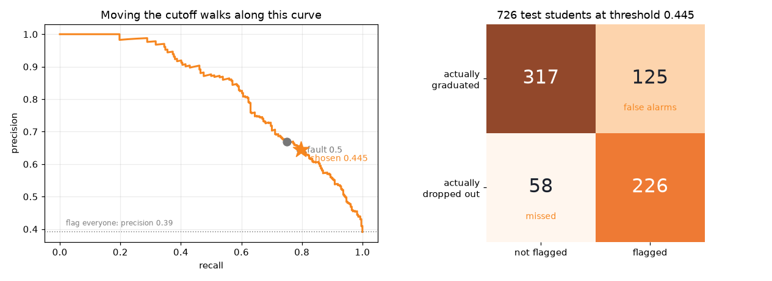
The verdict, and what it costs
726 test students at the operating cutoff of 0.445.
226
58
leavers caught
missed
125
graduates contacted who were never going to leave
Recall 0.796 before the fix at a cutoff chosen against staffing, on enrollment-time data only. The shipped system adds the exponentiated-gradient fairness fix, recall 0.718, gender gap from a real 0.177 to 0.009, which spans zero.
Train PR AUC 0.840 against test 0.822, a gap of 0.018. The model learned the pattern, not the noise.
Gender is mitigated. Scholarship and debtor are deliberately not, because neither is a protected trait and both track real risk. Age band is unresolved, error gap 0.572, and it needs its own pass.
The fair model picks the list, the base model orders it, and the fair set of 410 fits capacity.
Those 125 are the real cost of this tool. A student pulled into a retention conversation they did not need has been told, in effect, that a system thinks they are failing.
A dropout model is not a scoreboard but a decision about which students get help, and the right way to use this one is as a ranked prompt for a support team, checked by a person.

