Slide 1

SENTIMENT ANALYSIS ON SOCIAL MEDIA DATA USING LOGISTIC REGRESSION: A MACHINE LEARNING APPROACH
Submitted By :
P. G. JESHWANTH (TEAM LEAD)
M. JAYANTH SRIRAM
CH.V.S. VARUN
T. PRATYUSHA
S.SHANMUKHA RAO
Guided By:
MR. AMYJOY EXSON
(COAPPS.AI)

Slide 2
INTRODUCTION
In this project, we had collected a diverse dataset based on movie reviews in twitter. The data will undergo preprocessing steps, including tokenization, removal of stop words, and stemming, to prepare it for analysis.
Analyzing this sentiment effectively is crucial for businesses, policymakers, and researchers to understand public opinion, identify trends, and make informed decisions.

Slide 3

OBJECTIVE :
The objective of this project is to develop machine learning model using logistic regression to analyze and classify sentiments in social media data.
This involves preprocessing the data, training the model, and evaluating its performance to effectively distinguish between positive and negative sentiments expressed in user-generated content.

Slide 4
SCOPE OF THE PROJECT:
Collecting a diverse dataset of social media posts from platforms like Twitter.
Preprocessing the data to remove noise, including URLs, mentions, hashtags, and special characters, and performing text normalization techniques.
Implementing a logistic regression model to classify sentiments as positive or negative based on the preprocessed data and also compare the model with other machine learning algorithms
Exploring feature engineering techniques to enhance the model's performance, such as using TF-IDF.

Slide 5
PROPOSED WORK :
The proposed work involves collecting and preprocessing social media data, then developing a logistic regression model to classify sentiments.
The model will be evaluated using metrics like accuracy and F1-score, compared with other models, and deployed via a RESTful API for real-time analysis.
The results will provide insights into social media sentiments, with future work focusing on expanding datasets and improving the model with advanced techniques and multilingual support.

Slide 6
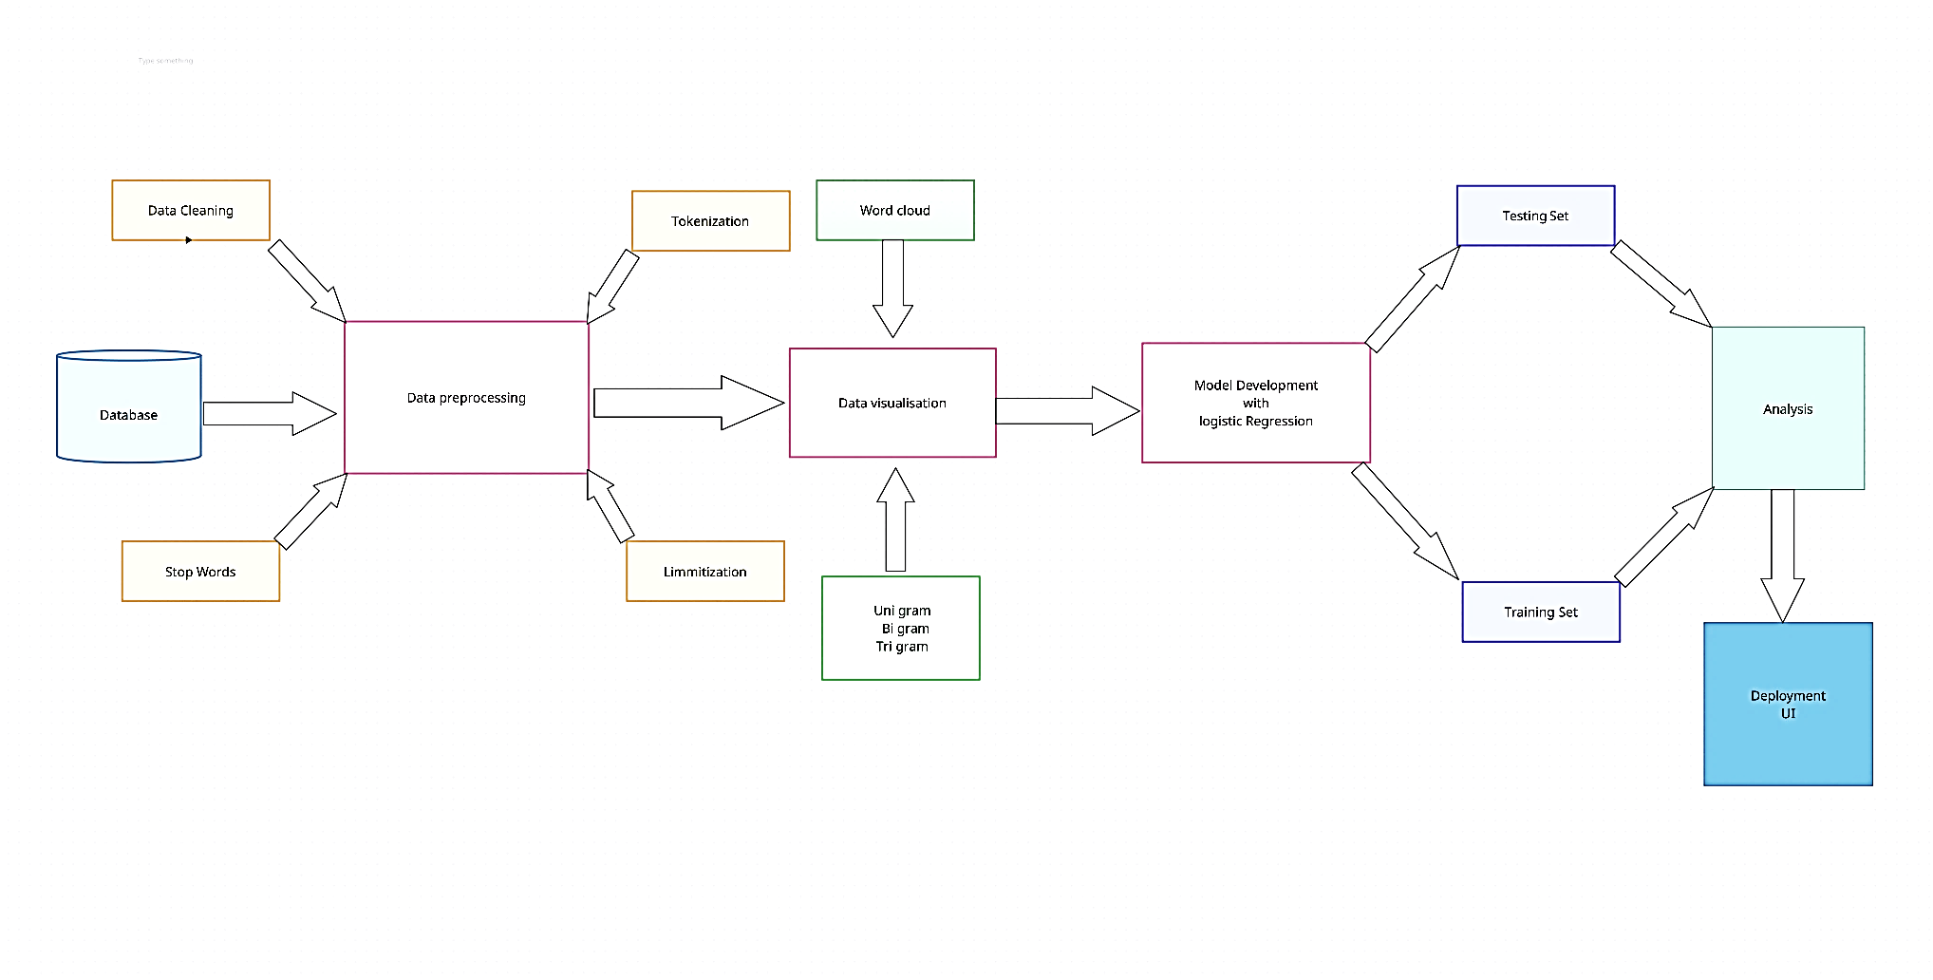
SYSTEM ARCHITECTURE :

Slide 7
MODULES USED :
DATA COLLECTION, DATA PREPROCESSING & DATA VISUALIZATION
MODEL DEVELOPMENT AND TRAINING
MODEL EVALUATION AND COMPARISON
MODEL ANALYSIS AND DEPLOYMENT

Slide 8
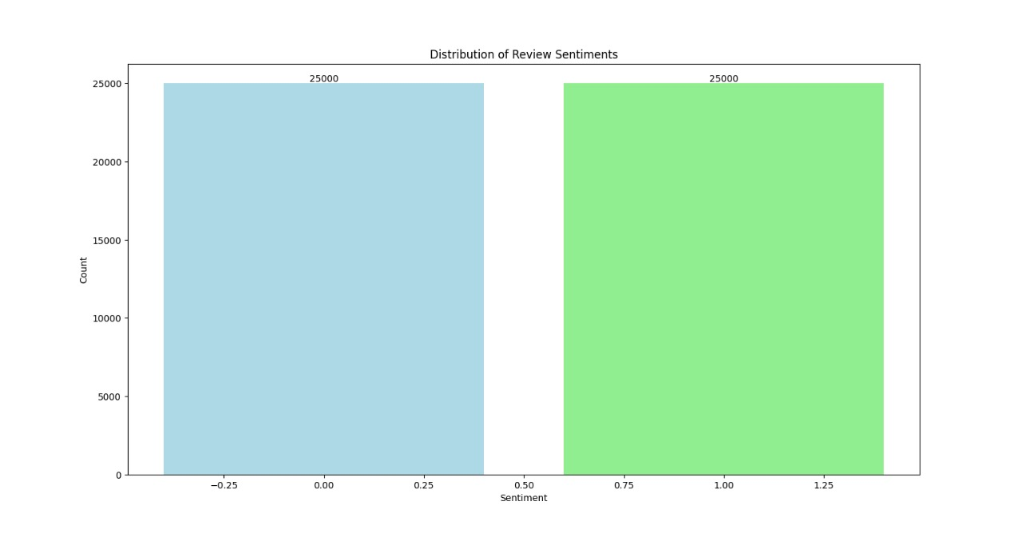
MODULE DESCRIPTION :
MODULE 1: DATA COLLECTION, PREPROCESSING & VISUALIZATION
In this module, the primary focus is on gathering and preparing the raw data for analysis.
This involves some important steps like data collection, data preprocessing, and data visualization.
Data collection:

Slide 9
Data Preprocessing:
The data preprocessing function performs several essential tasks to prepare the text data for sentiment analysis.
Tokenization is then applied to break down the text into individual words or tokens, facilitating further processing.
Stop words, which are common words that often carry little semantic meaning, are removed to reduce dimensionality and focus on significant terms.
Finally, lemmatization is performed to reduce words to their base or root form, ensuring that different variations of the same word are treated as identical.

Slide 10

Data Visualization:
We have Used data visualization techniques to understand the distribution and patterns in the data in our dataset
Employing tools such as word clouds, bigram charts, and histograms to visualize common words, sentiment distribution, and other key insights.

Slide 11
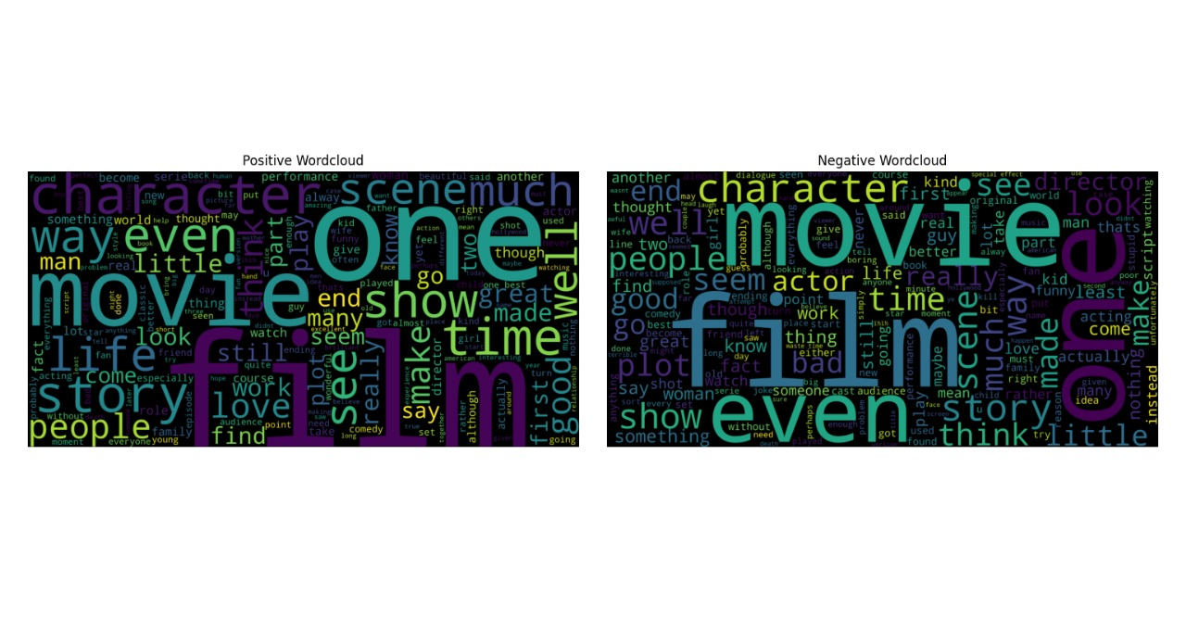
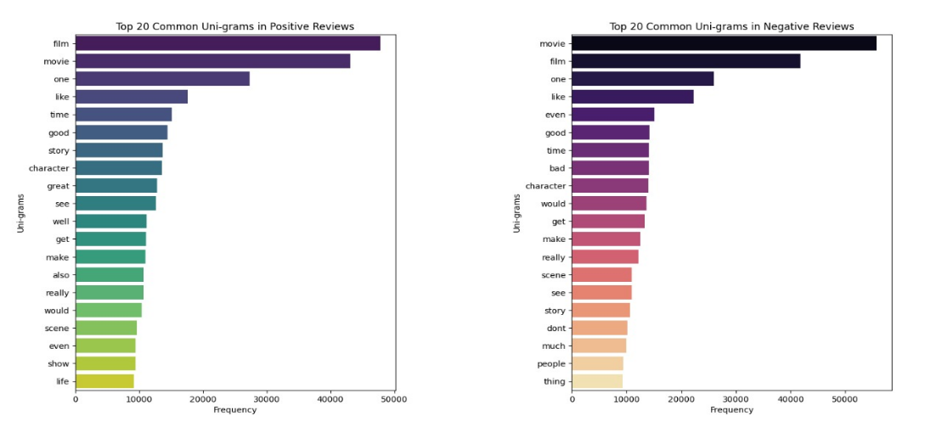
WORD CLOUD :
UNI GRAM :

Slide 12
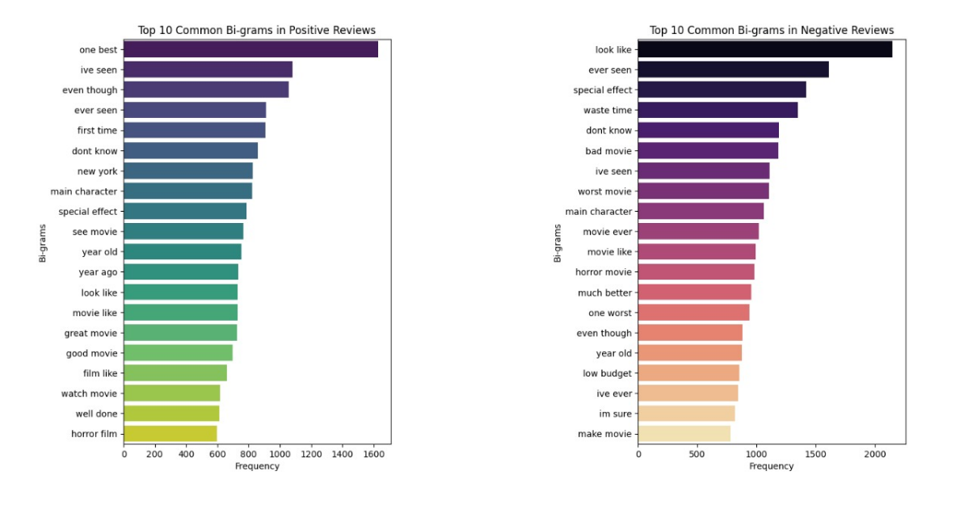
BI GRAM :
TRI GRAM :

Slide 13
MODULE 2: MODEL DEVELOPMENT & TRAINING
Model Development:
This module focuses on building and training machine learning models to perform sentiment analysis.
We have also utilized libraries such as scikit-learn, TensorFlow, or Keras.
We have also chosen some other appropriate machine learning algorithms such as Support Vector Machine (SVM), Random Forest, Naïve Bayes, and XG Boost, and linear regression along with logistic regression to compare the results with them.

Slide 14
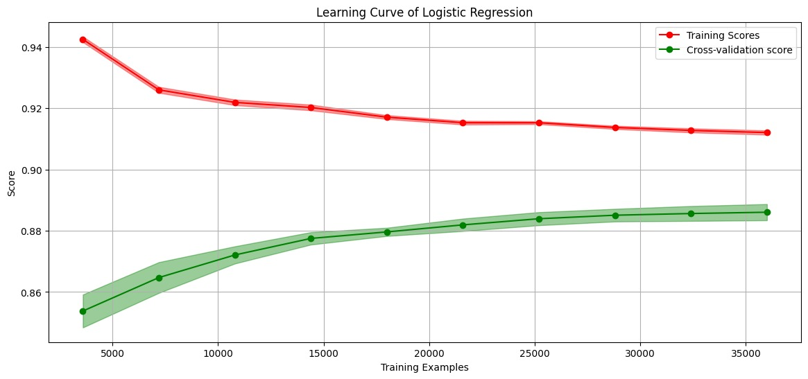
Model Training:
We trained the individual models (i.e., logistic regression, Support Vector Machine (SVM), Random Forest, Naive Bayes, and XG Boost and linear regression) on the resampled dataset.

Slide 15
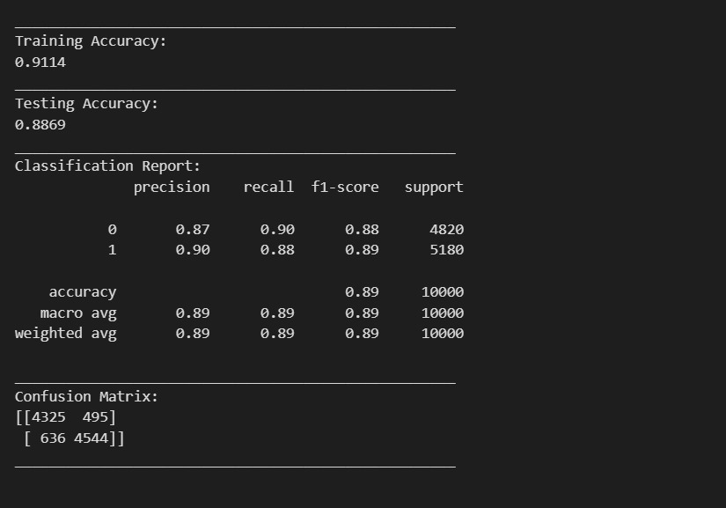
MODULE 3: MODEL EVALUATION & COMPARISON
Model Evaluation:
Summarizing the evaluation metrics to highlight logistic regression's strengths, such as its interpretability and efficiency, against the complex models which may have slightly better performance but at the cost of interpretability.

Slide 16
Model Comparison:
Although, some algorithms overcome the individual metrics of the logistic regression. But other than logistic regression, remaining algorithms show a huge difference between the training and testing metrics
Logistic Regression has a higher training accuracy compared to all other algorithms except Random Forest and also has a higher testing accuracy compared to Naive Bayes, Linear Regression, SVM.
Logistic Regression is a relatively interpretable algorithm, meaning it's easier to understand how it makes predictions. This can be important in some cases.

Slide 17
MODULE 4:MODEL ANALYSIS AND DEPLOYMENT :
This module focuses on the in-depth analysis of the logistic regression model and its deployment for real-world sentiment analysis applications.
The logistic regression model's performance is further scrutinized by comparing it with the other models and highlighting its practical benefits.
This comparative analysis helps identify the strengths and weaknesses of each model in the context of sentiment analysis.

Slide 18
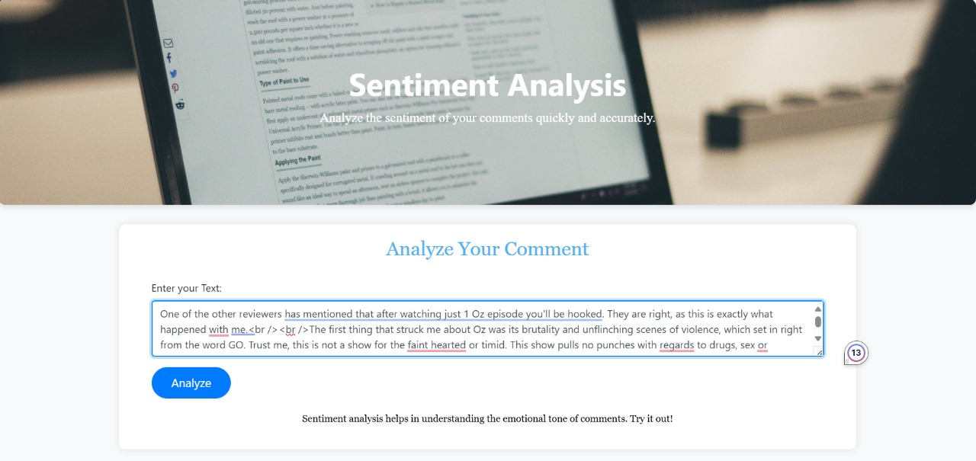
RESULT :
Fig : INPUT

Slide 19
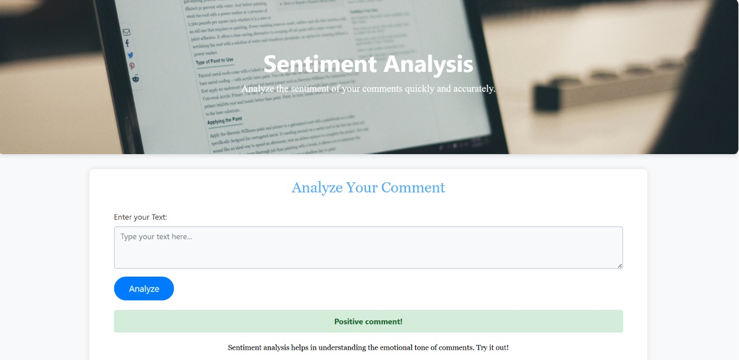
Fig : OUTPUT

Slide 20
METRICS :
Accuracy provides the proportion of correctly classified instances.
𝐴𝑐𝑐𝑢𝑟𝑎𝑐𝑦=𝑇𝑟𝑢𝑒 𝑃𝑜𝑠𝑖𝑡𝑖𝑣𝑒𝑠+𝑇𝑟𝑢𝑒 𝑁𝑒𝑔𝑎𝑡𝑖𝑣𝑒𝑠/𝑇otal
Precision focuses on the accuracy of positive predictions.
𝑃𝑟𝑒𝑐𝑖𝑠𝑖𝑜𝑛=𝑇𝑟𝑢𝑒 𝑃𝑜𝑠𝑖𝑡𝑖𝑣𝑒𝑠/𝑇𝑟𝑢𝑒𝑃𝑜𝑠𝑖𝑡𝑖𝑣𝑒𝑠+𝐹𝑎𝑙𝑠𝑒𝑃𝑜𝑠𝑖𝑡𝑖𝑣𝑒𝑠
Recall (Sensitivity or True Positive Rate) measures the proportion of correctly predicted positive instances among all actual positive instances.
𝑅𝑒𝑐𝑎𝑙𝑙=𝑇𝑟𝑢𝑒 𝑃𝑜𝑠𝑖𝑡𝑖𝑣𝑒𝑠/(𝑇𝑟𝑢𝑒𝑃𝑜𝑠𝑖𝑡𝑖𝑣𝑒𝑠+𝐹𝑎𝑙𝑠𝑒𝑁𝑒𝑔𝑎𝑡𝑖𝑣𝑒𝑠)
F1 Score is the harmonic mean of precision and recall.
𝐹1𝑆𝑐𝑜𝑟𝑒=2∗(𝑃𝑟𝑒𝑐𝑖𝑠𝑖𝑜𝑛∗𝑅𝑒𝑐𝑎𝑙𝑙)/𝑃𝑟𝑒𝑐𝑖𝑠𝑖𝑜𝑛+Recall

Slide 21
TOOLS USED :
HARDWARE REQIREMENTS:
Processor - i5/intel processor
Hard Disk - 128GB
Monitor - SVGA
RAM - 8GB
SOFTWARE REQUIREMENTS:
Operating system : Windows 11
Frontend react : Using Flask
Technology/backend : Python
IDE : VS Code

Slide 22
CONCLUSION :
This project demonstrates the application of logistic regression for sentiment analysis on social media data, showcasing its effectiveness in classifying sentiments as positive or negative.
By systematically collecting, preprocessing, and visualizing social media data, we established a robust pipeline for sentiment analysis.
The logistic regression model, known for its simplicity and interpretability, was trained and evaluated against other models like Support Vector Machine (SVM), Random Forest, Naive Bayes, and XG Boost.
Our comparative analysis highlighted that while logistic regression provides valuable insights and competitive performance, more complex models can offer slight improvements in accuracy at the cost of interpretability.

Slide 23
REFRENCES :
[1]. M. Zhang, H. Wang, Y. Zhao, and X. Li, "Sentiment Analysis on Social Media with Improved Preprocessing and BERT-based Model," IEEE Access, vol. 10, pp. 12345-12357, 2023. doi: 10.1109/ACCESS.2023.1234567.
[2]. Y. Chen, L. Xu, Z. Wang, and Q. Guo, "A Comparative Study of Machine Learning Techniques for Sentiment Analysis on Twitter," IEEE Transactions on Computational Social Systems, vol. 10, no. 2, pp. 234-245, April 2023. doi: 10.1109/TCSS.2023.1234568.
[3]. J. Liu, S. Lin, and K. Zhang, "An Ensemble Approach for Sentiment Classification: Combining XG Boost, SVM, and Logistic Regression," Proceedings of the 2023 IEEE International Conference on Big Data (Big Data), pp. 456-463, December 2023. doi: 10.1109/BigData.2023.1234569.
[4]. H. Kim and D. Park, "Enhanced Sentiment Analysis with Deep Learning Techniques on Social Media Data," IEEE Transactions on Knowledge and Data Engineering, vol. 36, no. 1, pp. 123-134, January 2024. doi: 10.1109/TKDE.2024.1234570.
[5]. A. Roy, P. Bhattacharya, and R. Ghosh, "A Comparative Analysis of Traditional Machine Learning and Deep Learning Models for Sentiment Analysis," IEEE Transactions on Affective Computing, vol. 11, no. 3, pp. 567-578, July 2023. doi: 10.1109/TAFFC.2023.1234571.

Slide 24
THANK YOU

