Slide 1





MAR BASELIOS INSTITUTE OF TECHNOLOGY AND SCIENCE
DEPARTMENT
OF
ELECTRONICS AND COMMUNICATION ENGINEERING
MINIPROJECT FINAL REVIEW ON THE TOPIC
DIGITAL MEASURING TAPE
Guided by:
Prof. Teena Abraham
Assistant Professor
Mr. Eldhose Joy, Tradesman
ECE Department
Presented by: S6 ECE
Jesald Tony (MBI23EC015)
Richard S Areckal (MBI23EC020)
Sreejith VB (MBI23EC023)
Notes:
1
Department Name
Project /Seminar Code

Slide 2

OUTLINE
1. Introduction
2. Literature review
3. Objective
4. Design and Simulation Results
5. Block Diagram
6. Budget
7. Work Plan
8. Project Demonstration
8. Advantages
9.Future Scope
10.Conclusion
11.References
ECD 334
11 March 2026
ECD 334
Notes:
2

Slide 3

INTRODUCTION
A digital measuring tape is an electronic device used to measure linear distance accurately using sensors and a microcontroller.
This project uses an Arduino Nano and a rotary encoder to convert wheel rotation into digital distance values.
The measured distance is calculated electronically and displayed in real-time on a 16×2 LCD screen.
It demonstrates a practical application of embedded systems in measurement and automation.
ECD 334
Notes:
3

Slide 4

INTRODUCTION
By using hardware interrupts, the Arduino ensures every pulse is recorded, even during fast movement. The distance is calculated by the below equation
ECD 334
Notes:
3

Slide 5


LITERATURE REVIEW
SL.NO | TOPIC | AUTHOR | YEAR OF PUBLICATION | DESCRIPTION
1. | Digital Measuring Tape | S. P. Sabarinath | 2021 | Describes the design and working of a digital measuring tape using a micro-controller and rotary encoder to measure distance electronically.
ECD 334

Slide 6

LITERATURE REVIEW
SL.NO | TOPIC | AUTHOR | YEAR OF PUBLICATION | DESCRIPTION
2. | Digital Tape Measure Using Rotary Encoder | Arduino Forum Community | 2024 | Discusses technical challenges and solutions in decoding encoder pulses for accurate distance measurement using Arduino.
ECD 334
11 March 2026

Slide 7
OBJECTIVES
Improve accessibility to quick and accurate distance measurement
Promote convenient and error-free digital measurement
Ensure ease of use with real-time visual display
Encourage awareness of modern digital measurement techniques
ECD 334

Slide 8
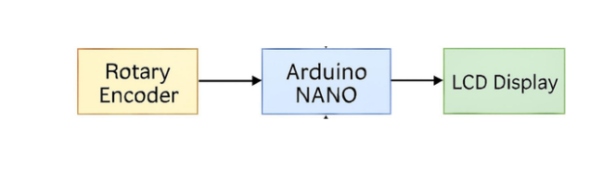
BLOCK DIAGRAM
FIG 1: BLOCK DIAGRAM
ECD 334

Slide 9
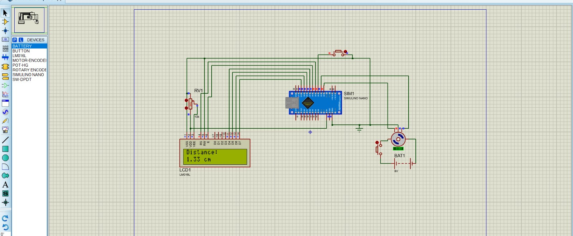
DESIGN AND SIMULATION RESULTS
FIG 2: SIMULATION RESULT
ECD 334

Slide 10
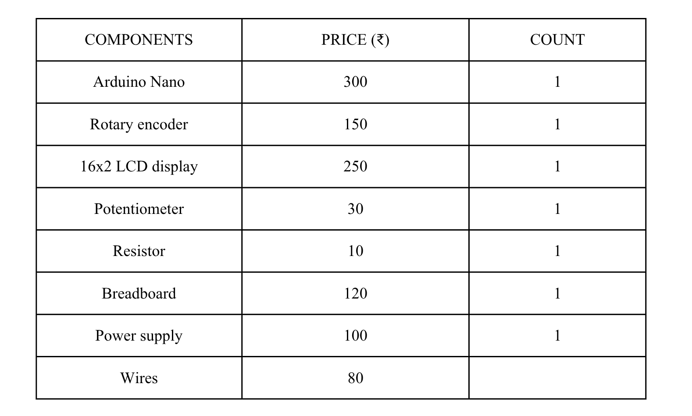
BUDGET
Table 1 : Budget
ECD 334
Notes:
‹#›

Slide 11
WORK PLAN
DATE | WORK DONE
11/12/2025 | Decided the project topic
15/12/2025 | Submitted abstract
18/12/2025 | Conducted zeroth review presentation
15/01/2026 | Partially Completed the simulation part using Arduino IDE
05/02/2026 | Completed the simulation part using Arduino IDE
12/02/2026 | First review presentation
05/03/2026 | Hardware implementation
11/03/2026 | Second Review Presentation
24/03/2026 | Mini-project binded report submission
26/03/2026 | Final Presentation
Table 2 : Work plan
ECD 334

Slide 12

PROJECT DEMO
VIDEO DEMONSTRATION OF DIGITAL MEASURING TAPE
ECD 334
7 February 2026

Slide 13
ADVANTAGES
Provides accurate and real-time digital distance measurement with minimal error
Compact and portable design ensures ease of handling and operation
Cost-effective system with a simple and reliable circuit architecture
Enhances understanding of embedded systems, microcontrollers, and sensor interfacing
ECD 334

Slide 14
FUTURE SCOPE
Wireless data transmission using Bluetooth or Wi-Fi
Storing measured data using memory modules or SD card
Integration with mobile applications for visualization
Improved accuracy using higher resolution encoders
ECD 334

Slide 15
CONCLUSION
The digital measuring tape successfully measures distance accurately using a rotary encoder and Arduino Nano.
The project demonstrates effective conversion of mechanical motion into digital data with real-time display.
It serves as a simple and reliable learning platform for embedded systems and automation concepts.
ECD 334
ECD 334
14

Slide 16
REFERENCES
S. P. Sabarinath, “Digital Measuring Tape,” ElectronicWings, Dec. 13, 2021.
J. Craftsman, “How to Make a Digital Tape Measure: Step-by-Step Guide (Arduino + 3D Print),” YouTube, Apr. 2023.
Arduino Forum, “Digital Tape Measure – Decoding Serial Data,” Arduino.cc, Dec. 14, 2024.
Atmel Corporation, “ATmega328P 8-bit AVR Microcontroller with 32K Bytes In- System Programmable Flash - Datasheet,” 2015.
J. Maini, "Digital Electronics: Principles, Devices and Applications," John Wiley & Sons, 2007.
ECD 334

Slide 17
THANK YOU

