Slide 1



MAR BASELIOS INSTITUTE OF TECHNOLOGY AND SCIENCE
DEPARTMENT
OF
ELECTRONICS AND COMMUNICATION ENGINEERING
MINIPROJECT FIRST REVIEW ON THE TOPIC
DIGITAL MEASURING TAPE
Guided by:
Prof. Teena Abraham
Assistant Professor
ECE Department
Presented by: S6 ECE
Jesald Tony (MBI23EC015)
Richard S Areckal (MBI22EC0)
Sreejith VB (MBI22EC0)
13/05/25
ECD 334
1
Notes:
1
Department Name
Project /Seminar Code

Slide 2
OUTLINE
1. Introduction
2. Literature review
3. Objective
4. Design and Simulation Results
5. Block Diagram
6. Budget
7. Work Plan
8. Advantages
9.Future Scope
10.Conclusion
11.References
7 February 2026
ECD 334
‹#›
Notes:
2

Slide 3
INTRODUCTION
  A digital measuring tape is an electronic device used to measure linear distance accurately using sensors and a microcontroller.
  This project uses an Arduino Nano and a rotary encoder to convert wheel rotation into digital distance values.
  The measured distance is calculated electronically and displayed in real-time on a 16×2 LCD screen.
  It demonstrates a practical application of embedded systems in measurement and automation.
7 February 2026
ECD 334
3
Notes:
3

Slide 4
LITERATURE REVIEW
SL.NO | TOPIC | AUTHOR | YEAR OF PUBLICATION | DESCRIPTION
1. | Digital Measuring Tape | S. P. Sabarinath | 2021 | Describes the design and working of a digital measuring tape using a microcontroller and rotary encoder to measure distance electronically.
7 February 2026
ECQ 413
4

Slide 5
LITERATURE REVIEW
SL.NO | TOPIC | AUTHOR | YEAR OF PUBLICATION | DESCRIPTION
2. | Digital Tape Measure Using Rotary Encoder | Arduino Forum Community | 2024 | Discusses technical challenges and solutions in decoding encoder pulses for accurate distance measurement using Arduino.
7 February 2026
ECD 334
5

Slide 6
OBJECTIVES
  Improve accessibility to quick and accurate distance measurement
  Promote convenient and error-free digital measurement
  Ensure ease of use with real-time visual display
  Encourage awareness of modern digital measurement techniques
7 February 2026
ECD 334
6

Slide 7
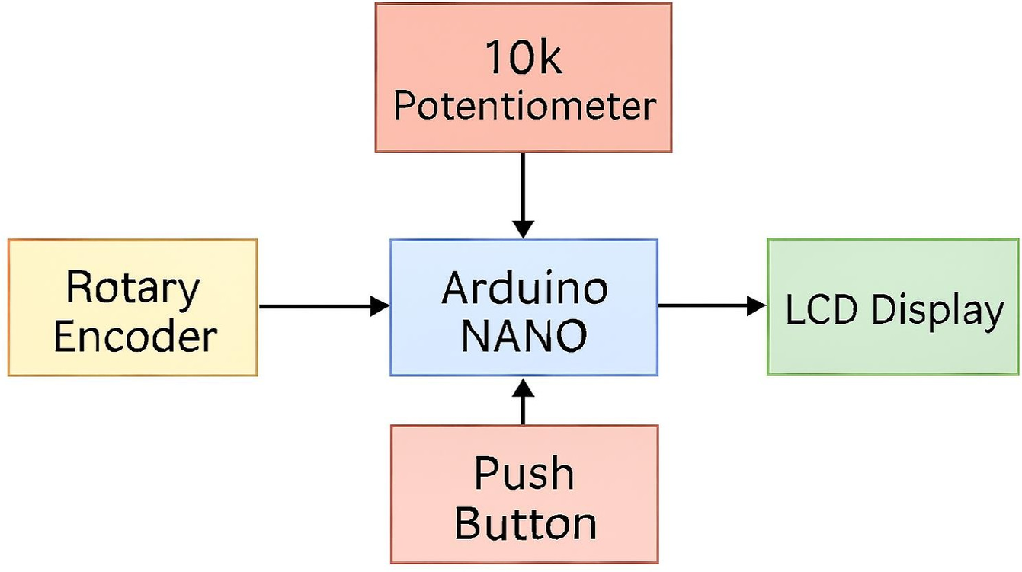
BLOCK DIAGRAM
7 February 2026
ECD 334
8

Slide 8
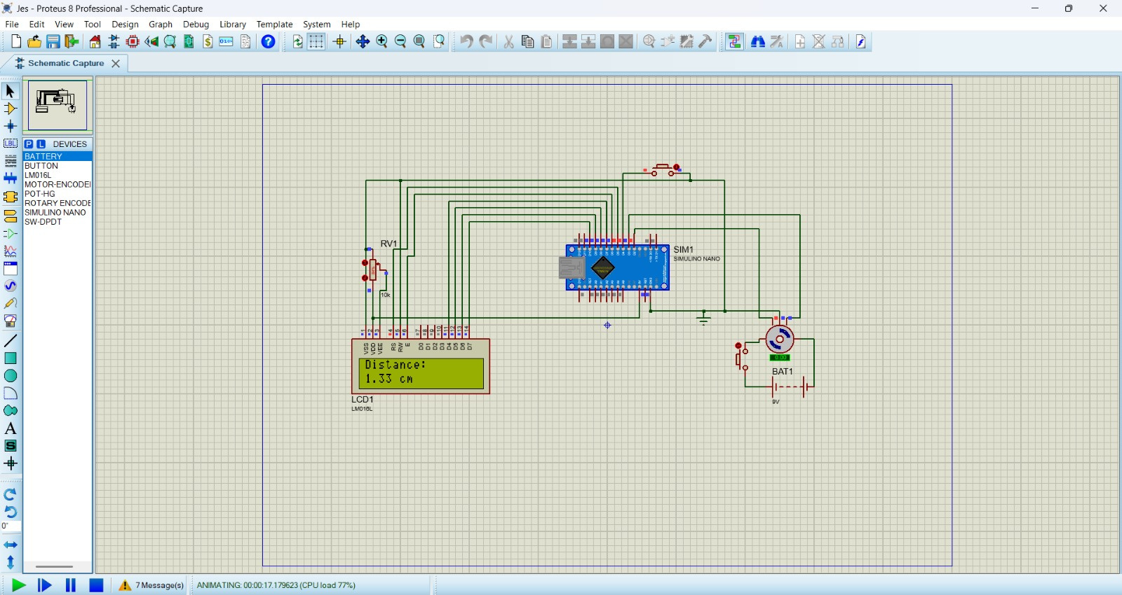
DESIGN AND SIMULATION RESULTS
7 February 2026
ECD 334
7

Slide 9
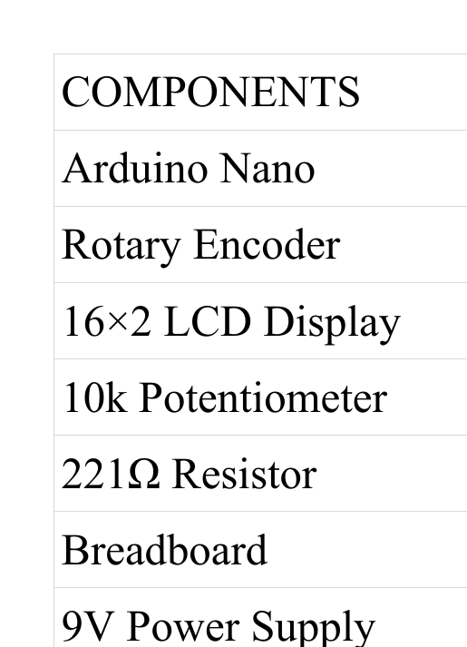
BUDGET
Table 2 : Work plan
‹#›
Notes:
‹#›

Slide 10

WORK PLAN
Table 2 : Work plan
DATE | WORK DONE | WORK TO BE DONE
11/12/2025 | Decided the project topic | _
15/12/2025 | Submitted abstract | _
18/12/2025 | Conducted zeroth review presentation | _
15/01/2026 | Partially Completed the simulation part using Arduino IDE
05/02/2026 | Completed the simulation part using Arduino IDE | _
11/02/2026 | _ | First review presentation

Slide 11
ADVANTAGES
  Provides accurate and real-time digital distance measurement
  Compact, portable, and easy to use
  Low-cost and simple circuit design
  Helps in learning embedded systems and sensor interfacing
7 February 2026
ECD 334
11

Slide 12
FUTURE SCOPE
  Wireless data transmission using Bluetooth or Wi-Fi
  Storing measured data using memory modules or SD card
  Integration with mobile applications for visualization
  Improved accuracy using higher resolution encoders
7 February 2026
ECD 334
13

Slide 13
CONCLUSION
  The digital measuring tape successfully measures distance accurately using a rotary encoder and Arduino Nano.
  The project demonstrates effective conversion of mechanical motion into digital data with real-time display.
  It serves as a simple and reliable learning platform for embedded systems and automation concepts.
7 February 2026
ECD 334
14

Slide 14
REFERENCES
  S. P. Sabarinath, “Digital Measuring Tape,” ElectronicWings, Dec. 13, 2021.
  J. Craftsman, “How to Make a Digital Tape Measure: Step-by-Step Guide (Arduino + 3D Print),” YouTube, Apr. 2023.
  Arduino Forum, “Digital Tape Measure – Decoding Serial Data,” Arduino.cc, Dec. 14, 2024.
7 February 2026
ECD 334
15

Slide 15
THANK YOU
7 February 2026
ECD 334
16

