Slide 1
Annual Operating Plan
Citi Finance
April 6, 2023
Notes:
1

Slide 2
2022E: revenue up, but cost of credit drives net income down
Revenues
$18.0bn
vs $17.0bn | +6%
Higher rates lift net interest income (+23%); lower fee income and Banking offset part.
Operating expenses
$13.0bn
vs $13.5bn | (4%)
No repeat of $1.2bn Legacy divestiture costs; ICG and PBWM keep investing.
Cost of credit
$1.8bn
vs $(0.5)bn | +$2.3bn swing
Credit losses normalise and 2021 reserve releases become 2022 builds.
Net income
$2.5bn
vs $3.2bn | (21%)
Credit swing outweighs the $1.5bn gain from revenue and expenses.
Revenues +$1.0bn and expenses –$0.5bn add $1.5bn to pre-credit profit; a $2.3bn adverse swing in cost of credit takes pre-tax income down $0.8bn.
Source: Citi Finance FP&A forecast summary and YE ’22 financials. $m unless stated; 2022E = forecast, 2021A = actual.

Slide 3
Revenues up 6% on higher rates, led by ICG and PBWM
ICG +3% ($9.2bn)
TTS, Securities Services and Fixed Income strength, partly offset by lower Investment Banking and Equity Markets.
PBWM +5% ($6.1bn)
US Personal Banking +10% on loan growth and rates; Global Wealth down 6% on lower investment revenue.
Legacy Franchises (6%) ($2.1bn)
Exit markets and Korea / Russia wind-downs, partly offset by the Thailand sale gain.
Corporate / Other +$0.6bn ($0.7bn)
Higher investment-portfolio income as interest rates rise.
Consolidated: net interest income +$2.5bn (+23%); non-interest revenue –$1.5bn (–24%), mainly commissions and fees.
Source: Citi Finance FP&A forecast summary and YE ’22 financials. $m unless stated; 2022E = forecast, 2021A = actual.

Slide 4
Operating expenses down 4% as divestiture costs roll off
ICG +6% ($6.6bn)
Transformation, business-led and volume-related costs, partly offset by FX and productivity savings.
PBWM +7% ($4.3bn)
Transformation investment and risk and control initiatives.
Legacy Franchises (38%) ($1.8bn)
2021 included $1.2bn of divestiture-related costs; exit markets add savings.
Corporate / Other (23%) ($0.2bn)
Lower consulting expenses.
Consolidated: compensation –$475m and other operating –$273m outweigh technology +$274m (+13%).
Source: Citi Finance FP&A forecast summary and YE ’22 financials. $m unless stated; 2022E = forecast, 2021A = actual.

Slide 5
Cost of credit swings $2.3bn from a release to a charge
Net credit losses +36% ($1.2bn)
Normalising from historically low levels, especially Retail Services (PBWM losses $908m, +60%).
Net ACL $(1.4)bn release to $0.6bn build
PBWM builds on cards growth and weaker macro assumptions; ICG releases on lower Russia exposure.
Other provisions (34%) ($25m)
Policyholder, HTM and other asset provisions; immaterial.
By unit: PBWM ~$1.7bn (2021: $(296)m); ICG $56m (2021: $(281)m); Legacy $123m (2021: $112m).
Source: Citi Finance FP&A forecast summary and YE ’22 financials. $m unless stated; 2022E = forecast, 2021A = actual.

Slide 6
Net income down 21%: credit costs outweigh operating gains
Income from continuing ops ($m) | 2021A | 2022E | Main driver
ICG | 2,330 | 1,916 | Higher expenses and cost of credit
PBWM | 1,613 | 114 | Cost-of-credit build; higher expenses
Legacy Franchises | (620) | 75 | No repeat of $1.2bn divestiture costs
Corporate / Other | (144) | 431 | Higher investment income; lower costs
Total | 3,179 | 2,536 | (20%)
Bottom line: the $2.3bn credit swing more than absorbs $1.5bn of revenue and expense gains.
Source: Citi Finance FP&A forecast summary and YE ’22 financials. $m unless stated; 2022E = forecast, 2021A = actual.

Slide 7
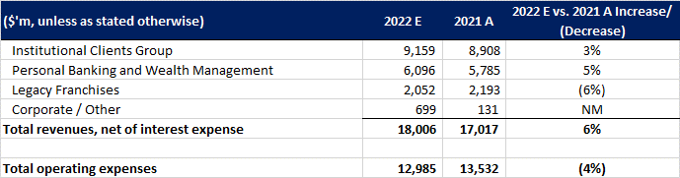
Appendix: Financial Forecast to 31 Dec ’22

Slide 8
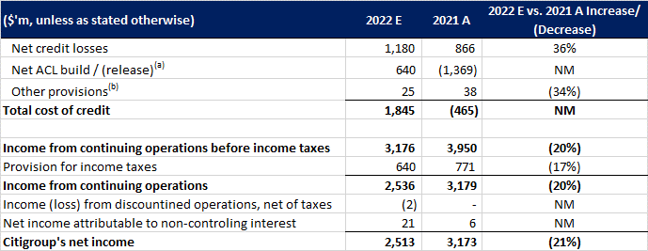
Appendix: Financial Forecast to 31 Dec ’22 (cont.)
(a) Includes credit reserve build / (release) for loans and provision for credit losses on unfunded lending commitments.
(b) Includes provisions for policyholder benefits and claims, HTM debt securities and other assets.

