Slide 1
FSST string compression
FSST = Fast Static Symbol Table
Peter Boncz (CWI)
Viktor Leis (FSU Jena)
Thomas Neumann (TU Munich)
Open-source code (Linux, MacOS, Windows)
+replication package: https://github.com/cwida/fsst

Slide 2
String Compression in a DBMS
Dictionary Compression
Whole string becomes 1 code, points into a dictionary D
works well if there are few unique strings (many repetitions)
Heavy-weight/general-purpose Compression
Lempel-Zipf plus possibly entropy coding
Zip, gzip, snappy, LZ4, zstd, …
Block-based decompression

Slide 3
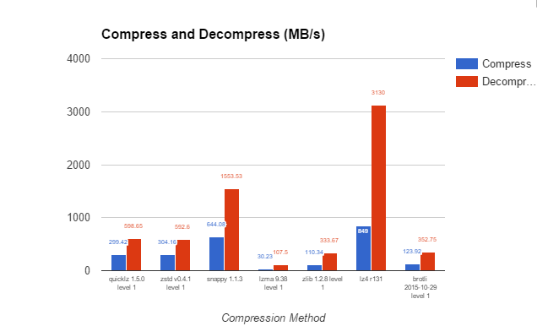
String Compression in a DBMS
www.percona.com/blog/2016/04/13/evaluating-database-compression-methods-update/
“LZ4 is the best compression library for database applications, if high speed is desired”

Slide 4
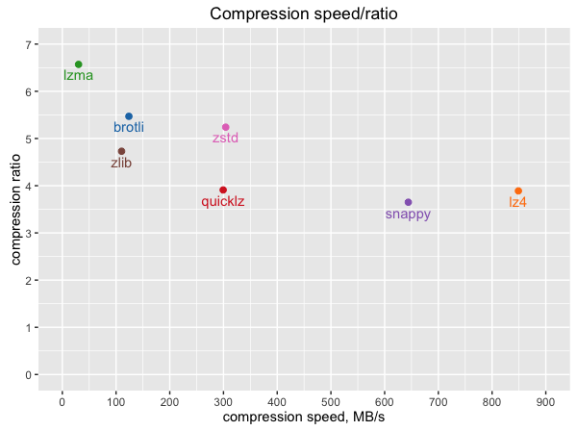
String Compression in a DBMS
www.percona.com/blog/2016/04/13/evaluating-database-compression-methods-update/
“LZ4 is the best compression library for database applications, if high speed is desired”

Slide 5
String Compression in a DBMS
Dictionary Compression
Whole string becomes 1 code, points into a dictionary D
works well if there are few unique strings (many repetitions)
Heavy-weight/general-purpose Compression
Lempel-Zipf plus possibly entropy coding
Zip, gzip, snappy, LZ4, zstd, …
Block-based decompression
disk-block
D

Slide 6
String Compression in a DBMS
Dictionary Compression
Whole string becomes 1 code, points into a dictionary D
works well if there are few unique strings (many repetitions)
Heavy-weight/general-purpose Compression
Lempel-Zipf plus possibly entropy coding
Zip, gzip, snappy, LZ4, zstd, …
Block-based decompression
disk-block
D
string heap
disk-block
LZ4 block
decode

Slide 7
String Compression in a DBMS
Dictionary Compression
Whole string becomes 1 code, points into a dictionary D
works well if there are few unique strings (many repetitions)
Heavy-weight/general-purpose Compression
Lempel-Zipf plus possibly entropy coding
Zip, gzip, snappy, LZ4, zstd, …
Block-based decompression
disk-block
D
hash table
bucket
array
value
array
string
heap
string heap
disk-block
LZ4 block
decode

Slide 8
String Compression in a DBMS
Dictionary Compression
Whole string becomes 1 code, points into a dictionary D
works well if there are (relatively) few unique strings
Heavy-weight/general-purpose Compression
Lempel-Zipf plus possibly entropy coding
Zip, gzip, snappy, LZ4, zstd, …
Block-based decompression
must decompress (all=) unneeded values in scan
cannot be leveraged in hash tables, sorting, network shuffles
FSST targets compression of many small textual strings
disk-block
D
hash table
bucket
array
value
array
string heap
disk-block
LZ4 block
decode

Slide 9
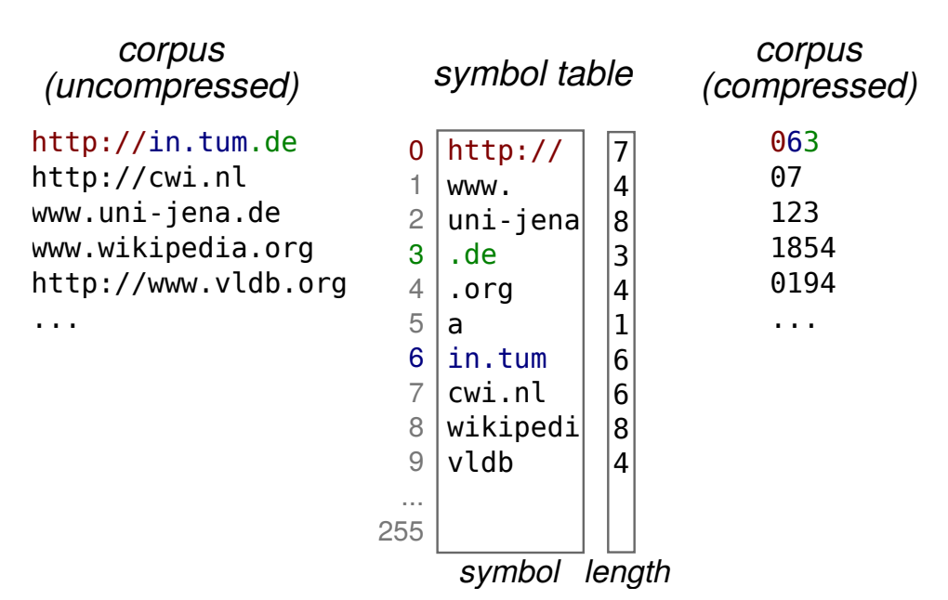
The Idea
Encode strings as a sequence of bytes, where each byte [0,254] is a
CODE
Each code stands for a 1-8 byte
SYMBOL
Byte 255 is special code marking
EXCEPTION
followed by 1 uncompressed byte
Closest existing scheme is RePair, but is >100x slower than FSST (both ways)
Small symbol table(s): RAM: 2.2KB, disk/network: ~500B

Slide 10
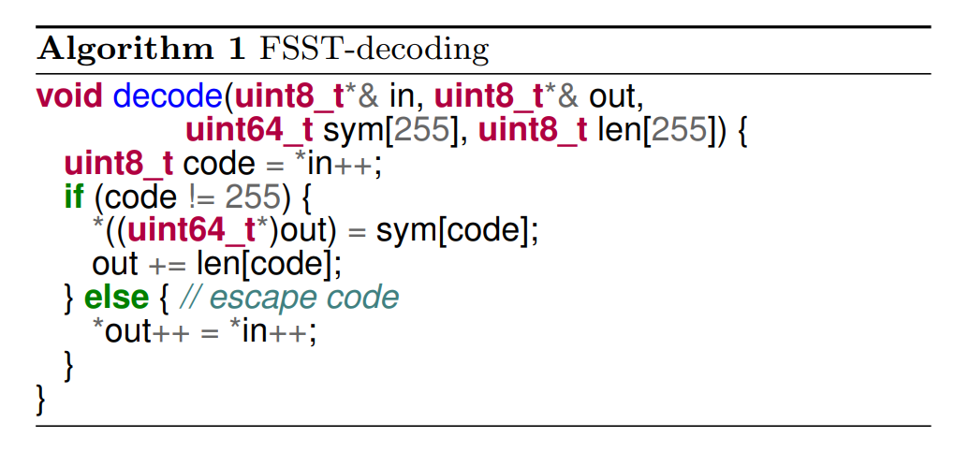
FSST Decoding

Slide 11
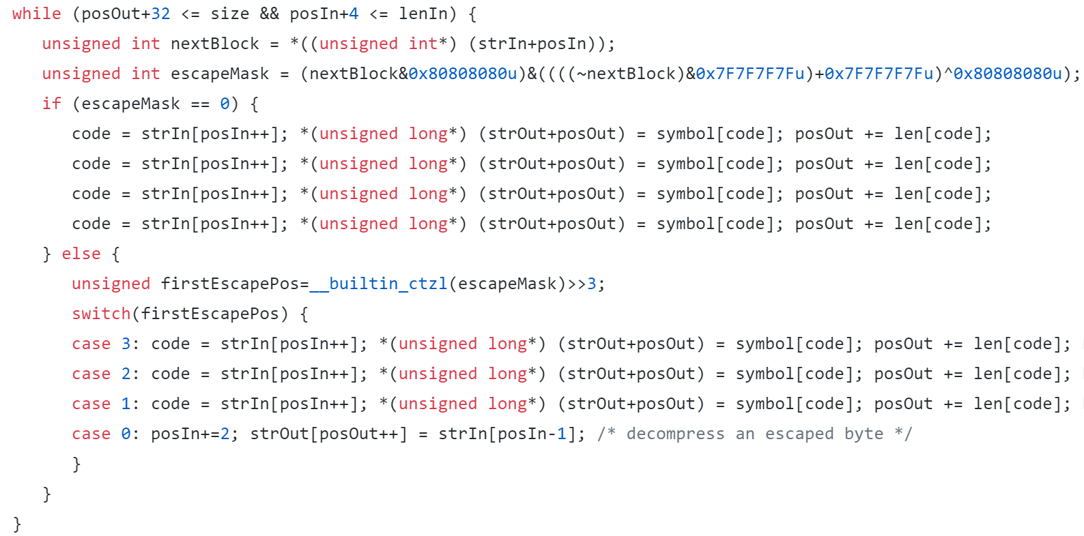
FFST Decoding, optimized..
fast-skip escapes
could also fast-skip looking at 8 bytes (now: 4 bytes), but then the probability of taking the shortcut drops
handle escapes with Duff’s device
ctlz quickly counts leading zeros

Slide 12
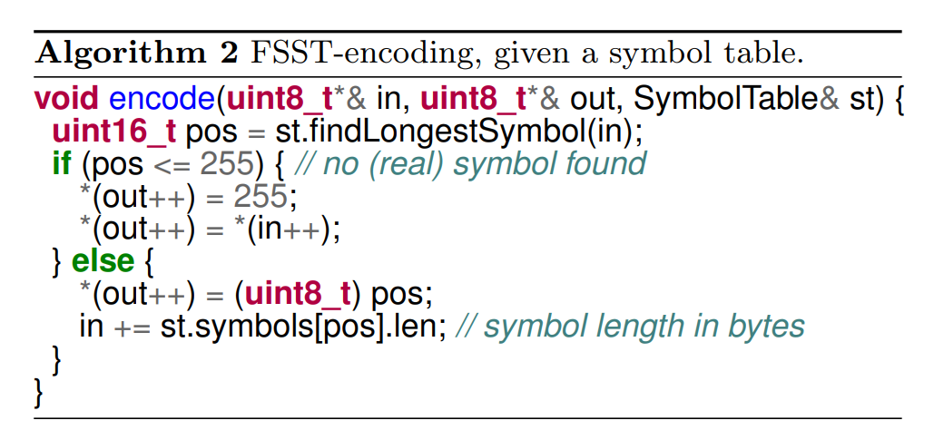
FSST encoding
Compression speed is all about findLongestSymbol()

Slide 13
FSST Compression in a DBMS
Dictionary Compression
column (green) contains dictionary codes
dictionary can be FSST compressed (smaller)
no decompression on scan; random access possible
FSST Compression
column (brown) contains offsets in string segment
eg 64KB block (self-aligned in RAM) starts with symbol table
vectors contain pointers into block
no decompression on scan; random access possible
disk-block
st
D
hash table
vector
bucket
array
value
array
vector
disk-block
st

Slide 14
Challenge: Finding a Good Symbol Table
Why is this hard? Dependency Problem!
First attempt:
Put the corpus in a suffix array
Identify the 255 common substrings with most gain (=length*frequency)
Problem 1:
Valuable symbols will be overlapping (they are not as valuable as they seem)
We tried compensating for overlap ➔ did not work
Problem 2: (greedy encoding)
The encoding will not arrive at the start of the valuable symbol, because the previous encoded symbol ate away the first byte(s)
We tried dynamic programming encoding (slow!!) ➔ no improvements

Slide 15
FSST bottom-up symbol table construction
Evolutionary-style algorithm
Starts with empty symbol table, uses 5 iterations:
We encode (a sample of) the plaintext with the current symbol table
We count the occurrence of each symbol
We count the occurrence of each two subsequent symbols
We also count single byte(-extension) frequencies, even if these are not symbols. For bootstrap and robustness.
Two subsequent symbols (or byte-extensions) generate a new concatenated symbol
We compute the gain (length*freq) of all bytes, old symbols and concatenated symbols and insert the 255 best in the new symbol table

Slide 16
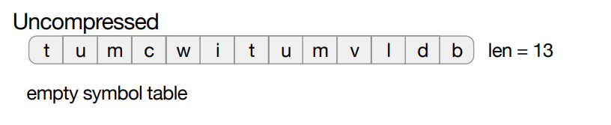
Algorithm Example (maxlen=3, |st|=5)

Slide 17
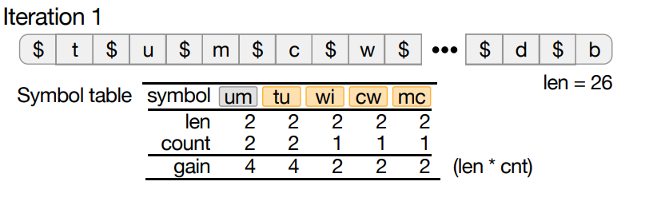
Algorithm Example (maxlen=3, |st|=5)

Slide 18
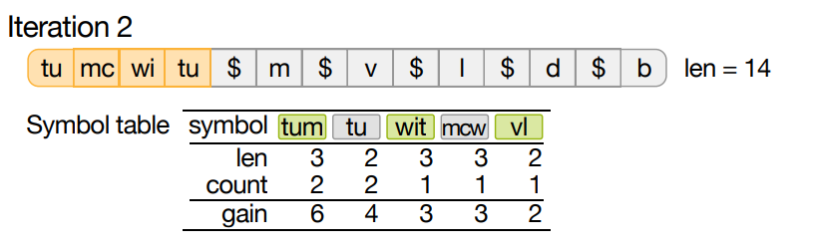
Algorithm Example (maxlen=3, |st|=5)

Slide 19
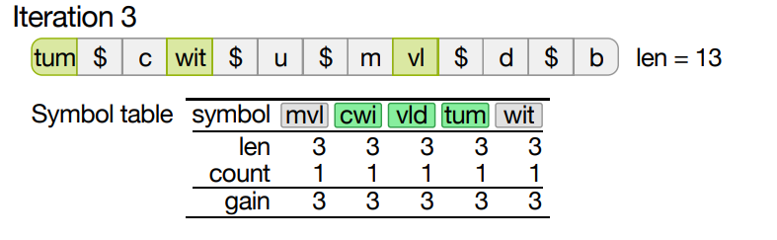
Algorithm Example (maxlen=3, |st|=5)

Slide 20
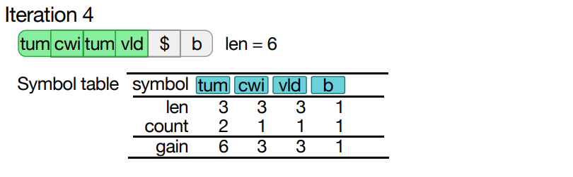
Algorithm Example (maxlen=3, |st|=5)

Slide 21
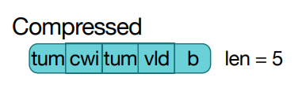
Algorithm Example (maxlen=3, |st|=5)

Slide 22
Making FSST encoding fast
findLongestSymbol()
Finds the next symbol
Naïve: range-scan in sorted list, indexed by first byte
Goal: encoding without for-loop and without if-then-else
Idea: Lossy Perfect Hash Table
Perfect: no collisions. How? Throw away colliding symbol with least gain
Lossy, therefore. But: we keep filling it with candidates until full anyway
Hash table lookup key is next 3 bytes
Use a shortCodes[65536] direct lookup array for the next two bytes
Choose between these two lookups with a conditional move
hashHit?hashCode:shortCode

Slide 23
Making FSST encoding fast
Idea: Lossy Perfect Hash Table
Perfect: no collisions. How?
Throw away colliding symbol with least gain
Lossy, therefore.
But: we keep filling it with candidates until full anyway
Hash table key is next 3 bytes
Use a shortCodes[65536] direct lookup array for the next two bytes
Append a terminator single-byte symbol to plaintext (typically byte 0)
u16 shortCodes[65536]; // code:12,length:4 +------------+----+
struct Symbol { | code | len|
union { char str[maxLength]; u64 num; } val; +------------+----+
u32 icl; // icl = u64 ignoredBits:16,code:12,length:4
} +----------------+------------+----+
Symbol hashTab[4096]; | ignoredBits | code | len|
+----------------+------------+----+

Slide 24
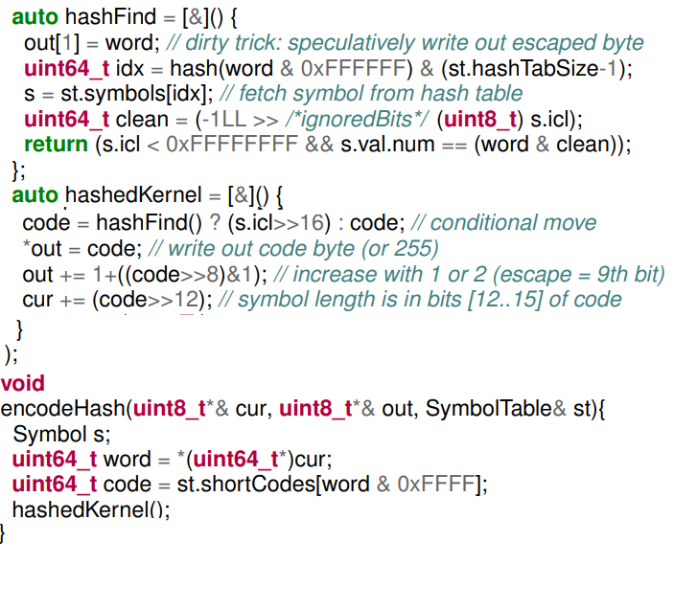
Lossy Perfect Hash Table
String encoding without for-loop and without if-then-else

Slide 25
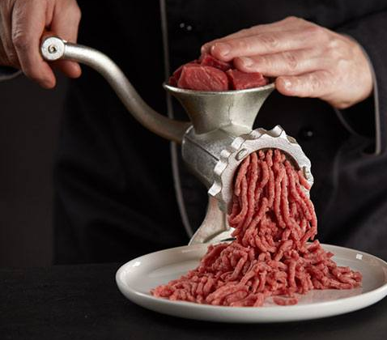
AVX512 Implementation
Idea: compress 8 strings in parallel (8 lanes of 64-bits)
*3 = 24 in parallel (unrolled loop)
job queue: 511 byte (max) string chunks
Add terminator symbol to each chunk
Sort jobs on string length (longest first) – load balancing, keep lanes busy
512 jobs of 511B input, 1024B output (768KB buffer)
Each iteration:
Insert new jobs in (any) free lanes (expand-load)
findLongestSymbol()in AVX512
Match 1 symbol in input, add 1 code to output strings (in each lane)
Involves 3xgather (2x hashTab 1xshortCodes) + 1xscatter (output)
Append finished jobs in result job array (compress-store)

Slide 26
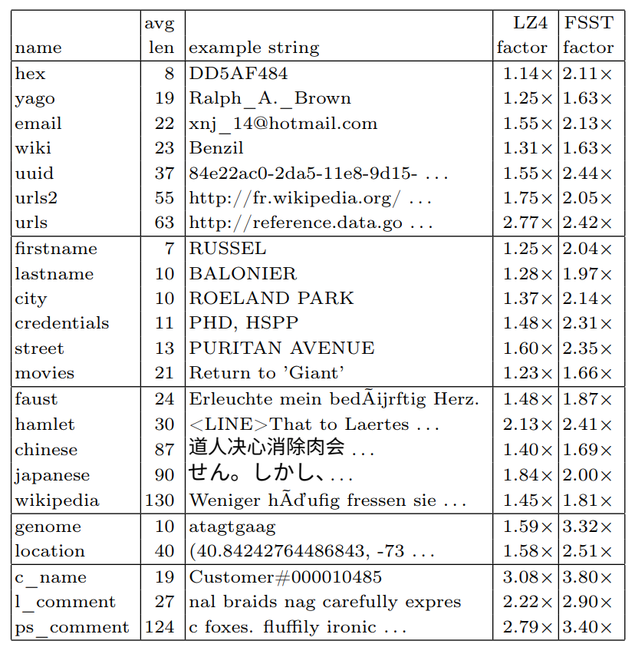
Evaluation: dbtext corpus
machine-readable identifiers (hex, yago, email, wiki,`uuid, urls2, urls),
human-readable names (firstname, lastname, city, credentials,street, movies),
text (faust, hamlet, chinese, japanese, wikipedia),
domain-specific codes (genome, location)
TPC-H data (c_name, l_comment, ps_comment)
Note: traditional compression datasets (e.g. Silesia) contain >50% binary files. Our new corpus is representative for DB text.

Slide 27
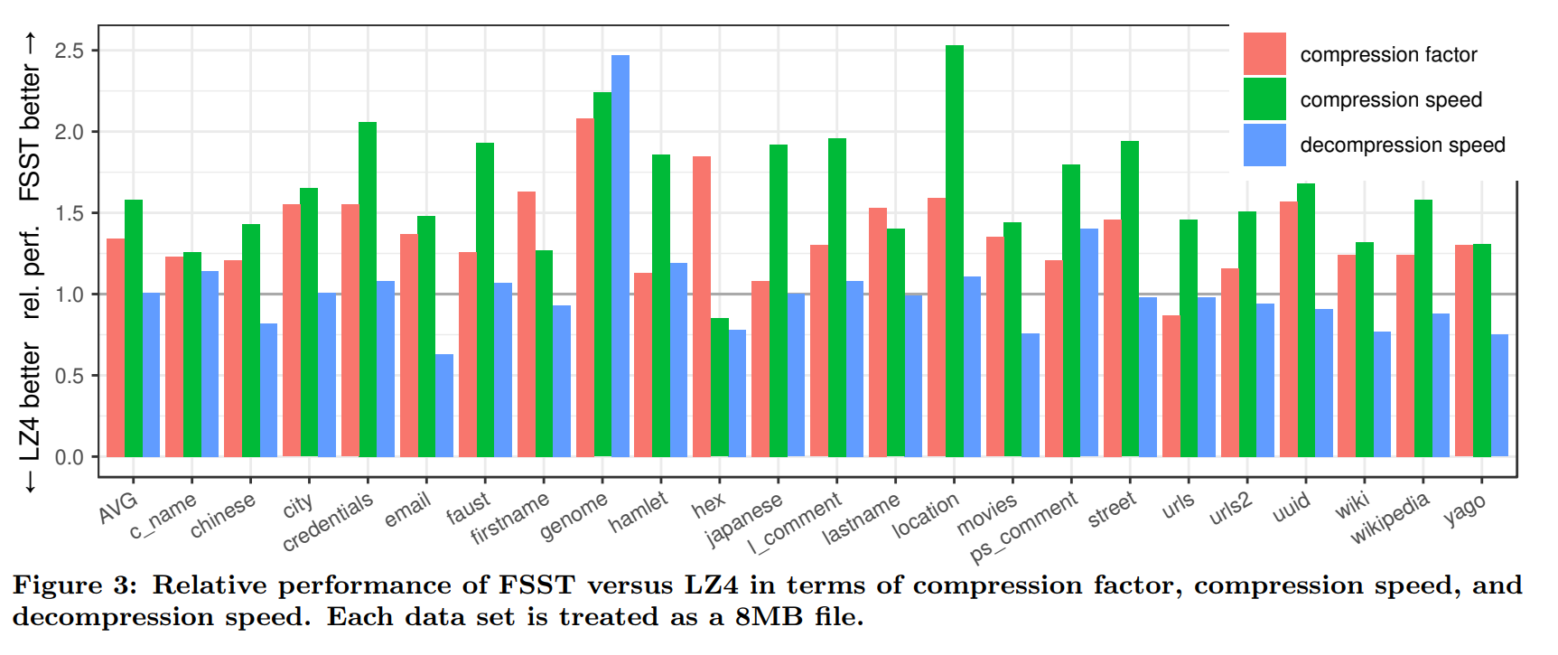
FSST vs LZ4
Note first bar with overall average (AVG)
FSST has better compression factor and better compression speed than LZ4
equal decompression speed

Slide 28
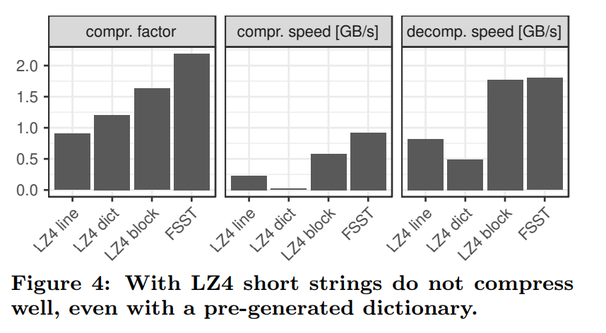
LZ4 as a database compressor
It does not make sense to use LZ4 to compress strings one-by-one (“line”), even when using a pretrained zstd dictionary (“dict”). It is slow and has bad compression factor. General-purpose compression should be block-based.

Slide 29
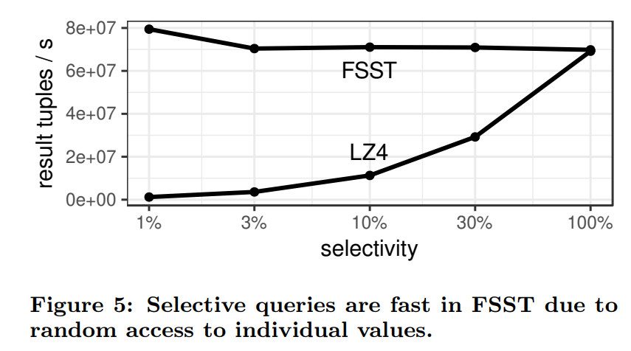
Random Access: FSST vs LZ4
Use case: Scan with a pushed down predicate (selection % on X axis)
LZ4 must decompress all strings, FSST only the selected tuples
FSST might even choose not to decompress strings (would even be faster)

Slide 30
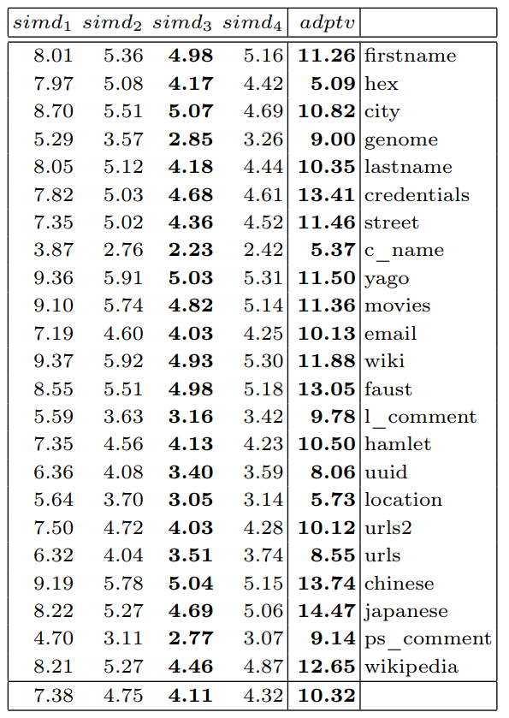
SIMD vs Scalar
Encoding performance
400MB/s scalar
900MB/s AVX512
Note:
Without AVX512, LZ4 compression is faster than FSST
But FSST speed still 70% of LZ4

Slide 31
Conclusion
Databases are full of strings (see Public BI benchmark, DBtest “get real” paper)
String processing is a big bottleneck (CPU, RAM, network, disk)
String compression is therefore a good idea (less RAM, network, disk)
Operating on compressed strings is very beneficial
FSST provides:
random access to compressed strings!
comparable/better (de)compression speed and ratio than the fastest general purpose compression schemes (LZ4)
Useful opportunities of FSST:
Compressed execution, comparisons on compressed data
Late decompression (strings-stay-strings). Has 0-terminated mode.
Easy integration in existing (database) systems
MIT licensed, code, paper + replication package github.com/cwida/fsst

