Slide 1
Focus on proficiency
Language learning and
barriers to success in the netherlands
Introduction Dataset Objectives Analysis Conclusions
Jessica Roehrig
19 December 2024

Slide 2
Introduction
Language and cultural inclusion

Slide 3
Civic integration & Proficiency
Language proficiency is closely linked with civic integration
Employment and education (Davia, et al., 2022)
Acculturation (Hammer, 2017)
Social life and interpersonal relationships (Derwing & Waugh, 2012)
Focus on success stories vs. failures
Recent research has begun to examine barriers to success (Dalderop, et al., 2023; Wood & Lens, 2024)
Contributing factors include housing and mobility, lack of childcare, legal procedures (e.g. asylum process)
Notes:
Davia et al (2022) - https://ojs.ual.es/ojs/index.php/RIEM/article/view/6322
Hammer (2021) - https://www.degruyter.com/document/doi/10.1515/9783110477498-012/html?lang=en
Derwing & Waugh (2012) - https://irpp.org/research-studies/language-skills-and-the-social-integration-of-canadas-adult-immigrants/
Wood & Lens (2024) - https://www.nature.com/articles/s41599-024-03034-0
Dalderop, et al. (2023) - https://www.leslla.org/blog/2023/5/31/integration-policies
Only very recently have researchers started to examine barriers to success (Dalderop, et al., 2023; Wood & Lens, 2024)
Contributing factors include housing and mobility, lack of childcare, legal procedures (e.g. asylum process)
Wood & Lens (2024) - https://www.nature.com/articles/s41599-024-03034-0
Dalderop, et al. (2023) - https://www.leslla.org/blog/2023/5/31/integration-policies

Slide 4
Netherlands’ Civic integration
Requirements include:
Knowledge exams
Staatsexamen Nederlands (STEX)
3-year timeline
“Integration” is required for residency, with some exceptions
From certain countries (Liechtenstein)
Having a university degree from Dutch institute for course taught in Dutch or having attended Dutch primary/secondary school for 8+ years
“Voluntary” integration also possible
Notes:
https://www.inburgeren.nl/en/integration-in-the-netherlands/

Slide 5
dataset

Slide 6
Dataset overview: Origin
Created for study by Schepens, et al. (2019) on L1-target language similarity and proficiency
Adapted from raw data in open-access database
Focus on B2 level in Common European Framework of Reference for Languages (upper-intermediate)
50,235 learners representing 70 native languages
Contents roughly broken down into language landscape and learner landscape

Slide 7
Dataset contents: LANGUAGE LANDSCAPE
"Family" - Language Family
"ISO639.3" - Language ID code according to Ethnologue
"Enroll" - country's educational accessibility at the time learners have left their country of origin
“morph" - Morphological similarity
“lex" - Lexical similarity
“new_feat" - Phonological similarity (in terms of new features)
“new_sounds" - Phonological similarity (in terms of new sounds)
NOT A FOCUS OF CURRENT EDA!

Slide 8
Dataset contents: LEARNER LANDSCAPE
"L1" - The native language of the learner
"C" - The country of birth
"L1L2" - The combination of first and best additional language besides Dutch
"L2" - The best additional language besides Dutch
"AaA" - Age at Arrival in the Netherlands in years (starting date of residence)
"LoR" - Length of residence in the Netherlands in years
"Edu.day" - Amount of daily education (categorized)
“Sex” – male or female
“Speaking" - The STEX test score for speaking proficiency
Notes:
"Edu.day" - Duration of daily education (1 low, 2 middle, 3 high, 4 very high). From 1992 until 2006, learners' education has been measured by means of a side-by-side matrix question in a learner's questionnaire. Learners were asked to mark which type of education they have had (elementary, secondary, or tertiary schooling) by means of filling in for how many years they have been enrolled, in which country, and whether or not they have graduated. Based on this information we were able to estimate how many years learners have had education on a daily basis from six years of age onwards. Since 2006, the question about learners' education has been altered and it is asked directly how many years learners have had formal education on a daily basis from six years of age onwards. Possible answering categories are: 1) 0 thru 5 years; 2) 6 thru 10 years; 3) 11 thru 15 years; 4) 16 years or more. The answers have been merged into the categorical answer.

Slide 9
objectives

Slide 10
Understanding the language learners
Where were the learners born?
What are the learners’ most- & least-spoken native languages?
When did the learners arrive in the Netherlands? How long have they been there?
How educated are the learners?
1

Slide 11
Understanding the speaking score
How did learners perform on the speaking test overall?
How is the speaking score correlated to other factors?
2

Slide 12
Zooming in on the poorest performing learners
Defining poor performance
Which factors are problematic?
Which factors are significant?
Which learners are most vulnerable or overlooked?
What strategies can be adopted to aid these learners?
3

Slide 13
Exploratory Data analysis

Slide 14
Data cleaning
Duplicates: none
NaN values:
Retained: morph, new_feat, new_sounds
Dropped: Edu.day
Unexpected results
Country: USSR, Yugoslavia
Family: “Other” = NaN (dropped)
L2: Dutch (dropped), Monolingual (retained)
AaA: 0 years + Netherlands country of origin (dropped)
49,898 learners remaining
Notes:
### COUNTRY: The country of birth presents some problems, particularly in relation to country names being outdated (such as "USSR"), or countries which no longer exist (such as "Yugoslavia"). However, some of the learners are older, such as in their 80's, and the country names may have been accurate at the time they were born. Furthermore, the country of birth may not have had much impact on the learners overall; some learners, for example, were born in one country but then arrived in the Netherlands at a very young age.
### FAMILY: Although our data analysis focuses more on learner aspects rather than features of the native language, "Other" in the category of "Language Family" essentially serves as a null value. Therefore, these values will be removed.
### MONOLINGUAL: Interestingly, the second most common entry for L2 is "Monolingual", meaning that the learner only speaks their native language and Dutch, with no other second language capability. For some data analysis questions, "Monolingual" could therefore be interpreted as a null value. For our current data analysis purposes, however, this information is useful and will be retained.
### DUTCH: Although this column is meant to represent a learner's most proficient second language *other than Dutch*, some entries include Dutch as the L2. It very well may be that these learners are functionally the same as the above "Monolinguals", who speak no second language other than Dutch. However, this cannot be assumed in all cases, as these may represent data-entry errors or mis-reporting by learners or researchers. Therefore, "Dutch" is an unexpected value in this column, and these entries should be removed.
### AaA + Netherlands: Apparently, 60 of the learners in our dataset were born and raised in the Netherlands, while a further 193 were born elsewhere but raised in the Netherlands. However, being born or raised in a particular country does not guarantee proficiency in the dominant language of that country. Therefore, neither "Netherlands" as a country of birth nor "0" as age of arrival serve as unexpected values and will not be removed. These data points may, in fact, serve to shed light on the complexities of language proficiency and un- or underserved markets and will be revisted during the exploratory data analysis.

Slide 15
Understanding the language learners
Where were the learners born?
What are the learners’ most- & least-spoken native languages?
When did the learners arrive in the Netherlands? How long have they been there?
How educated are the learners?
1

Slide 16
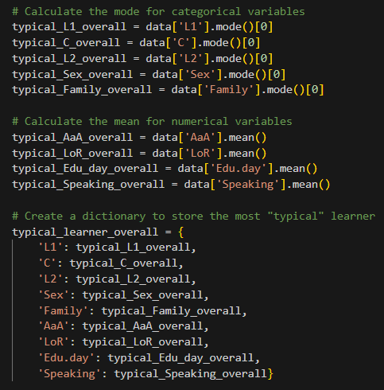
A woman who was born in Germany, arrived in the Netherlands in her mid-20's and has been resident for about 4 years. Her native language is Arabic, and she also speaks English. She has 11-15 years of formal, daily education. Her speaking proficiency score on the STEX was 517.
Understanding the language learners
“TYPICAL” LEARNER

Slide 17
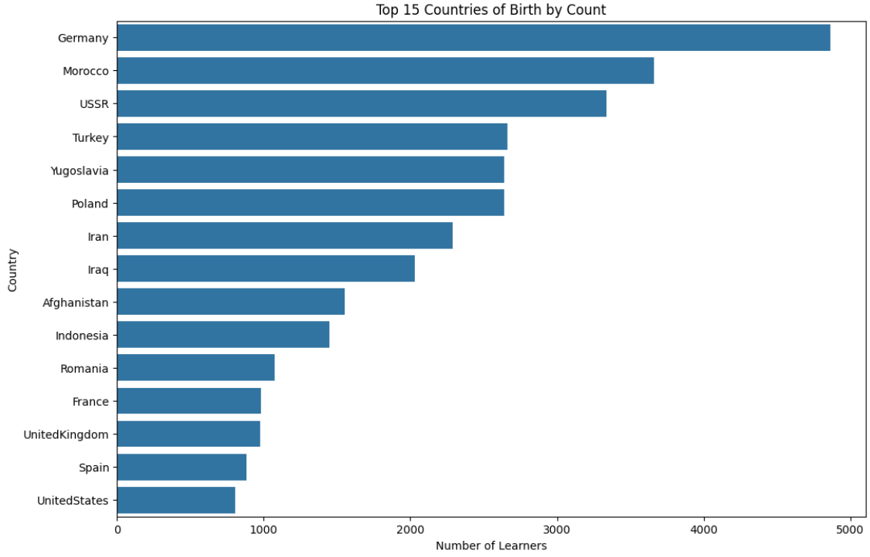
COUNTRY OF ORIGIN
Understanding the language learners
Unexpected Results
Meaningful information?
Disconnect between country of birth and native language
Young arrival in Netherlands: 249 left their country of origin before the age of 5

Slide 18
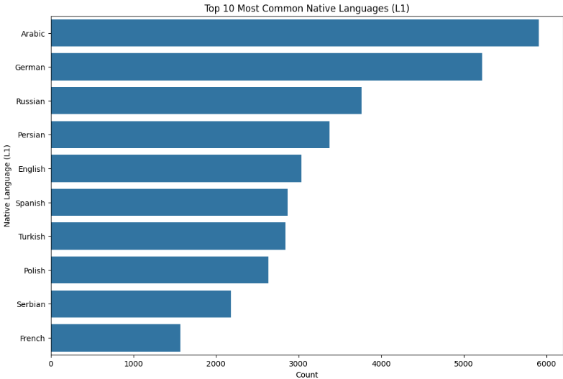
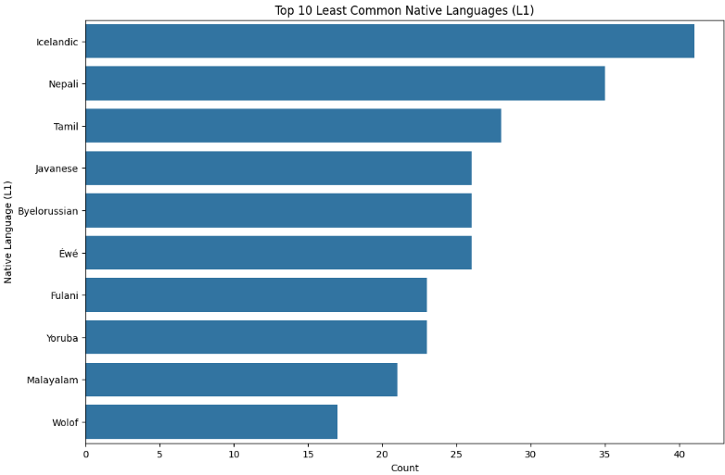
MOST- & LEAST-SPOKEN NATIVE LANGUAGES
Understanding the language learners

Slide 19
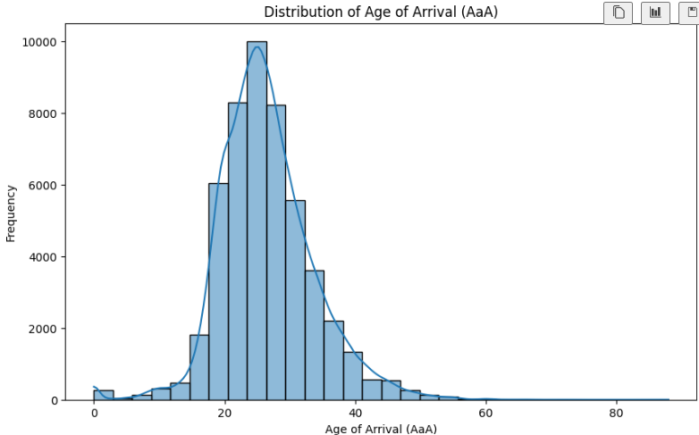
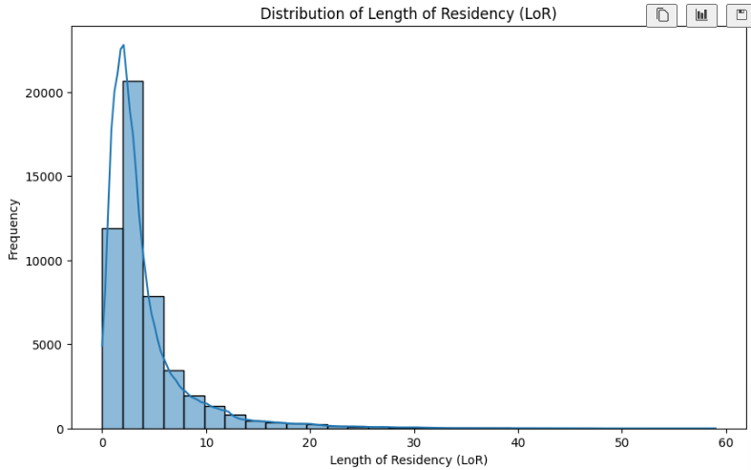
ARRIVAL & RESIDENCY IN THE NETHERLANDS
Understanding the language learners

Slide 20
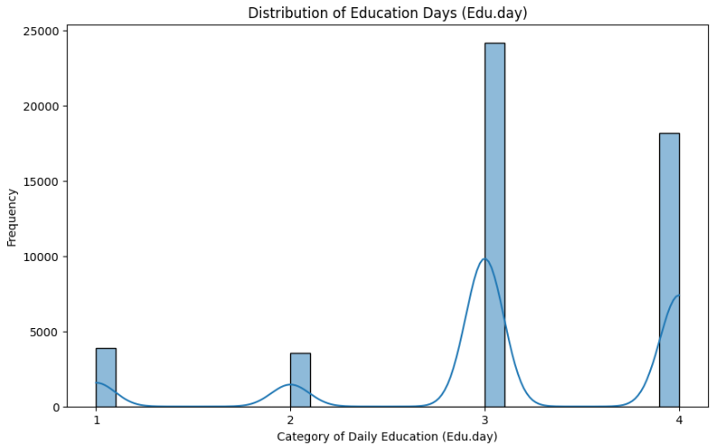
Level of education
Understanding the language learners
Category Meaning:
1: 0-5 years
2: 6-10 years
3: 11-15 years
4: 16+ years
Motivations for taking exam
Education
Employment

Slide 21
learner landscape: Key observations
Native language and L2 is much more important than country of origin, especially given the problems with country information
Language transference can boost but not guarantee learner success
The learners are overall highly or very highly educated, so they are cognitively capable of language acquisition

Slide 22
Understanding the speaking score
How did learners perform on the speaking test overall?
How is the speaking score correlated to other factors?
2

Slide 23
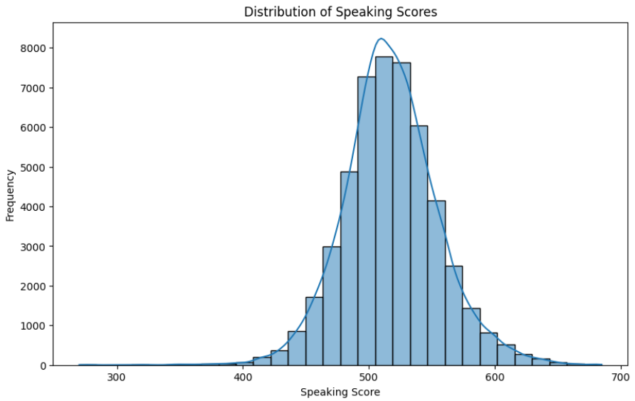
Overall proficiency performance
Mostly normal distribution
Skewed towards higher results
0-700 possible
Average = 517

Slide 24
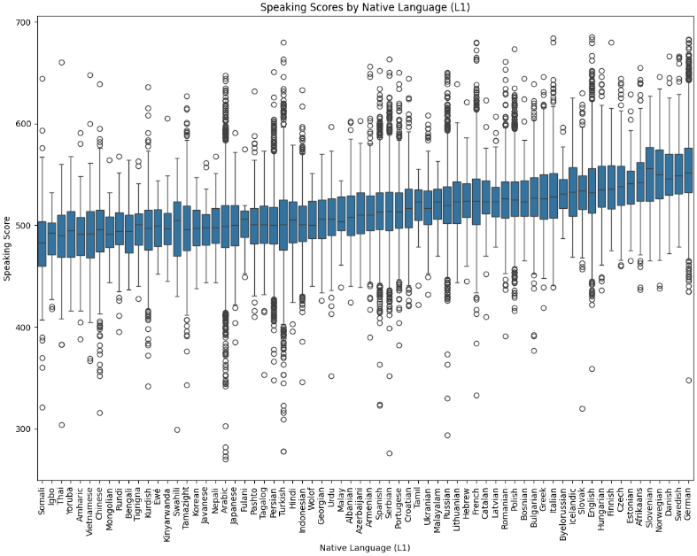
Native language
Understanding the speaking score & correlation
Native language is correlated with the speaking score
The correlation is highly statistically significant
F-Statistic: 494.05883948616
P-Value: 0.0

Slide 25
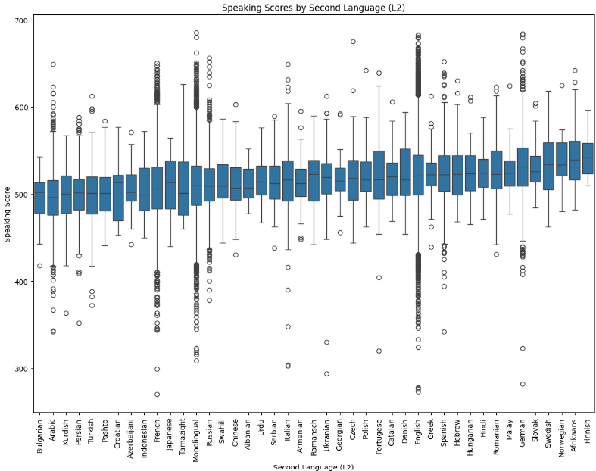
L2 proficiency
Understanding the speaking score & correlation
L2 language is correlated with the speaking score
The correlation is highly statistically significant
F-Statistic: 250.6968330774
P-Value: 0.0

Slide 26
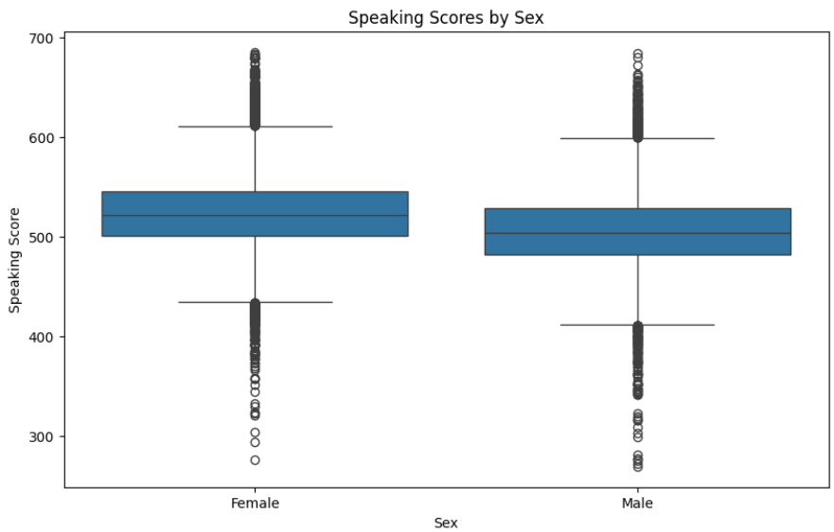
sex
Females perform better than males
The correlation is highly statistically significant
Z-Test: 51.56720064772813
P-Value: 0.0

Slide 27
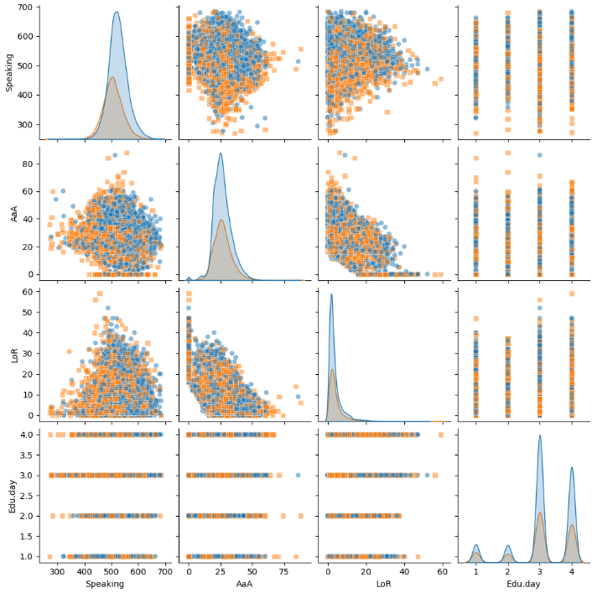

Aaa, lor, & Edu vs speaking score
Age of arrival is inversely correlated to the speaking score
The correlation is highly statistically significant
Pearson Correlation Coefficient: -0.1382
P-Value: 1.7741357911264393e-211
Length of residency is positively correlated the speaking score
The correlation is not statistically significant, but it is just over the threshold
Pearson Correlation Coefficient: 0.007862872946
P-Value: 0.07902342319706
Education level is positively correlated the speaking score
The correlation is highly statistically significant
F-statistic: 54.41276283515
P-Value: 4.182155189294792e-35
Sex, AaA, LoR, & Edu are all impactful

Slide 28
The speaking score & correlations: Key observations
The positive skew of the speaking score may suggest that significant numbers of real-world learners are not included in the data (e.g., they knew they would not pass so chose not to take the exam).
We should remain “open-minded” about sample sizes

Slide 29
The speaking score & correlations: Key observations
Language is highly correlated with proficiency (p-value = 0.0), but cannot (and should not) be isolated as the cause of success/failure – sex, age of arrival, length of residency, and education help map the cultural-linguistic landscape
Male and female learners should be considered separately

Slide 30
Zooming in on the poorest performing learners
Defining poor performance
Which factors are problematic?
Which factors are significant?
Which learners are most vulnerable or overlooked?
What strategies can be adopted to aid these learners?
3

Slide 31
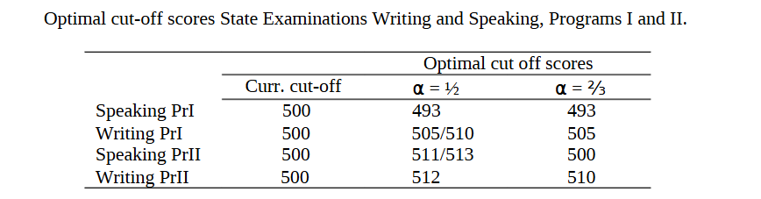
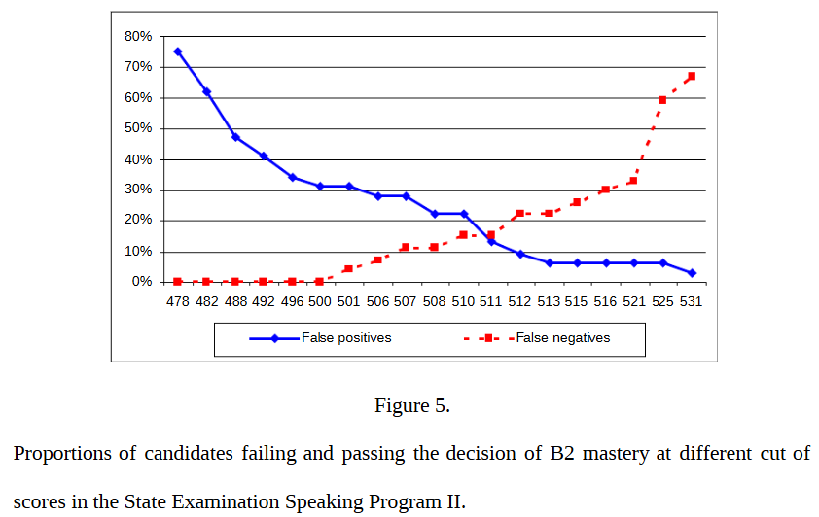
Defining poor performance
Poor Performance <= 510
Bechger, et al. (2009) examined how STEX corresponds to CEFR
New cut score:
511 to avoid false positives
513 to avoid false negatives
21576 learners failed
the speaking exam
(m: 9689, f: 11895)
Notes:
### In their paper, "Standard Setting in Relation to the Common European Framework of Reference for Languages: The Case of the State Examination of Dutch as a Second Language", Bechger, et al. (2009) discuss how STEX scores correspond to the Common European Framework of Reference (CEFR) and whether the previously-used cut-off score of 500 was adequate. Through their data analysis, they suggested that a cut score of 511 or 513 would lead to fewer false positives and false negatives, respectively. Our current data analysis is principally concerned with learners who are not achieving language proficiency, which therefore means we need to avoid false positives as much as possible. We will therefore use 511 as our cut-off score, meaning we will from here-on only be looking at learners with scores of 510 or lower

Slide 32
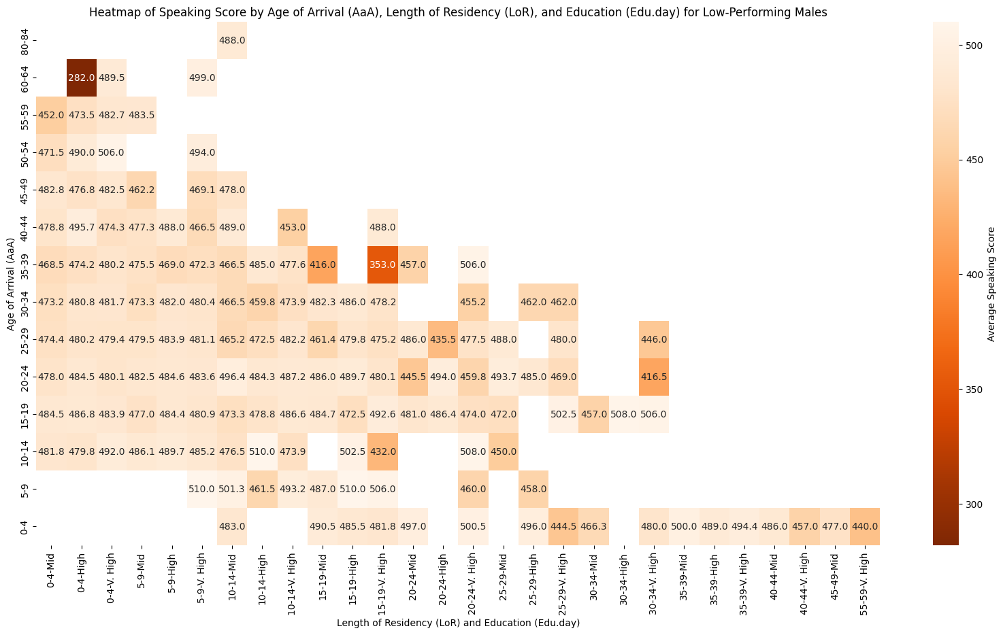
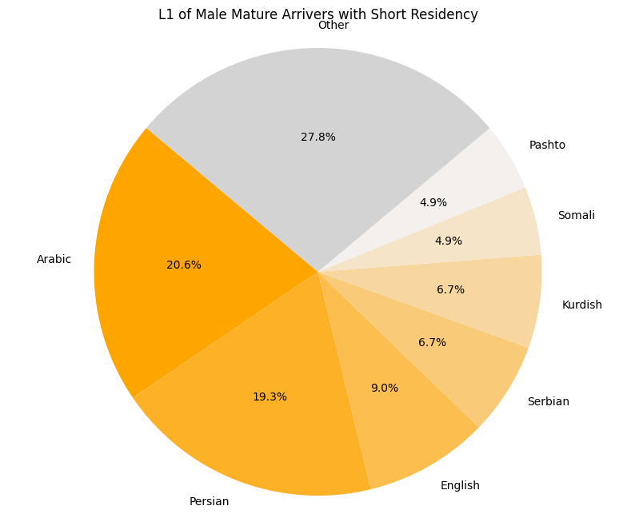
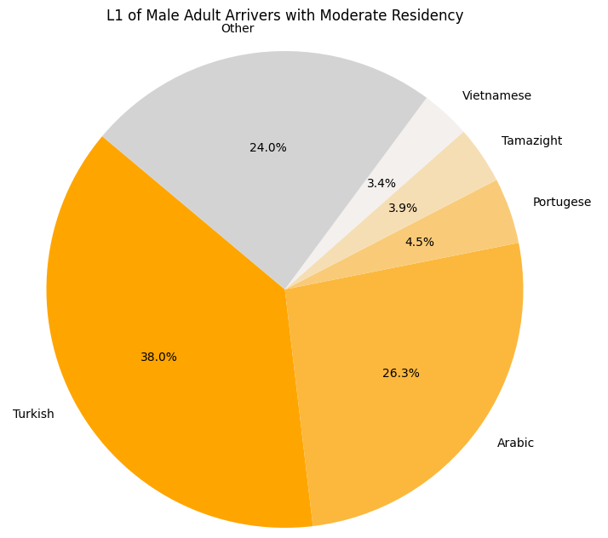
FINAL TIPS & TAKEAWAYS
poorest performing
male learners
Mature Arrivers w/ Short Residency
Teenage & Adult Arrivers w/ Moderate Residency
Consistent rehearsal
Strengthen your familiarity
Refine delivery style
Pacing, tone, and emphasis
Timing and transitions
Aim for seamless, professional delivery
Practice audience
Enlist colleagues to listen & provide feedback
Seek feedback
Reflect on performance
Explore new techniques
Set personal goals
Iterate and adapt
Only 46 learners total
Young Arrivers w/ Long Residency
Young Arrivers w/ Moderate Residency
Notes:
Young Arrivers with Long Residency: AaA <= 10, LoR >= 40, now 50+ ➔ 17
Young Arrivers with Moderate Residency: AaA <= 14, LoR = 20-30, now 34-44 ➔ 29
Adult Arrivers with Moderate Residency: AaA = 20-39, LoR = 15-34, now 35-73 ➔ 179
Mature Arrivers with Short Residency: AaA >= 45, LoR <= 9, now 45+ ➔ 223

Slide 33
Male Poor performers: Key observations
EU & NL pre-2021 policies for Turkish nationals have severely negatively impacted adult males w/ moderate residency
01
Legal procedures (such as seeking asylum) may interfere with proficiency
02
Higher education level may push unprepared males to “reach for the stars”
03
Notes:
https://migrant-integration.ec.europa.eu/news/turkish-citizens-coming-netherlands-must-take-civic-integration-courses-abroad-starting-2021_en

Slide 34
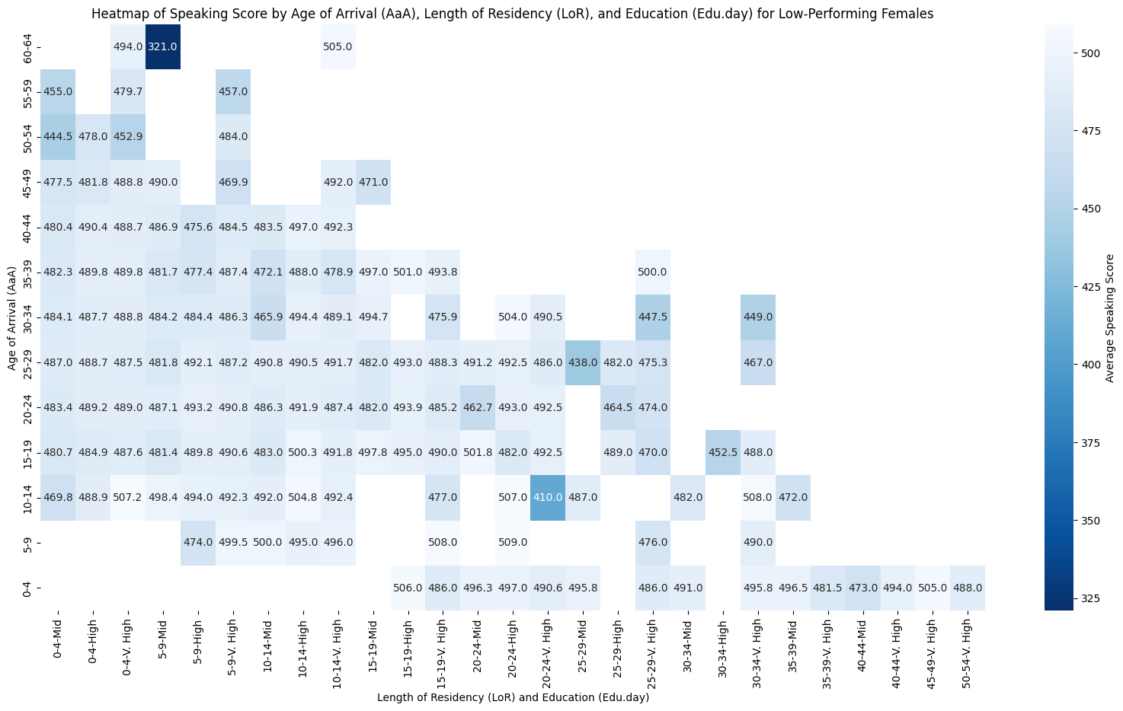
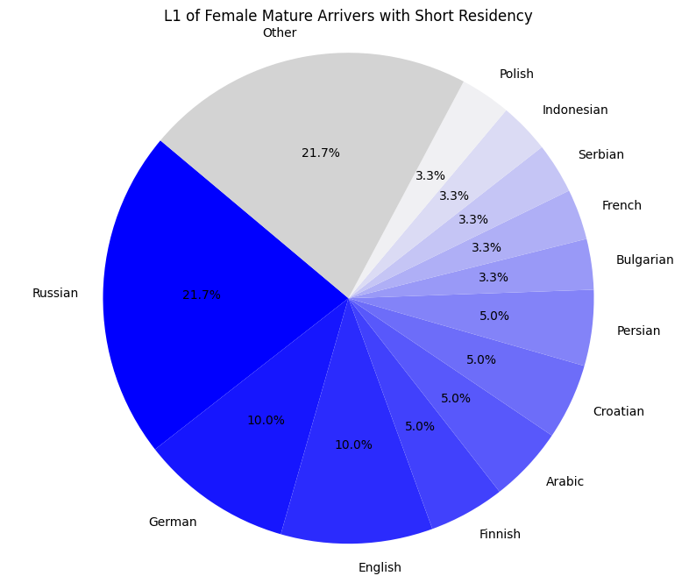
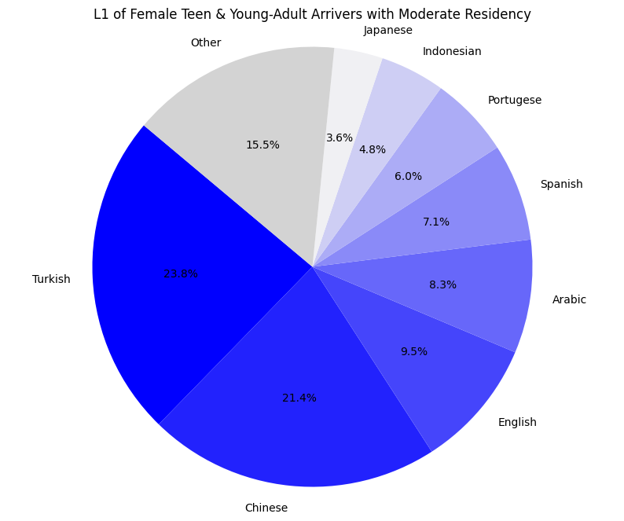
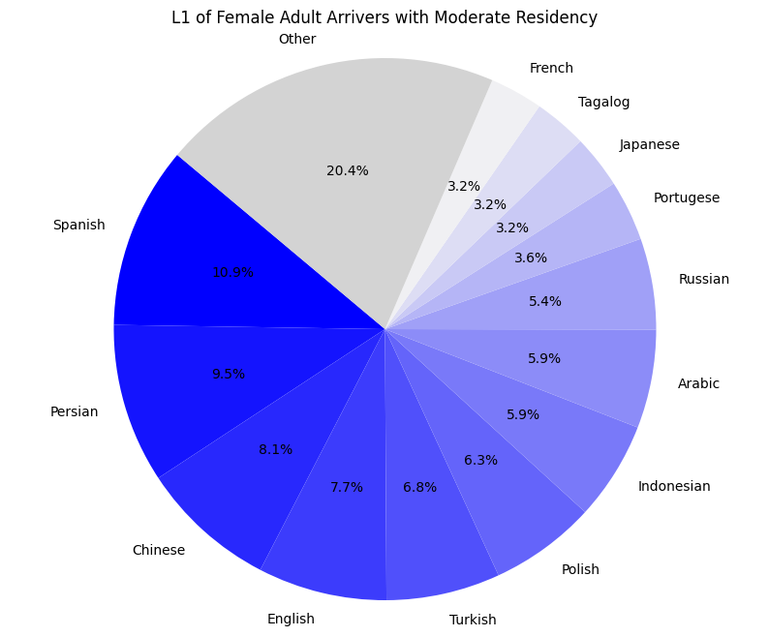
poorest performing
female learners
Mature Arrivers w/ Short Residency
Adult Arrivers w/ Moderate Residency
Teenage & Adult Arrivers w/ Moderate Residency
Notes:
Teenage & Young Adult Arrivers with Moderate Residency: AaA = 10-34, LoR = 20-34, now 30-68 ➔ 84
Adult Arrivers with Moderate Residency: AaA = 30-49, LoR = 10-19, now 40-68 ➔ 221
Mature Arrivers with Short Residency: AaA >= 50, LoR <= 9, now 50+ ➔ 60

Slide 35
Female Poor performers: Key observations
EU & NL pre-2021 policies for Turkish nationals have negatively impacted young adult females w/ moderate residency
01
Much greater linguistic diversity amongst female adults with moderate residency suggests other influencing factors, such as access to childcare
02
Recently-arrived Russian & northern-EU women with medium education levels, whatever their reasons for migrating, are underserved
03
Notes:
https://migrant-integration.ec.europa.eu/news/turkish-citizens-coming-netherlands-must-take-civic-integration-courses-abroad-starting-2021_en

Slide 36
conclusions

Slide 37
Summary of Key observations
Turkish- and Arabic-speaking learners are underserved, especially among adult men and young adult women
01
Social and economic factors present significant barriers to language proficiency success, especially for adult and mature women
02
Education level, whether higher or lower, can present barriers to language proficiency success
03

Slide 38
Strategic recommendations
Create more Turkish-to-Dutch language programs and Turkish-language promotional materials to distribute among Turkish cultural, religious, and social groups; similar for Arabic
Support female learners by providing transportation to and childcare during classes, or, in the case of asylum seekers, more on-site intervention in refugee centers
Appeal to older learners with lower education levels through content-based (rather than language-based) instruction and service learning

Slide 39
Future data analysis
Augment dataset with additional data points, such as socio-economic level or motivation for exam
Longitudinal study of impact of free transport and childcare on female proficiency and on-site instruction in refugee centers
Effects of EU & NL policy changes
EU: 2021 EU law
NL: 2021 (PIP) & 2025 Turkish integration policies

Slide 40

References
“Immigration to the Netherlands” https://www.government.nl/topics/immigration-to-the-netherlands
“State Exam NT2” https://www.staatsexamensnt2.nl/
Bechger, et al. (2009). “Standard Setting in Relation to the Common European Framework of Reference for Languages: The Case of the State Examination of Dutch as a Second Language” http://dx.doi.org/10.1080/15434300802457521
Capman (2022). “Impact of English Skills in the workplace” https://capman.es/blog/impact-english-skills-workplace
Dalderop, et al. (2023) “Integration policies” https://www.leslla.org/blog/2023/5/31/integration-policies
Davia, et al. (2022). “Language proficiency and immigrants’ employment outcomes in Spain” https://ojs.ual.es/ojs/index.php/RIEM/article/view/6322
Derwing, et al. (2012). “Language Skills and the Social Integration of Canada’s Adult Immigrants” https://irpp.org/research-studies/language-skills-and-the-social-integration-of-canadas-adult-immigrants/
Hammer (2017). “Sociocultural integration and second language proficiency following migration” https://www.degruyter.com/document/doi/10.1515/9783110477498-012/html?lang=en
Hartshorne, et al. (2019). “A critical period for second language acquisition: Evidence from 2/3 million English speakers” https://pmc.ncbi.nlm.nih.gov/articles/PMC6559801/
Kang, et al. (2021). “Language and nonlanguage factors in foreign language learning: evidence for the learning condition hypothesis” https://www.nature.com/articles/s41539-021-00104-9#citeas
Schepens, et al. (2019). “Big Data Suggests Strong Constraints of Linguistic Similarity on Adult Language Learning”. https://www.sas.rochester.edu/cls/assets/pdf/schepens-van-hout-jaeger-2020-big-data-suggest-strong-constraints-of-linguistic-similarity-on-adult-language-learning.pdf
Wood, et al. (2024). “Does timing matter? Language course participation and language outcomes amongst new immigrants” https://www.nature.com/articles/s41599-024-03034-0

Slide 41
Thank you!

