Slide 1

Project Title: Budget Required to Maintain a Healthy Student life.
Team Project:
Group 7
Jaykumar Maheshbhai Bhingaradia,
Songjiu Xu,
Jeseeka Shah

Slide 2
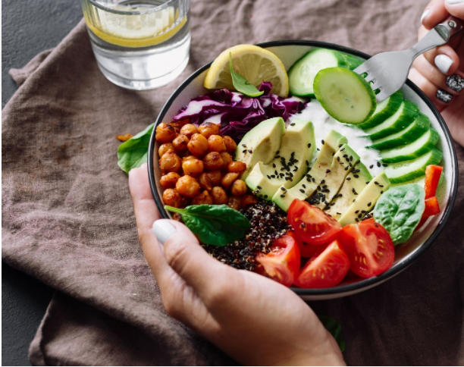
Introduction
The database used here is based on the survey that was taken using the software Qualtrics and collected the answers from them.
The survey conducted was to estimate the budget that a student would have during the busy schedule to maintain a healthy life as per the survey answered.
The survey had various question such as distance from the gym, type of meal and beverages they choose, calories in-take, and time that they spend in the gym etc.
After completing the survey, the answer was stored in the backend of the software Qualtrics, and we converted it into a excel sheet and replaced the questions with appropriate column names. So, in total we have 31 variables and 30 rows in our dataset. In which 20 are numerical and rest are categorical in nature.

Slide 3
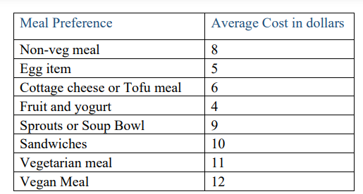
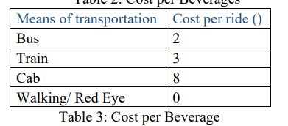
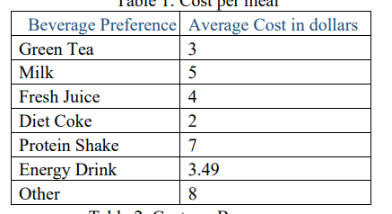

Based on the preferences the cost in dollars was allocated

Slide 4

EDA

Slide 5
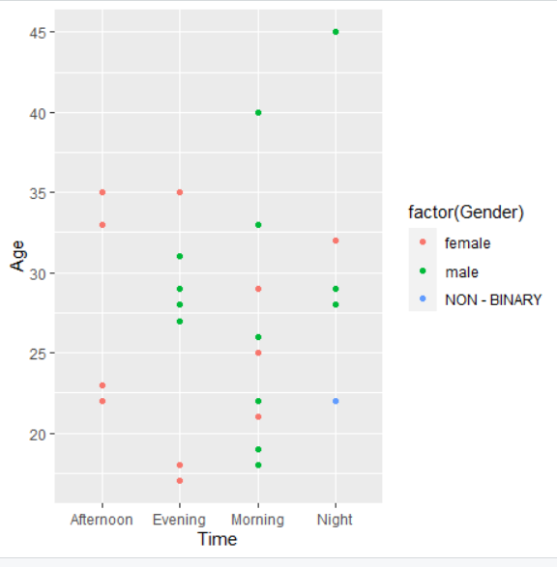
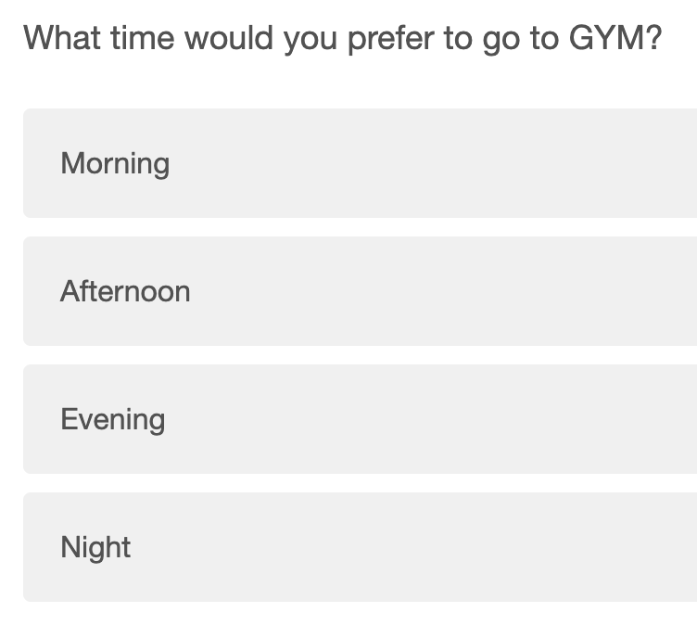
Plotting graph of age group and time based on the gender

Slide 6
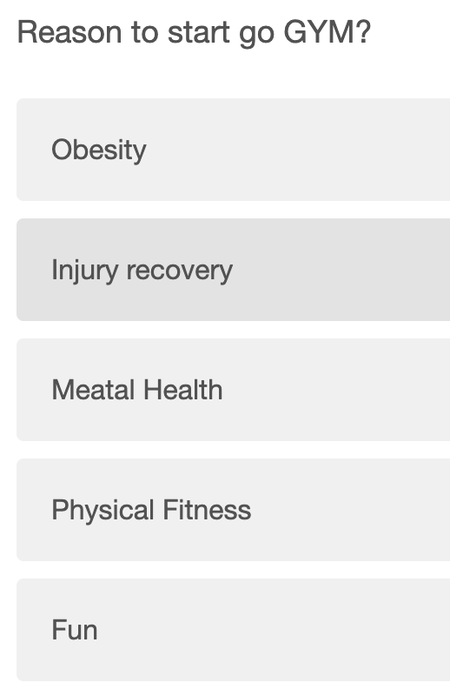
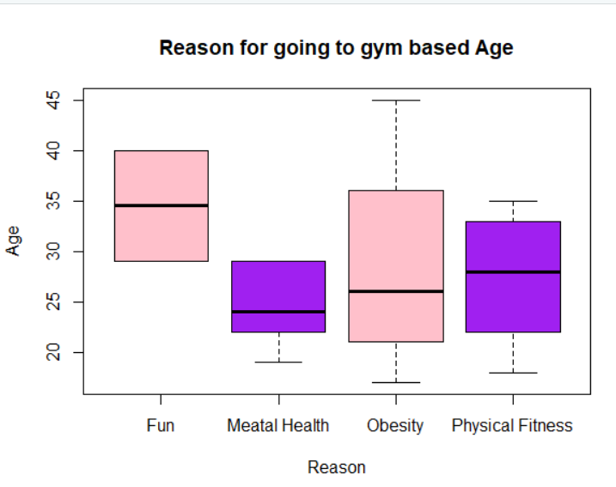

Slide 7
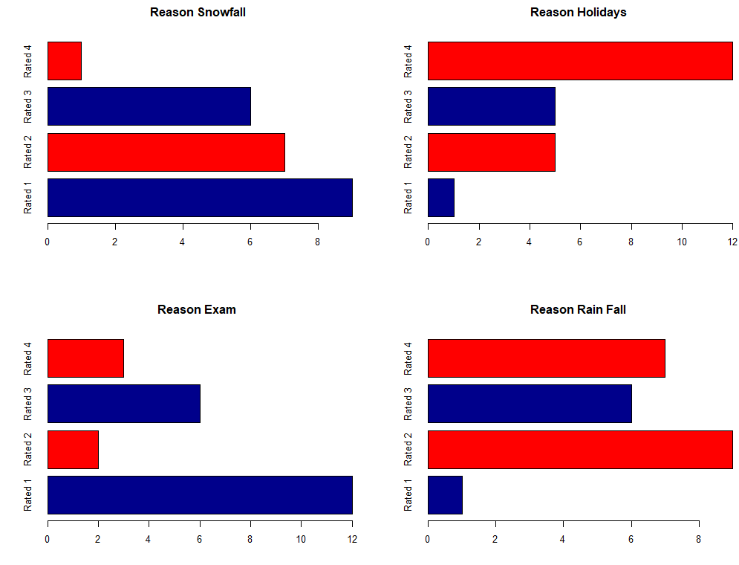
Reason for avoiding going to gym

Slide 8
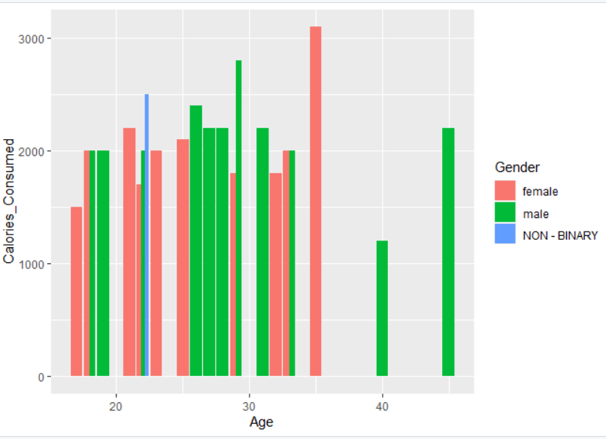
How many calories consumed per day ?

Slide 9
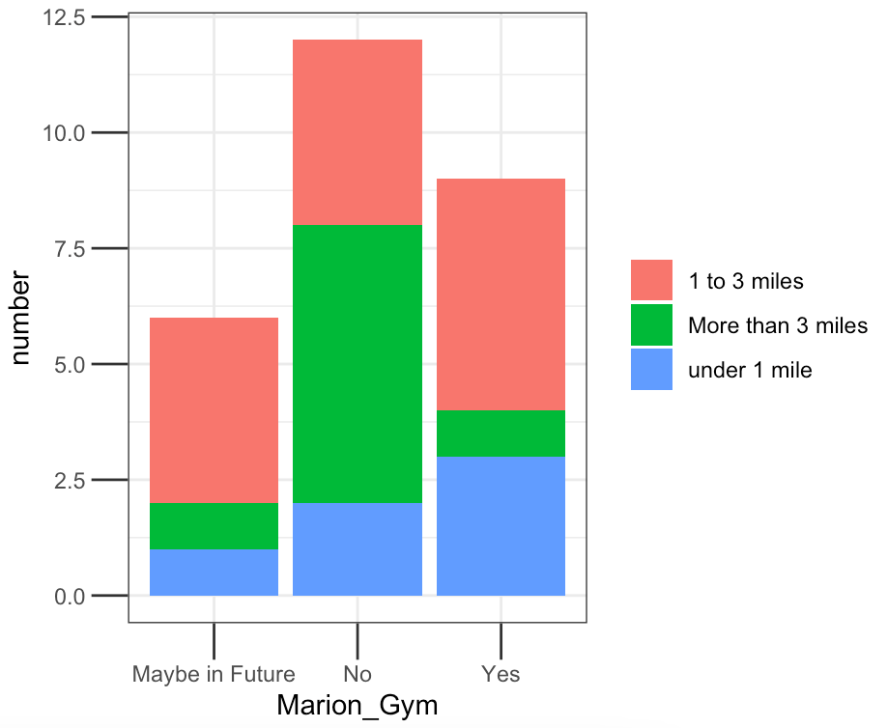
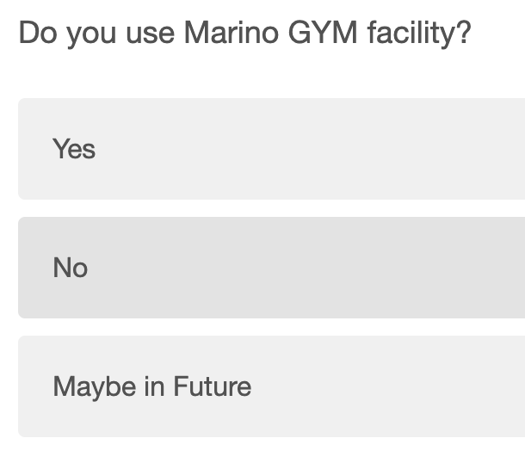
Plotting the no of people vs. choices of going to gym or not based the distance

Slide 10
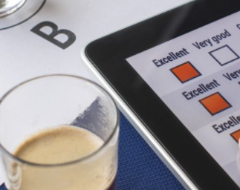
Models

Slide 11
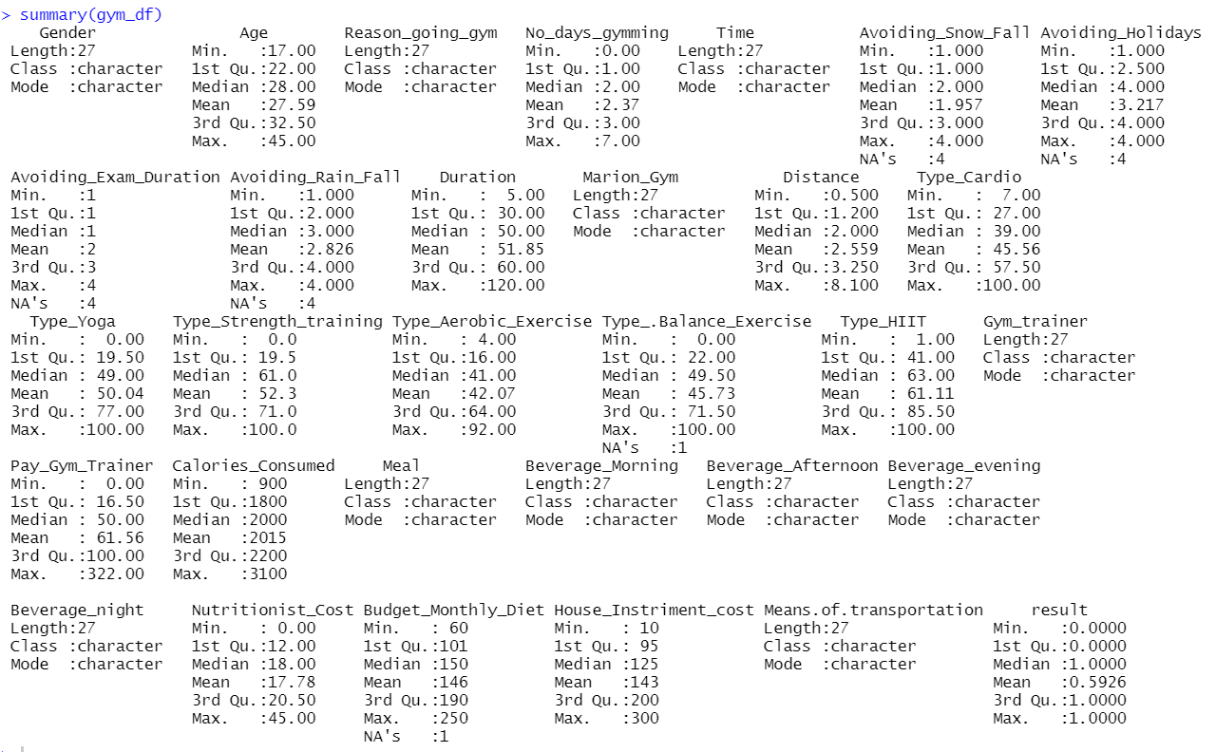
MODEL :- GENERAL LINEAR MODEL
Here, the model taken takes the response variable as result – which shows the if the student saw a change in the fitness based on the routine ticked/ mentioned in the survey.
Using the parameter other parameter as the independent parameter as shown below to check if the model is accurate or not .
result~ Nutritionist_Cost + House_Instriment_cost + Protein_Shake3 +Protein_Shake1 + Fresh_Juice1 + Pay_Gym_Trainer + Avoiding_Rain_Fall + No_days_gymming + Calories_Consumed + Budget_Monthly_Diet + Bus + Gym_trainer

Slide 12
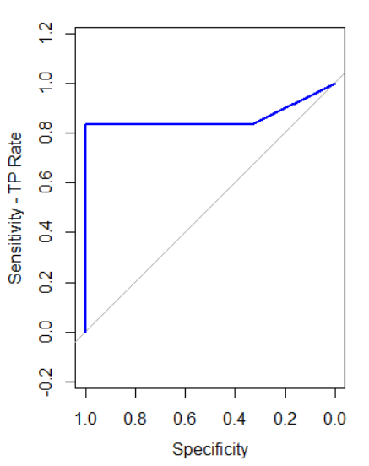
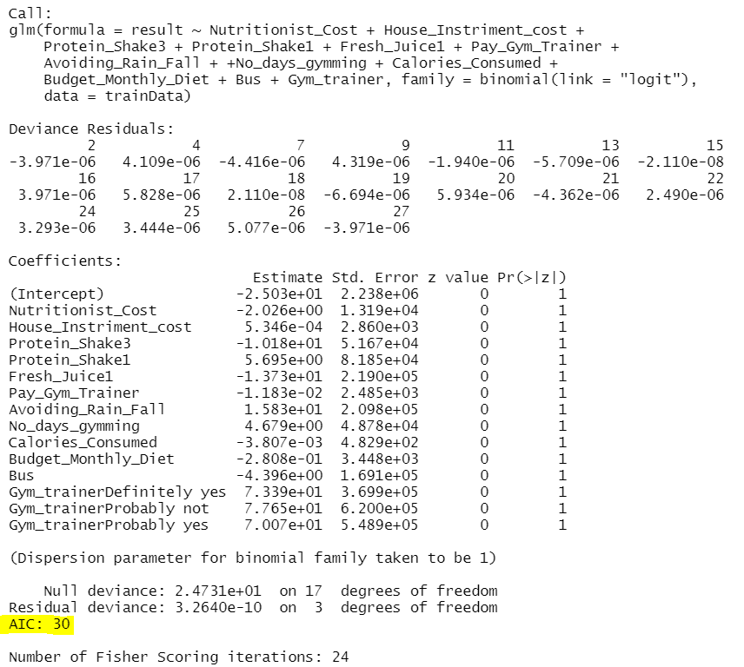
MODEL 1: GLM
AUC: 87%
AIC:30

Slide 13
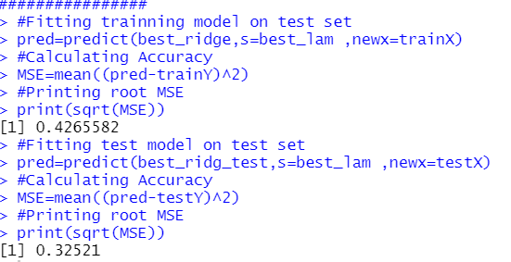
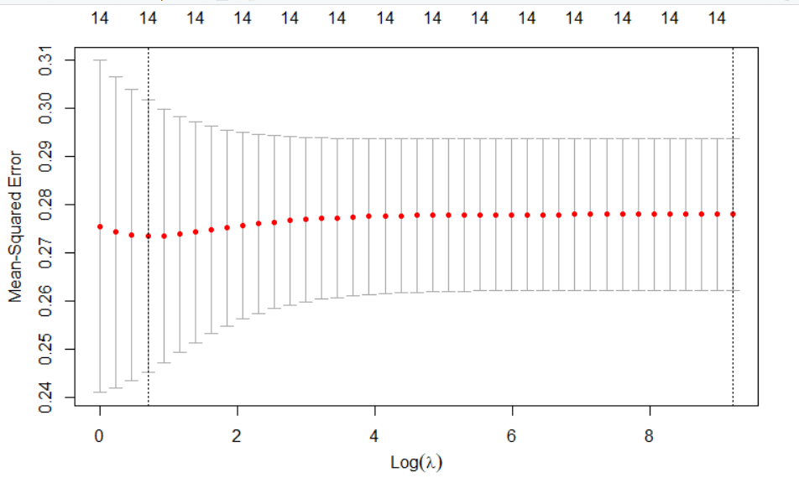
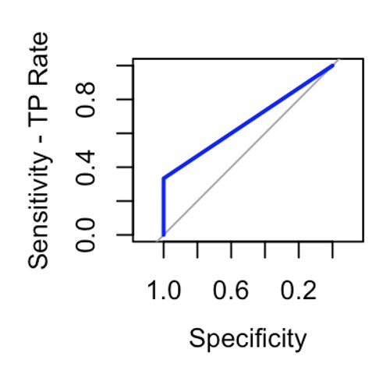
MODEL 2: Ridge Model
AUC: 60.5%

Slide 14
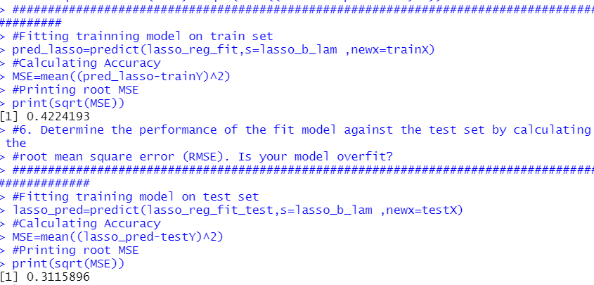
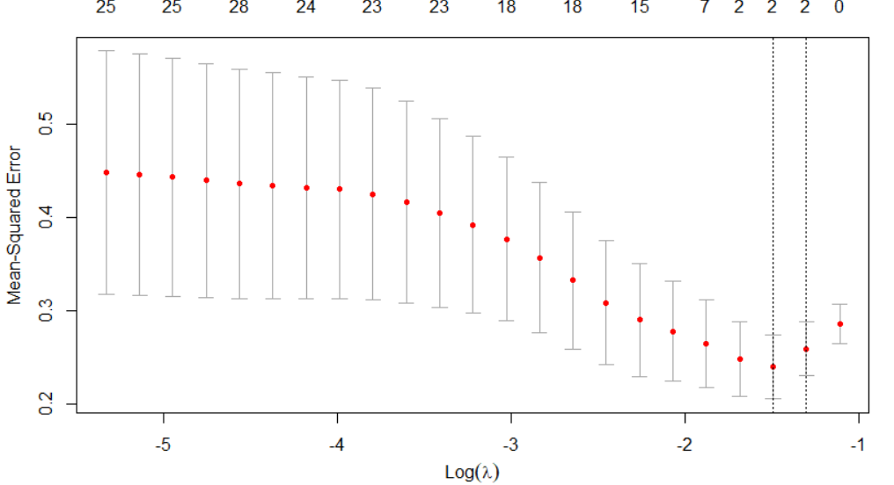
MODEL 2: Lasso Model
AUC: 62%

Slide 15
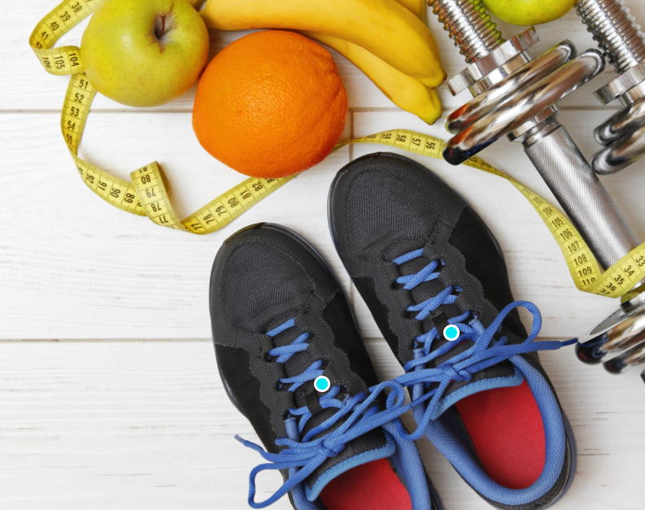
Conclusion : -
Best result was given by GLM than ridge and lasso model with 87 percent accuracy!
The student needs to considered this parameter as listed in the model to have a healthy life with an average budget of 149.28.

Slide 16

Thank You

