Slide 1
Roles in Data Analytics
By:-
Jeseeka Shah
Nuid-002134289

Slide 2
Roles in Data analytics are :-
1)Business Intelligence
2)Business Analyst
3)Data Analyst
4)Data Engineer
5)Data Scientist
6)AI/ML Engineer
1

Slide 3
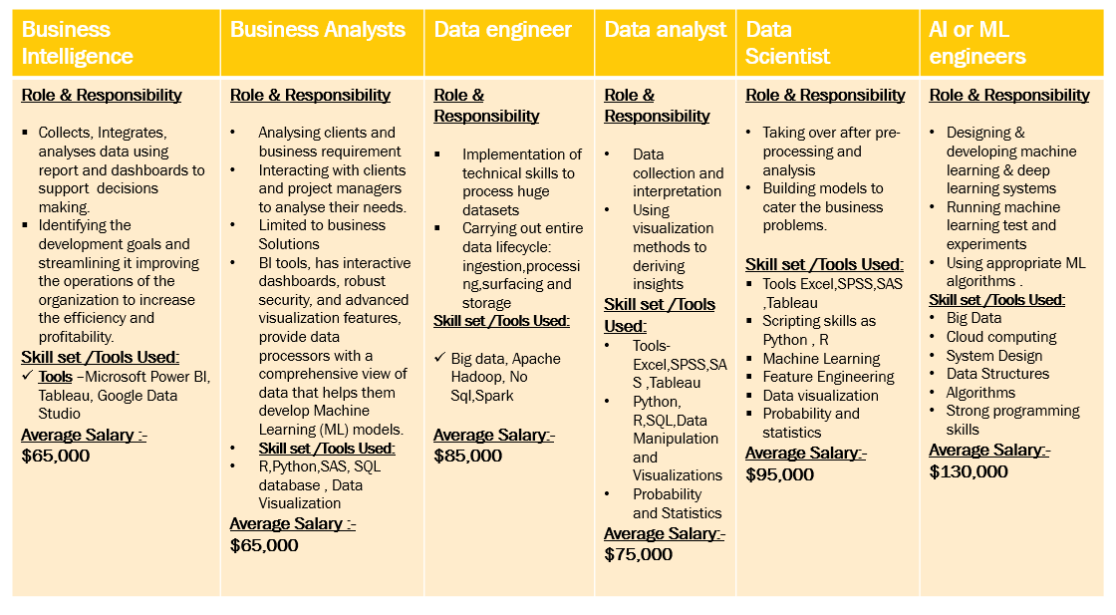

Slide 4
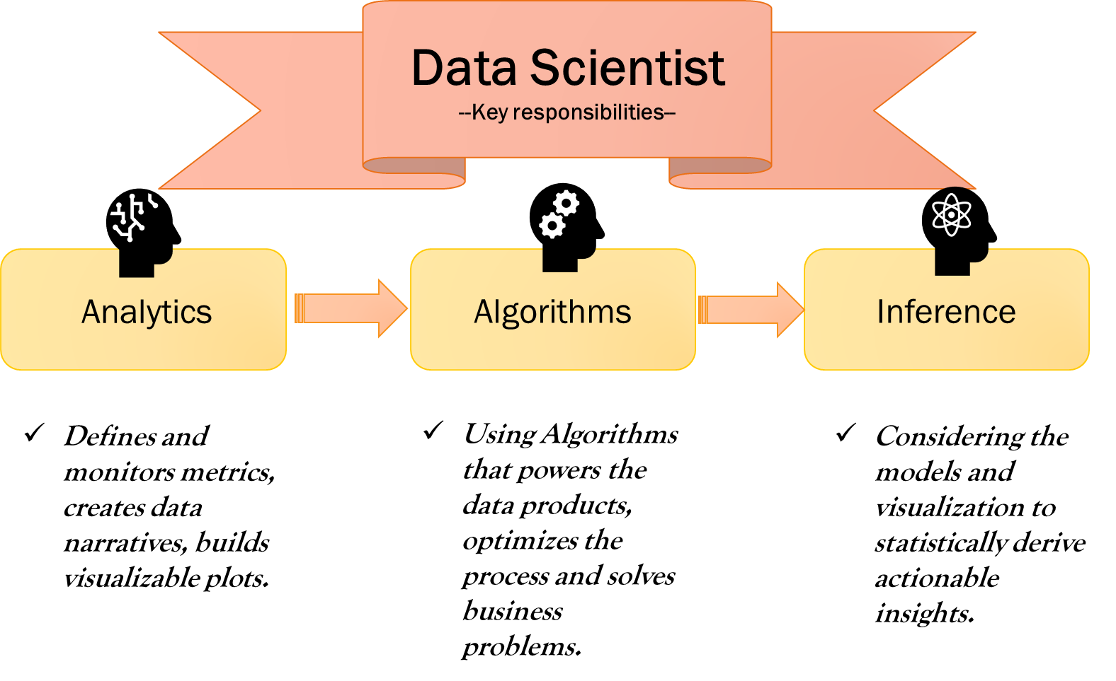

Slide 5








Database Knowledge
Statistics
Data wrangling
Programming tools
Big Data Technologies
Machine Learning
Data Visualization
5

Slide 6
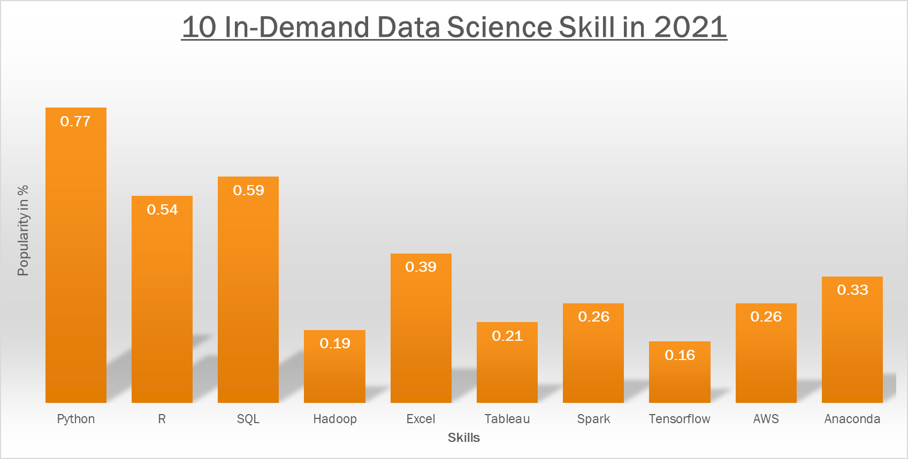
Courtesy data source:- Kdnuggets and PayScale ,Plotting using R studio

Slide 7
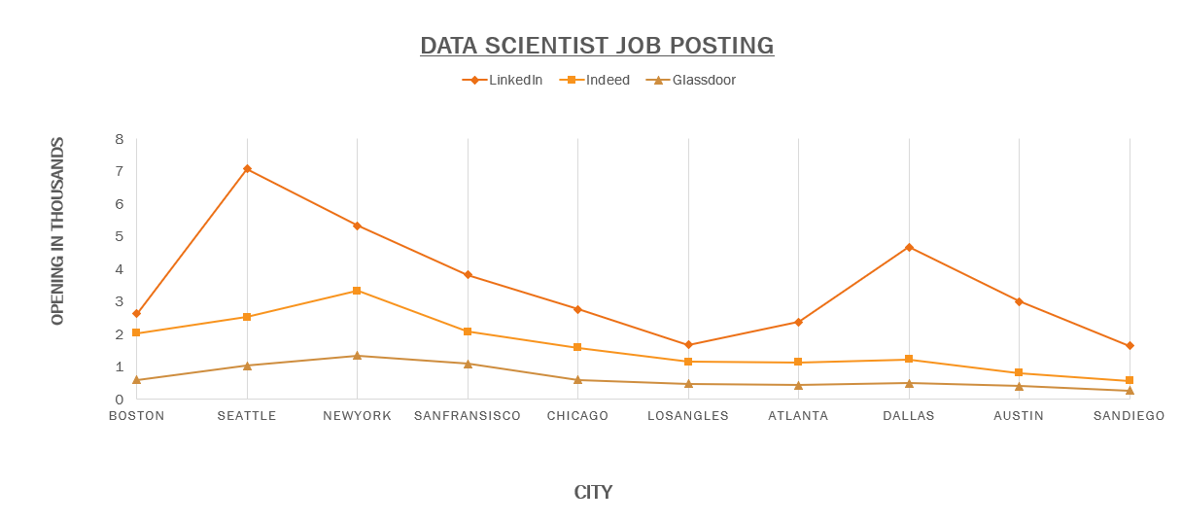
Courtesy data source:-LinkedIn, Indeed and Glassdoor, Plotting using R studio

Slide 8
Courtesy data source:-LinkedIn, plotting using R studio
(Note: the classification of industry in LinkedIn is user defined and subject to inconsistencies in the data).

Slide 9
Reference
The different data science roles in the industry. (n.d.). KDnuggets. https://www.kdnuggets.com/2015/11/different-data-science-roles-industry.html
What is the Role of a business analyst in a Company? (2021, June 28). Analytics Vidhya. https://www.analyticsvidhya.com/blog/2021/06/what-is-a-business-analyst-and-what-is-the-role-of-a-business-analyst-in-a-company/
Foote, K. D. (2018, September 25). A Brief History of Analytics. DATAVERSITY. https://www.dataversity.net/brief-history-analytics/
Zaheer, Z. (n.d.). Amazon Data Scientist Salaries | $170k-577k+. Levels.Fyi. https://www.levels.fyi/company/Amazon/salaries/Data-Scientist/
The University of Adelaide. (2020, August 10). Data Scientist vs Data Analyst vs Data Engineer. University of Adelaide. https://online.adelaide.edu.au/blog/data-scientist-vs-data-analyst-vs-data-engineer
View all posts by GilPress →. (2011, September 23). Big Data Bytes of the Week: The End of Big Data? What’s The Big Data? https://whatsthebigdata.com/2011/09/23/big-data-bytes-of-the-week-the-end-of-big-data/
Team, T. A. I. (2020, December 11). Know What Employers are expecting for a Data Scientist Role. Towards AI — The World’s Leading AI and Technology Publication. https://towardsai.net/p/careers/know-what-employers-are-expecting-for-a-data-scientist-role-in-2020-65ad68553cc4

Slide 10
Thank you.

