Slide 1

Group Project 1 “Snow Way”
Jesus Guerrero Naomi Douglas Carter Griffin

Slide 2

USER
Problem Definition
Ice Cream shoppers cannot truly see what they will eat, until it is already served to them.

Slide 3
General Requirements
Recipe Card Animations
Step-by-Step Instructions
Ingredient Checklist
Hover Highlight
Responsive Layout

Slide 4
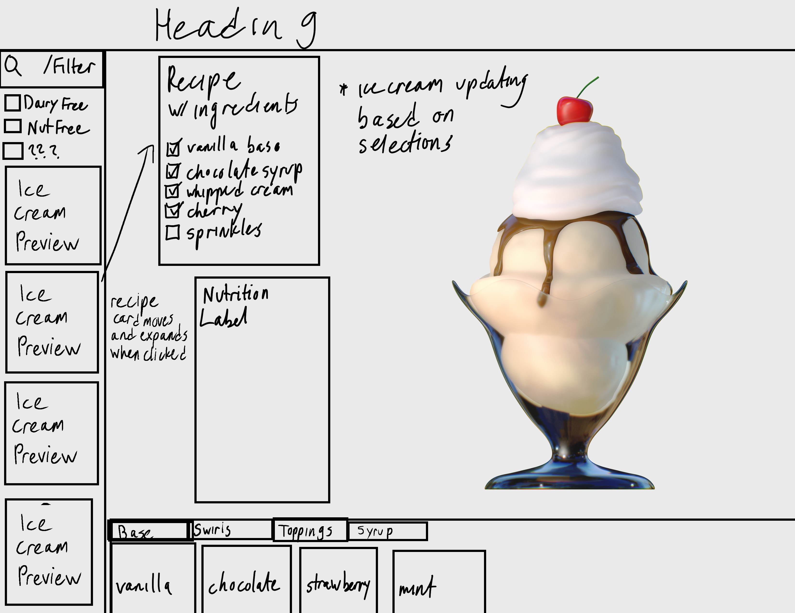
Design

Slide 5
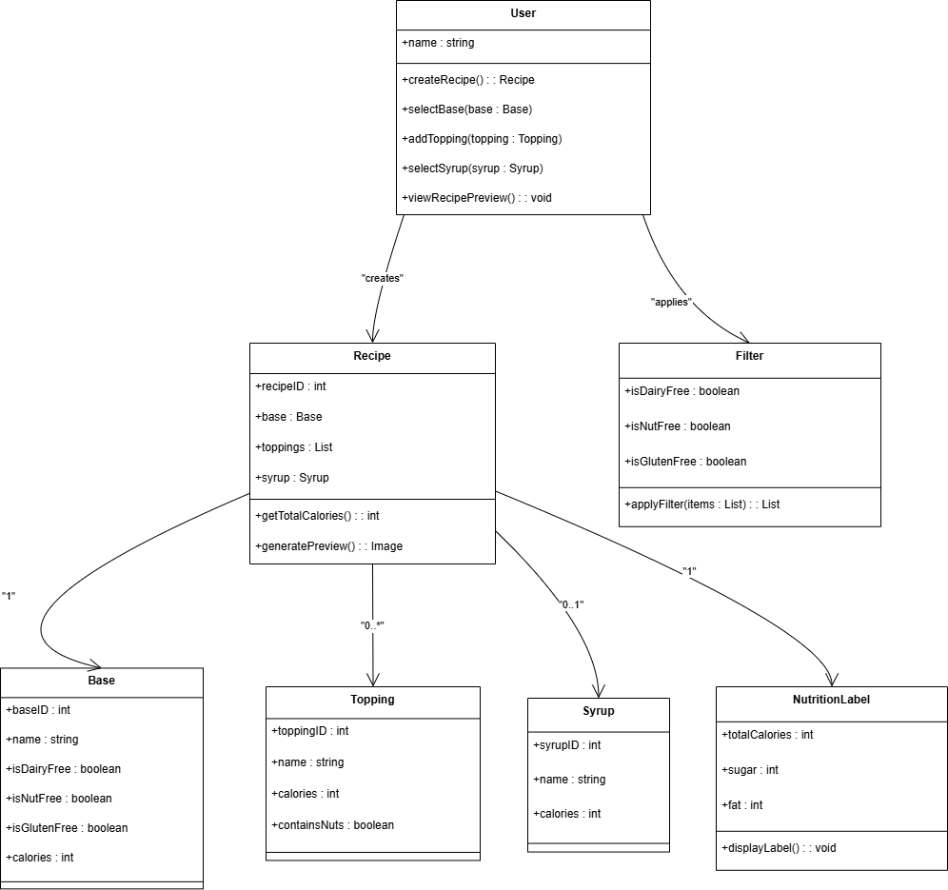
UML Class Diagram

Slide 6
Key Features
Ingredient Selection
Popular Flavors Selection
Ice Cream Selection Visual
Recipe/ Nutrition Labels

Slide 7
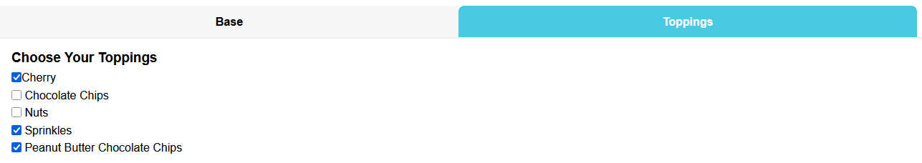
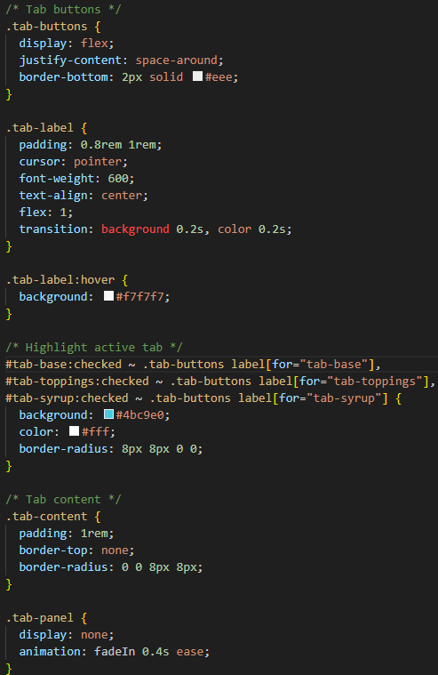
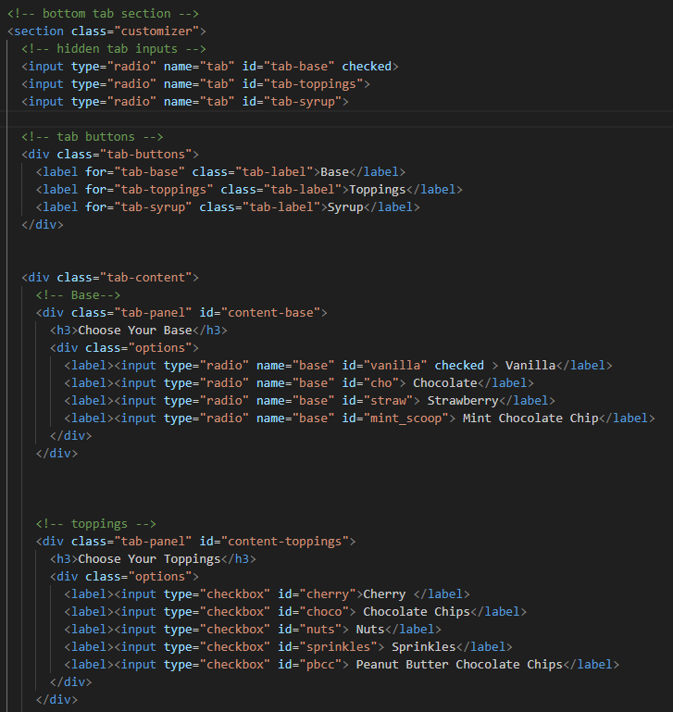
Ingredient Selection

Slide 8
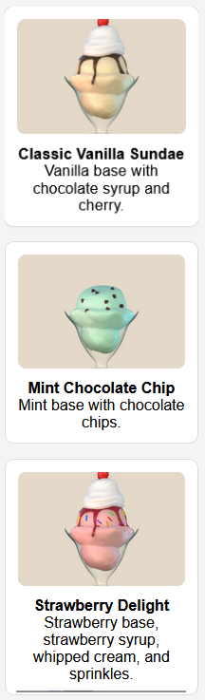
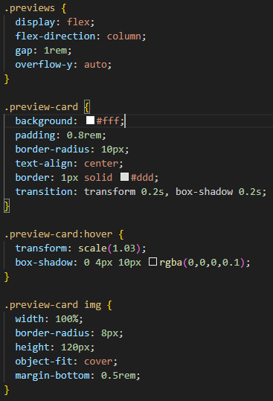
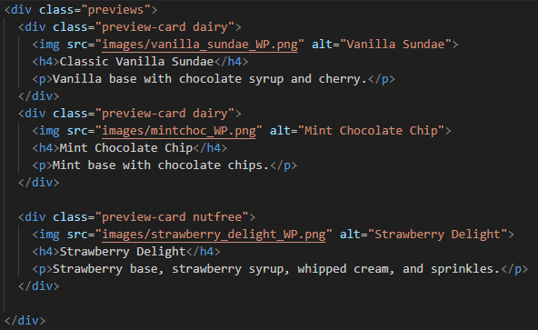
Popular Flavors Selection

Slide 9
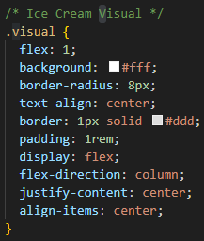
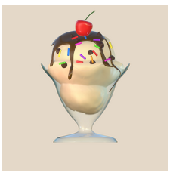
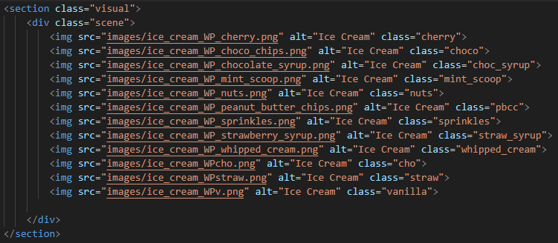
Ice Cream Selection Visualizer

Slide 10
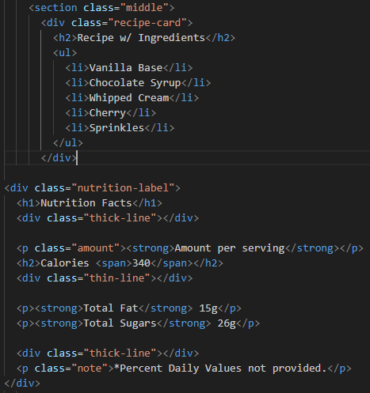
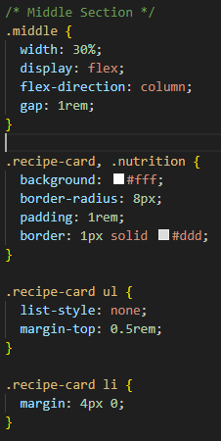
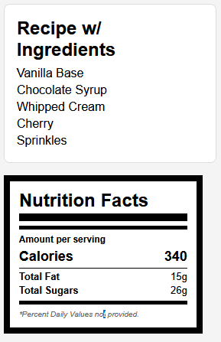
Recipe/ Nutrition Labels

Slide 11
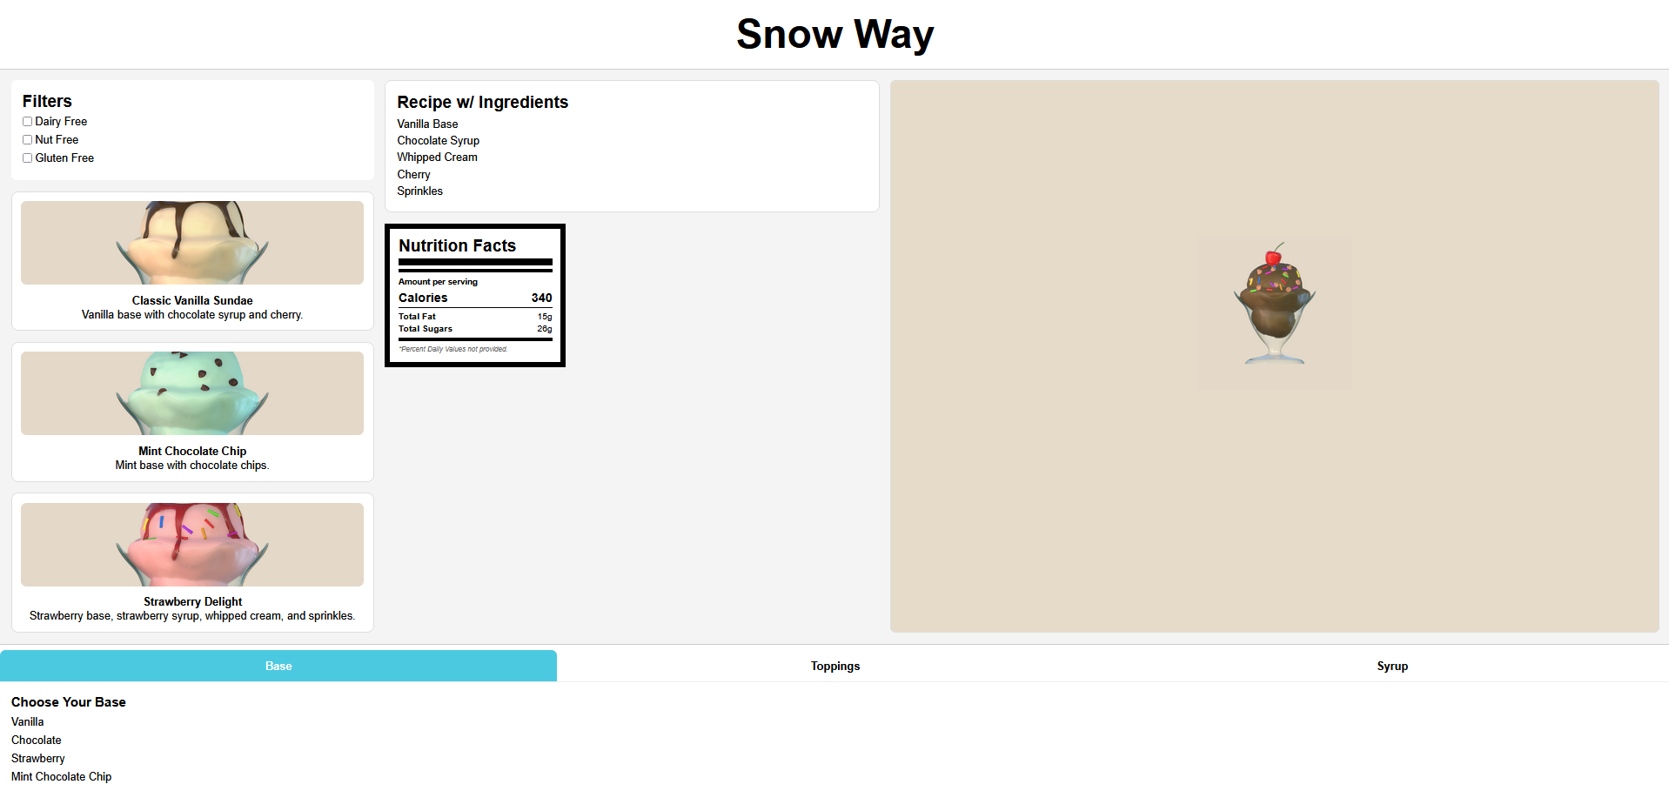
Finished Design

Slide 12
DEMO RUN

Slide 13
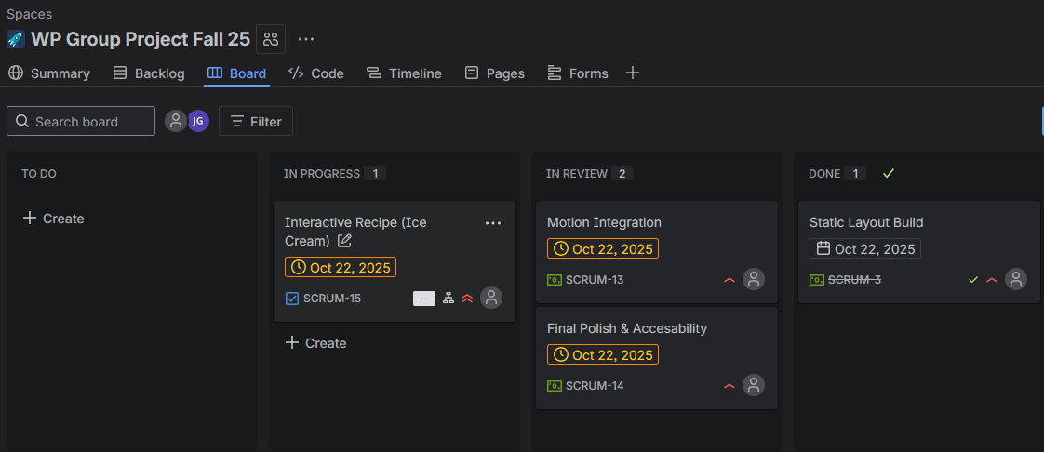
Jira
Pros
Cons
Visible Progress
Easily Categorized
Adaptability
Learning Curve
Difficulty Integrating with GitHub
Not useful for frequent communication

