Slide 1

Group Project 1 “Snow Way”
Jesus Guerrero Naomi Douglas Carter Griffin

Slide 2

USER
Problem Definition
Ice Cream shoppers cannot truly see what they will eat, until it is already served to them.

Slide 3
General Requirements
Recipe Card Animations
Step-by-Step Instructions
Ingredient Checklist
Hover Highlight
Responsive Layout

Slide 4
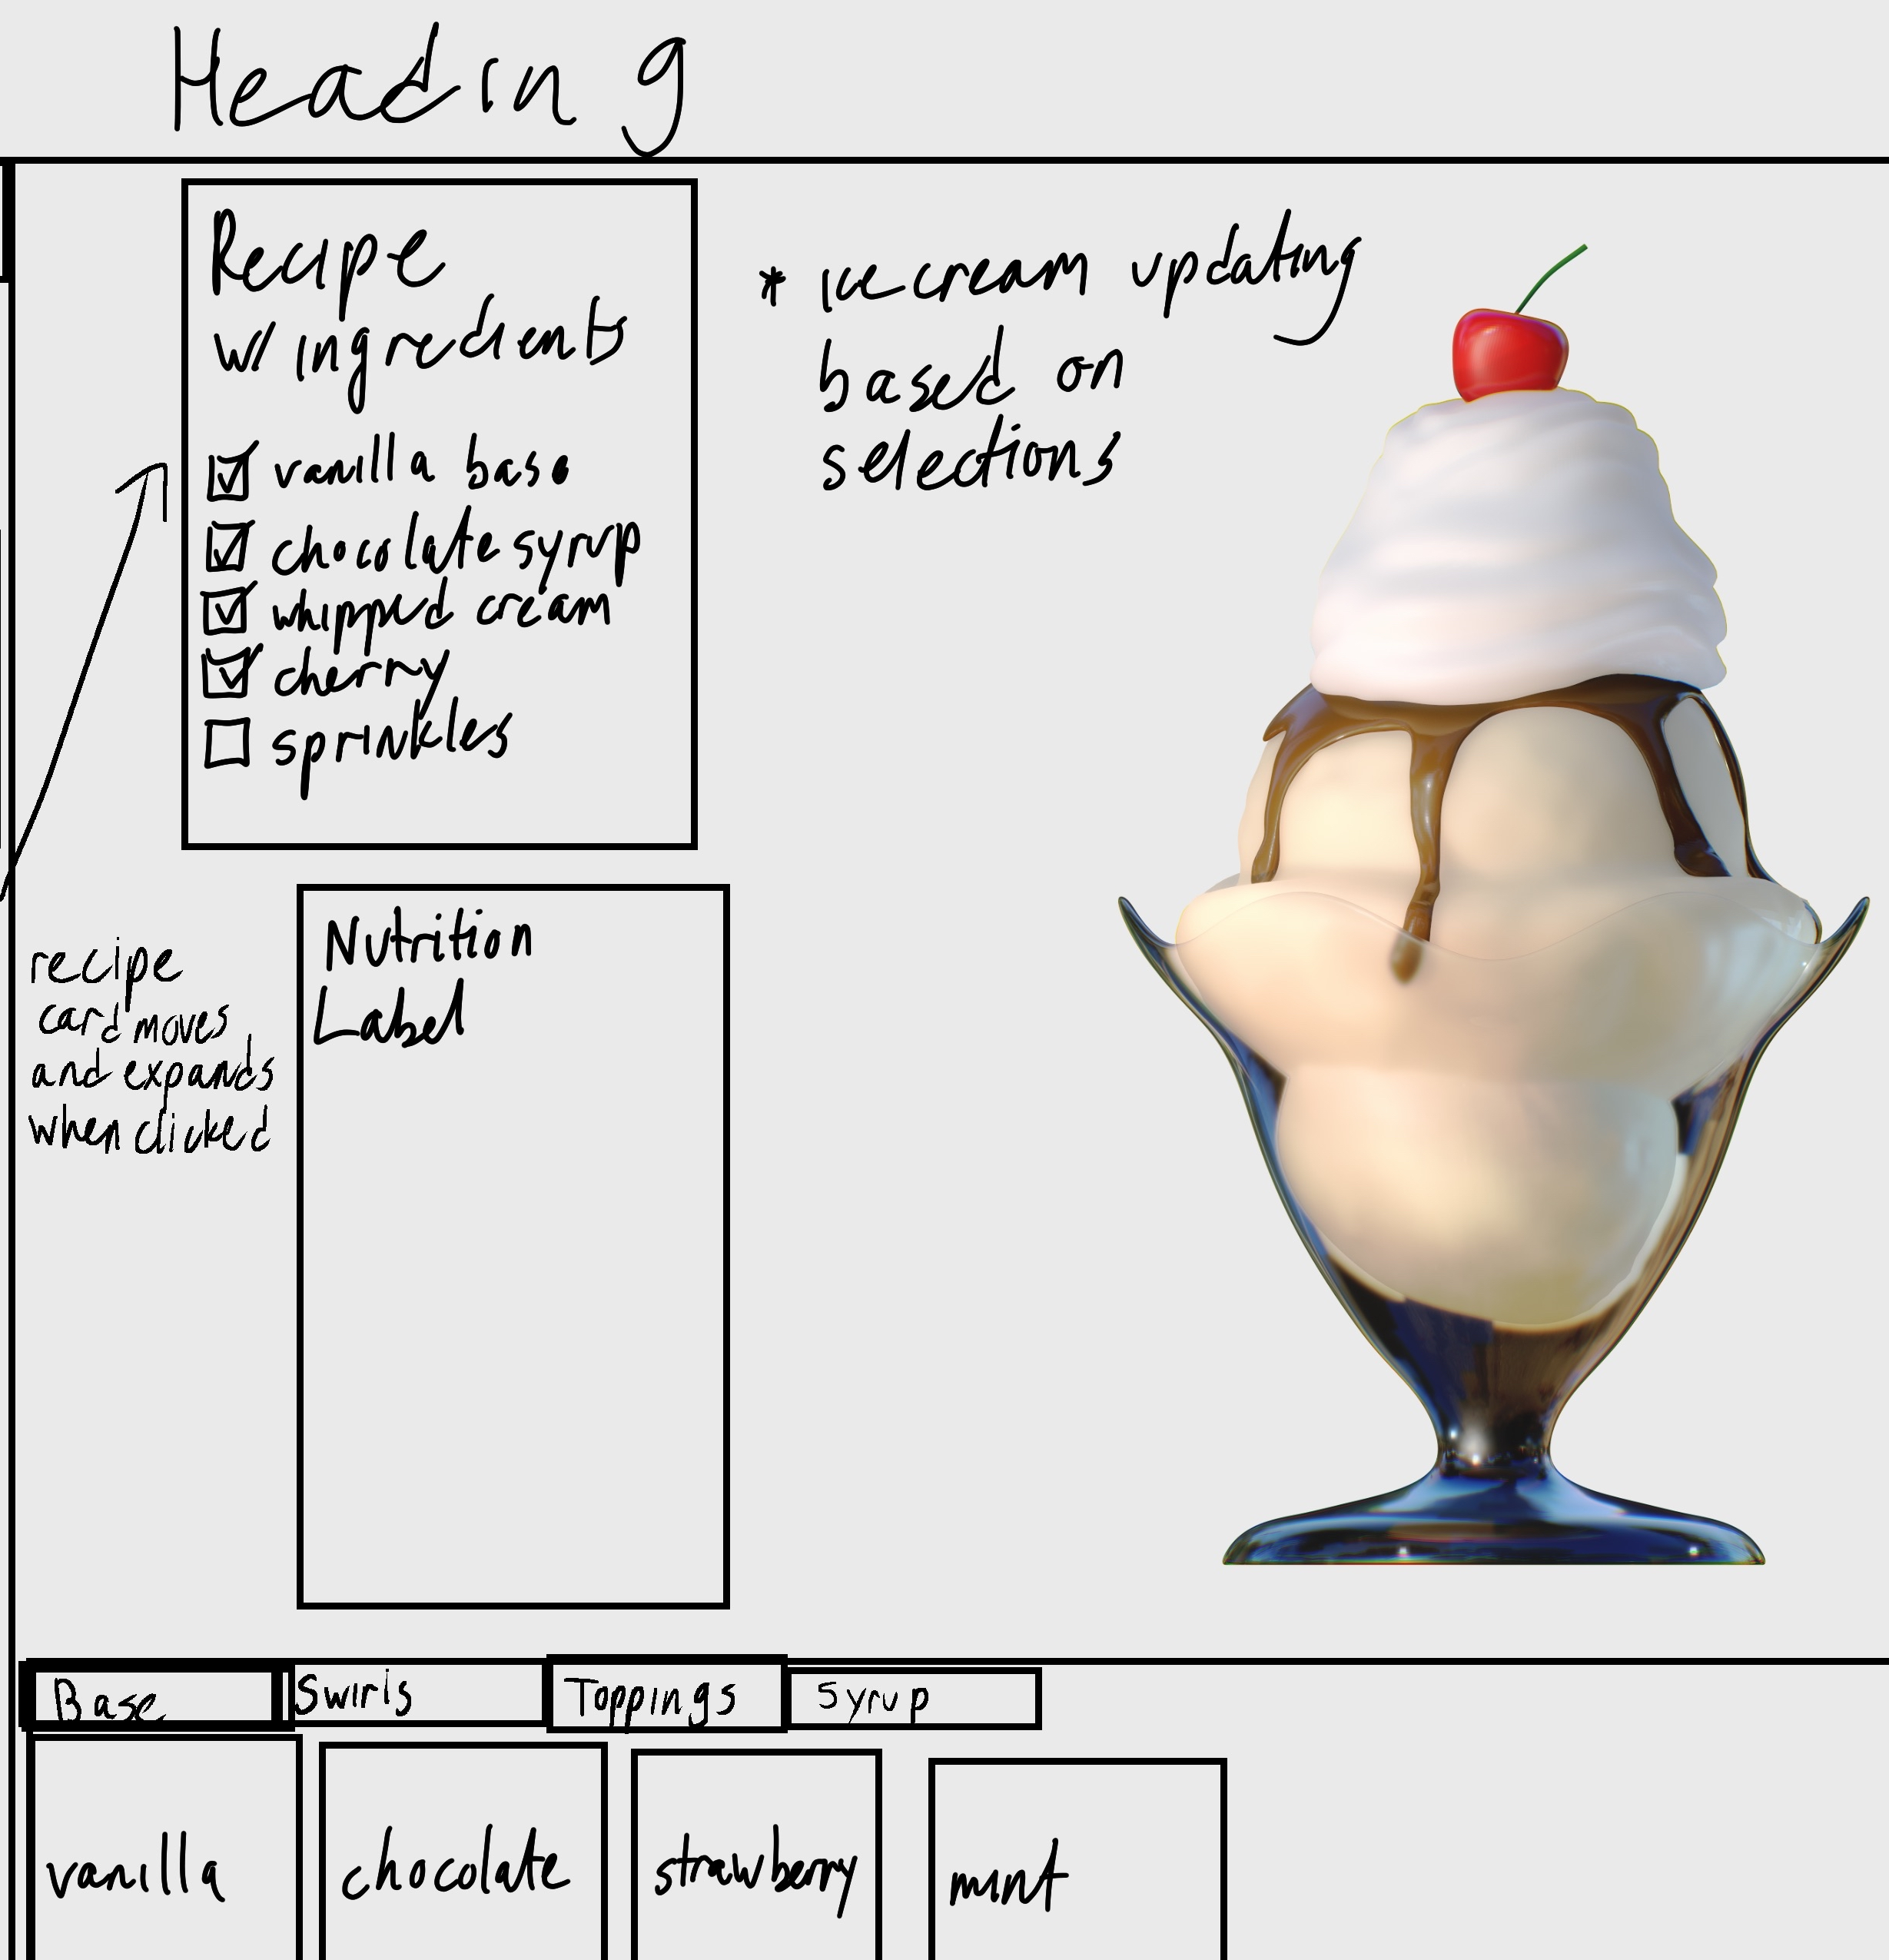
Design

Slide 5
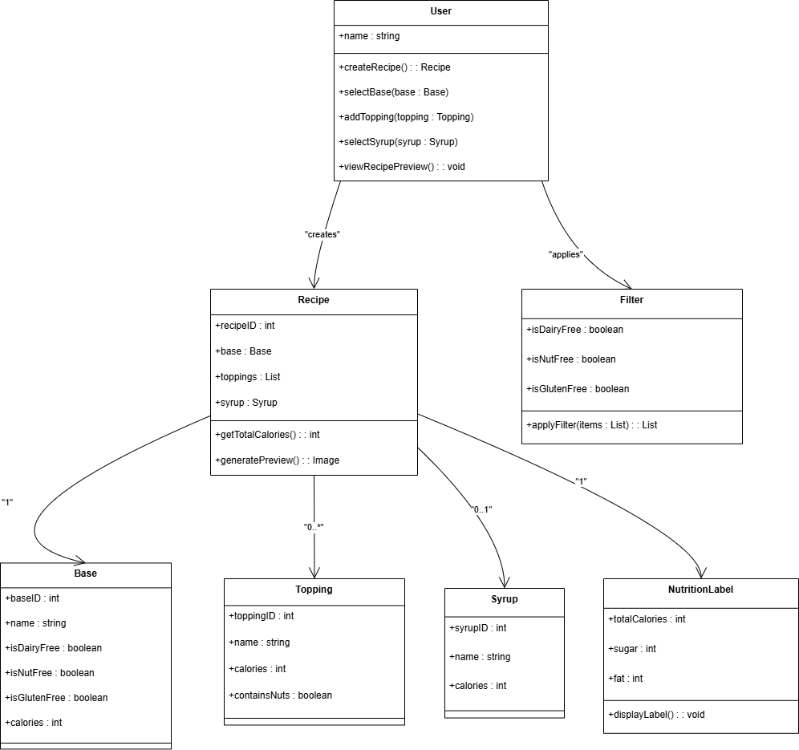
UML Class Diagram

Slide 6
Key Features
Ingredient Selection
Popular Flavors Selection
Ice Cream Selection Visual
Recipe/ Nutrition Labels

Slide 7
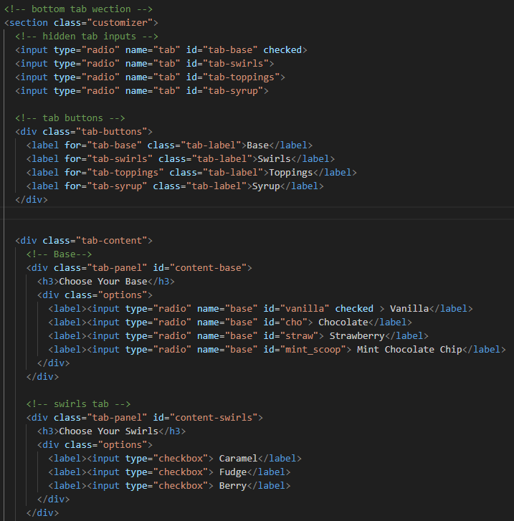
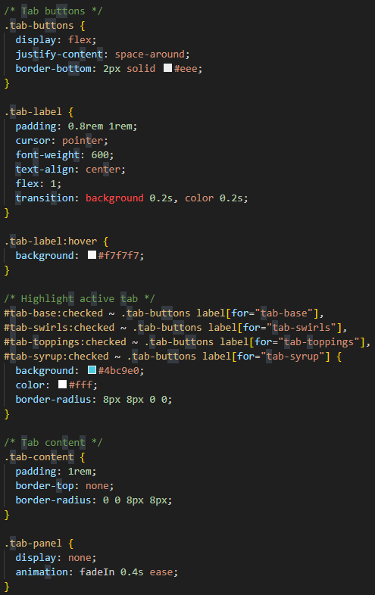
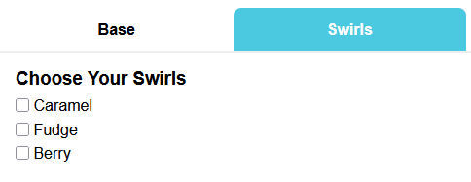
Ingredient Selection

Slide 8
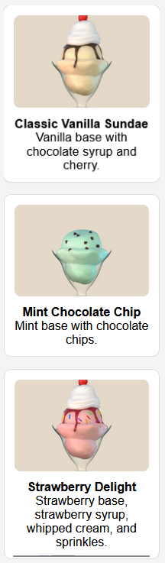
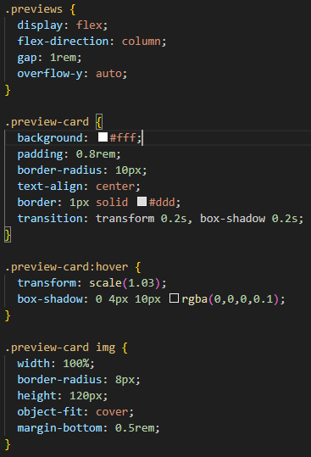
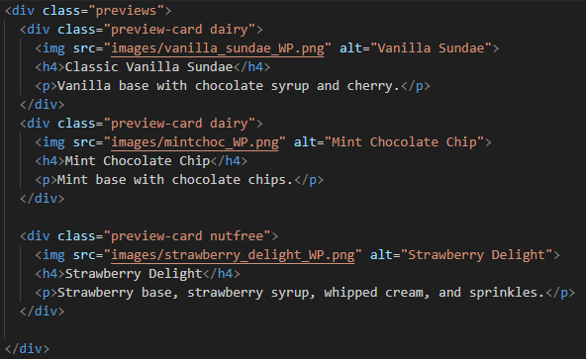
Popular Flavors Selection

Slide 9
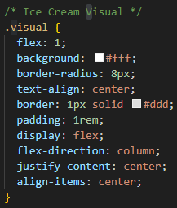

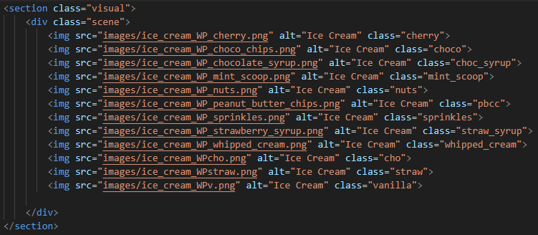
Ice Cream Selection Visualizer

Slide 10
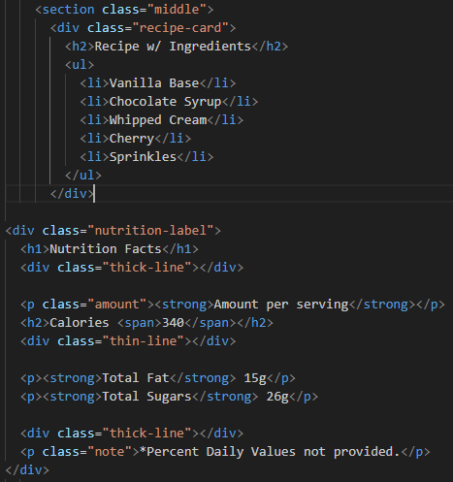
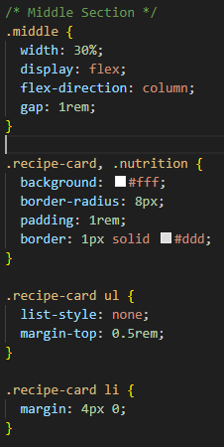
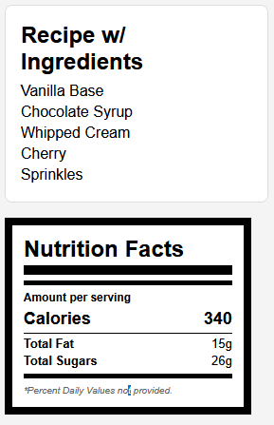
Recipe/ Nutrition Labels

Slide 11
Finished Design

Slide 12
DEMO RUN

