Slide 1
#0 Angular 2.0
Let’s get started with angular-cli

Slide 2
What you need…
Nodejs 6.6 +
Visual Code (Editor)
Git (optional)
If using windows (Required if going to use angular-cli)
npm install --global windows-build-tools ( on window power shell)
npm install –g angular-cli (recommend )

Slide 3
Start a project with angular-cli
Command
$: ng new <project-name>
Example
Command
$: ng new helloworld

Slide 4
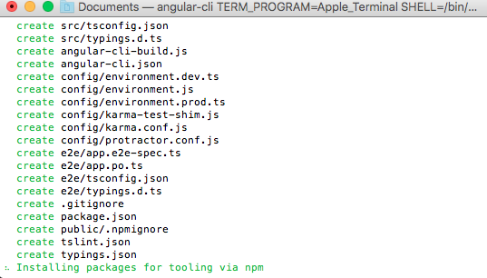
Some process you could skip(If you have files)
Create needed files
Download library

Slide 5
CTRL + C
Terminate to process

Slide 6
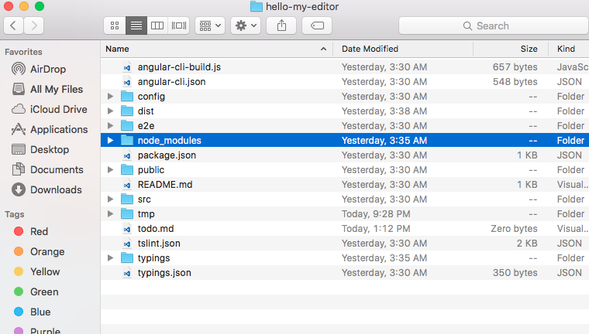
Terminate process and copy node_modules

Slide 7
Change directory to your project
Command
$: cd <project-name>
Example
Command
$: cd helloworld

Slide 8
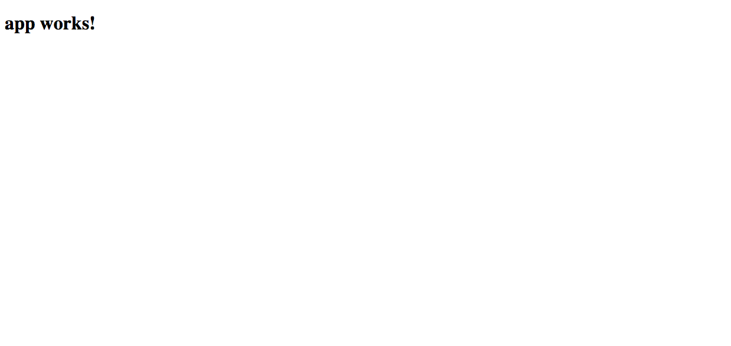
Run it
Command
$: ng serve
localhost:4200

Slide 9
Files that matter!

Slide 10
Use Git SVN

Slide 11
Commit and push your change
Command
$: git push

