Slide 1
#1 Basic Component
For Angularjs2 By Sompop Kulapalanont

Slide 2
What we want to do

Slide 3
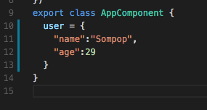
app.component.ts

Slide 4
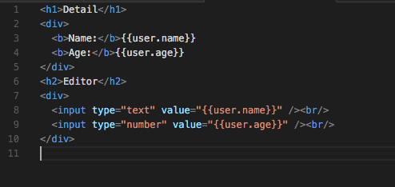
app.component.html

Slide 5
Not 2 ways binding! Why?

Slide 6
app.component.html
No NG Model

Slide 7
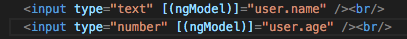
app.component.html

Slide 8
app.component.ts

Slide 9
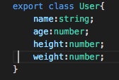
user.ts

Slide 10
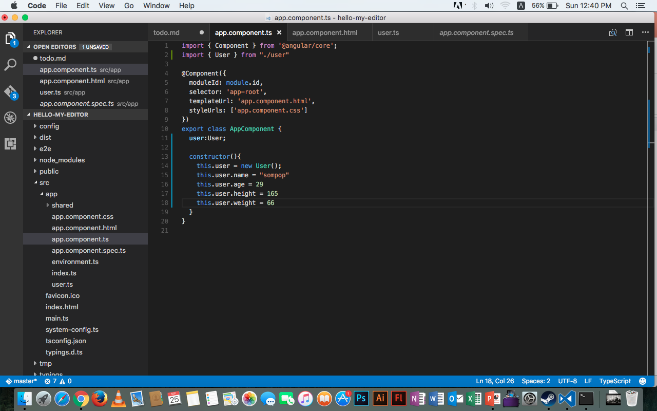
app.component.ts

Slide 11
app.component.ts

Slide 12
Fun Fact
this in typescript will always refer to property of it’s class
this in Java Script is not

Slide 13
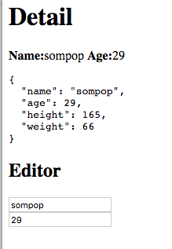
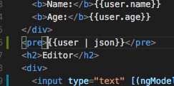
Simple Debug method via view

Slide 14
Add Behavior to user

Slide 15
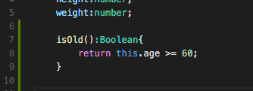
user.ts

Slide 16
Fun Fact!
Be able to assign data type is one of the strong point of Type Script

Slide 17
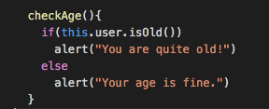
app.component.ts

Slide 18
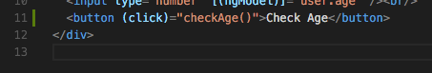
app.component.ts

Slide 19
Display data with conditional

Slide 20
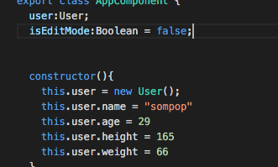
app.component.ts

Slide 21
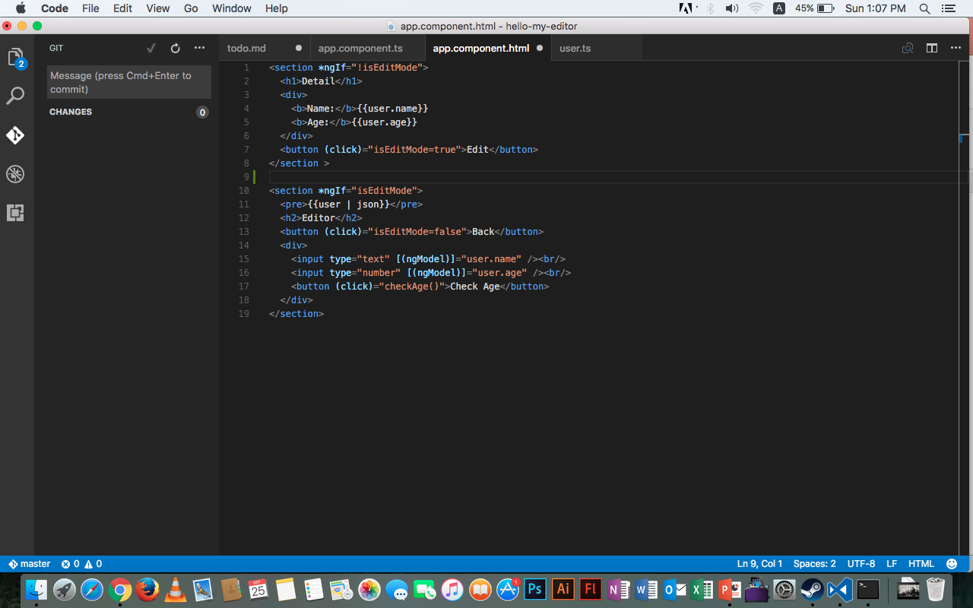
app.component.html

Slide 22
app.component.html
\

Slide 23
Check Health
Lab work #1

Slide 24
Detail
Add user’s behavior isHealty():boolean to determine either if user is healthy or not healthy
If user is healthy 3.5 >= height:weight >= 2
Otherwise user is not healthy
add method checkHealth() in app.component.ts to check if user is healthy
Report the result of checkHealth() via alert
Add button to call checkHealth()

Slide 25
What we want to do

