Slide 1
#2 Master / Detail
ngFor

Slide 2
What we try to do

Slide 3
Step 1.
Create array of users

Slide 4
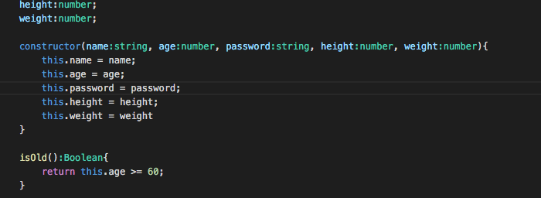
Build constructor on user.ts
Why? Because every user need all of these properties

Slide 5
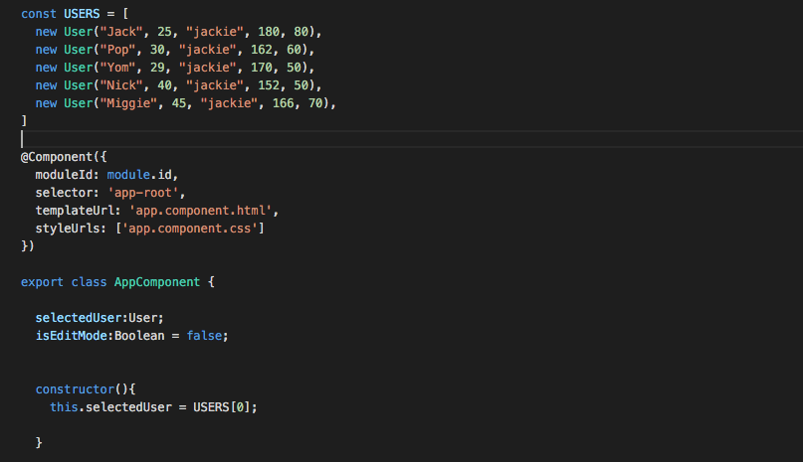
Create USERS on app.component.ts

Slide 6
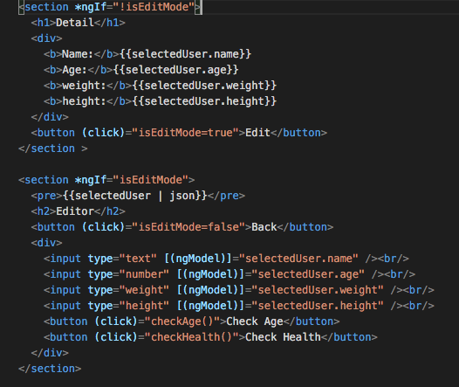
Update template
user => selectedUser

Slide 7
Step 2.
Create a users selector

Slide 8
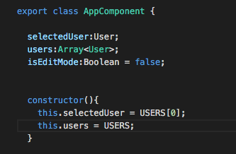
Create property users in app.component.ts
Declare type of users
Assign users

Slide 9
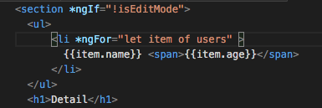
Use *ngFor to display array in app.component.html

Slide 10
Fun Fact
let is kinda like var but make more sense like other programming lang
From my experience Angular 1 Developer likely to use of instead of in which make it error. Example let item in items instead of item of items
Which mean if you got error from *ngFor make sure it’s of not in

Slide 11
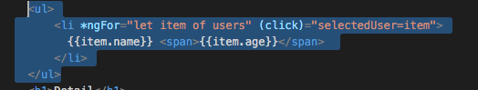
Add Event click in item of users

Slide 12
Step 3.
Add some style

Slide 13
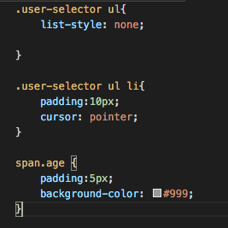
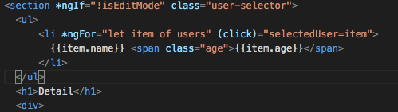
app.component.css / app.component.html

