Slide 1
Life cycle
angularjs

Slide 2
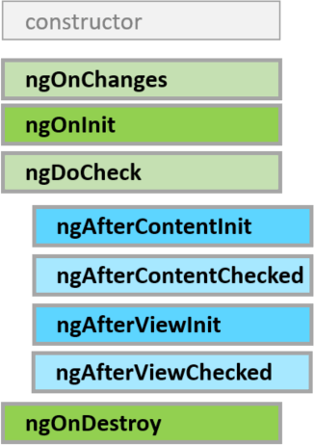
Lifecycle Hook
Angular calls lifecycle hook methods on
directives and components
as it creates, changes, and destroys them.
https://angular.io/docs/ts/latest/guide/lifecycle-hooks.html

Slide 3
Example
{{hello}}
Update on Hook Method
class AppComponent {
hello = “Hello”
}
<input type=“text” [(ngModel)]=“hello” />
Directives which make you bind input with AppComponent.hello
(that created by angular)

Slide 4
Example
{{hello}}
<input type=“text” [(ngModel)]=“hello” />
Update on Hook Method

Slide 5
Example
Hello
{{hello}}
Update on Hook Method
Hello
<input type=“text” [(ngModel)]=“hello” />
Directives which make you bind input with AppComponent.hello
(that created by angular)

Slide 6
Example
Every {{ }} update it value
Hell
Angular calls lifecycle hook methods on
directives and components
as it creates, changes, and destroys them.
Hell
Have some update make Angular call
Lifecycle Hook Method

Slide 7
Example
Every {{ }} update it value
Hell
Hell
Input properties have change call onChanges

Slide 8
Example

Slide 9
Example
Hello
{{hello}}
Update on Hook Method
Hello
<input type=“text” value=“{{hello}}” />
Update on Hook Method

Slide 10
Example
{{hello}}
Update on Hook Method
class AppComponent {
hello = “Hello”
}
<input type=“text” value=“{{hello}}” />
Update on Hook Method

Slide 11
Example
{{hello}}
Update on Hook Method
<input type=“text” value=“{{hello}}” />
Update on Hook Method

Slide 12
Example
Hello
{{hello}}
Update on Hook Method
Hello
<input type=“text” value=“{{hello}}” />
Update on Hook Method

Slide 13
Example
Nothing change
Hello
Angular calls lifecycle hook methods on
directives and components
as it creates, changes, and destroys them.
Hell
Input properties have change but wont call
Lifecycle Hook method
Because don’t use directive [(ngModel)]

