Slide 1
Pipe
Transform displayed values within a template.

Slide 2
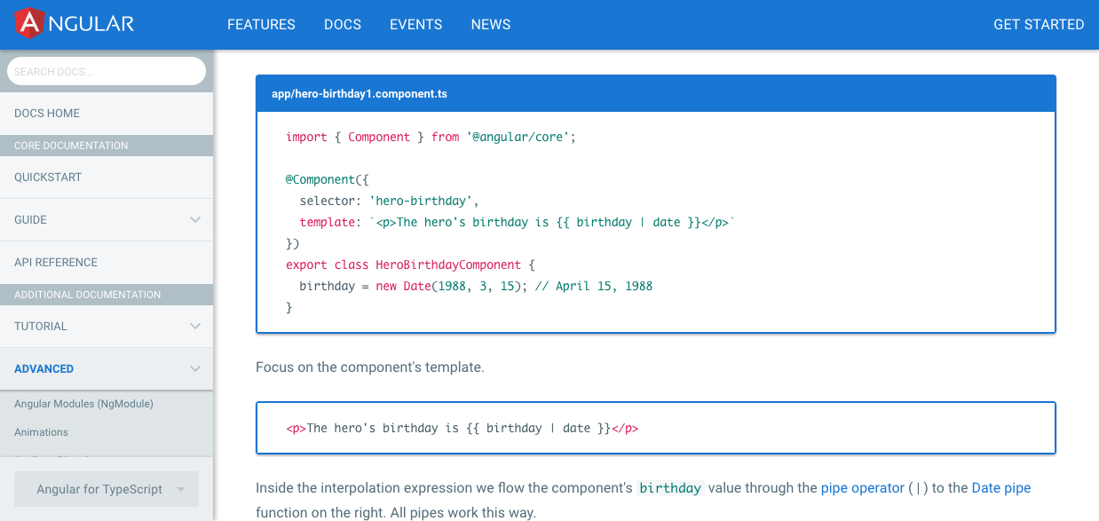
Using Pipe

Slide 3
Using Pipe
Apr 15, 1988

Slide 4
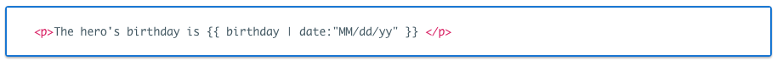
Parameterizing a Pipe
04/15/88

Slide 5
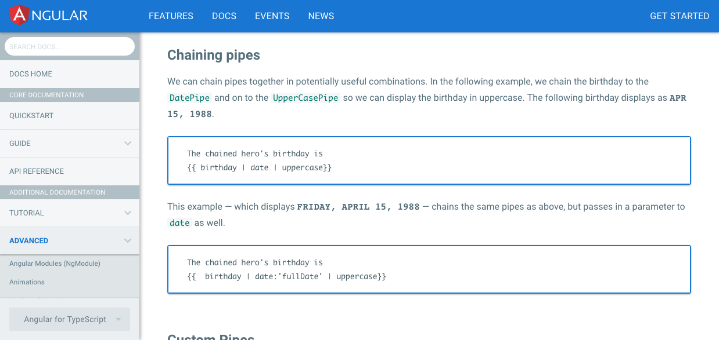
Chaining a Pipe
APR 15, 1988.
FRIDAY, APRIL 15, 1988

Slide 6
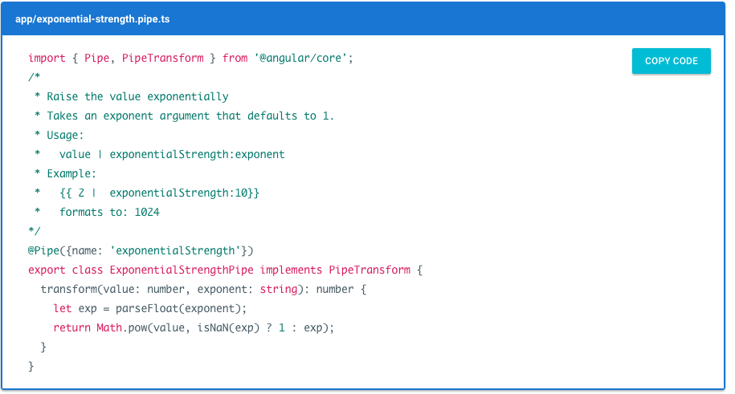
Custom Pipe

Slide 7
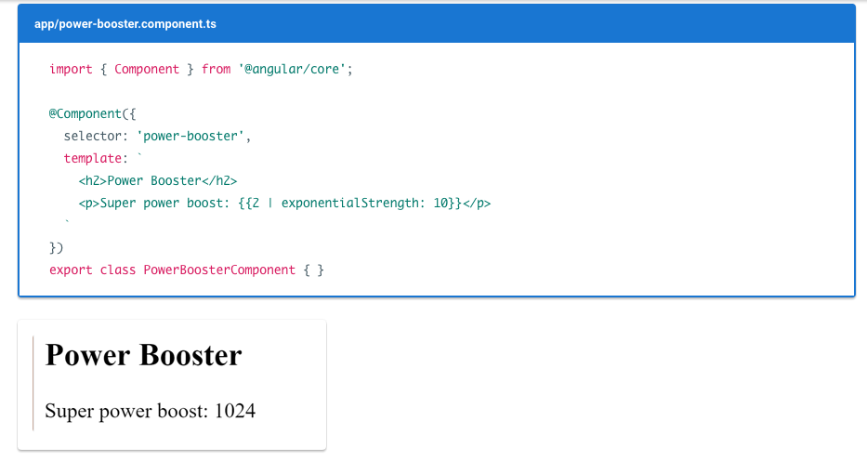
Custom Pipe

Slide 8
Pipe and Change Detection
Angular looks for changes to data-bound values through a change detection process that runs after every JavaScript event: every keystroke, mouse move, timer tick, and server response. This could be expensive. Angular strives to lower the cost whenever possible and appropriate.
Pipe use Pure or Impure to determined

Slide 9
What we did yesterday
users Array not update
Because The reference to the array hasn't changed.
same array, no change, no display update.
But if we replace the array it would update

Slide 10
Pure Pipes
String
Change Value
Number
Update
Boolean

Slide 11
Pure Pipes
Date
Change Reference (replace)
Array
Update
Function
Object

Slide 12
ImPure Pipes
every component change detection cycle
Try it now!

