Slide 1
Edge Detection
Computer Vision
Week 5

Slide 2


Slide 3
Learning Outcomes
Understand the concept of edges and image gradients in images.
Apply first and second derivatives to detect edges mathematically.
Use Sobel and Prewitt operators and compare their performance.
Explain and implement the steps of the Canny edge detector.
Analyze the impact of scale and thresholding in edge detection results.

Slide 4

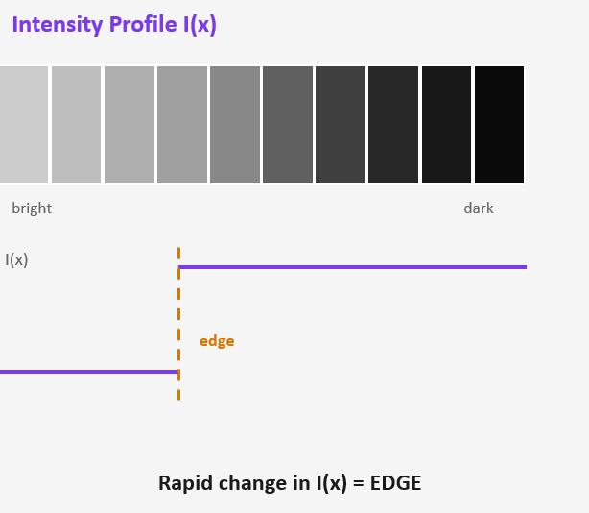
What is an Edge?
Introduction
What is an Edge?
Image Gradient
Derivatives
First Derivative
Second Derivative
First Vs Second Derivative
Edge Detection Operators
Sobel Kernels
Prewitt Operators
Sobel vs Prewitt
Canny Edge Detector
Overview
Gaussian Smoothing
Gradient Calculation
Non-Maximum Suppression (NMS)
Double Thresholding
Edge Tracking (Hysteresis)
Hysteresis Tracking Logic
Practical Issues
Scale Issues
Thresholding Issues
Common Thresholding Problems
Choosing T_low and T_high
Definition:
An edge is a location in an image where pixel intensity changes rapidly.
Edges arise from:
Surface discontinuities
Depth discontinuities
Illumination changes
Texture boundaries

Slide 5
Image Gradient
Introduction
What is an Edge?
Image Gradient
Derivatives
First Derivative
Second Derivative
First Vs Second Derivative
Edge Detection Operators
Sobel Kernels
Prewitt Operators
Sobel vs Prewitt
Canny Edge Detector
Overview
Gaussian Smoothing
Gradient Calculation
Non-Maximum Suppression (NMS)
Double Thresholding
Edge Tracking (Hysteresis)
Hysteresis Tracking Logic
Practical Issues
Scale Issues
Thresholding Issues
Common Thresholding Problems
Choosing T_low and T_high
The gradient vector at pixel (x, y):
Key Properties
∇I = [ ∂I/∂x , ∂I/∂y ]ᵀ
∇I ⊥ edge | Gradient is perpendicular to the edge direction
High |∇I| | Strong edges have large magnitude
θ encodes | Angle tells us edge orientation (H/V/diagonal)
Discrete ≈ | Finite differences replace true derivatives
Gradient vector (direction of max increase)
|∇I| = √( (∂I/∂x)² + (∂I/∂y)² )
Gradient magnitude = edge strength
θ = atan2( ∂I/∂y , ∂I/∂x )
Gradient direction = edge orientation

Slide 6
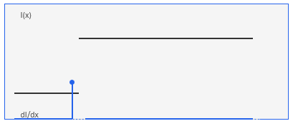

1st Derivative
Introduction
What is an Edge?
Image Gradient
Derivatives
First Derivative
Second Derivative
First Vs Second Derivative
Edge Detection Operators
Sobel Kernels
Prewitt Operators
Sobel vs Prewitt
Canny Edge Detector
Overview
Gaussian Smoothing
Gradient Calculation
Non-Maximum Suppression (NMS)
Double Thresholding
Edge Tracking (Hysteresis)
Hysteresis Tracking Logic
Practical Issues
Scale Issues
Thresholding Issues
Common Thresholding Problems
Choosing T_low and T_high
03
Definition
Measures rate of intensity change.
Properties
Detects edges at maximum gradient values
Less sensitive than second derivative
Widely used in practice
First Derivative dI/dx
dI/dx ≈ I(x+1) - I(x-1)
Edge = PEAK in |dI/dx|

Slide 7
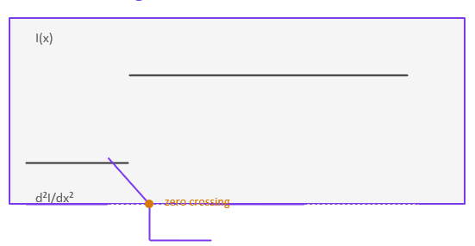

2nd Derivative
Introduction
What is an Edge?
Image Gradient
Derivatives
First Derivative
Second Derivative
First Vs Second Derivative
Edge Detection Operators
Sobel Kernels
Prewitt Operators
Sobel vs Prewitt
Canny Edge Detector
Overview
Gaussian Smoothing
Gradient Calculation
Non-Maximum Suppression (NMS)
Double Thresholding
Edge Tracking (Hysteresis)
Hysteresis Tracking Logic
Practical Issues
Scale Issues
Thresholding Issues
Common Thresholding Problems
Choosing T_low and T_high
Definition
Measures rate of change of gradient.
Properties
Detects edges at zero-crossings
More sensitive to noise
Used in Laplacian-based methods
Second Derivative d²I/dx²
d²I/dx² ≈ I(x+1) - 2I(x) + I(x-1)
Edge = ZERO CROSSING of d²I/dx²

Slide 8
1st Vs 2nd Derivative
Introduction
What is an Edge?
Image Gradient
Derivatives
First Derivative
Second Derivative
First Vs Second Derivative
Edge Detection Operators
Sobel Kernels
Prewitt Operators
Sobel vs Prewitt
Canny Edge Detector
Overview
Gaussian Smoothing
Gradient Calculation
Non-Maximum Suppression (NMS)
Double Thresholding
Edge Tracking (Hysteresis)
Hysteresis Tracking Logic
Practical Issues
Scale Issues
Thresholding Issues
Common Thresholding Problems
Choosing T_low and T_high
Feature | First Derivative | Second Derivative
Meaning | Measures rate of intensity change | Measures rate of change of gradient
Detects | Edges (gradient magnitude) | Edge locations (zero-crossings)
Output | High at edges | Zero at edge center
Direction Info | Yes (gives edge orientation) | No direction information
Sensitivity to Noise | Less sensitive | More sensitive
Operators | Sobel, Prewitt | Laplacian
Edge Thickness | Produces thicker edges | Produces thin edges
Significance | Detects presence of edge | Pinpoints exact edge location

Slide 9
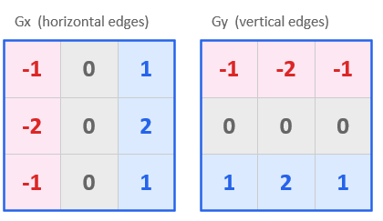

Sobel Kernels
Introduction
What is an Edge?
Image Gradient
Derivatives
First Derivative
Second Derivative
First Vs Second Derivative
Edge Detection Operators
Sobel Kernels
Prewitt Operators
Sobel vs Prewitt
Canny Edge Detector
Overview
Gaussian Smoothing
Gradient Calculation
Non-Maximum Suppression (NMS)
Double Thresholding
Edge Tracking (Hysteresis)
Hysteresis Tracking Logic
Practical Issues
Scale Issues
Thresholding Issues
Common Thresholding Problems
Choosing T_low and T_high
Definition
A discrete differentiation operator that computes gradient using convolution kernels.
Center row/col weighted ×2 → built-in Gaussian smoothing
Key Points
Adds smoothing (via weights like 2)
More noise-resistant than basic gradient
Detects edges in both directions

Slide 10
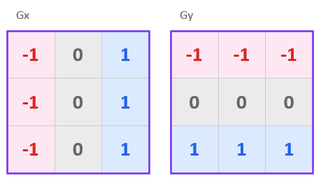
Prewitt Operator
Introduction
What is an Edge?
Image Gradient
Derivatives
First Derivative
Second Derivative
First Vs Second Derivative
Edge Detection Operators
Sobel Kernels
Prewitt Operators
Sobel vs Prewitt
Canny Edge Detector
Overview
Gaussian Smoothing
Gradient Calculation
Non-Maximum Suppression (NMS)
Double Thresholding
Edge Tracking (Hysteresis)
Hysteresis Tracking Logic
Practical Issues
Scale Issues
Thresholding Issues
Common Thresholding Problems
Choosing T_low and T_high
Definition
A simpler gradient operator using uniform weights.
Key Points
Simpler than Sobel
Less smoothing → more noise sensitive
Faster computation
Uniform weights → simpler, slightly more noise-sensitive

Slide 11
Sobel vs Prewitt Operator
Introduction
What is an Edge?
Image Gradient
Derivatives
First Derivative
Second Derivative
First Vs Second Derivative
Edge Detection Operators
Sobel Kernels
Prewitt Operators
Sobel vs Prewitt
Canny Edge Detector
Overview
Gaussian Smoothing
Gradient Calculation
Non-Maximum Suppression (NMS)
Double Thresholding
Edge Tracking (Hysteresis)
Hysteresis Tracking Logic
Practical Issues
Scale Issues
Thresholding Issues
Common Thresholding Problems
Choosing T_low and T_high
Feature | Sobel Operator | Prewitt Operator
Definition | Gradient-based edge detector with smoothing effect | Simple gradient-based edge detector
Kernel Weights | Uses weighted center (2) | Uses uniform weights (1)
Noise Handling | Better (due to smoothing effect) | Worse (more sensitive to noise)
Edge Detection Quality | More accurate and smoother edges | Less accurate compared to Sobel
Computation | Slightly more complex | Simpler and faster
Weight Distribution | Gives more importance to central pixels | Treats all pixels equally
Usage | Commonly used in practice | Used for basic understanding

Slide 12
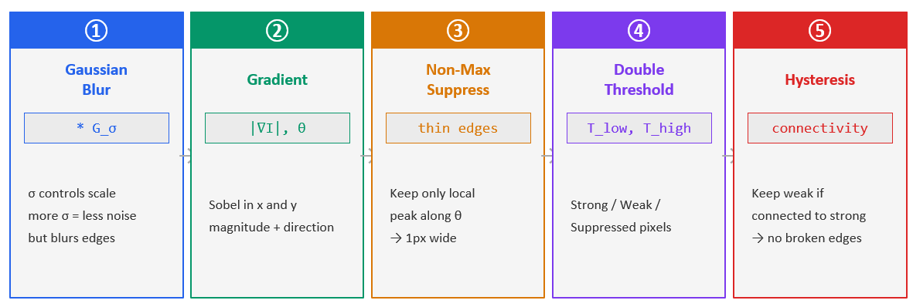
Canny Edge Detector
Introduction
What is an Edge?
Image Gradient
Derivatives
First Derivative
Second Derivative
First Vs Second Derivative
Edge Detection Operators
Sobel Kernels
Prewitt Operators
Sobel vs Prewitt
Canny Edge Detector
Overview
Gaussian Smoothing
Gradient Calculation
Non-Maximum Suppression (NMS)
Double Thresholding
Edge Tracking (Hysteresis)
Hysteresis Tracking Logic
Practical Issues
Scale Issues
Thresholding Issues
Common Thresholding Problems
Choosing T_low and T_high
Canny = Optimal Edge Detector under: good detection · good localisation · single response per edge

Slide 13
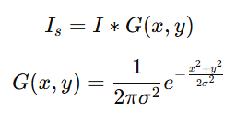
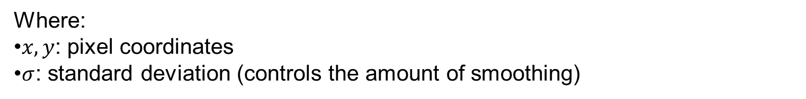
Gaussian Smoothing
Introduction
What is an Edge?
Image Gradient
Derivatives
First Derivative
Second Derivative
First Vs Second Derivative
Edge Detection Operators
Sobel Kernels
Prewitt Operators
Sobel vs Prewitt
Canny Edge Detector
Overview
Gaussian Smoothing
Gradient Calculation
Non-Maximum Suppression (NMS)
Double Thresholding
Edge Tracking (Hysteresis)
Hysteresis Tracking Logic
Practical Issues
Scale Issues
Thresholding Issues
Common Thresholding Problems
Choosing T_low and T_high
Gaussian Smoothing (Gaussian Blur) is a fundamental technique in image processing used to reduce noise and detail by smoothing an image using a Gaussian (normal distribution) function.
The 2D Gaussian function is:
Where:
$x,y$: pixel coordinates
$σ$: standard deviation (controls the amount of smoothing)

Slide 14
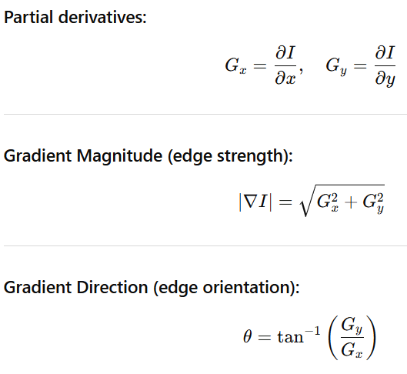
Gradient Calculation
Introduction
What is an Edge?
Image Gradient
Derivatives
First Derivative
Second Derivative
First Vs Second Derivative
Edge Detection Operators
Sobel Kernels
Prewitt Operators
Sobel vs Prewitt
Canny Edge Detector
Overview
Gaussian Smoothing
Gradient Calculation
Non-Maximum Suppression (NMS)
Double Thresholding
Edge Tracking (Hysteresis)
Hysteresis Tracking Logic
Practical Issues
Scale Issues
Thresholding Issues
Common Thresholding Problems
Choosing T_low and T_high
Gradient calculation is used to detect edges by measuring how rapidly image intensity changes at each pixel.
An edge = sudden change in intensity
Gradient measures this change in x and y directions
Intuition
High gradient → strong edge
Low gradient → smooth region

Slide 15
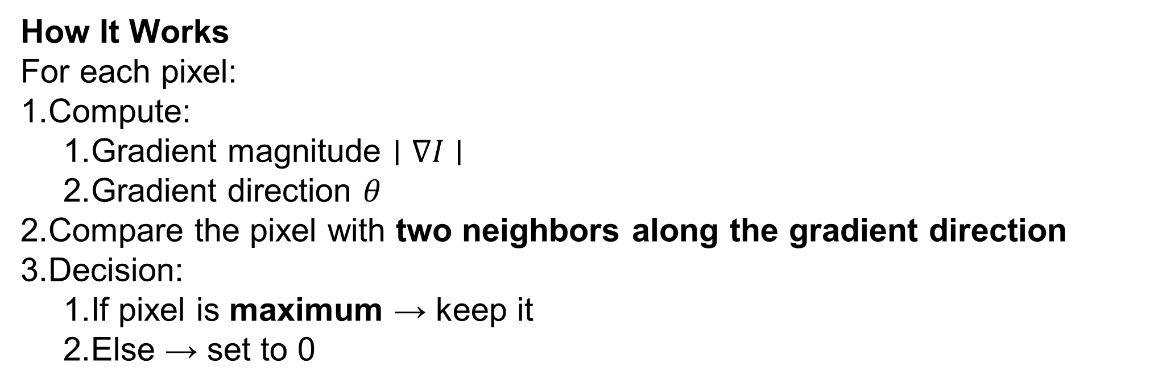
Non-Maximum Suppression (NMS)
Introduction
What is an Edge?
Image Gradient
Derivatives
First Derivative
Second Derivative
First Vs Second Derivative
Edge Detection Operators
Sobel Kernels
Prewitt Operators
Sobel vs Prewitt
Canny Edge Detector
Overview
Gaussian Smoothing
Gradient Calculation
Non-Maximum Suppression (NMS)
Double Thresholding
Edge Tracking (Hysteresis)
Hysteresis Tracking Logic
Practical Issues
Scale Issues
Thresholding Issues
Common Thresholding Problems
Choosing T_low and T_high
Non-Maximum Suppression is a step in edge detection (especially in the Canny algorithm) used to thin edges and keep only the most important pixels.
How It Works
For each pixel:
Compute:
Gradient magnitude $∣∇I∣$
Gradient direction $θ$
Compare the pixel with two neighbors along the gradient direction
Decision:
If pixel is maximum → keep it
Else → set to 0

Slide 16
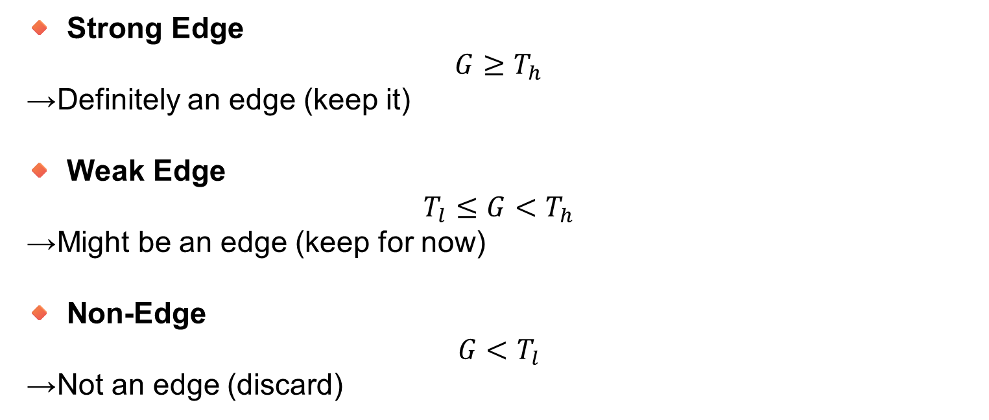
Double Thresholding
Introduction
What is an Edge?
Image Gradient
Derivatives
First Derivative
Second Derivative
First Vs Second Derivative
Edge Detection Operators
Sobel Kernels
Prewitt Operators
Sobel vs Prewitt
Canny Edge Detector
Overview
Gaussian Smoothing
Gradient Calculation
Non-Maximum Suppression (NMS)
Double Thresholding
Edge Tracking (Hysteresis)
Hysteresis Tracking Logic
Practical Issues
Scale Issues
Thresholding Issues
Common Thresholding Problems
Choosing T_low and T_high
Double Thresholding is used to classify edges into strong, weak, and non-edges after Non-Maximum Suppression.
🔸 Strong Edge
$$G≥T_{h}$$
→ Definitely an edge (keep it)
🔸 Weak Edge
$$T_{l}≤G<T_{h}$$
→ Might be an edge (keep for now)
🔸 Non-Edge
$$G<T_{l}$$
→ Not an edge (discard)
Use two thresholds:
High Threshold (Tₕ)
Low Threshold (Tₗ)

Slide 17
Edge Tracking (Hysteresis)
Introduction
What is an Edge?
Image Gradient
Derivatives
First Derivative
Second Derivative
First Vs Second Derivative
Edge Detection Operators
Sobel Kernels
Prewitt Operators
Sobel vs Prewitt
Canny Edge Detector
Overview
Gaussian Smoothing
Gradient Calculation
Non-Maximum Suppression (NMS)
Double Thresholding
Edge Tracking (Hysteresis)
Hysteresis Tracking Logic
Practical Issues
Scale Issues
Thresholding Issues
Common Thresholding Problems
Choosing T_low and T_high
Edge Tracking by Hysteresis is the final step in edge detection that decides which weak edges are real edges and which are noise.
How It Works
For each weak edge pixel:
Check its 8-connected neighborhood (surrounding pixels)
If at least one neighbor is a strong edge:
Keep it as an edge
Otherwise:
Suppress it (set to 0)

Slide 18
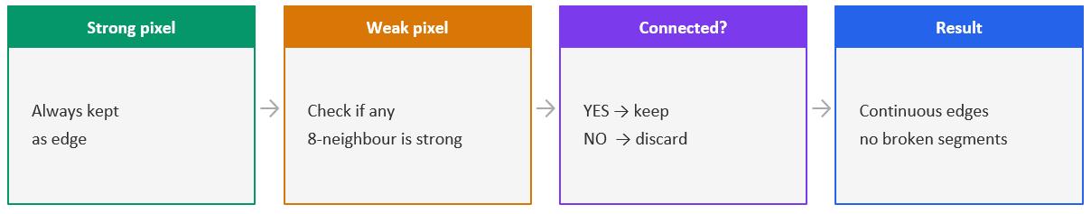
Hysteresis Tracking Logic:
Introduction
What is an Edge?
Image Gradient
Derivatives
First Derivative
Second Derivative
First Vs Second Derivative
Edge Detection Operators
Sobel Kernels
Prewitt Operators
Sobel vs Prewitt
Canny Edge Detector
Overview
Gaussian Smoothing
Gradient Calculation
Non-Maximum Suppression (NMS)
Double Thresholding
Edge Tracking (Hysteresis)
Hysteresis Tracking Logic
Practical Issues
Scale Issues
Thresholding Issues
Common Thresholding Problems
Choosing T_low and T_high

Slide 19

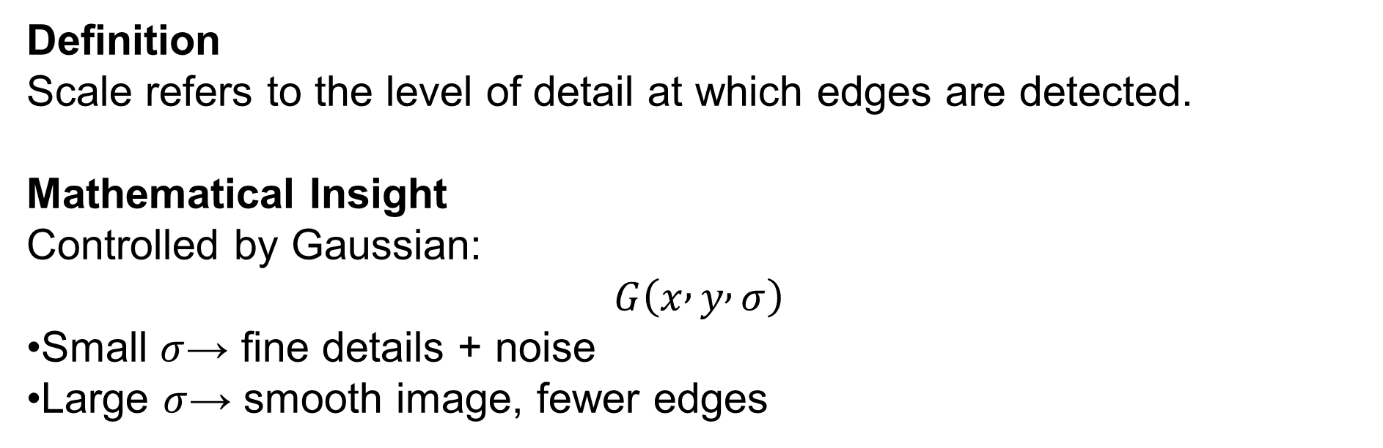
Scale Issues
Introduction
What is an Edge?
Image Gradient
Derivatives
First Derivative
Second Derivative
First Vs Second Derivative
Edge Detection Operators
Sobel Kernels
Prewitt Operators
Sobel vs Prewitt
Canny Edge Detector
Overview
Gaussian Smoothing
Gradient Calculation
Non-Maximum Suppression (NMS)
Double Thresholding
Edge Tracking (Hysteresis)
Hysteresis Tracking Logic
Practical Issues
Scale Issues
Thresholding Issues
Common Thresholding Problems
Choosing T_low and T_high
Definition
Scale refers to the level of detail at which edges are detected.
Mathematical Insight
Controlled by Gaussian:
$$G\left(x , y , σ\right)$$
Small $σ$→ fine details + noise
Large $σ$→ smooth image, fewer edges

Slide 20
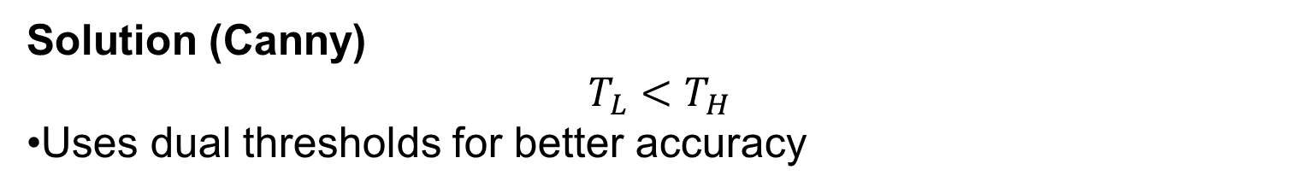
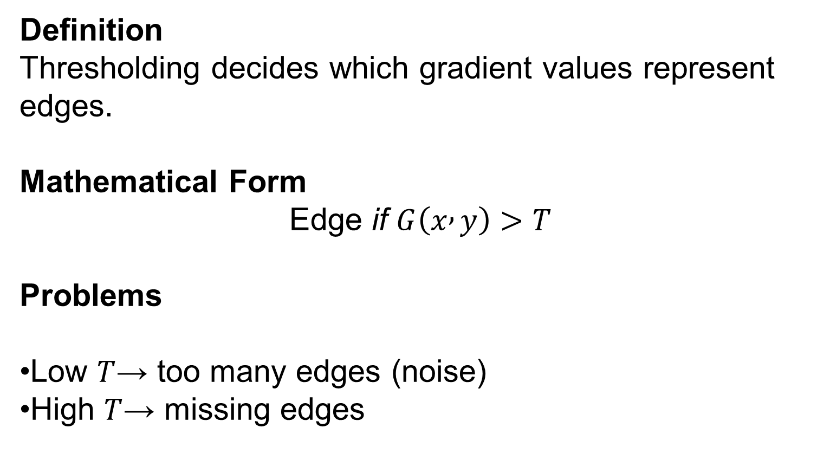
Thresholding Issues
Introduction
What is an Edge?
Image Gradient
Derivatives
First Derivative
Second Derivative
First Vs Second Derivative
Edge Detection Operators
Sobel Kernels
Prewitt Operators
Sobel vs Prewitt
Canny Edge Detector
Overview
Gaussian Smoothing
Gradient Calculation
Non-Maximum Suppression (NMS)
Double Thresholding
Edge Tracking (Hysteresis)
Hysteresis Tracking Logic
Practical Issues
Scale Issues
Thresholding Issues
Common Thresholding Problems
Choosing T_low and T_high
Definition
Thresholding decides which gradient values represent edges.
Mathematical Form
$$\text{Edge} \text{if} G\left(x , y\right)>T$$
Problems
Low $T$→ too many edges (noise)
High $T$→ missing edges
Solution (Canny)
$$T_{L}<T_{H}$$
Uses dual thresholds for better accuracy

Slide 21
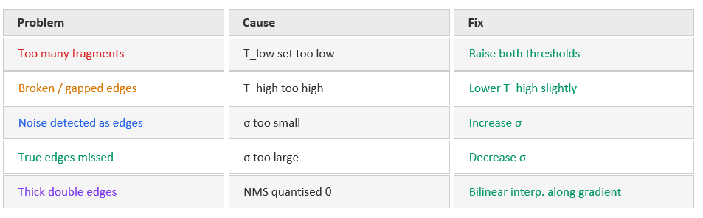
Common Thresholding Problems
Introduction
What is an Edge?
Image Gradient
Derivatives
First Derivative
Second Derivative
First Vs Second Derivative
Edge Detection Operators
Sobel Kernels
Prewitt Operators
Sobel vs Prewitt
Canny Edge Detector
Overview
Gaussian Smoothing
Gradient Calculation
Non-Maximum Suppression (NMS)
Double Thresholding
Edge Tracking (Hysteresis)
Hysteresis Tracking Logic
Practical Issues
Scale Issues
Thresholding Issues
Common Thresholding Problems
Choosing T_low and T_high

Slide 22
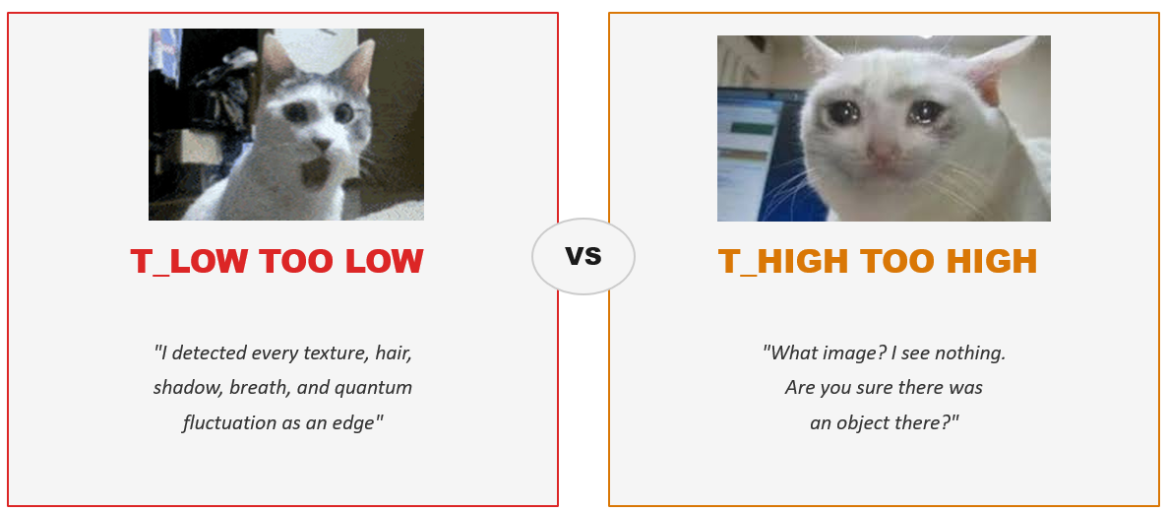
Trying to tune T_Low and T_High
Introduction
What is an Edge?
Image Gradient
Derivatives
First Derivative
Second Derivative
First Vs Second Derivative
Edge Detection Operators
Sobel Kernels
Prewitt Operators
Sobel vs Prewitt
Canny Edge Detector
Overview
Gaussian Smoothing
Gradient Calculation
Non-Maximum Suppression (NMS)
Double Thresholding
Edge Tracking (Hysteresis)
Hysteresis Tracking Logic
Practical Issues
Scale Issues
Thresholding Issues
Common Thresholding Problems
Choosing T_low and T_high

Slide 23


