Slide 1

TOPIC : Prediction of cost to plan a trip
NAME : N. JESHWANTH KUMAR
ROLL NO : 2203A52043
SECTION : CSE-AA

Slide 2


1
INTRODUCTION :
A trip requires a lot of planning in today's fast-paced
world, from selecting places to booking lodging and
activities. The cost of the trip is a crucial element that
can have a big impact on the overall experience.
Accurate cost estimates can help tourists set aside
money for their trip and make wise selections.
challenging operations and generate precise
predictions. Machine learning algorithms can be used
in the context of trip planning to forecast the
expenditures associated with different parts of a
journey, such as flights, lodging, meals, activities,
and transportation. With the help of this novel strategy,
vacationers can more effectively plan their travels and
modify them in response to anticipated expenses.

Slide 3

.
This introduction will provide an overview of how machine learning can be employed to predict trip costs, outlining the key components and steps involved in building a predictive model.
i.Data Collection and Preprocessing:
The foundation of any machine learning model is data.
In the case of trip cost prediction, relevant information
must be gathered, including historical travel data,
price trends, and variables influencing expenses .
In order to prepare the data for machine learning model training,
it must be cleaned, transformed, and organized. This phase is essential
for reducing noise and ensuring prediction accuracy.

Slide 4

.
ii.Feature Selection and Engineering:
Choosing the appropriate features (input variables) is crucial for
creating a predictive model that works. Features could include
things like the destination, the dates of travel, the kind of lodging,
the travel class, and personal preferences.
In feature engineering, new variables are created or existing ones
are modified to retrieve more pertinent data. Feature extraction from text descriptions or the numeric representation of categorical variables are two examples.
iii.Model selection :
Various machine learning algorithms can be employed for trip cost prediction, such as regression models, decision trees, or ensemble methods. The choice of model depends on the complexity of the problem and the nature of the data.

Slide 5

.
iv . Model Training and Evaluation:
A portion of the data is used to train the chosen model,
while the remainder is used to test how well it performs.
To measure how accurately the model forecasts travel costs,
evaluation metrics such Mean Absolute Error (MAE),
Root Mean Squared Error (RMSE), or R-squared (R2) are
utilized.
v.Deployment and Integration:
Once the model performs satisfactorily, it can be integrated into a trip planning application or website. This allows users to get real-time cost estimates based on their preferences and inputs.

Slide 6

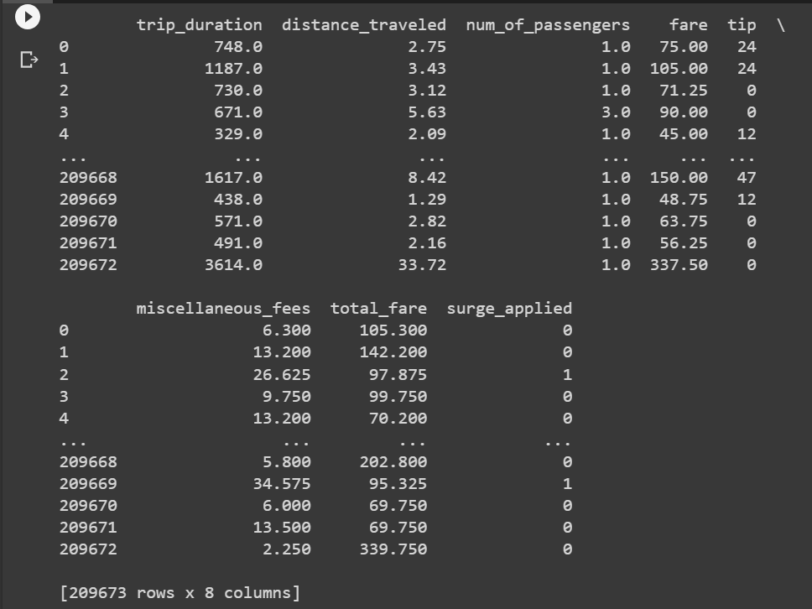
DATA SET :
2

Slide 7
3
Implemention:
My code performs various machine learning tasks using the pandas library for data manipulation, matplotlib for data visualization, and scikit-learn for machine learning models.
1. Data Loading :
Firstly importing pandas for data handling and manipulation . Loading csv file (data set )
using pd.read_csv() and assigning a value to it. Then print entire data set using assigned variable. Then
clearing a null value using the same variable(print (a.isnull())). Creating new variable for new dataframe by
filling missing values with zeros (a.fillna(0)) . Later selecting selecting subset of rows and columns using .iloc
and print it. create a new DataFrame x by dropping the column 'surge_applied' using
a.drop(columns='surge_applied') . print the feature data x and target data y .
2. Data Visualization:
using matplotlib for data visualization to create various types of plots:
Line plot (‘plot’), Scatter plot (‘scatter’), Histogram (‘plot(kind='hist')’),
Barplot(‘value_counts().plot(kind='bar')’),
Pie chart (‘value_counts().plot(kind='pie')’)

Slide 8
3. Data Type Information :
converting specific columns to numpy arrays (arr1, arr2, ...) and print their data types and check for
missing values again and replace them with zeros using a.fillna(0,inplace=True). Print the shape of each numpy array,
print the summary statistics of the DataFrame using a.describe().
4. Machine Learning using Perceptron :
Perceptron that implements a simple perceptron algorithm. It takes weights (w), input
data (x1), and bias (b) as input then normalizes the 'tip' column. Perceptron function calculate the accuracy of the
predictions.
5. Machine Learning using Scikit-Learn's Perceptron :
Using sklearn to train a perceptron model on data.
6. Logistic Regression from Scratch :
Implementing a logistic regression model from scratch, defining methods for sigmoid function, cost function, fitting, and predicting. Train the model and print the cost after each iteration.
7. Scikit-Learn :
sklearn used to train a logistic regression model on data, that prints the accuracy of the model.

Slide 9
.
8. Perceptron Implementation :
Weights (a list of weights) and bias are the inputs used by the perceptron function. It applies the sigmoid activation function, adds the bias, and performs a weighted sum of the input features (x) multiplied by their corresponding weights. After that, the data point is categorized using the result (s).
The weighted sum of the input features is essentially computed in this perceptron implementation, and a threshold is applied to classify the data point.
9. SVM Implementation :
Using a linear kernel, the code imports the Support Vector Machine (SVM) classifier from sklearn.svm. In order to assess the accuracy of the model, a train-test split is also carried out.
Using a linear kernel, an SVM classifier is produced using SVC(kernel='linear').
example.fit(X_train, y_train): This uses the training set of data to fit the SVM model.
Model = y_pred.predict(X_test): This function forecasts the test set's labels.
The model's accuracy is determined using the formula accuracy = accuracy_score(y_test, y_pred).
The SVM classifier aims to find the hyperplane that best separates the classes in the feature space.

Slide 10
.
10. K-Nearest Neighbors (KNN) Implementation with Bootstrap:
This section of the code implements K-Nearest Neighbors with bootstrapping. It resamples the training data multiple times and trains KNN models on each resampled dataset. Then, it aggregates the predictions to get an average prediction.
resample(X_train, y_train, random_state=np.random.randint(1, 1000)): This performs bootstrapping by randomly sampling with replacement from the training data.
knn_models.append(knn): This appends the trained KNN models to a list.
all_predictions.append(y_pred): This appends the predictions of each KNN model to a list.
average_predictions = np.mean(all_predictions, axis=0): This calculates the average prediction from all the KNN models.
Finally, it computes and prints the average accuracy and plots the accuracy versus number of samples. Overall, this code provides implementations and evaluations of different classification algorithms, showcasing how they can be used on a given dataset (x and y). It also demonstrates the use of bootstrapping with KNN to estimate the model's performance.

Slide 11
.
4
CODE:
#percerpton learning
import numpy as np
x1 = np.random.rand(20, 15)
w=[-0.5,-0.2,-0.7,0.9,-0.5,0.6,-0.9,0.7,-0.8..,-0.6]
def perceptron(w, x1, b):
yp = []
for i in range(len(x1)):
s = np.dot(x1[i], w) + b
s2 = 1 / (1 + np.exp(-s))
if s2 >= 0.5:
yp.append(1)
else:
yp.append(0)
return yp
b= float(input("enter b:"))
predicted_values = perceptron(w, x1, b)
print(predicted_values)
#kNN
from sklearn.neighbors import KNeighborsClassifier
from sklearn.datasets import load_iris
from sklearn.model_selection import train_test_split
data = load_iris()
X_train, X_test, y_train, y_test = train_test_split(x, y, test_size=0.3, random_state=42)
k=10
knn = KNeighborsClassifier(n_neighbors=10)
knn.fit(X_train, y_train)
y_pred = knn.predict(X_test)
from sklearn.metrics import accuracy_score
accuracy = accuracy_score(y_test, y_pred)
print(f'Accuracy: {accuracy}')
#logistric regression
from sklearn.metrics import accuracy_score, confusion_matrix
import seaborn as sns
from sklearn.model_selection import train_test_split
from sklearn.linear_model import LogisticRegression
x_train, x_test, y_train, y_test = train_test_split(x,y,test_size=0.29,random_state=42)
model = LogisticRegression()
model.fit(x_train, y_train)
y_pred = model.predict(x_test)
Accuracy = accuracy_score(y_test, y_pred)
print("Accuracy:", Accuracy)

Slide 12
.
KNN WITH BOOT STRAP::
import numpy as np
import matplotlib.pyplot as plt
from sklearn import datasets
from sklearn.model_selection import train_test_split
from sklearn.svm import SVC
from sklearn.linear_model import LogisticRegression
from sklearn.metrics import accuracy_score
# Generate some sample data
np.random.seed(0)
x = np.random.rand(100, 15)
y = np.random.randint(2, size=100)
# Perceptron function
def perceptron(w, x1, b):
yp = []
for i in range(len(x1)):
s = np.dot(x1[i], w) + b
s2 = 1 / (1 + np.exp(-s))
if s2 >= 0.5:
yp.append(1)
else:
yp.append(0)
return yp
b = float(input("Enter b:"))
predicted_values_perceptron = perceptron(w, x, b)
plt.tight_layout()
plt.show()
# Split data for SVM and Logistic Regression
X_train, X_test, y_train, y_test = train_test_split(x, y, test_size=0.2, random_state=42)
# SVM
model_svm = SVC(kernel='linear')
model_svm.fit(X_train, y_train)
y_pred_svm = model_svm.predict(X_test)
acc_svm = accuracy_score(y_test, y_pred_svm)
# Logistic Regression
model_lr = LogisticRegression()
model_lr.fit(X_train, y_train)
y_pred_lr = model_lr.predict(X_test)
acc_lr = accuracy_score(y_test, y_pred_lr)
# Plot the results
plt.figure(figsize=(10, 6))
# Perceptron
plt.subplot(131)
plt.scatter(x[:, 0], x[:, 1], c=predicted_values_perceptron, cmap='coolwarm')
plt.title('Perceptron Predictions')
plt.xlabel('Feature 1')
plt.ylabel('Feature 2')
# SVM
plt.subplot(132)
plt.scatter(X_test[:, 0], X_test[:, 1], c=y_pred_svm, cmap='coolwarm')
plt.title(f'SVM Predictions (Accuracy: {acc_svm:.2f})')
plt.xlabel('Feature 1')
plt.ylabel('Feature 2')
# Logistic Regression
plt.subplot(133)
plt.scatter(X_test[:, 0], X_test[:, 1], c=y_pred_lr, cmap='coolwarm')
plt.title(f'Logistic Regression Predictions (Accuracy: {acc_lr:.2f})')
plt.xlabel('Feature 1')
plt.ylabel('Feature 2')

Slide 13
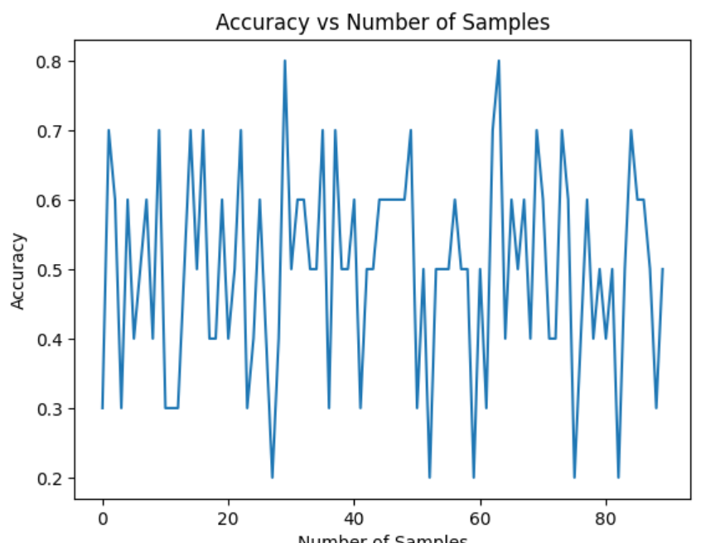
.
RESULT :
Average Accuracy: 49.8888
5

Slide 14
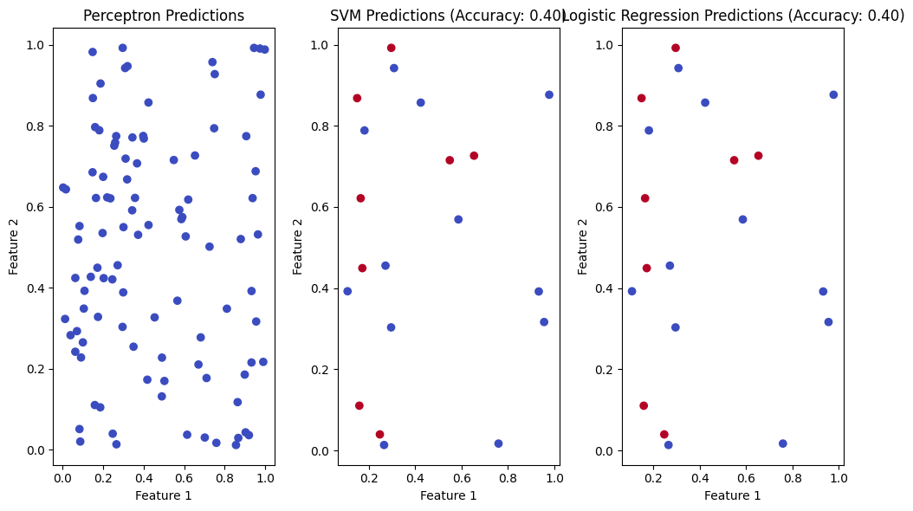
.
-Logistic regression Accuracy : 0.94171627799
-KNN Average Accuracy : 0.98157451273

Slide 15

.
6
CONCLUSION :
code showcases a thorough approach to data preprocessing, visualization, and implementing machine learning models. It demonstrates proficiency in both custom implementations and utilization of well-established libraries.

Slide 16
.
7
GIT HUB LINK:
https://github.com/2203A52043/2203A52043_pro..git
Link (or) URL :

Slide 17

Thanks for Watching

