Slide 1

RSA Encryption using Diffie-Hellman and AES Algorithm
Group 12: Avro Mukherjee
Karan Modi
Vincent Loud
Professor: Dov Kruger
Course: CPE593 - Data Structures and Algorithms
All

Slide 2
Problem Definition: Sending Encrypted Data from one point to another
When we talk about the Security-of-Security, we're talking about securing all aspects of your physical security system-including communications, servers, and data. You should be able to keep your entire system safe from cyber-threats and attacks as well as illegal or unauthorized access.
Keeping the above point in mind, business solutions have developed three tools to achieve security. They are:
Encryption
Authorization
Authentication
In this project, we plan to utilize Diffie-Hellman and AES encryption with RSA to achieve a solution to our encryption problem.
Avro

Slide 3
Techniques Used FOR ENCRYPTION
There are two basic techniques for encrypting information:
Asymmetric encryption ( also called public and private key encryption) – RSA Algorithm
Symmetric encryption (also called the secret key encryption) - AES Algorithm
Using the Secret Key generated by Diffie Hellman Key Exchange
Avro

Slide 4
Diffie – Hellman Key Exchange
The Diffie-Hellman algorithm was developed by Whitfield Diffie and Martin Hellman in 1976.
This algorithm was devised not to encrypt the data but to generate same private cryptographic key at the both ends so that there is no need to transfer this key from one communication end to another.
Asymmetric Encryption of data requires transfer of cryptographic private key. The most challenging part of the encryption key from sender to receiver without anyone intercepting this key in between.
This transfer or rather generation on same cryptographic keys at both sides secretively was made possible by Diffie-Hellman Algorithm.
Diffie - HellMan algorithm is an algorithm that allows two parties to shared secret key using the communication channel, which is not protected from the interception but is protected from modification.
Avro

Slide 5
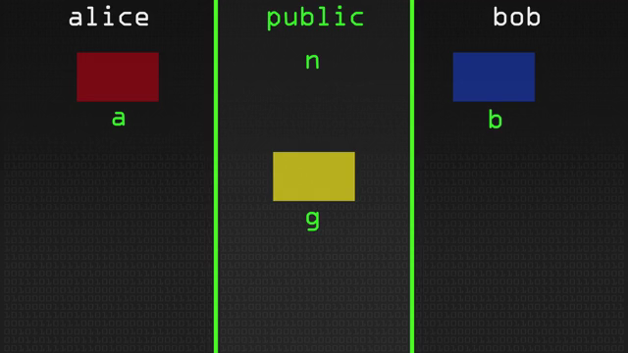
Diffie – Hellman Key Exchange WORKING
https://gfycat.com/arcticpowerlessgeese-weird-science
Avro

Slide 6
RSA (Rivest–Shamir–Adleman) Encryption
RSA (Rivest–Shamir–Adleman) is an algorithm used by modern computers to encrypt and decrypt messages. It is an asymmetric cryptographic algorithm.
RSA involves a public key and private key. The public key can be known to everyone- it is used to encrypt messages. Messages encrypted using the public key can only be decrypted with the private key.
It uses Prime Factorization on Big numbers which is very hard to decipher.
Karan

Slide 7
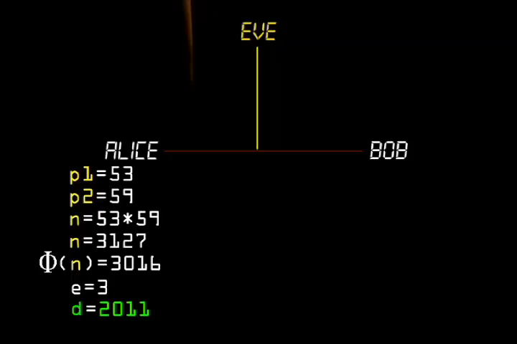
RSA Working
https://www.khanacademy.org/
Karan

Slide 8
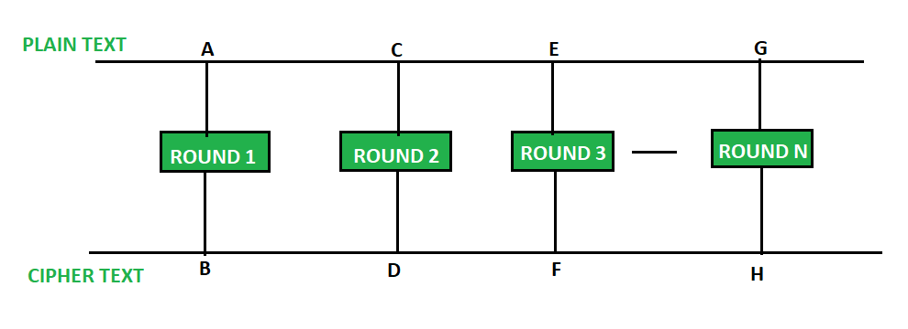
AES - Advanced Encryption Standard
Advanced Encryption Standard(AES) is a symmetric key block cipher technique. It is based on a substitution permutation network.
AES uses a key expansion process in which the initial key comes up with a series of newly generated keys called round keys.
These round keys are generated over multiple rounds of changes which makes it harder to crack the encryption.
The AES encryption is more complex with the increase in rounds of encryption. The 256 bit key gives the highest level of encryption.
Vincent

Slide 9
GMP Library Big Integer Implementation
GMP stands for the GNU Multi Precision Library. It is a popular library that gives us the ability to operate with arbitrary precision integers, rational numbers and floating point numbers.
In our code, we used GMP library to generate Prime numbers, which are used in RSA encryption to generate the private and public keys.
It's implemented in our code with trial division by the first 70 prime numbers and then a Miller-Rabin primality test which runs (by default) 30 iterations the length of the prime value is given in 'number of bits' as it randomly generates values until a tested value returns true for the prime test it can find prime values with 2000 (or less) digits in under a minute.
Vincent

Slide 10

Structure of Code Implementation
Vincent

Slide 11
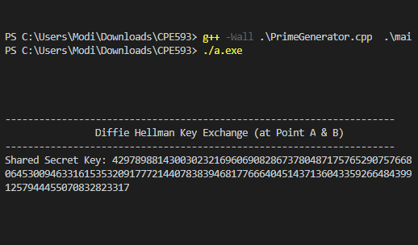
STEP 1: Generating Diffie Hellman Shared Key
Karan

Slide 12
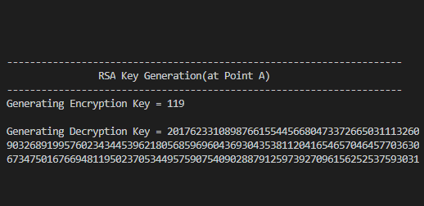
STEP 2: Generating RSA Encryption KEY and Decryption Key
Karan

Slide 13
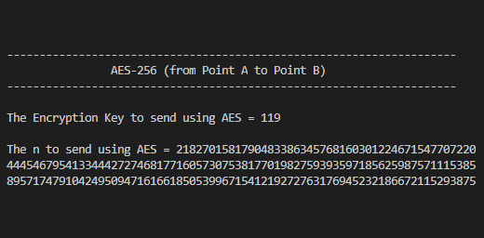
STEP 3 : SEND e and n from a to b
We would use AES to Encrypt the Encryption Key “e” and Prime Multiple “n = p* q” and transmit it from A to B using DH shared secret key
Karan

Slide 14
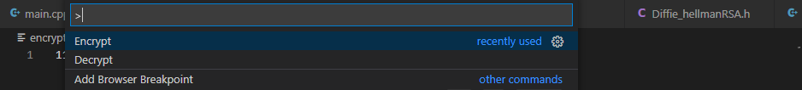
STEP 4 : encrypting and Sending enc key
Step a
Step b
Passphrase is shared secret key
Step c
Similarly, we would use AES to Encrypt n = p* q and transmit it from A to B and vice versa
Karan

Slide 15
STEP 5: decrypting Received enc key
Step a
Step b
Passphrase is shared secret key
Step c
Similarly, we would use AES to Decrypt n = p* q and transmit it from A to B and vice versa
Karan

Slide 16
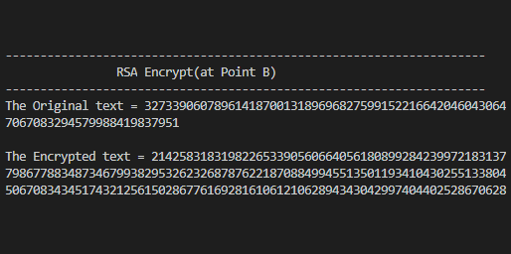
STEP 6 : Encrypting message using Enc key
We would use the Encryption Key “e” and Prime Multiple “n = p* q” received from A and encrypt the message from B
Karan

Slide 17
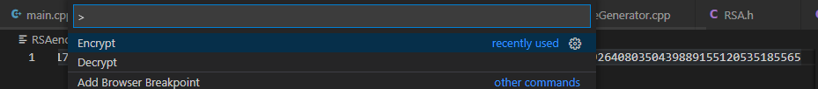
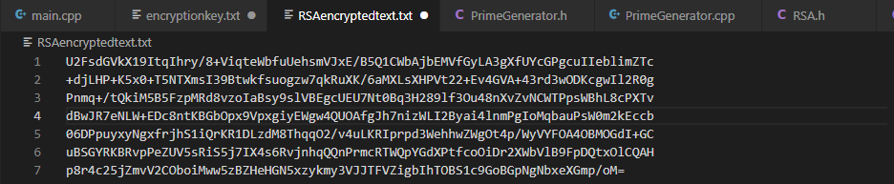
STEP 7 : encrypting and Sending Message
Step a
Step b
Step c
Like earlier, we would use AES to decrypt the encrypted Cipher Text at A
Karan

Slide 18
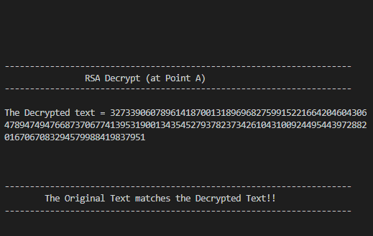
STEP 8: Decrypting message using Dec key
We use the Decryption Key “d” and “n”; and apply it to RSA Cipher Text to decrypt it and receive the original message.
Karan

Slide 19
ENVIRONMENT
Libraries Used
GMP library (GNU multiple precision)
AES VSCode plugin (Encryption VSCode)
Tools Used
VSCode
MinGW
Operating System
Windows 10
MacOS
Programming Language
C++
Vincent

Slide 20
Challenges Faced
Big integer Division/Mod:
Power calculation using floating points was an issue, also power of a big integer to another was a problem but Powermod helped fixing it
Storing the number in big integer:
Big initial challenge making all these function work with GMP but it was later fixed by Karan and Vincent
Diffie Hellman handshake using AES:
We were not able to integrate AES and Diffie-Hellman, then we used VSCode’s inbuilt AES plugins to link the two.
Vincent

Slide 21
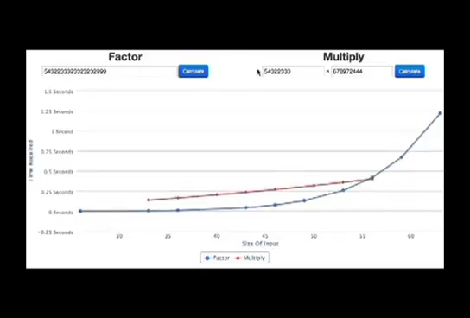
Conclusion
Each of cryptographic algorithms has weakness points and strength points. We select the cryptographic algorithm based on the demands of the application that will be used.
The program uses RSA for Cipher Text and uses AES for transversal of Data from Point A to B by using Shared Secret Key generated by Diffie Hellman.
Since a lot of Random Prime number combinations are used, it is very hard to decode and would take years to decipher which is our motive and security strength.
Avro

Slide 22
References
http://cs.indstate.edu/~skallam/doc.pdf
https://www.academia.edu/43523042/A_Novel_Text_Encryption_Algorithm_using_enhanced_Diffie_Hellman_and_AES
https://reader.elsevier.com/reader/sd/pii/S157106610505053X?token=04C88FD0A5030FBD62FEE0EDE7E8443260EF667A9A210D86BCA922B49F6F07CDE6388CD224A9D69FCFFA2D533AC80F21
https://www.researchgate.net/profile/Ako_Abdullah/publication/317615794_Advanced_Encryption_Standard_AES_Algorithm_to_Encrypt_and_Decrypt_Data/links/59437cd8a6fdccb93ab28a48/Advanced-Encryption-Standard-AES-Algorithm-to-Encrypt-and-Decrypt-Data.pdf
https://en.wikipedia.org/wiki/Diffie–Hellman_key_exchange
https://www.khanacademy.org/
Avro

Slide 23
THANK YOU
Avro Mukherjee, Karan Modi and Vincent Loud
Avro

