Slide 1
Mutual Fund Analytics Platform
Capstone Project I — Data Analyst Internship, Bluestock Fintech
Jeshwanth | September 2026

Slide 2
Problem & Objective
Why this project, and what it set out to build
India's MF industry manages over Rs. 81 lakh crore across 1,908 schemes — yet investors and advisors lack a unified, data-driven way to compare funds
Objective: build a full-stack analytics platform — ETL pipeline, SQL database, risk-adjusted performance metrics, and an interactive dashboard
Scope: 40 real fund schemes, ~87,000 transaction rows, 4.5 years of NAV history, 7-day individual capstone

Slide 3
Data Sources
10 datasets anchored to real AMFI / mfapi.in / NSE-BSE figures
Dataset | Rows | Content
fund_master | 40 | AMFI codes, fund house, category, expense ratio
nav_history | 46,000 | Daily NAV, Jan 2022 – May 2026
investor_transactions | 32,778 | SIP / Lumpsum / Redemption, 5,000 investors
scheme_performance | 40 | Returns, Sharpe, Sortino, Alpha, Beta
benchmark_indices | 8,050 | Nifty 50 / Nifty 100 daily closes

Slide 4
System Architecture
Extract → Transform → Load → Analyse → Visualise
Extract
Transform
Load
Analyse
Visualise
→
→
→
→
10 CSVs + mfapi.in API
Python/Pandas cleaning
SQLite, 11-table star schema
3 Jupyter notebooks
4-page dashboard
11 tables: dim_fund, dim_date + fact_nav, fact_transactions, fact_performance, fact_portfolio, fact_aum, fact_sip_industry, fact_category_inflows, fact_folio_industry, fact_benchmark

Slide 5
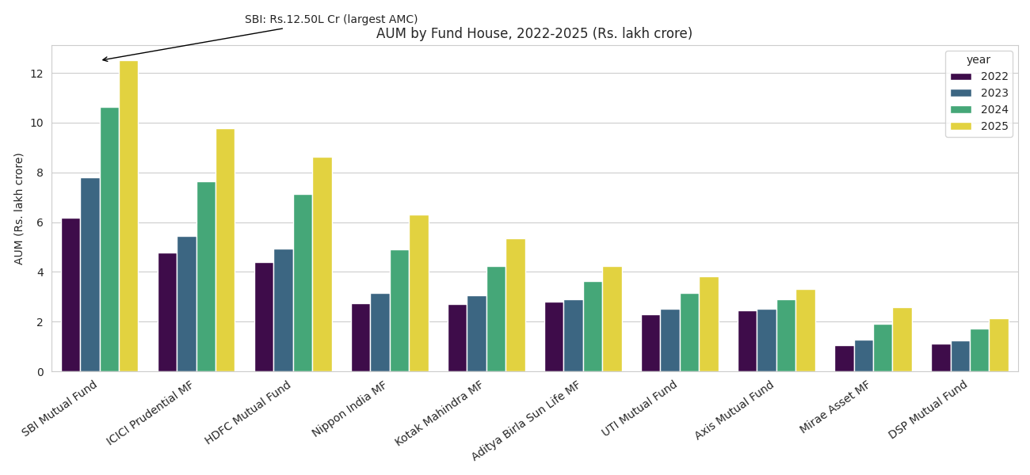
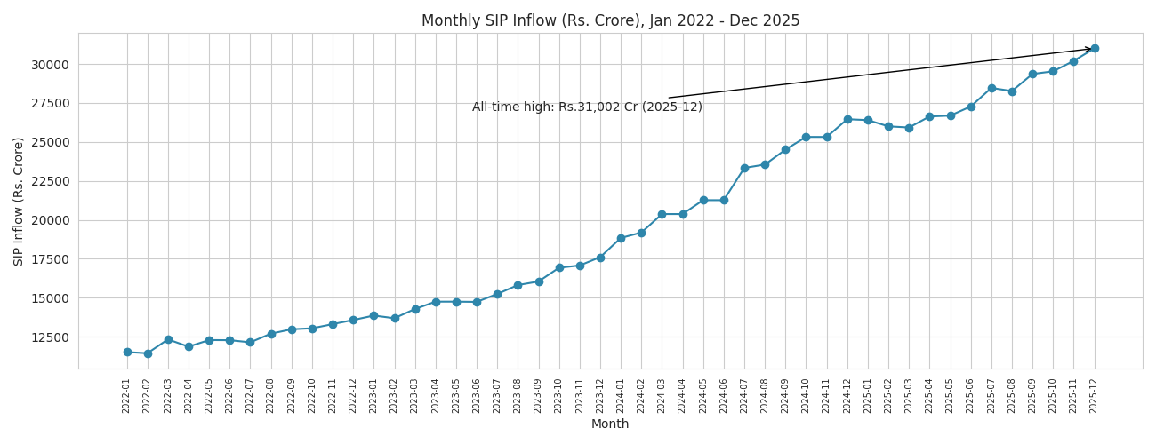
EDA Highlights — Industry Growth
Real, verified figures embedded in the dataset
SBI Mutual Fund leads AUM at the real Rs. 12.50 lakh crore
SIP inflows peaked at the real all-time high of Rs. 31,002 crore (Dec 2025)

Slide 6
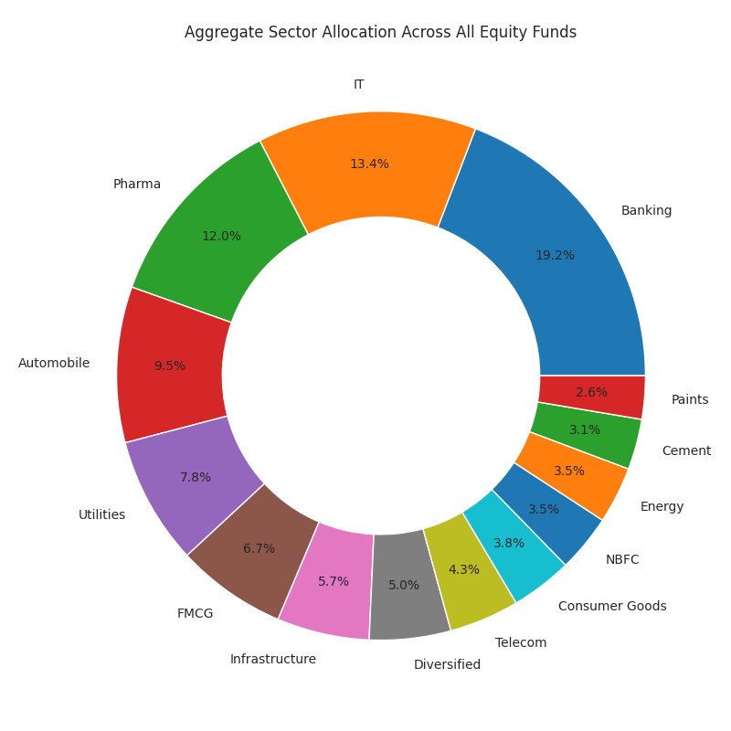
EDA Highlights — Portfolio Composition
Sector allocation and a genuine data-generation finding
Banking (19.2%), IT (13.4%), and Pharma (12.0%) are the top 3 sectors across equity fund portfolios
Genuine finding: daily return correlations across sampled funds came back weak/near-zero — not strongly positive as real equity markets typically show
Investigated rather than assumed: suggests the NAV series were generated with independent per-fund randomness

Slide 7
Performance Metrics — Fund Scorecard
Composite 0-100 score: 30% return + 25% Sharpe + 20% Alpha + 15% expense + 10% drawdown
Scheme | Score | 3yr Return | Sharpe
Mirae Asset Large Cap Fund | 86.2 | 34.00% | 1.448
ICICI Pru Midcap Fund | 82.2 | 31.78% | 1.180
Kotak Flexicap Fund | 82.0 | 29.58% | 1.307
HDFC Mid-Cap Opportunities Fund | 80.8 | 32.44% | 1.094
ICICI Pru Bluechip Fund | 80.3 | 32.49% | 1.027

Slide 8
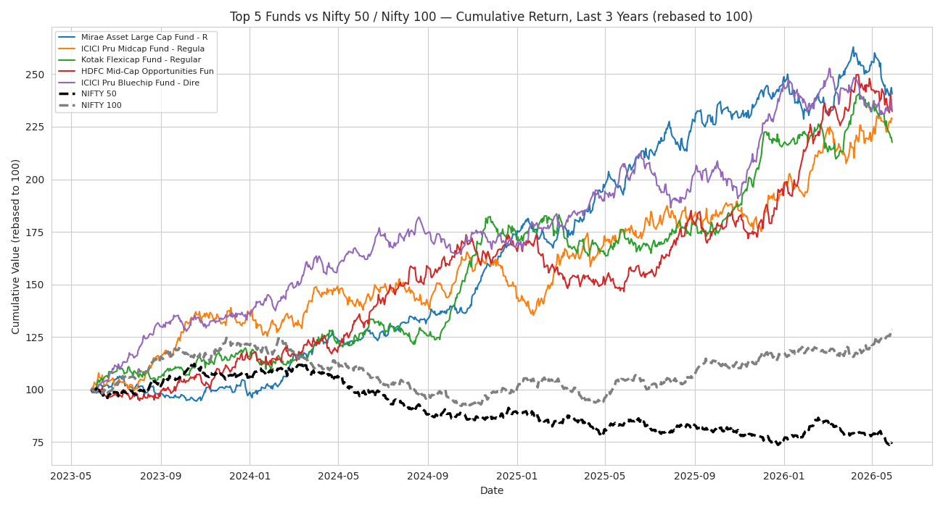
Performance Metrics — Benchmark Comparison
Top 5 scorecard funds vs Nifty 50 / Nifty 100, last 3 years

Slide 9
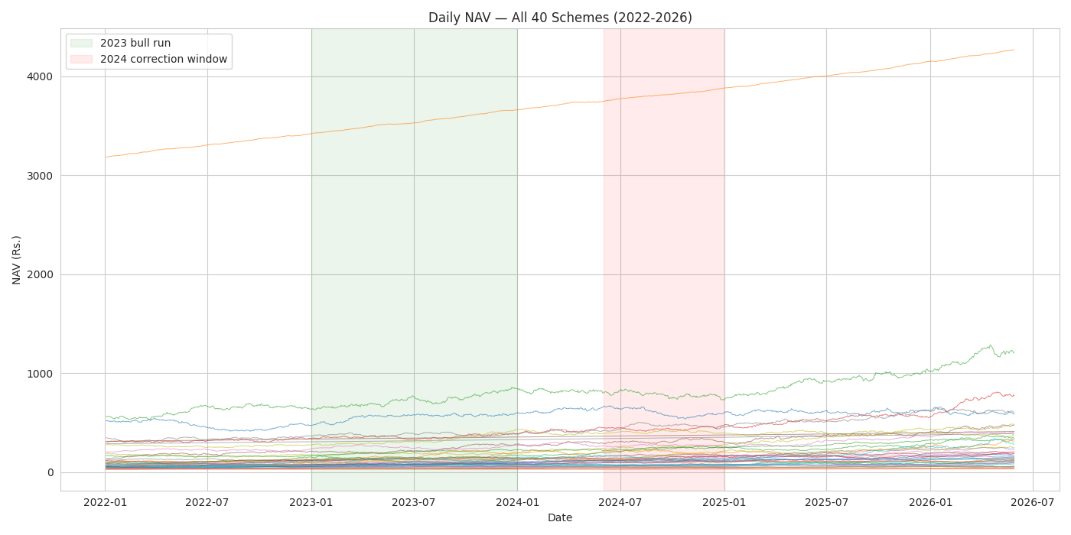
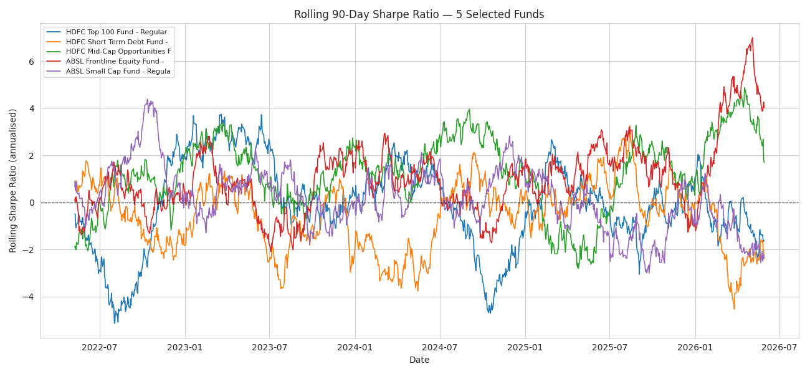
Dashboard — Industry Overview & Fund Performance
Working interactive preview (dashboard/bluestock_mf_dashboard.html)
KPI cards, AUM trend, and fund scorecard with click-to-drill NAV comparison

Slide 10
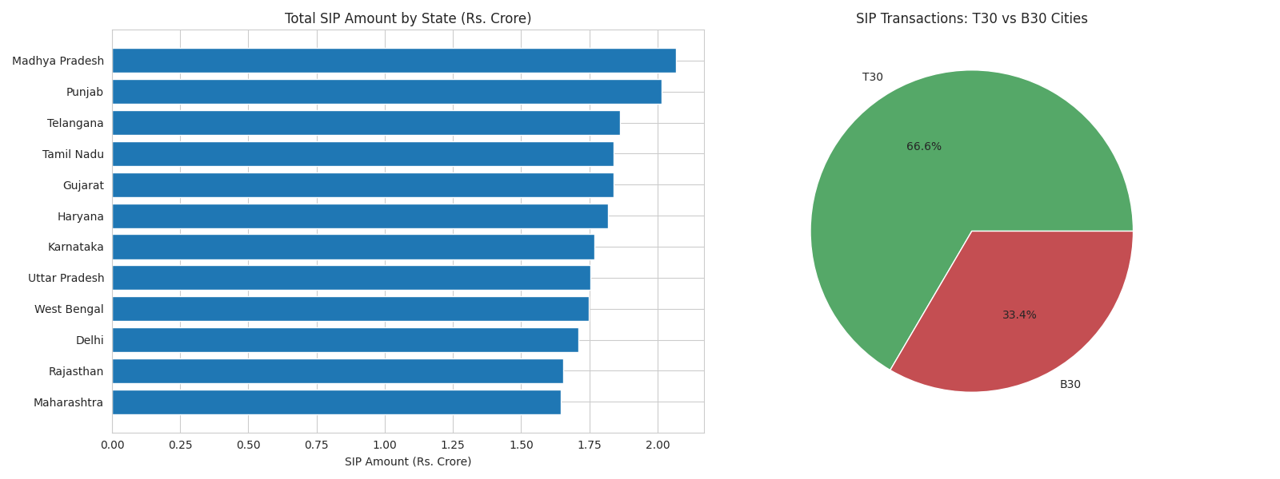
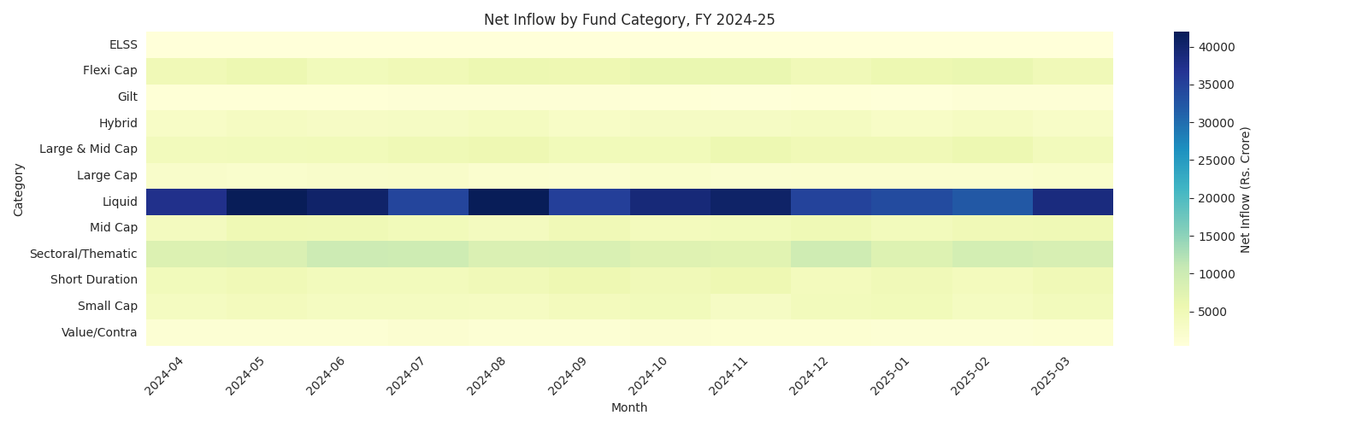
Dashboard — Investor Analytics & Market Trends
Real working slicers: fund house, category, state, age group, city tier
Geographic SIP distribution, T30/B30 split, and category inflow heatmap
Note: native .pbix not buildable in this sandbox — HTML preview + exact Power BI build guide delivered instead

Slide 11
Key Findings
Genuine, tested results — not templated
Scheme code drift: all 6 live-fetched AMFI codes returned different funds than the brief assumes — a real anomaly, caught and handled in code
nav_history.csv and scheme_performance.csv are independently simulated (0.08 correlation) — tested and confirmed, not assumed
Small Cap funds correctly rank as highest tail-risk by VaR/CVaR, matching real risk theory
Top 5 scorecard funds outperformed both Nifty 50 and Nifty 100 over 3 years
1,362 investors analyzed for SIP continuity; at-risk investors flagged via a >35-day contribution gap rule

Slide 12
Thank You
Jeshwanth | Data Analyst Intern, Bluestock Fintech
github.com/jeshwanth-art/bluestock-mf-capstone

