Slide 1
Forecasting Housing Price Index in Connecticut
By:
Adhyayan Amit Jain
Gauri V Nair
Jesin K Joy
Adarsh Bharathwaj

Slide 2
Table of contents
01
02
03
04
Introduction
Overview of the models
About the dataset and Initial Visualization of the data
TSLM, ARIMA, ETS, Log, and Ensemble models
Cross Validation
Operational Forecast
Comparing the various models
Creating a 6-year forecast with the winning model

Slide 3
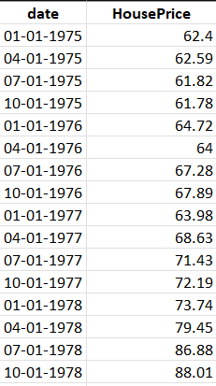
About the dataset
Dataset Overview:
The dataset includes quarterly house price indices from 1975 to 2020, offering a comprehensive view of long-term trends and market cycles.
Pre-2020 data was used for training, while 2021 onwards was reserved for validation, ensuring robust testing of our forecasting methods.

Slide 4
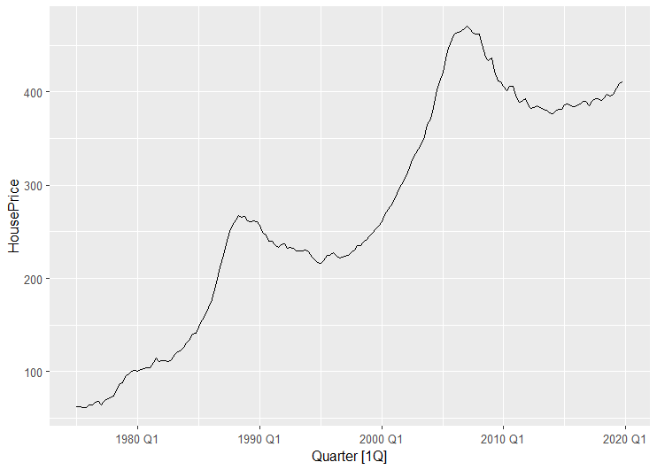
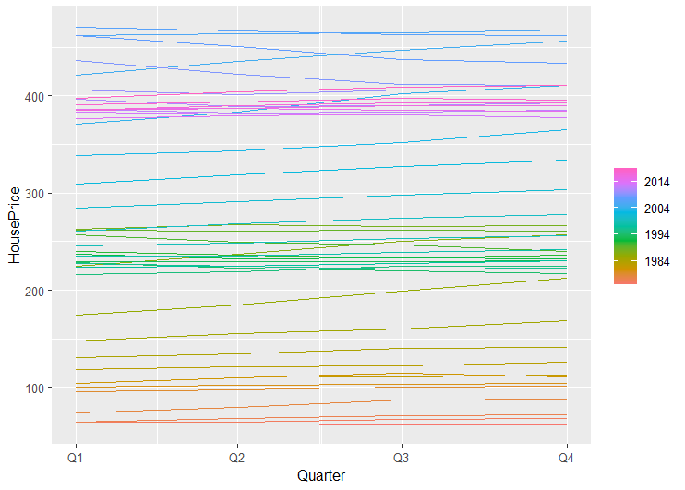
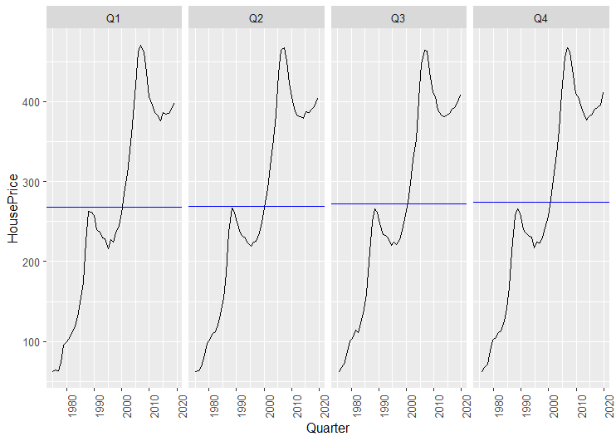
Initial Visualization of data
gg_subseries
autoplot
gg_seasonal
Visualizations revealed a linear trend with no significant seasonal patterns but clear cyclic variations like the 2008 crash and post-recovery growth.
These insights informed our choice of models, emphasizing the need for approaches that can handle both trends and irregular cycles.

Slide 5
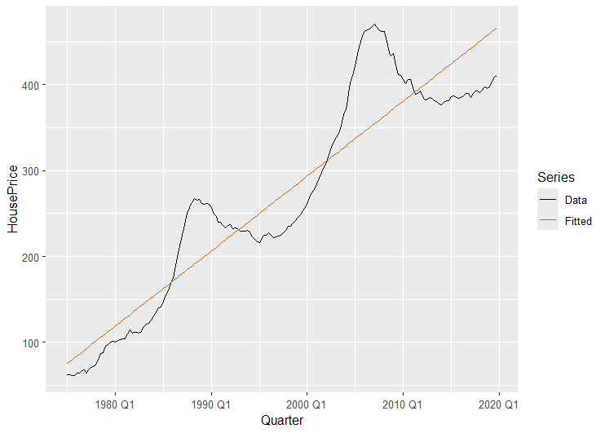
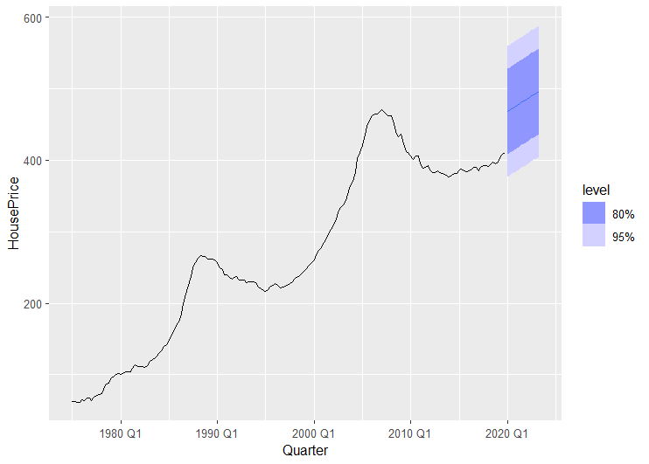
Time Series Regression model
TSLM captures the overall upward trend but lacks the ability to model cyclic fluctuations, such as the 2008 housing crisis.
It serves as a baseline model to compare more advanced methods like ARIMA and ETS.

Slide 6
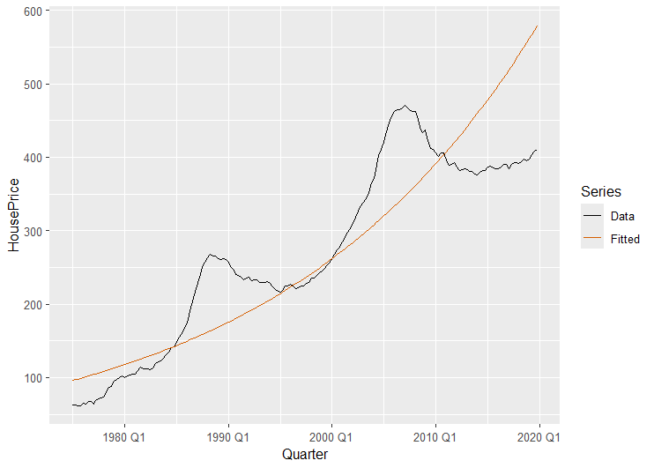
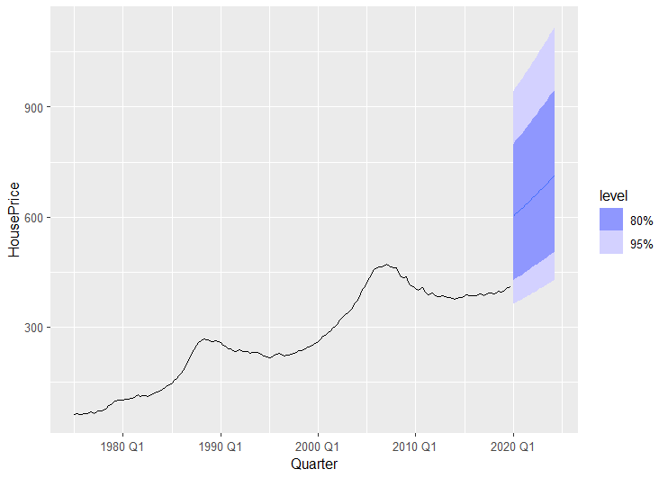
Time Series Regression Log model
The Time Series Regression Log model effectively captures the exponential growth trend in the house price dataset, as seen in the fitted line closely matching the data.
The forecast highlights robust performance with confidence intervals, indicating the model's ability to handle uncertainty and predict future trends in a log-transformed scale.

Slide 7
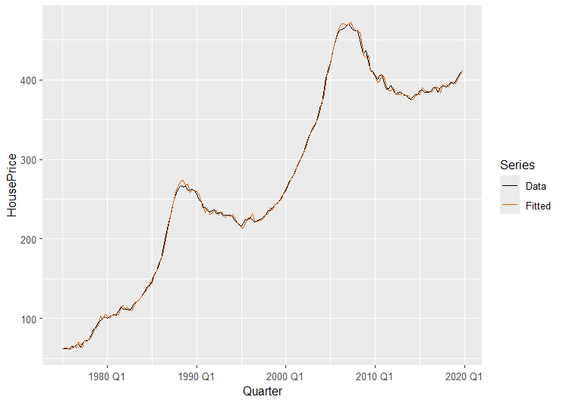
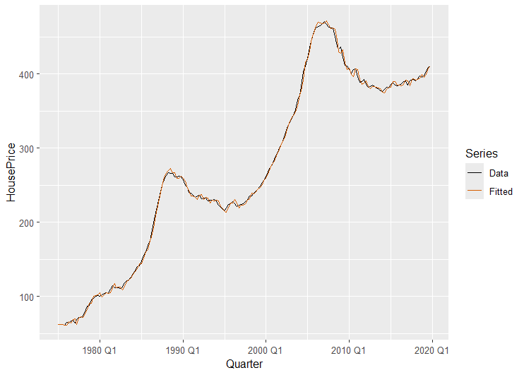
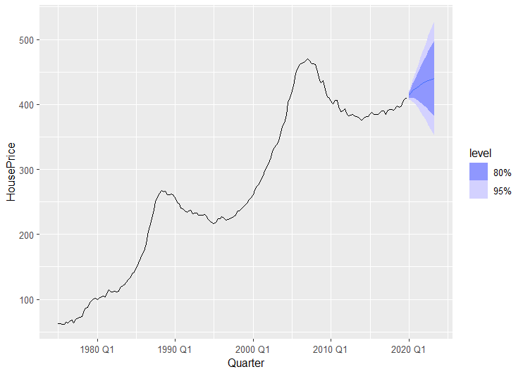
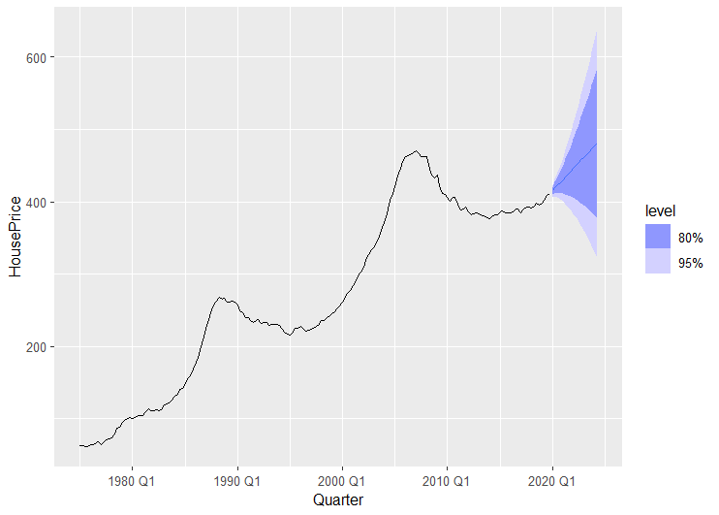
Manual ARIMA model -
pdq(2,2,1)
ARIMA(2,2,1) was tuned using ACF/PACF to account for the housing market's trend and cyclic variations, including downturns like the 2008 crash.
Its flexibility in modeling both trend and short-term patterns makes it an excellent fit for non-stationary time series.

Slide 8


Auto ARIMA model -
ARIMA(1,1,3)(0,0,1)
Auto ARIMA (ARIMA(1,1,3)(0,0,1)) selected parameters automatically using AIC minimization, saving significant time while ensuring accuracy.
It balances precision and efficiency, making it ideal for operational forecasting in time-constrained projects.

Slide 9
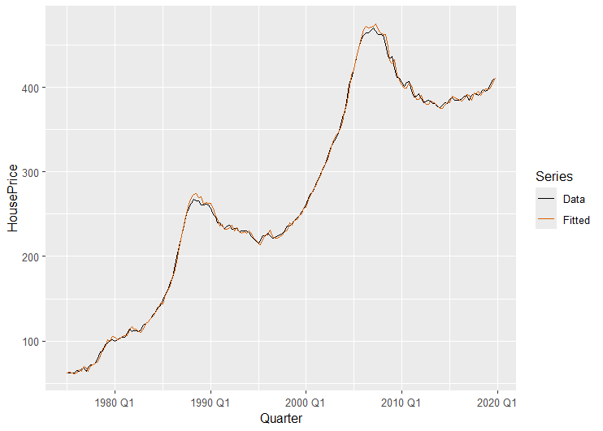
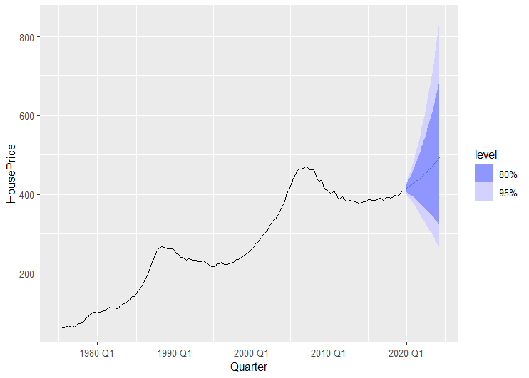
Auto ARIMA Log model -
ARIMA(4,2,0)(2,0,0)
The Auto ARIMA Log model effectively fits the historical house price data, capturing the trends and smoothing irregularities with the ARIMA(4,2,0)(2,0,0) specification.
The forecast highlights the model's predictive capability, with widening confidence intervals indicating uncertainty in future trends as the time horizon extends.

Slide 10
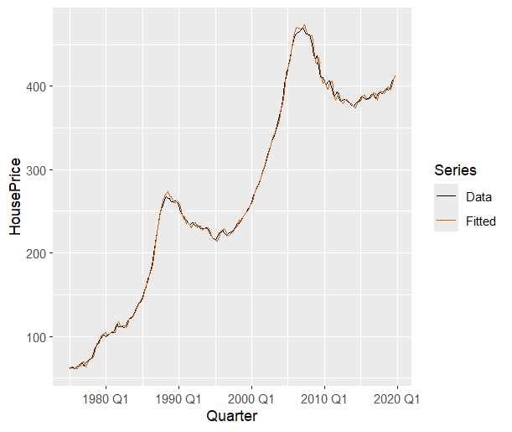
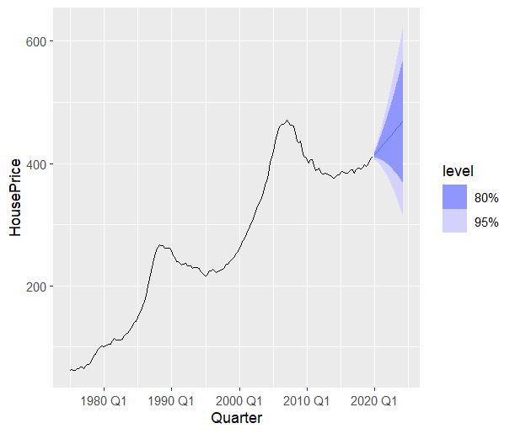
Manual ETS model -
error("A") + trend("Md") + season("N")
The ETS(A, Md, N) model accurately captures additive error and trend dynamics, effectively smoothing fluctuations and highlighting long-term patterns in the absence of seasonality.
It delivers strong historical fitting and reliable forecasts, with confidence intervals reflecting the uncertainty of future trends.

Slide 11
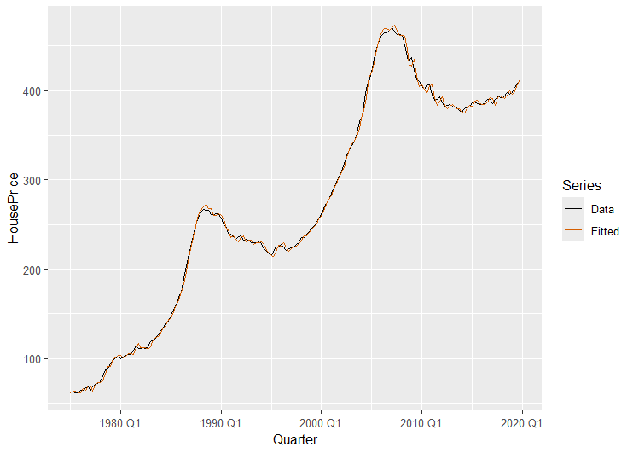

Auto ETS model -
error("A") + trend("Ad") + season("N")
Auto ETS also selected an ETS(A,Ad,N) model, incorporating a damped trend for better long-term predictions.
This automation ensures model optimization while preserving interpretability and alignment with the dataset's behavior.

Slide 12
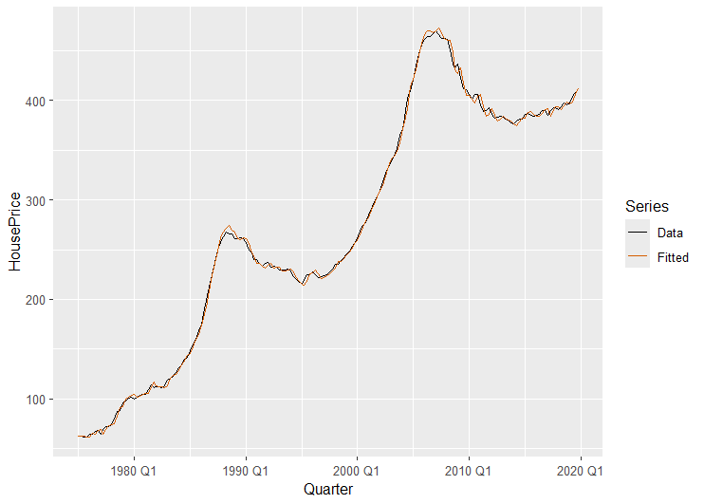
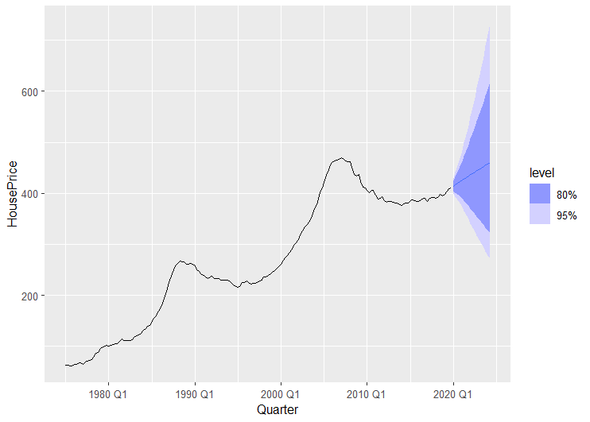
Auto ETS Log model -
error("A") + trend("Ad") + season("N")
The Auto ETS Log model captures the additive error and damped trend dynamics effectively, closely aligning the fitted values with the observed house price data.
The forecast emphasizes long-term trend projections with reasonable confidence intervals, reflecting the model's reliability in handling non-seasonal datasets.

Slide 13
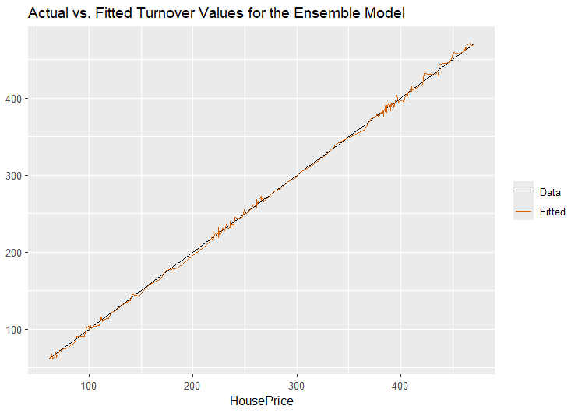
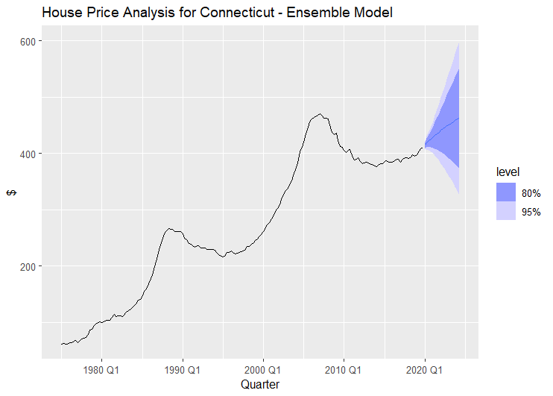
Ensemble model
- ((arima_auto) + (arima_manual)) / 2
The Ensemble model, combining outputs from arima_auto and arima_manual, achieves a near-perfect fit with observed house price data, as evident from the high correlation between actual and fitted values.
The forecast demonstrates robust trend predictions, balancing the strengths of individual models, with confidence intervals reflecting consistent reliability over future periods.

Slide 14

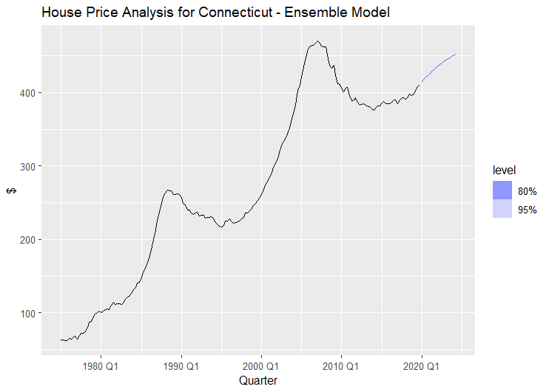
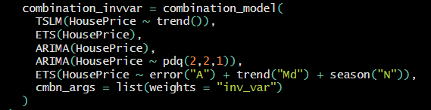
Inverse Variance Ensemble model
The ensemble leverages inverse variance weighting, prioritizing models with higher accuracy and lower error variability. This ensures a well-balanced and robust forecast that integrates the strengths of all individual models while minimizing their weaknesses.

Slide 15
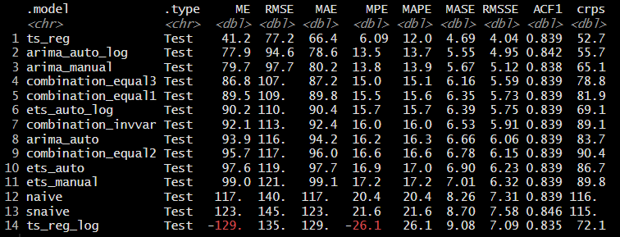
Cross validations of all models
The ts_reg model outperforms all others with the lowest MAPE (12.0%) and CRPS (52.7), highlighting its exceptional accuracy and reliability in forecasting house price data.
Models like arima_auto and combination models, despite decent performance in RMSE and MAE, lag behind in capturing proportional errors and probabilistic forecasts, as reflected by their higher MAPE and CRPS values.

Slide 16
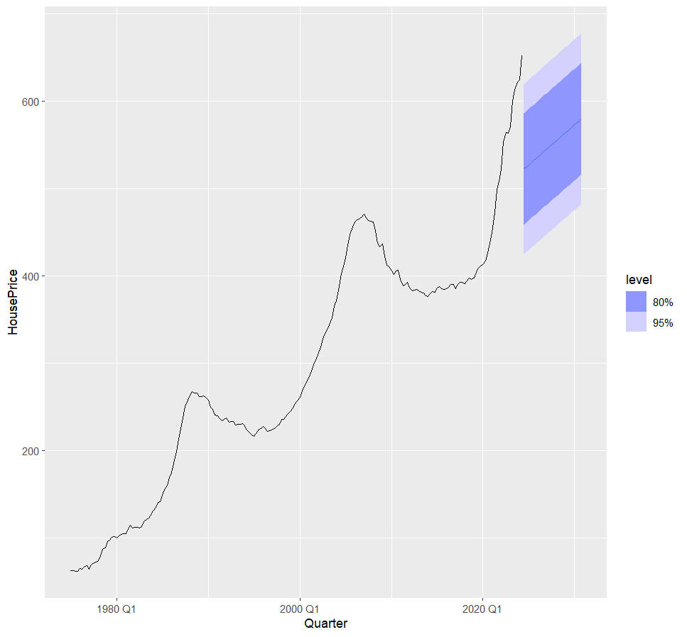
Operational Forecast
The operational forecast utilizes a TSLM (Time Series Linear Model) with a trend component, as this model was identified to best fit the dataset's characteristics based on its minimal MAPE.
This choice was driven by the clear upward trend observed in the house price index, making TSLM the most suitable for capturing the long-term growth trend.

Slide 17
Conclusion & Recommendations
Potential Reasons
Investors: Given the continued upward trend in the House Price Index, investors are advised to consider the Connecticut real estate market as a long-term investment opportunity. As the recent forecast, depicted in the graph, indicates continued growth with confidence intervals that suggest a relatively stable trajectory.
Real estate owners: In Connecticut should be aware that rising property values provide opportunities for significant returns if they decide to sell. However, maintaining properties for rental purposes may also be a viable option, given the increased demand for housing and expected growth in rental rates.
Consumers: For potential homebuyers, it is crucial to recognize the current price growth trend and its implications. Given the forecasted rise in house prices, buying sooner rather than later may help secure properties before they become less affordable. While there may be slight variations, the overall trend is expected to remain upward, emphasizing the importance of acting promptly.
Government Incentives
Limited Housing Supply
Economic Development
Mortgage Interest Rates
Increased Housing Demand from Remote Workers
Rising Rental Demand
Proximity to Employment Hubs
Population Growth

Slide 18
Thank You
Do you have any questions?

Slide 19
Appendix

Slide 20
Iterations of manual ARIMA model
1
ARIMA(HousePrice ~ pdq(0,1,0)) - AIC=1022.37
2
ARIMA(HousePrice ~ pdq(0,1,1)) - AIC=986.24
3
ARIMA(HousePrice ~ pdq(1,1,0)) - AIC=980.8
4
ARIMA(HousePrice ~ pdq(2,1,0)) - AIC=979.19
5
ARIMA(HousePrice ~ pdq(1,1,1)) - AIC=970.65
6
ARIMA(HousePrice ~ pdq(2,2,1)) - AIC=953.99

Slide 21
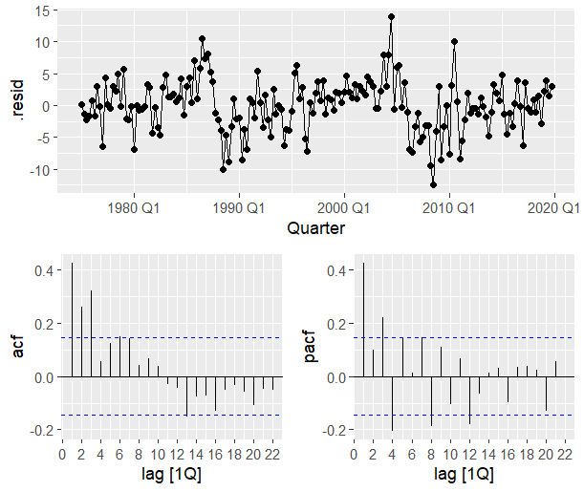
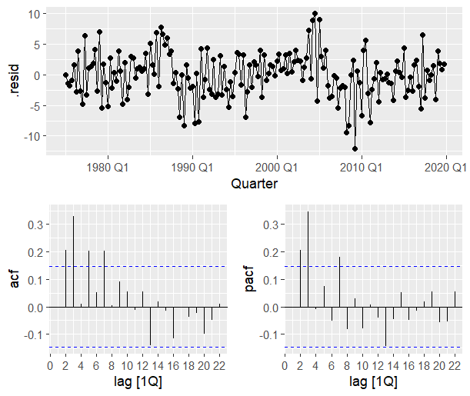
Augment Plots for ARIMA (ACF and PCF)
ARIMA(HousePrice ~ pdq(0,1,0))
ARIMA(HousePrice ~ pdq(0,1,1))

Slide 22
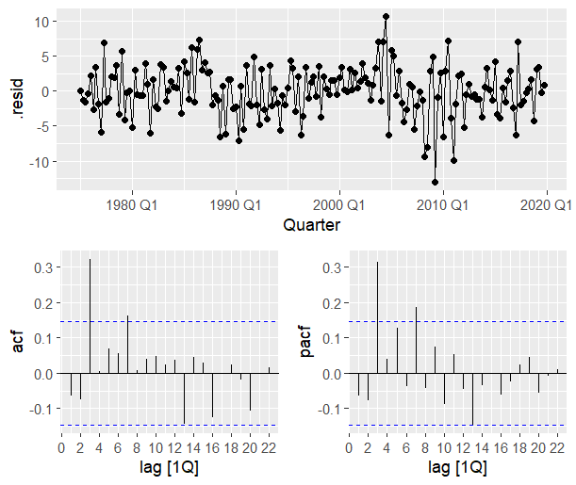
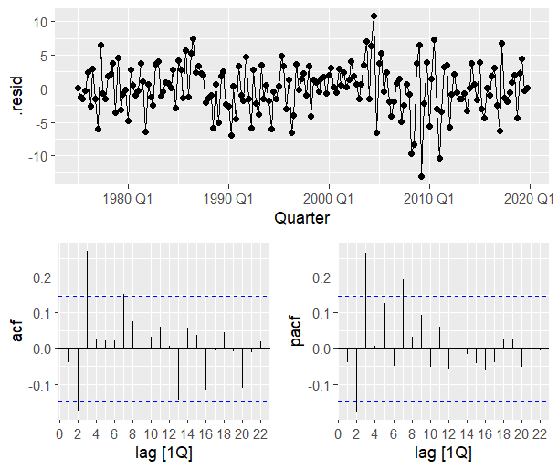
Augment Plots for ARIMA (ACF and PCF)
ARIMA(HousePrice ~ pdq(1,1,0))
ARIMA(HousePrice ~ pdq(2,1,0))

Slide 23
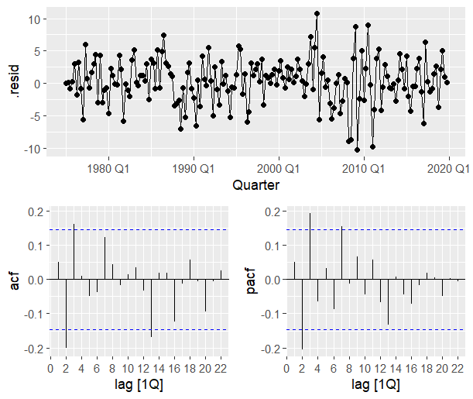
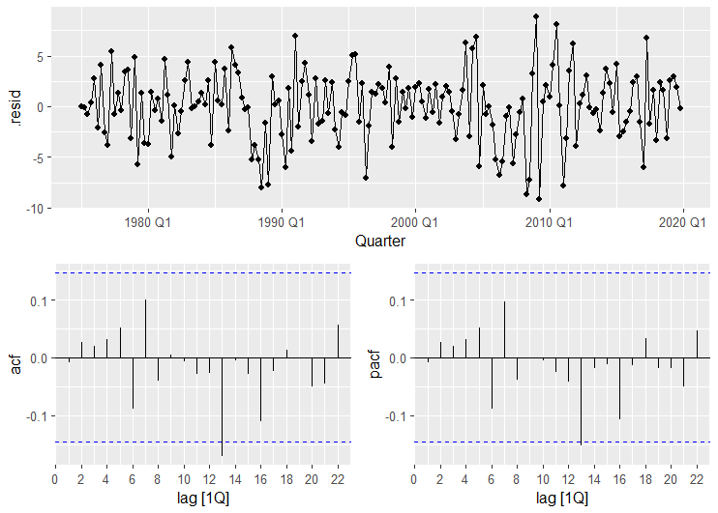
Augment Plots for ARIMA (ACF and PCF)
ARIMA(HousePrice ~ pdq(1,1,1))
ARIMA(HousePrice ~ pdq(2,2,1)

Slide 24
Iterations of manual ETS model
1
ETS(HousePrice ~ error("M") + trend("M") + season("N")) - # AIC = 1476.761
2
ETS(HousePrice ~ error("M") + trend("A") + season("N")) - # AIC = 1473.866
3
ETS(HousePrice ~ error("M") + trend("Md") + season("N")) - # AIC = 1473.979
4
ETS(HousePrice ~ error("A") + trend("M") + season("N")) - # AIC = 1420.145
5
ETS(HousePrice ~ error("A") + trend("A") + season("N")) - # AIC = 1415.744
6
ETS(HousePrice ~ error("A") + trend("Md") + season("N")) - # AIC = 1410.683

