Slide 1
Activity Board

Slide 2
Activity Board Übersicht
Gadgets are activity modules with electronic or mechanical parts to play with. Gadgets will be placed independently on a wooden board with a central master module providing power supply and other common features. Gadgets range from simple mechanical knobs to electronic games with OLED display (e.g. tretris, snake, pong).
USB-C
charging
USB-C
upload
Sound Library
microSD Card
Master Module
Battery
Pack
Master
Controller
Sound
System
Speaker
Volume
Control
Activity Bus (I2C BUS)
USB-C
upload
Music Gadget
Sun Gadget
Pong Gadget
Buttons
Panel
Indicators
Panel
Music
Controller
Time of Day Panel
Sunlight
Panel
Sun
Controller
OLED
Display
Controller
Panel
PingPong
Controller
Music Gadget consists of 4 buttons and 4 LED indicators.
Every button is accompanied by a picture and corresponds to an individualsound in the master sound library. If a button is pressed the corresponding sound is played and the LED indicator lights up.
Sun Gadget consists of a "Time of Day" knob to turn and control the "Sunlight". The knob is round and points to phases during a normal day (early morning, late morning, midday, afternoon, evening, night) identified by symbols. Turning this knob controls the brightness of the "Sunlight" represented by a round convex lid illuminated by a white LED. If exact positions are hit a song correspondingt to the phase is played (e.g. at "night" a lullaby).
Pong Gadget is a simple implementation of the ping pong game. It consists of a small OLED display (1 or 2 inch) and a Controller Panel with "start / stop" buttons and a potentiometer to control the racket. It also plays "ping / pong" sounds when rackets hit the "ball".

Slide 3
Standard Specifications
Soldered Connection
JST 2.54 XH (2 poles)
JST 2.54 XH (4 poles)
USB (4 poles)
x
Resistor
x µF
Capacitor
USB Pin | Ardino Pin | Kabelfarbe | Bedeutung
G | GND | schwarz | Power minus
VBUS | 5V | rot | Power plus
D- | A4 | weiß | SDA
D+ | A5 | gelb | SCL

Slide 4
Activity Bus Board

Slide 5
Activity Bus Board
Gadget
Selector
Power
Panel Port USB
Activity Bus Board
5k
Peripherical 1
Panel Port USB
Peripherical n
Panel Port USB
5k
Gadget 1
Panel Port USB
Gadget n
Panel Port USB
2 Pull-Up-Widerstände am Master Module
5 kΩ (normalerweise 2,2 - 4,7 kΩ)
von Master SDA nach VCC und
von Master SCL nach VCC

Slide 6
Connecting Periphericals and Gadgets via Activity Bus Board
Activity Bus Board
USB Pin Belegung
G : GND
D- : SDA (Ardino A4)
D+ : SCL (Ardino A5)
V : VCC (5V)
USB
USB
USB
USB
USB
USB
USB
USB
USB
USB
Peripherical 1
Peripherical …
…
Gadget 1
Gadget …

Slide 7
Power Supply

Slide 8
Power Supply
Power Supply Board
Charging
Panel Port (USB)
TP4056
Charging
OUT+
MT3608
Step Up
OUT-
VIN-
VIN+
Power Switch
on / off
B+
B-
220
OUT+
OUT-
Charging
use any USB chager
Battery Pack
3,7 V – 5200 mAh
Red (+)
Power Output
Panel Port (USB)
Power Mapping
only V5 and GND are provided
Black (-)
Power LED
USB Pin Belegung
G : GND
V : VCC (5V)

Slide 9
Sound Module

Slide 10
Sound Module
Service Mapping
GND, D-, D+ pass thru
VBUS left open
connect computer for software
upload and debugging
Service
Panel Port (USB)
Speaker
connect 8 Ohm 4 Watt
use banana connectors
Sound Module Board
Player Pin Mapping
Pin 2 (RX) : D10 (TX) (1 k Ohm)
Pin 3 (TX) : D11
Pin 16 (busy) : D12
1k
D12
D11
D10
GND
5V
GND
Arduino Nano
D2
D3
D4
Volume Control
Pin 6
2
3
16
Speaker Panel Port
(Banana Sockets)
Rotary Encoder Mapping
CLK : D2
DT : D3
SW : D4
GND : GND
+ : 5V
Black (-)
DFPlayer Mini
5V and GND connections
not shown in diagram
A4
A5
D9
Red (+)
Pin 8
5V
GND
VBUS (left open)
14
15
1 7 (10)
USB C Breakout Board
470 µF
220
D+
5V
5k
D-
Player LED
5V
GND
GND
Sound Upload
Panel Port (USB)
Sound Upload Board Mapping
D+ : Pin 14
D- : Pin 15
GND : connected
VBUS : left open
Activity Bus
Panel Port (USB)
Sound Upload
connect computer USB
use explorer to manage sd card

Slide 11
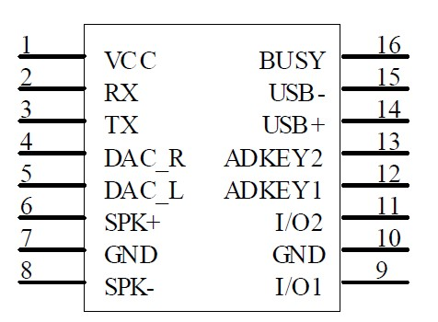
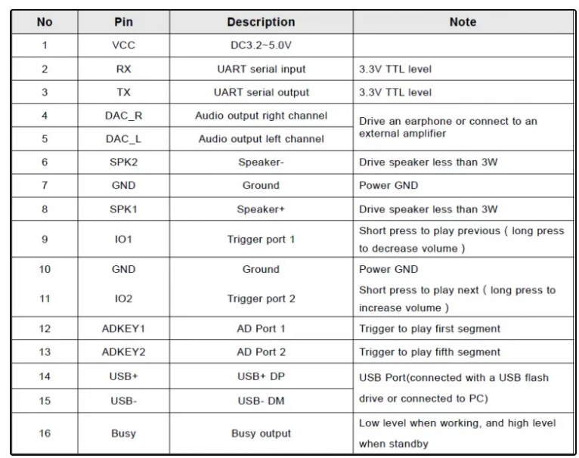
DFRobotDFPlayerMini player;
SoftwareSerial playerSerial(11, 10); // RX, TX
…
setup
playerSerial.begin(9600);
player.begin(playerSerial, true, false);
loop
player.next();
Arduino Pin auf Player Pin
D2 (TX) auf 10 (RX) braucht 1 k Ohm Widerstand
D3 (RX) auf 11 (TX)

Slide 12
Numpad Module

Slide 13
Numpad Module
USB Pin Belegung
G : GND
D- : SDA
D+ : SCL
V : VCC (5V)
PCF8574 | Numpad | Bedeutung
P0 | Pin 2 | row 1
P1 | Pin 7 | row 2
P2 | Pin 6 | row 3
P3 | Pin 4 | row 4
P4 | Pin 3 | col 1
P5 | Pin 1 | col 2
P6 | Pin 5 | col 3
P7 | unbelegt | col 4
Numpad Module Board
VCC
Activity Bus
Panel Port (USB)
GND
PCF8574
SDA
SCL
GND
VCC
Numpad
https://github.com/RobTillaart/I2CKeyPad

Slide 14
USB Pin Mapping
G : GND
D- : SDA (Ardino A4)
D+ : SCL (Ardino A5)
V : 5V
I2C Sockets Board
Gadget A
Panel Port USB
Gadget B
Panel Port USB
Gadget C
Panel Port USB
Gadget D
Panel Port USB
I2C Bus
Panel Port (USB)
Service
Panel Port (USB)
V
GND
D+
D-
General Gadget Board
A5
A4
GND
Arduino Nano
5V
other component
other component
other component
other component

Slide 15
Computer
Arduino IDE
software upload
debugging
USB Power Mapping
only V5 and GND are provided
Charging (USB)
Power Supply Board
Li Battery Pack
TP4056
MT3608
Power Out
Port (USB)
Power / Service Port (USB)
Master Board
DFPlayer Mini
common components
5V
Arduino Nano
GND
A5
A4
V
GND
D+
D-
USB Pin Mapping
G : GND
D- : SDA (Ardino A4)
D+ : SCL (Ardino A5)
V : 5V
Gadget A
I2C Port (USB)
more Gadgets …
I2C Port (USB)
I2C Port (USB)
Service Port (USB)
Gadget Board A
V
GND
D+
D-
A5
A4
GND
Arduino Nano
5V

Slide 16
Computer
Arduino IDE
software upload
debugging
USB Power Mapping
only V5 and GND are provided
Charging (USB)
Power Supply Board
Li Battery Pack
TP4056
MT3608
Power Out
Port (USB)
Power / Service Port (USB)
Master Board
DFPlayer Mini
common components
5V
Arduino Nano
GND
A5
A4
V
GND
D+
D-
USB Pin Mapping
G : GND
D- : SDA (Ardino A4)
D+ : SCL (Ardino A5)
V : 5V
Gadget A
I2C Port (USB)
more Gadgets …
I2C Port (USB)
I2C Port (USB)
Service Port (USB)
Gadget Board A
switch V
V
GND
D+
D-
A5
A4
Arduino Nano
GND

Slide 17
Light Field
red-red-brown
220 k Ohm
+
L1
-
GND
…
…
TF Card, FAT32, Folder "mp3"
Files "0001.mp3" … "0004.mp3"
red-red-brown
220 k Ohm
+
L4
-
…
D8
D11
VCC
D11 / RX
VCC Pin 1
DFPlayer
Mini
SPK_1 Pin 6
Speaker
8 Ohm
Arduino
Nano
+
D10 / TX
100 µF
GND Pin 7
SPK_2 Pin 8
GND
-
A0
…
TX Pin 3
RX Pin 2
D4
D7
brown-black-red
1 k Ohm
Button Field
T1
…
T4
Master
Switch
Battery Box
GND
VCC Pin 1
+
-
Poti
4,5 V
Pin 2
VCC
GND Pin 3
GND

Slide 18
https://wokwi.com/projects/474422651455561729
https://wolles-elektronikkiste.de/dfplayer-mini-ansteuerung-mit-dem-arduino

Slide 19
Power Supply Board

Slide 20
Power Board Panel Laser Template Controls
Panel
inkl. nut : 90 x 94
innen : 80 x 84
Platine
Höhe : 30
Battery Pack
Höhe : 39
Controls Area
Höhe : 15
Breite : 80
Charging USB (links)
- Links :
USB
SW
USB

Slide 21

Power Board Panel Laser Template Labels
Panel
inkl. nut : 90 x 94
innen : 80 x 84
Platine
Höhe : 30
Battery Pack
Höhe : 39
Controls Area
Höhe : 15
Breite : 80
Charging USB (links)
- Links :
Fizz Bizz
Charge
Master Switch
Output
[Power Supply Module]
USB
SW
USB

Slide 22


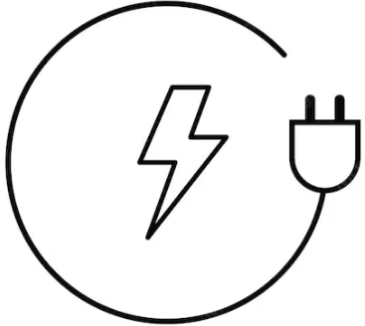
Power Board Panel Laser Template Frame
Frame
außen : 115 x 120
innen : 79 x 84
Rand : 18
Fizz Bizz
power supply 5V=

Slide 23
Lingo Bingo

Slide 24
Lingo Bingo Controls
Panel
inkl. nut : 115 x 133
innen : 100 x 120
LED Kreis
von oben: 50
Radius: 30
Charging USB (links)
- Links :
6
2
3
0,77 cm
4
5
1
0,77 cm

Slide 25

Lingo Bingo Frame
Frame
außen : 136 x 156
innen : 100 x 120
Rand : 18
Fizz Bizz
Lingo Bingo

Slide 26

Frame
Breite : 86

Slide 27
https://sfxr.me/
https://www.myinstants.com/en/search/?name=pacman
https://sonniss.com/category/sound-libraries/bundles/

Slide 28
Numpad via PCF8574-I2C-Extender

Slide 29
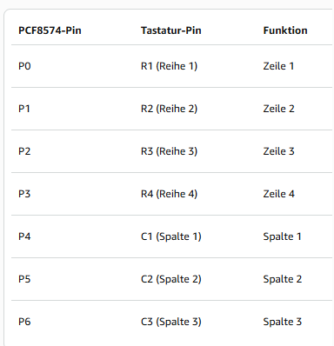
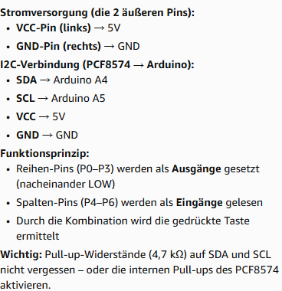
Numpad mit PCF8574-I2C-Extender

Slide 30
