Slide 1

Disaster preparedness and response
ASHRAAY
Advanced Safety and Hazard Response for Aid, Assistance and safetY
Your shelter in every emergency.
A multi-agent AI system that predicts floods, verifies citizen reports and plans the response, with a person approving every warning and action.
Predict
›
Verify
›
Approve
›
Respond
Team
Jeslin Joseph · Benny Libin · Mathew George · Yadunath R
Notes:
Title. ASHRAAY: Advanced Safety and Hazard Response for Aid, Assistance and safetY. One line: a multi-agent AI system that predicts floods, verifies citizen reports and plans the response, with a person approving every warning and action.
Logo: ASHRAAY brand mark.
Team: Jeslin Joseph, Benny Libin, Mathew George, Lijo, Yadunath R.

Slide 2
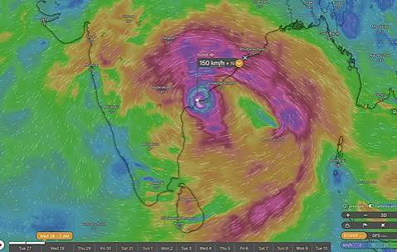
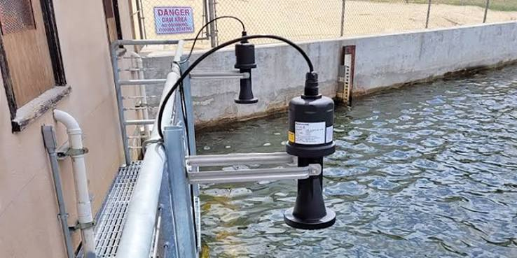
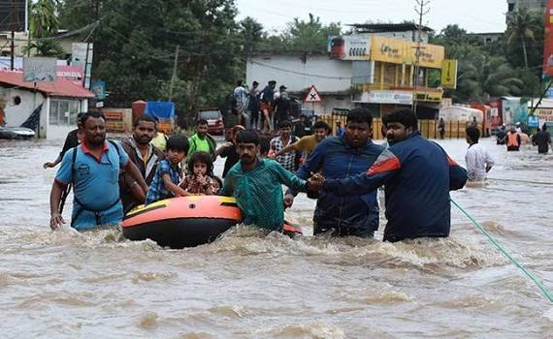
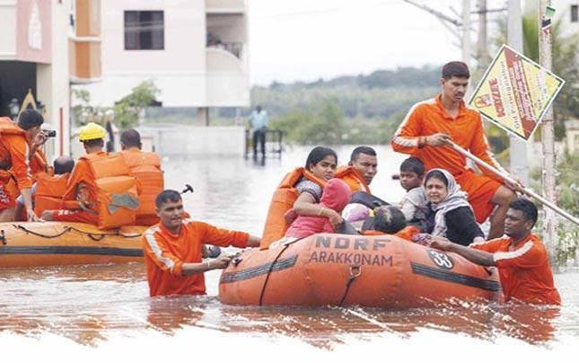










Background | ASHRAAY: Advanced Safety and Hazard Response for Aid, Assistance and safetY
The hard part of disaster response is coordination, not detection
India has strong early warning systems. But during disasters, critical information is fragmented, delayed and hard to turn into coordinated action.
What responders have today
Official alerts + forecasts
Sensor data
Residents + communities
Emergency resources
Weather forecasts
Flood warnings
Risk advisories
River levels
Rainfall
Field sensors
Satellite data
Safety check-ins
Help requests
Photos, text, location
Local observations
NDRF / SDRF
Police + fire services
Ambulances + hospitals
Shelters + relief support
The coordination gap These sources exist, but they are not connected
Fragmented information
Unclear ground conditions
Limited resources
Rapidly changing conditions
Data arrives from many sources, in different formats and at different times
Little visibility into who is safe, at risk or urgently needs help
Rescue teams, boats, medical care and shelters have finite capacity
New incidents and shifting resources make earlier plans obsolete
The need: one shared, verified picture that turns alerts, reports and resources into coordinated, approved action.
2
Notes:
Talking points:
- India already has strong early warning systems; detection is not the hard part.
- The hard part is coordination: alerts, sensors, citizen reports and emergency resources all exist, but they are not connected.
- Four gaps: fragmented information, unclear ground conditions, limited resources, rapidly changing conditions.
- What is needed: one shared, verified picture that turns all of this into coordinated, approved action.
Sources: ASHRAAY design document (SAHAY_Detailed_Architecture_Design.docx, the project's earlier working name) and the ASHRAAY executive deck.
Photos are illustrative; confirm usage rights before external sharing.

Slide 3








Overview | ASHRAAY: Advanced Safety and Hazard Response for Aid, Assistance and safetY
How ASHRAAY closes the coordination gap
A multi-agent AI system that connects people, data and resources, and answers each gap with a specific capability
What ASHRAAY brings together
The gap
How ASHRAAY closes it
Official alerts
Fragmented information
One verified picture
IMD / CWC / NDMA
Weather forecasts · flood warnings · risk zones
Every channel and official feed lands in one incident record; duplicates merged, evidence kept
Many sources, formats and timings
Handled by A1 + A2
Sensor data
IMD / CWC
Unclear ground conditions
Live view of who needs help
Live readings · sensor health · satellite + field data
Safety check-ins, verified reports and field status on one map, with confidence shown
Resident safety check-in
Little visibility into who is safe or at risk
Handled by A1
Citizen app, WhatsApp, SMS
I’m safe · I’m at risk · I need urgent help
Limited resources
Right help to the right place
Field reports + social media
Shelters, teams and supplies matched by priority and safety; the commander approves
Volunteers, field teams, posts
Three AI agents
Teams, boats, care and shelters are finite
Help requests · photos, text, location
Handled by A3 + Decision Gate
Human approval
Emergency resources
Fail-safe by design
Rapidly changing conditions
Plans update as things change
District + state agencies
Forecasts trigger early preparation; field status flows back and A3 re-plans
NDRF / SDRF · police, fire · hospitals · shelters
Earlier plans quickly become obsolete
Handled by A2 + A3
The closed loop how the gap stays closed, incident after incident
Listen every channel
Assess + verify A2 + A1
Plan A3 Response
Approve commander
Act alerts + tasks
Track field status
Field status and new evidence feed back in, so the picture and the plan stay current
Pilot targets
to be validated in the pilot
< 5 min
< 15 min
≥ 90%
100%
3 languages
citizen report to verified incident
flood alert to approved response plan
duplicate reports merged automatically
warnings + dispatches approved by a person
English, Hindi + pilot state language
3
Notes:
Talking points:
- Left: the five sources ASHRAAY brings together.
- Middle and right: each gap is answered by a specific capability, with the agent that handles it.
- Bottom: the closed loop (listen, assess + verify, plan, approve, act, track) keeps the gap closed incident after incident.
- Pilot targets are goals to be validated in the pilot, not measured results. The 100% human-approval target is a design rule; the 3 languages follow the localization design.
Sources: ASHRAAY design document (SAHAY_Detailed_Architecture_Design.docx, the project's earlier working name) and the ASHRAAY executive deck.

Slide 4



















Users and channels
Who uses ASHRAAY, and how they reach it
Each persona reaches ASHRAAY through the channel that fits their situation and connectivity
How to read the table
Report sends reports to ASHRAAY
Resident Reporter
Community Member
Verified Volunteer
Incident Commander
Response Agency
Platform Admin
Receive receives alerts or updates
Two-way sends and receives updates
Reports flooding, trapped people or urgent needs
Receives verified, local-language alerts for their area
Accepts approved, safe tasks and reports progress
Reviews evidence; approves, modifies or rejects plans
Deploys teams and supplies; updates field status
Manages identity, roles, integrations and audit
Citizen App Photo · voice note · GPS · tracking | Two-way | Receive | – | – | – | –
WhatsApp Text · voice note · photo · location pin | Two-way | Receive | – | – | – | –
SMS Low-connectivity fallback | Two-way | Receive | – | – | – | –
Phone helpline (IVR) Keypad menu · voice message | Report | Receive | – | – | – | –
Emergency call Operator logs the call · callback | Two-way | – | – | Two-way | – | –
Volunteer App Task offer · route · status · offline | – | – | Two-way | – | – | –
Field Tracking Live route · timeline · field status | – | – | – | – | Two-way | –
Command Center (web) Map · evidence · plan approval | – | – | – | Two-way | Receive | –
Admin Console (web) Identity · roles · integrations · audit | – | – | – | – | – | Two-way
Designed for everyone
Low connectivity
Local language
Consent + privacy
Accessible
SMS fallback · keypad helpline · save offline, send later
English, Hindi + pilot state language; original kept with translation
Consent at report · volunteer location masking
Screen readers · high contrast · large buttons · non-audio options
4
Notes:
Talking points:
- Six personas, each with a distinct role.
- Every persona reaches ASHRAAY through a channel that suits their situation, including SMS and a keypad helpline for low connectivity.
- Report = sends in; Receive = gets alerts; Two-way = sends and receives.
- Designed for everyone: low connectivity, local language, consent and privacy, accessibility.
Note: WhatsApp needs an approved business provider integration. Emergency calls are logged by a control-room operator on the commander's team.
Sources: ASHRAAY design document (SAHAY_Detailed_Architecture_Design.docx, the project's earlier working name) and the ASHRAAY executive deck.

Slide 5
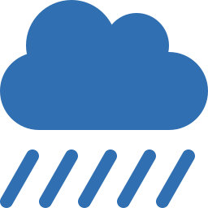












Agents
Three focused agents, one human decision gate
Agents predict, verify and plan through a secure hub; a person approves every warning and action
Agent A1
Agent A2
Agent A3
Human in the loop
Community Intelligence
Hazard Intelligence
Response Coordination
Decision Gate
Verifies citizen reports
Predicts official flood risk
Prepares early, plans the response
Approves every warning and action
Understands any language, text or voice note
Finds where, what help is needed, and when
Merges duplicates, cross-checks, sets priority
Reads official weather, river + sensor data
Predicts where and when flooding is likely
Shows how severe and how certain
Readies teams, shelters + supplies early
Matches help to verified needs, safety first
Drafts warnings, plans and messages
Approve · modify · reject · escalate
after checking evidence + confidence
Low-confidence items flagged for review, never auto-actioned
In Citizen reports + flood forecast
In Official weather, river + sensor data
In Forecast, incidents, resources, rules
In Warning draft or rescue plan
Out Verified incident + confidence
Out Flood forecast + risk
Out Readiness or rescue plan
Out Approved warnings, tasks + alerts
Never acts on social media alone
Never issues an official warning itself
Cannot dispatch without approval
All decisions recorded
Secure message hub agents never talk directly; they post and read fixed-format messages · one tracking ID follows each incident
How one incident flows From forecast to field status: predict and warn first, then verify and respond
Before the flood predict, prepare + warn
During the flood verify + respond
1
2
3
4
5
6
7
8
9
Forecast in
Flood predicted
Warning drafted
Warning approved
Citizen report in
Incident verified
Rescue planned
Rescue approved
Field status back
Official feeds
A2 Hazard
A3 Response
Incident Commander
App, WhatsApp, SMS
A1 Community
A3 Response
Incident Commander
Field apps
→ A2 Hazard
→ A1 · A3
→ Decision Gate
→ Alert channels
→ A1 Community
→ A3 · dashboard
→ Decision Gate
→ Tasks + alerts
→ A1 · A3
forecast.ingested
risk.assessed
plan.proposed
message.approved
observation.received
incident.updated
plan.proposed
task.approved
assignment.status
Agents never chat freely
No double actions
Failed messages retried
One ID per incident
Backup rules if AI is down
Low confidence → review
5
Notes:
Talking points:
- Three focused agents: A1 verifies citizen reports, A2 predicts official flood risk, A3 prepares early and plans the response.
- They never talk directly; they exchange fixed-format messages through a secure hub, with one tracking ID per incident.
- The Decision Gate is the human in the loop: the commander approves, modifies, rejects or escalates every warning and action.
- The incident flow runs before the flood (predict, prepare, warn) and during it (verify, respond), ending with field status flowing back.
- If the AI is wrong or unsure: every output carries a confidence score; anything below the threshold is flagged to the commander and never acted on automatically.
- Grey labels under each step are the technical message names, for technical reviewers.
Sources: ASHRAAY design document (SAHAY_Detailed_Architecture_Design.docx, the project's earlier working name) and the ASHRAAY executive deck.

Slide 6









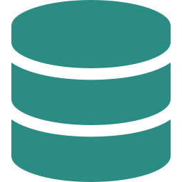
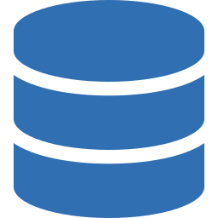
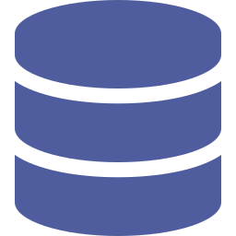

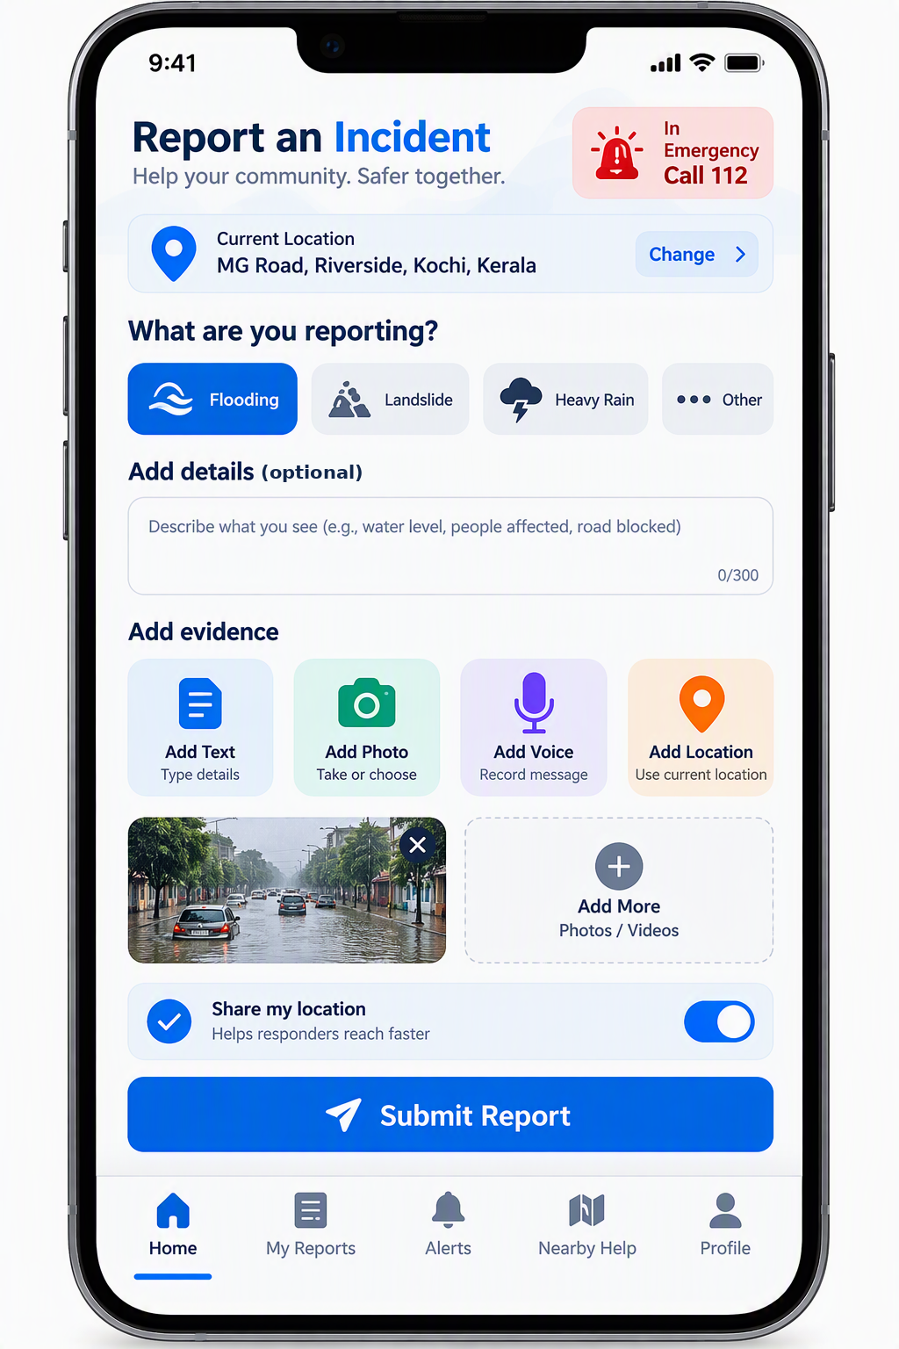
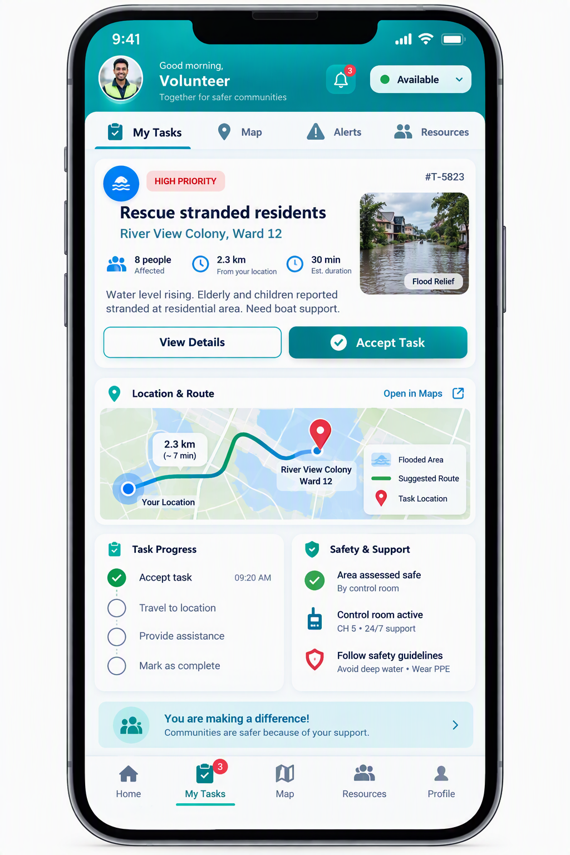
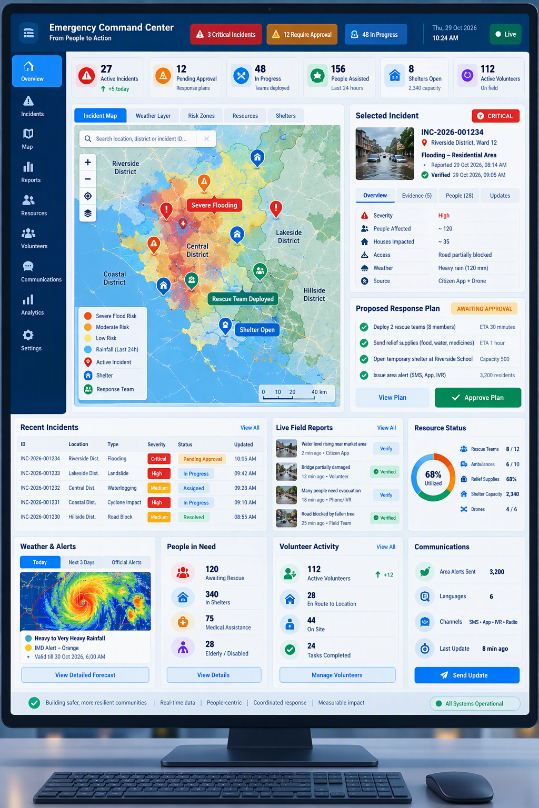
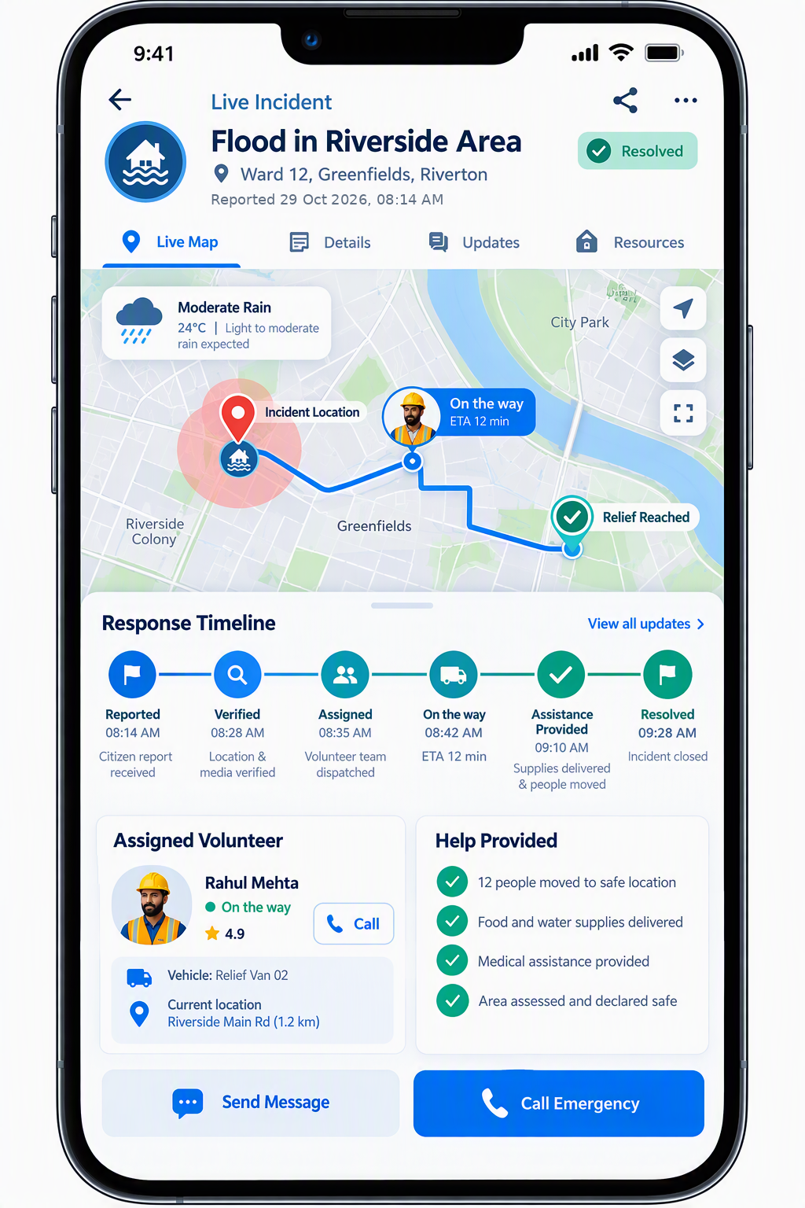



Architecture
Persona-led solution architecture
People first · intelligence bounded · action approved
Layer 4
Web + mobile
API gateway
Message hub
AI agents
Monitoring
Security + audit
Identity + keys
Cloud
Foundation
Hosts every layer
A1 → A3 verified evidence · A2 → A1 + A3 risk context
Agent A1
Agent A2
Agent A3
Human in the loop
Community Intelligence
Hazard Intelligence
Response Coordination
Decision Gate
Layer 3
Verifies citizen reports
Predicts official flood risk
Prepares early, plans the response
No dispatch, evacuation or alert without commander approval
Intelligence
Core
Translate · locate · corroborate
Input: weather + river feeds
Ready · prioritize · match
Approve
Modify
Incident + Evidence Store
Hazard + Geospatial Store
Resource + Assignment Store
Reject
Escalate
Reports · media · field status
Alerts · sensors · maps
Shelters · tasks · status
Approved → alert, task, dispatch
Service flow
1 Capture
›
2 Validate + consent
›
3 Incident service
›
4 Event orchestration
›
5 Approve + dispatch
›
6 Notify + track
uses step 1
uses step 6
uses steps 5–6
uses step 5
uses step 6
Layer 2
Citizen App
Alert Channel
Volunteer App
Command Center
Field Tracking
Admin Console
Role
Experiences
Photo, voice + GPS report
SMS, WhatsApp, push, IVR
Task, route, status
Map, evidence, approval
Live route + timeline
Governs identity + keys
Resident Reporter
Community Member
Verified Volunteer
Incident Commander
Response Agency
Platform Admin
Layer 1
People +
Goals
“Report flooding fast”
“Is my area at risk?”
“A safe, approved task”
“Evidence before approval”
“Right team, right supplies”
“Secure, governed platform”
→ Case ID + guidance
→ Verified local alert
→ Routed safe task
→ Audited decision
→ Live field update
→ Governed access
Closed loop Field status + new evidence re-enter at Step 1 → Incident + Evidence Store → updated alerts and the next decision
6
Notes:
Talking points:
- Read bottom to top: people and their goals, the app each uses, the service flow, the agents with their data stores, and the cloud foundation.
- Every app is tied to the service-flow step it uses.
- The Decision Gate sits between the agents and any action.
- Field status re-enters at step 1, closing the loop.
Note: forecasts enter through A2's official data input and follow the same flow.
Sources: ASHRAAY design document (SAHAY_Detailed_Architecture_Design.docx, the project's earlier working name) and the ASHRAAY executive deck.

Slide 7




Solution and demo
What you will see in the demo
One flood scenario in about 3½ minutes: predict, warn, respond and close the loop, with a person approving every warning and action
Before the flood predict, prepare + warn
During the flood verify + respond
0:00
0:20
0:45
1:05
1:35
2:00
2:30
3:10
Human in
the loop
Human in
the loop
Forecast in
Prepare early
Warning approved
Warning sent
Citizen reports
Incident verified
Rescue approved
Loop closes
Rain + river forecast; A2 predicts the flood zone
A3 readies team + shelter and drafts the warning
Commander checks forecast + confidence
Local-language alert to the at-risk area
Voice + text from the predicted zone
A1 matches to forecast; low confidence flagged
A3 plans the rescue; commander approves
Field status flows back; a failed message is retried
How the loop closes
Human in the loop
Listen
The AI proposes; the Incident Commander decides
reports + forecasts
Track
Assess + verify
Before the flood demo 0:45
During the flood demo 2:30
field status
A2 + A1
Approve the early warning
Approve the rescue plan
Closed loop
Checks forecast, confidence and affected area
Checks evidence, priority and the assigned team
every field update feeds the next decision
Act
Plan
Approve
Modify
Reject
Escalate
alerts + tasks
A3 proposes
AI never sends a warning or dispatches on its own
Approve
Every decision is recorded: who, when and why
commander decides
If the AI is down, backup rules keep the flow running
Low-confidence reports and plans are flagged for review, never auto-actioned
Takeaway: the AI predicts, verifies and plans; a person approves; every field update closes the loop.
7
Notes:
Talking points:
- One flood scenario in about 3½ minutes.
- Before the flood: forecast in, prepare early, warning approved, warning sent.
- During the flood: citizen reports, incident verified, rescue approved, loop closes.
- Two human approvals: the early warning (0:45) and the rescue plan (2:30).
- The AI never warns or dispatches on its own; every decision is recorded; backup rules keep the flow running if the AI is down.
Demo timings for the before-the-flood steps are proposed; adjust to the actual demo. ASHRAAY warnings are advisories that cite the official source.
Sources: ASHRAAY design document (SAHAY_Detailed_Architecture_Design.docx, the project's earlier working name) and the ASHRAAY executive deck.

Slide 8
Implementation
Implemented project flow
Updated from the 99-file project reference: UI, simulator, API, database and runtime agents
ASHRAAY Simulator
Dashboard · Weather · Rivers & dams · Simulator · Monitor
Command Center
Hazard review · cases · people · approvals · operational dashboard
Mobile PWA
Citizen reporting · acknowledgements · volunteer acceptance · field status
Event Simulator
Synthetic hazard events and demo inputs
Shared browser layer
Authentication · localization · offline queue · static serving
FastAPI application / domain services
Accounts + security · hazard intelligence · simulator feed · incidents · plans · alerts · volunteer and field workflows
PostgreSQL
Operational state · agent_inbox · agent_message · agent runs · audit
A1 Evidence
Saved report/event → validated summary, urgency, action and confidence concerns
A2 Prediction
Synthetic forecast poll → checked risk/readiness; submit only on material change
A3 Planner
Verified incident/forecast → readiness or rescue plan → commander notification
Human Decision Gate
Verifier / Incident Commander reviews evidence; approves, modifies, rejects or escalates. No agent dispatches responders.
Approved public warning
Citizen app · in-app alert · downstream channels
Approved field work
Verified available volunteers · task acceptance
Closed-loop feedback
Acknowledgement · status · re-plan
9

Slide 9
Agent communication
Who produces, who consumes, and what crosses the boundary
Database-backed inbox and message contracts keep agents decoupled, traceable and human-controlled
A1 · Evidence / Community
INPUT saved report, observation, incident query
OUTPUT validated evidence summary, language, urgency, suggested action, credibility concerns
CONSUMERS verifier, incident service, A3
A2 · Hazard / Prediction
INPUT timer-polled synthetic prediction JSON
OUTPUT checked forecast, risk/readiness signal; no alert on low risk
CONSUMERS API, dashboard, A3
A3 · Planning
INPUT verifier decision, forecast, consent withdrawal or A1 response
OUTPUT readiness brief / rescue plan and commander notification
CONSUMERS Decision Gate, Command Center
PostgreSQL communication backbone
Triggers fan out subscribed domain events and agent messages into deduplicated agent_inbox · polling default 500 ms · LISTEN/NOTIFY wake-up
A3 evidence query
agent_message kind=query
conversationId · runId · incidentId · hop
A1 evidence lookup
A3 calls planning API
agent_message kind=response
inReplyTo · same conversationId · evidence summary
A1 response
Identity
Per-agent API credentials + role limits
Trace
conversationId · inReplyTo · runId · hop
Reliability
max 6 hops · 5 attempts · dead-letter
Authority
Agents propose; humans approve and dispatch
Optional model use is schema-validated; deterministic rules take over when the model is unavailable or invalid.
10

Slide 10









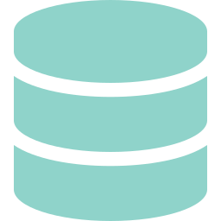












Scalability
Scalable by design: no architecture change
New hazards, agents and districts plug into the same platform; the core architecture is never redesigned
One architecture: add, never rebuild
Every agent, old or new, uses the same message hub, shows evidence + confidence and needs human approval to act
Plug-ins
Official data adapter
Playbook + rules
Alert templates
New agent
only these change
e.g. cyclone, heat, fire feeds
local procedures + priorities
messages in local languages
only if a new skill is needed
A1 In MVP
A2 In MVP
A3 In MVP
A4 Proposed
A5 Proposed
A6 Proposed
Agents
Community
Intelligence
Hazard
Intelligence
Response
Coordination
Health +
Medical
Relief
Logistics
Infrastructure
Status
plug in, same rules
Verifies citizen reports
Predicts official flood risk
Prepares early, plans the response
Hospital beds, ambulances, medical needs
Stock, warehouses, supply routes
Roads, power + telecom outages
Core
Every channel
Message hub
Decision Gate
Data stores
Apps
Fail-safe cloud
NO CHANGE
never changes
Six scenarios, one unchanged architecture
Each scenario reuses the same core and the MVP agents it needs; only the plug-ins differ
Flood + heavy rain
Cyclone + storm surge
Heatwave
Forest fire
Landslide
Disease outbreak
Data Rain + river levels
Data Cyclone + ocean data
Data Heat warnings
Data Satellite fire alerts
Data Rain + slope maps
Data Health surveillance
Agents A1–A3
Agents A1–A3 + A5, A6
Agents A1–A3 + A4
Agents A1–A3 + A6
Agents A1–A3 + A6
Agents A1, A3 + A4, A5
MVP, live in demo
Plug-in
Plug-in
Plug-in
Plug-in
Beyond disasters
Add a new scenario in 4 steps: no redesign
Why the architecture never changes
1
Connect
›
2
Load
›
3
Add an agent
›
4
Drill + go live
One message format: new agents plug into the same hub
the official data feed
playbook + alert templates
only if a new skill is needed
with the same Decision Gate
Standard adapters: each new feed uses the same formats
Split by district: new areas are configuration only
ROADMAP MVP: flood, one district → Pilot: shelters, volunteers, supplies + district data → Scale: more districts, agency links, new hazards after data checks
8
Notes:
Talking points:
- New hazards, agents and districts plug into the same platform; the core never changes.
- Only plug-ins change: data adapter, playbook, alert templates, and a new agent only if a new skill is needed.
- A4 to A6 are proposed extensions, not part of the MVP.
- No architecture change means the core stays the same; new adapters, playbooks and agents still need to be built, tested and drilled before go-live.
- Roadmap: MVP (flood, one district), then pilot, then scale.
Sources: ASHRAAY design document (SAHAY_Detailed_Architecture_Design.docx, the project's earlier working name) and the ASHRAAY executive deck.

