Slide 1
CS611 · Machine Learning Engineering
Loan Default
Medallion Architecture Strategy & Implementation
TL;DR
A monthly Bronze→Silver→Gold pipeline that turns 4 raw CSVs into an ML-ready feature store and label store for predicting loan default at application time.
By Jeslyn Wangsa · May 2026
CS611 · MLE Assignment 1 · Medallion Pipeline · Jeslyn Wangsa
1 / 10

Slide 2
02
The problem we're solving
What we need, what 'done' looks like, who reads this deck
Business problem
Definition of done
• Bank lends cash loans; some borrowers default.
• We need to score default risk at the moment of loan application, before any repayment data exists.
• An ML model will do the scoring (next assignment); this project ships the data pipeline that feeds it.
• Audience: ML engineers (will train the model), data engineers (will operate the pipeline), risk & business stakeholders (need to trust the inputs).
• Three medallion layers — Bronze (raw), Silver (cleaned), Gold (ML-ready) — for every source.
• Monthly snapshots from Jan 2023 to Dec 2024, idempotent and re-runnable.
• One Gold feature store + one Gold label store, joinable on (Customer_ID, snapshot_date).
• Zero target leakage: no post-application or repayment fields leak into features.
• Reproducible via docker-compose up and python main.py.
CS611 · MLE Assignment 1 · Medallion Pipeline · Jeslyn Wangsa
2 / 10

Slide 3
03
Raw data sources
Four CSVs, semicolon-delimited, monthly snapshots Jan 2023 – Dec 2024
File | Role | Grain | Key columns
feature_clickstream.csv | Feature | Customer × month | Customer_ID, snapshot_date, fe_1 … fe_20
feature_attributes.csv | Feature | Customer × month | Customer_ID, Name, Age, SSN, Occupation, snapshot_date
feature_financials.csv | Feature | Customer × month | Customer_ID, Annual_Income, Credit_Mix, Outstanding_Debt, EMI, snapshot_date
lms_loan_daily.csv | Label only | Loan × day | loan_id, Customer_ID, installment_num, overdue_amt, due_amt, snapshot_date
Why these splits matter for design
Three feature files have very different update cadences and quality profiles, so each gets its own Bronze / Silver pipeline. The loan file is repayment history — usable only for labels, never for features.
CS611 · MLE Assignment 1 · Medallion Pipeline · Jeslyn Wangsa
3 / 10

Slide 4
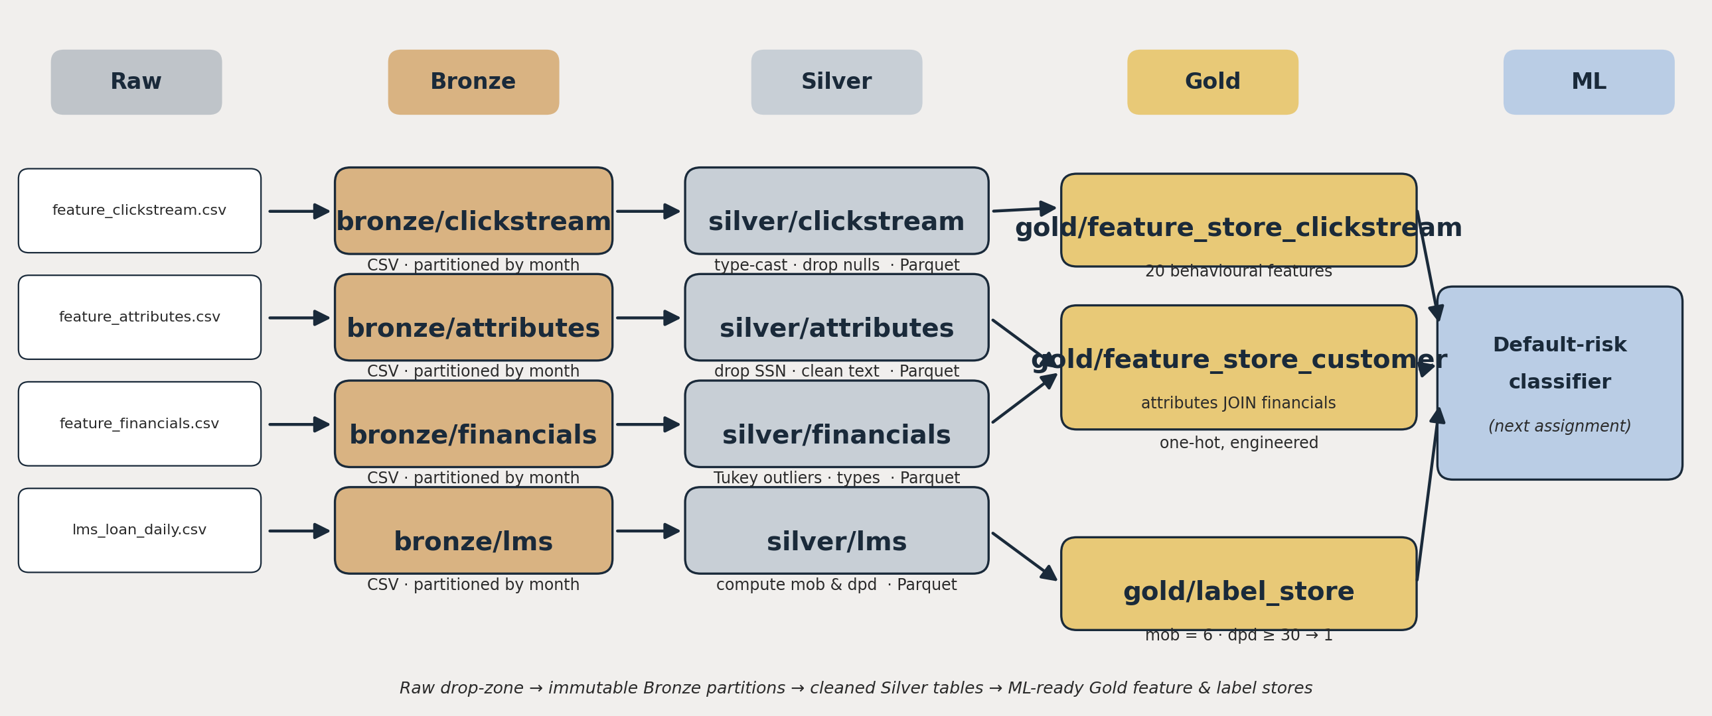
04
End-to-end architecture
Raw drop-zone → immutable Bronze → cleaned Silver → ML-ready Gold → downstream ML
CSV
Parquet
Monthly partition
Raw + Bronze: human-readable, easy to inspect
Silver + Gold: typed, compressed, columnar
One file per snapshot_date — incremental runs
CS611 · MLE Assignment 1 · Medallion Pipeline · Jeslyn Wangsa
4 / 10

Slide 5
05
Bronze — raw landing zone
Slice once, store immutably, never transform
Three design choices
Filename pattern
• Monthly partitions — one file per snapshot_date. Reprocessing is incremental, not full-history.
• CSV format preserved — keeps Bronze byte-identical to the source system so Silver fixes can never poison the raw record.
• Immutable on write — Bronze is the audit trail. Any Silver or Gold version can be reproduced from a frozen Bronze partition.
datamart/bronze/<source>/
bronze_<source>_YYYY_MM_01.csv
Example
datamart/bronze/clickstream/
bronze_clickstream_2023_01_01.csv
Driven by
utils/data_processing_bronze_table.py
main.py loops Jan-2023 → Dec-2024 and writes one partition per source per month.
No type casts, no filters, no joins at Bronze. The only operation is 'select * where snapshot_date = X'.
CS611 · MLE Assignment 1 · Medallion Pipeline · Jeslyn Wangsa
5 / 10

Slide 6
06
Silver — typed, cleaned, trustworthy
Parquet partitions with enforced schema and explicit data-quality rules
Issue found in raw | Treatment | Why
Mixed / wrong data types | Cast each column to its target type (Int, Float, Date, String) | Downstream feature engineering needs a stable schema
PII — SSN, Name | Drop SSN; keep Name only if needed for ops | Legal & privacy risk; SSN has no predictive value
Corrupted strings ("_______", "!@9#%8") | Drop the entire row | Looks like upstream encoding failure, not a missing value
Trailing underscores ("45_", "_") | Strip and re-cast | Recoverable noise — preserve the signal
Numeric outliers (Age = 8000, Income < 0) | Tukey IQR fences + domain bounds (Age 18–70) | Realistic loan applicants only; protects model from leverage points
Loan repayment fields (lms) | Compute mob (month-on-book) and dpd (days past due) | Engineered once at Silver so Gold label logic stays trivial
Output: datamart/silver/<source>/silver_<source>_YYYY_MM_01.parquet · one directory per month, schema-on-write.
CS611 · MLE Assignment 1 · Medallion Pipeline · Jeslyn Wangsa
6 / 10

Slide 7
07
Gold — feature store
Two tables, deliberately split by update cadence
feature_store_clickstream.parquet
feature_store_customer.parquet
20 numeric behaviour features (fe_1 … fe_20)
Grain: Customer_ID × snapshot_date
Real-time-ish — refreshed independently from batch sources
No engineered columns; trust the raw signal
INNER JOIN: silver attributes ⟕ financials on (Customer_ID, snapshot_date)
One-hot: Occupation, Credit_Mix, Payment_Behaviour
Type_of_Loan exploded into n_loans_<type> counts
Slow-changing snapshot — batch refresh on schedule
Why two tables, not one?
• Different update cadence — joining them at Gold would force the slower table to wait, or staleness to leak in.
• Different ownership — attributes/financials come from core banking; clickstream comes from web analytics.
• Joined on demand at training time via (Customer_ID, snapshot_date) — keeps storage normalised, joins explicit.
Schema preview — feature_store_customer: Customer_ID · snapshot_date · Age · Annual_Income · Outstanding_Debt · EMI · Credit_Mix_Good · Credit_Mix_Standard · n_loans_Personal · n_loans_Auto · …
CS611 · MLE Assignment 1 · Medallion Pipeline · Jeslyn Wangsa
7 / 10

Slide 8
08
Gold — label store
One row per loan, binary default flag observed 6 months after origination
Label definition
Why mob = 6 ?
Observation window
• Short enough to label most loans in the 24-month window.
• Long enough that early-stage hiccups stop being noise.
• Standard industry vintage horizon for unsecured lending.
mob = 6 (the 6th payment after loan start)
Default rule
dpd >= 30 → label = 1 (defaulted)
otherwise → label = 0 (current / paid)
Columns retained
loan_id · Customer_ID · label · label_def · snapshot_date
Code reuse
Label-store logic reused from Lab 2 verbatim — same Silver→Gold transformation on lms_loan_daily, same mob/dpd thresholds, same output schema.
Joinable to either feature_store table on (Customer_ID, snapshot_date) for ML training.
CS611 · MLE Assignment 1 · Medallion Pipeline · Jeslyn Wangsa
8 / 10

Slide 9
09
Data leakage controls
Rule: every feature must be knowable strictly before the loan application date
Target leakage
Temporal leakage
Train-test contamination
• Drop entire lms_loan_daily from features — it IS the answer (repayment history).
• Drop Interest_Rate — set by the underwriter after seeing the risk score; encodes the label.
• Re-check any 'Num_of_Delayed_Payment'-style fields: kept only when measured pre-application.
• Snapshot_date is the as-of cut. We never join a feature row from t+1 to a loan applied at t.
• Monthly partitions enforce the cut physically: a Jan-2023 training run only reads ≤ 2023-01-01 files.
• Clickstream & financials are user-level snapshots — confirmed safe.
• Feature engineering is fit per partition, not across the whole table.
• No global means / scalers computed at Gold — that work belongs to the ML pipeline, after the split.
• Same Customer_ID can appear in train and test, but only at different snapshot_dates.
Sanity check (recommended by brief)
Fit a simple logistic regression on Gold feature_store ⋈ label_store. If AUC is implausibly high (> 0.95) on held-out months, suspect a leaky column and trace it back through Silver.
CS611 · MLE Assignment 1 · Medallion Pipeline · Jeslyn Wangsa
9 / 10

Slide 10
10
Tech stack, repo & how to run
Reproducible end-to-end in one command
Tech stack
Python 3
PySpark
Docker
JupyterLab
Parquet
Git / GitHub
How to run
Repository
1. git clone <repo> && cd <repo>
github.com/<your-handle>/MLE_ASM1
clone the project
(see Readme.txt in submission zip)
2. docker-compose build
build the Spark + Jupyter image
3. docker-compose up
Deliverables in zip
launches JupyterLab on http://localhost:8888
• main.py
• Dockerfile · docker-compose.yaml
• requirements.txt
• utils/ · data/
• Readme.txt (repo link)
4. python main.py
loops Jan-23 → Dec-24, writes datamart/{bronze,silver,gold}
5. Inspect datamart/gold/ for ML-ready Parquet tables
feature & label stores land here
CS611 · MLE Assignment 1 · Medallion Pipeline · Jeslyn Wangsa
10 / 10

