Slide 1
Core Image

Slide 2
What is it?
Encapsulating low level gfx processing into a simple API
Provides near realtime processing
Works with Core Graphics, Core Video and Image I/O frameworks
Analysis and Processing of Images

Slide 3
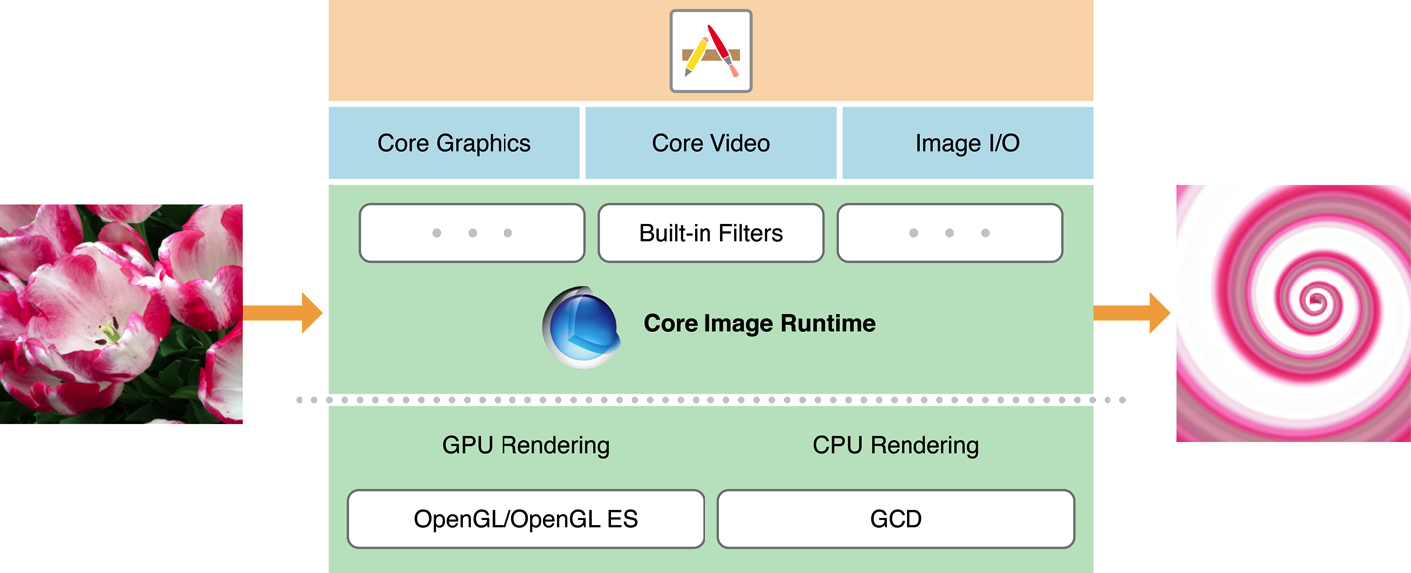
For the sophisticated ones..

Slide 4
What it gives you?
Built-in filters: beat instagram now
Face detection
Automatic Image Enhancement
Mix the filters!

Slide 5
Image Processing

Slide 6
Filters
90+ filters in iOS and 120+ for OSX
Forget imageMagick
Create instagram like apps

Slide 7
What you need to know?
CIContext
CIImage
CIFilter

Slide 8
CIContext
The object that knows how to draw stuffs
Immutable
Thread safe
Best practice: use a single context AFAP

Slide 9
CIImage
Image data. Not image.
Immutable. Thread safe
Follows lazy evaluation

Slide 10
CIFilter
Takes CImage as input, gives CImage as output.
Not mutable, or so for its most part.
Not thread safe

Slide 11
Putting them together
1. Make CIImage out of the Image you want to have the filters applied.
2. Make a CIFilter of the desired effect.
3. Set the CIImage created in Step 1 as inputImage parameter value.
4. Change the effects parameter to have the desired effect.
5. Get the output CIImage from outputImage key.
6. Repeat steps 2-5 until you are satisfied, with inputCIImage = outputCIImage
7. Ask the context to render/draw/create the image from image data.

Slide 12
In code
-(UIImage*) applySepiaEffectOnImage:(UIImage*)image
{
CIImage *inputImage = [CIImage imageWithCGImage:image.CGImage];
CIFilter *sepiaFilter = [CIFilter filterWithName:@"CISepiaTone"];
[sepiaFilter setValue:inputImage forKey:kCIInputImageKey];
NSNumber *intensityValue = [NSNumber numberWithFloat:.45];
[sepiaFilter setValue:intensityValue forKey:@"inputIntensity"];
CIImage *outputImage = [sepiaFilter valueForKey:kCIOutputImageKey];
CGImageRef outputImageRendered = [context createCGImage:outputImage fromRect:[outputImage extent]];
return [UIImage imageWithCGImage:outputImageRendered];
}

Slide 13
Demo

Slide 14
Face Detection

Slide 15
About
Detect faces
Not recognition
Features like eye, mouth positions

Slide 16
CIDetector

