Slide 1

Sales Analysis Dashboard
Power BI Project
Analyzing Sales, Profit & Orders to gain Business Insights

Slide 2

Project Objectives
Extract Insights
Analyze sales data to uncover meaningful patterns.
Understand Trends
Identify performance trajectories and seasonal variations.
Spot Top Performers
Pinpoint leading categories, regions, and products.
Support Decisions
Empower business choices with data visualization.

Slide 3
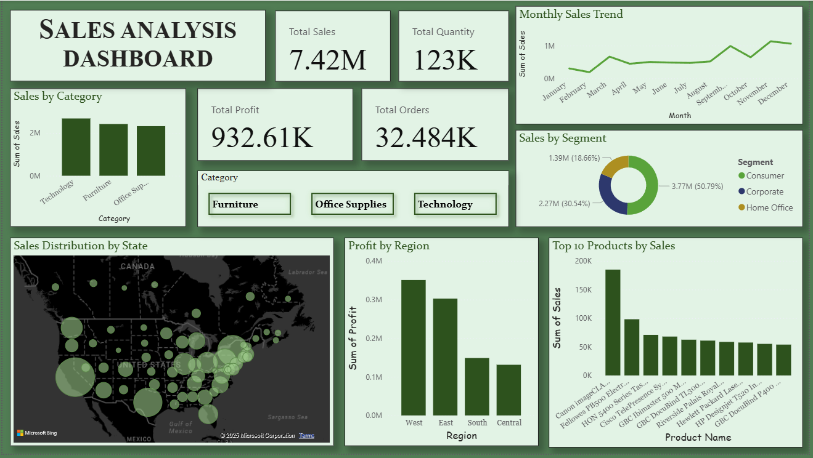

Slide 4
Sales by Category
Chart: Bar chart showing Technology, Furniture, Office Supplies
Key Insight: Technology leads in revenue, Furniture moderate, Office Supplies steady but lower
Talking Point: “Technology dominates sales, while Furniture and Office Supplies show consistent demand.”

Slide 5
Top 10 Products by Sales
Chart: Bar chart ranking products by total sales revenue
Key Insight: A few products contribute disproportionately higher revenue compared to others
Talking Point: “These top 10 products drive the bulk of sales, highlighting where demand is concentrated.”

Slide 6
Profit by Region
Chart: Bar chart comparing profit across regions (e.g., West, East, Central, South)
Key Insight: Western and Eastern regions show the highest profitability, while other regions contribute moderately
Talking Point: “Profitability is concentrated in the West and East, guiding where strategic focus should be applied.”

Slide 7
Distribution by State
Chart: Bubble Map showing sales volume across different states
Key Insight: States with larger bubbles represent higher sales concentration, highlighting geographic hotspots
Talking Point: “This map reveals sales distribution across states, helping identify regions with strong demand and potential growth opportunities.”

Slide 8
Monthly Sales Trend
Chart: Line chart showing monthly sales variation
Key Insight: November & December show peak sales, indicating strong seasonal demand
Talking Point: “Sales rise steadily through the year, with clear spikes in the festive months.”

Slide 9
Sales by Segment
Chart: Donut/Pie chart showing Consumer, Corporate, and Home Office segments
Key Insight: Consumer segment contributes the majority of sales, Corporate moderate, Home Office smaller share
Talking Point: “Consumer sales dominate overall performance, while Corporate and Home Office provide steady contributions.”

Slide 10
KPI Cards & Interactive Slicers
Content:
Cards: Show key metrics → Total Sales, Total Profit, Total Orders, Total Quantity
Slicers: Add interactive filters → Category,
Key Insight: Cards give quick KPI snapshots, slicers allow dynamic filtering for deeper analysis
Talking Point: “This slide combines high‑level KPIs with interactive slicers, enabling users to drill down into specific categories, regions, or time periods for customized insights.”

Slide 11
Data Cleaning Process
Content (Bullet Points):
Removed blank and duplicate records
Handled missing values (nulls)
Verified numerical fields (Sales, Profit, Quantity)
Standardized column names for consistency
Dropped irrelevant attributes to streamline analysis
Ensured date formats were uniform for time‑series analysis
Key Insight / Talking Point:
“Cleaning in Google Colab using Python ensured the dataset was accurate, consistent, and ready for Power BI visualization.”

Slide 12

Dataset & Tools
Dataset Description
Our analysis utilizes the Superstore / Retail Sales Data.
Includes: Orders, Sales, Profit, Quantity, Customers, Regions, Categories & Products.
Data Preparation
Data cleaning performed using Python.
Visualization Tool
All visualizations developed in Power BI.

Slide 13

Key Performance Indicators (KPIs)
$$
##
$$
Total Sales
Total Quantity Sold
Total Profit
Overall revenue generated.
Net earnings from sales.
Volume of products moved.
##
Total Orders
Number of transactions completed.

Slide 14
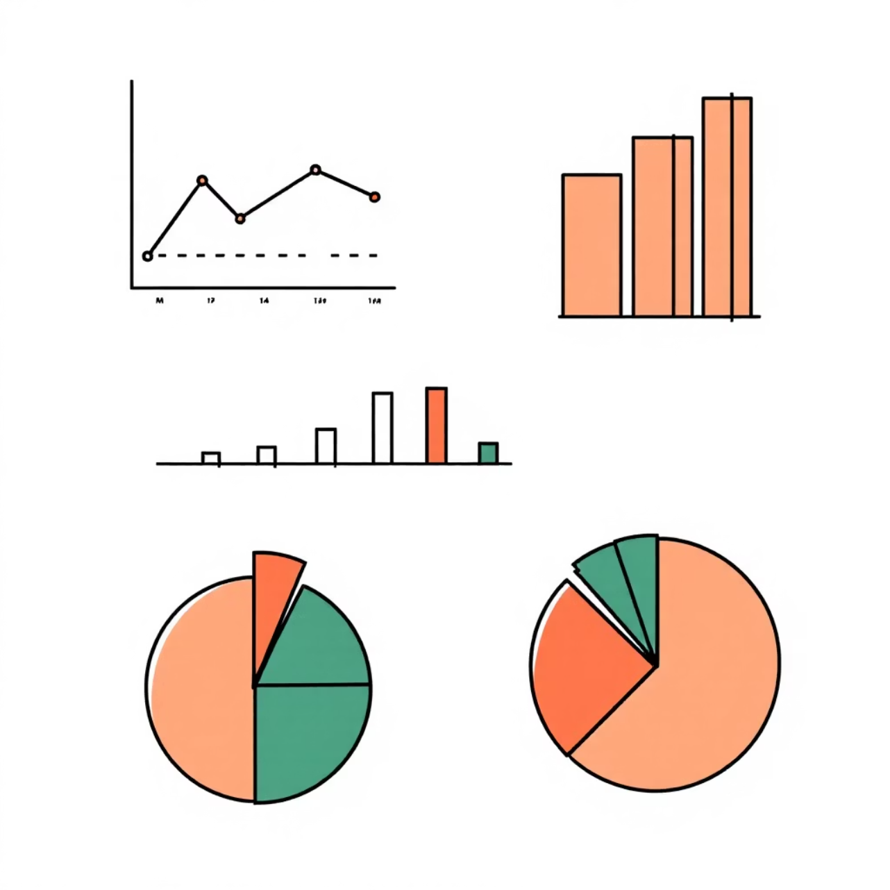
Sales Performance Analysis
Key Charts
Sales by Category
Sales by Segment
Monthly Sales Trend
Insights
These visualizations help us identify the best-performing categories and uncover crucial seasonal sales trends, guiding strategic planning.

Slide 15
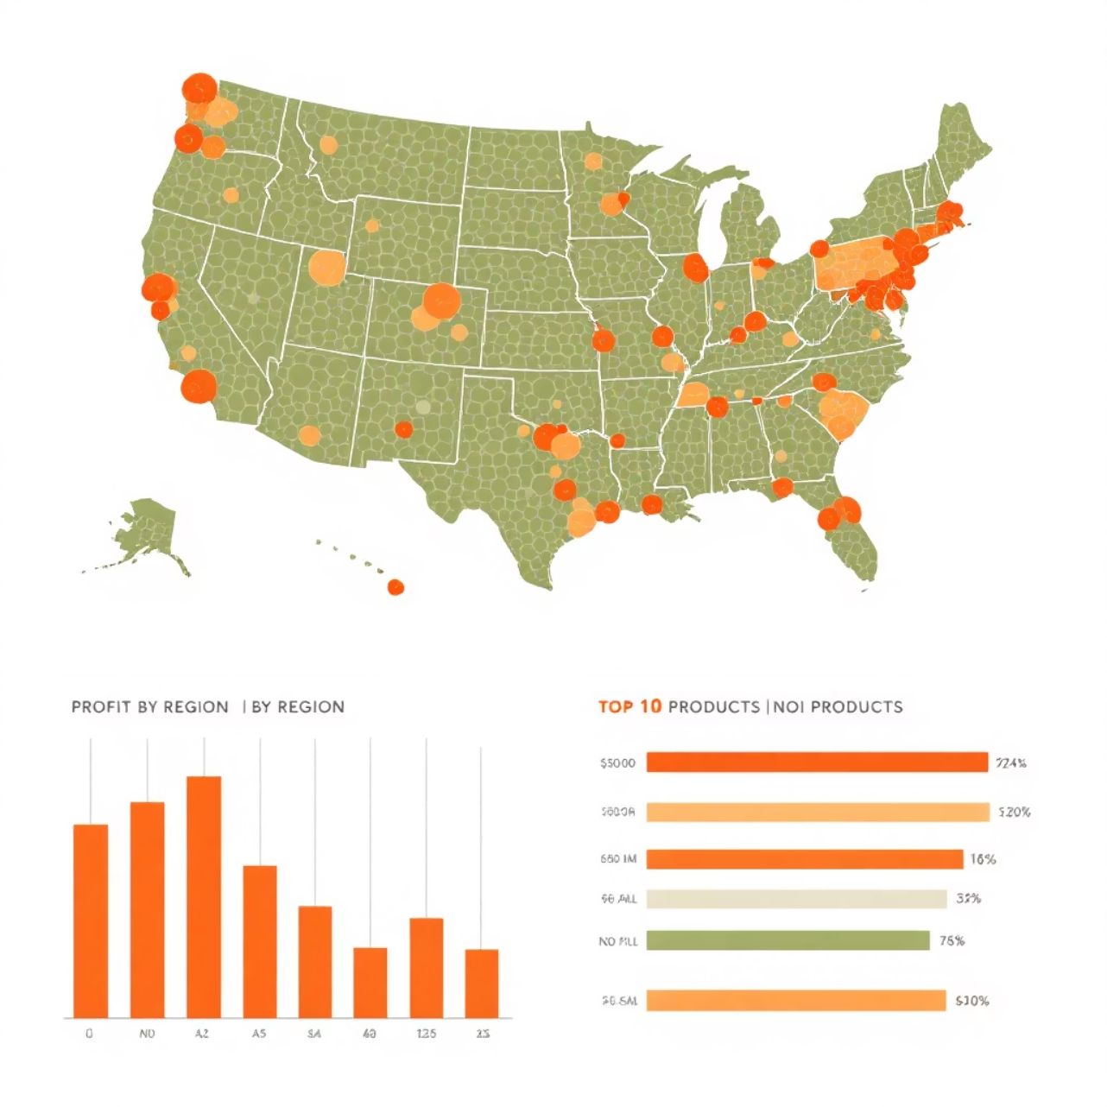
Profit & Orders Deep Dive
Key Charts
Profit by Region
Top 10 Products by Sales
Sales Distribution Map by State (Bubble Map)
Insights
Understand regional profitability, pinpoint best-selling products, and visualize geographic sales hotspots for targeted strategies.

Slide 16

Interactive Dashboard Overview
Interactive
Visual Storytelling
Trend Analysis
Dynamic and user-friendly interface.
Data presented as a compelling narrative.
Tools for identifying evolving patterns.
Category Filters
Clear Insights
Granular performance insights.
Actionable data for informed decisions.

Slide 17
Key Findings & Insights
1
Revenue Leader
Identified the highest revenue-generating category.
2
Profit Hub
Pinpointed the most profitable geographical region.
3
Sales Driver
Determined the segment contributing most to sales.
4
Top Products
Highlighted the best-selling products.
5
Sales Evolution
Analyzed monthly sales trends for seasonality.

Slide 18

Conclusion & Next Steps
1
Monitor Performance
Effectively track business health and progress.
2
Data-Driven Decisions
Make informed choices based on solid data.
3
Growth Opportunities
Identify new avenues for expansion and success.
4
Visual Trend Tracking
Keep an eye on business trends with clear visuals.

Slide 19

Thank You
For your attention and engagement.

