Slide 1
Rockbuster Stealth
Customer, Country, and Revenue Insights for Streaming Launch
By: Jessica Duong

Slide 2

Hello Streaming! Goodbye Status Quo
Rockbuster Stealth LLC is a once-iconic movie rental brand with global reach.
But the rules have changed. Streaming giants like Netflix and Amazon Prime
have rewritten customer expectations and have killed demand for physical rentals.
To win again, Rockbuster must evolve.
To reclaim relevance, Rockbuster plans to leverage its existing film
Licenses and launch a global streaming platform. This shift
demands evidence-based strategy.
This analysis provides the data intelligence required to
lead Rockbuster’s transformation from rental relic to streaming contender.

Slide 3
Key Business Questions
01
02
03
04
Which markets will give Rockbuster the biggest footprint at launch?
Where are our most valuable customers located today?
Which film and genres win, and which fail to monetize?
How do we leverage data to unlock smarter expansion and future-proof Rockbuster’s brand?

Slide 4
Rental Economics Snapshot Stable pricing and engagement levels
$2.98
$60,793.87
Avg Rental Rate
Total Revenue
5 Days
Avg Rental Duration
46-185 minutes
$101.50
$4.20
Film length range
Avg Revenue per Customer
Avg Transaction Value

Slide 5
Customers
Where Are the Customers?

Slide 6
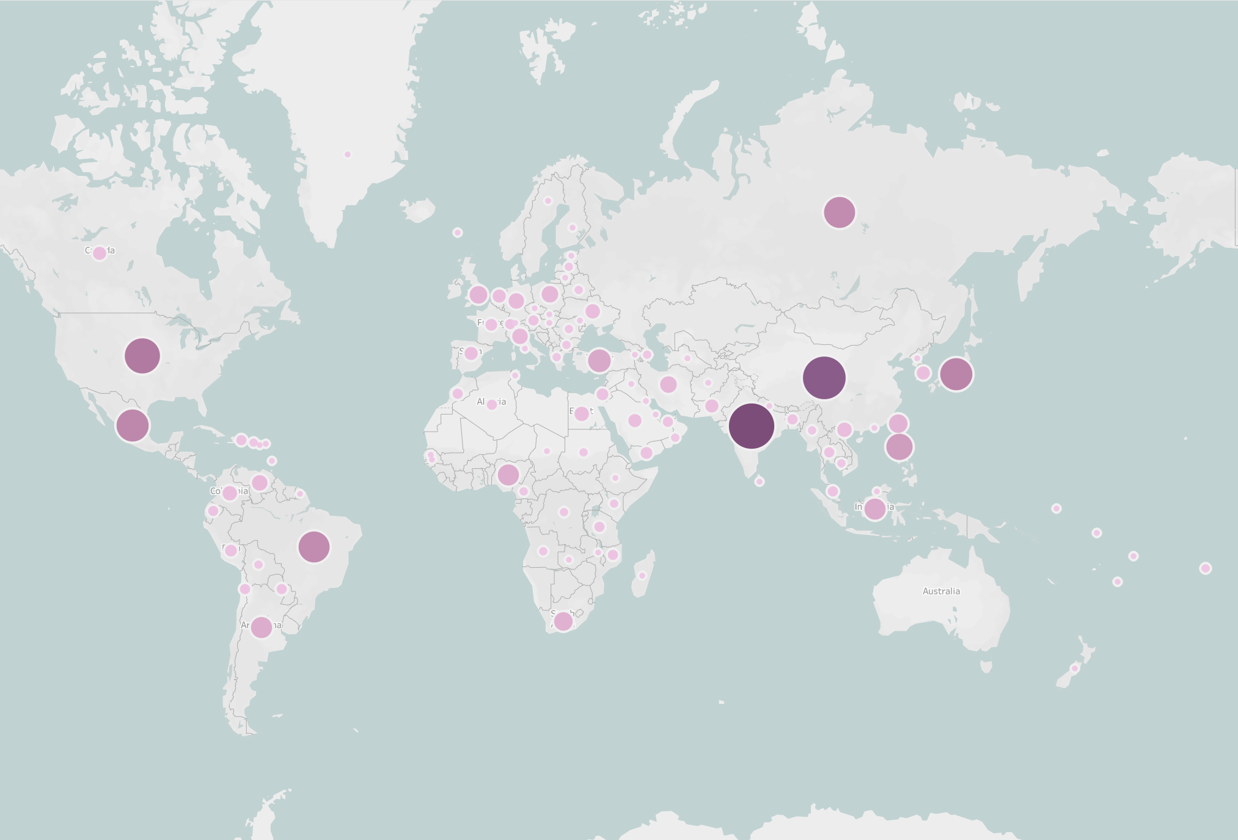
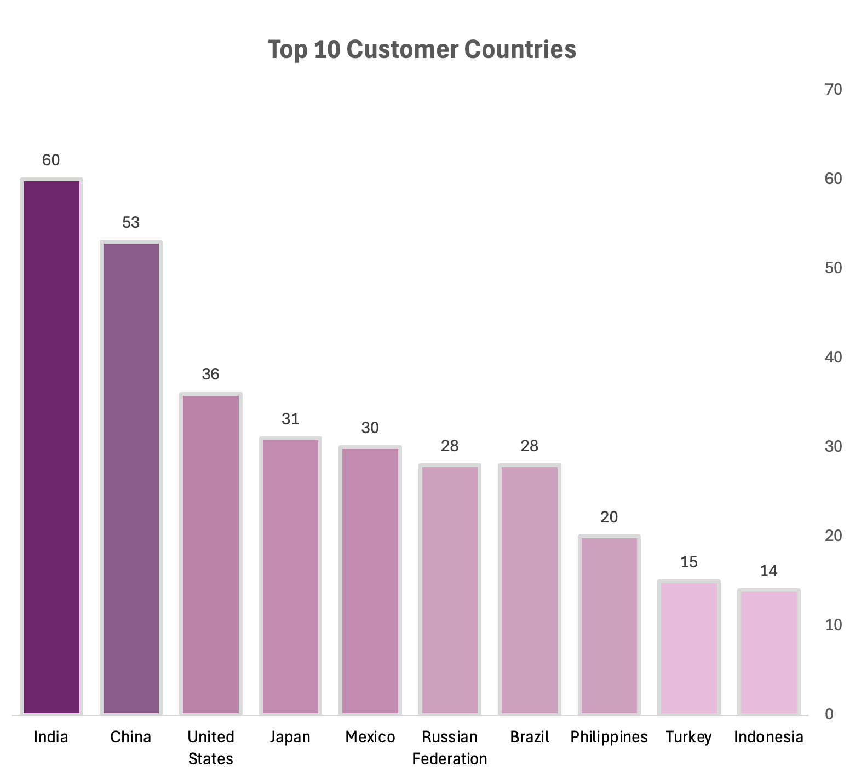
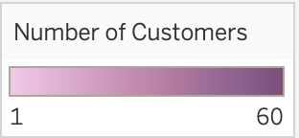
Where the Fans Are
A global customer base is a strategic asset as streaming expands reach beyond physical store locations.
Rockbuster currently serves 599 customers across 108 countries, proving global interest already exists.
Opportunity: A ready-to-convert audience base for digital rollout.

Slide 7
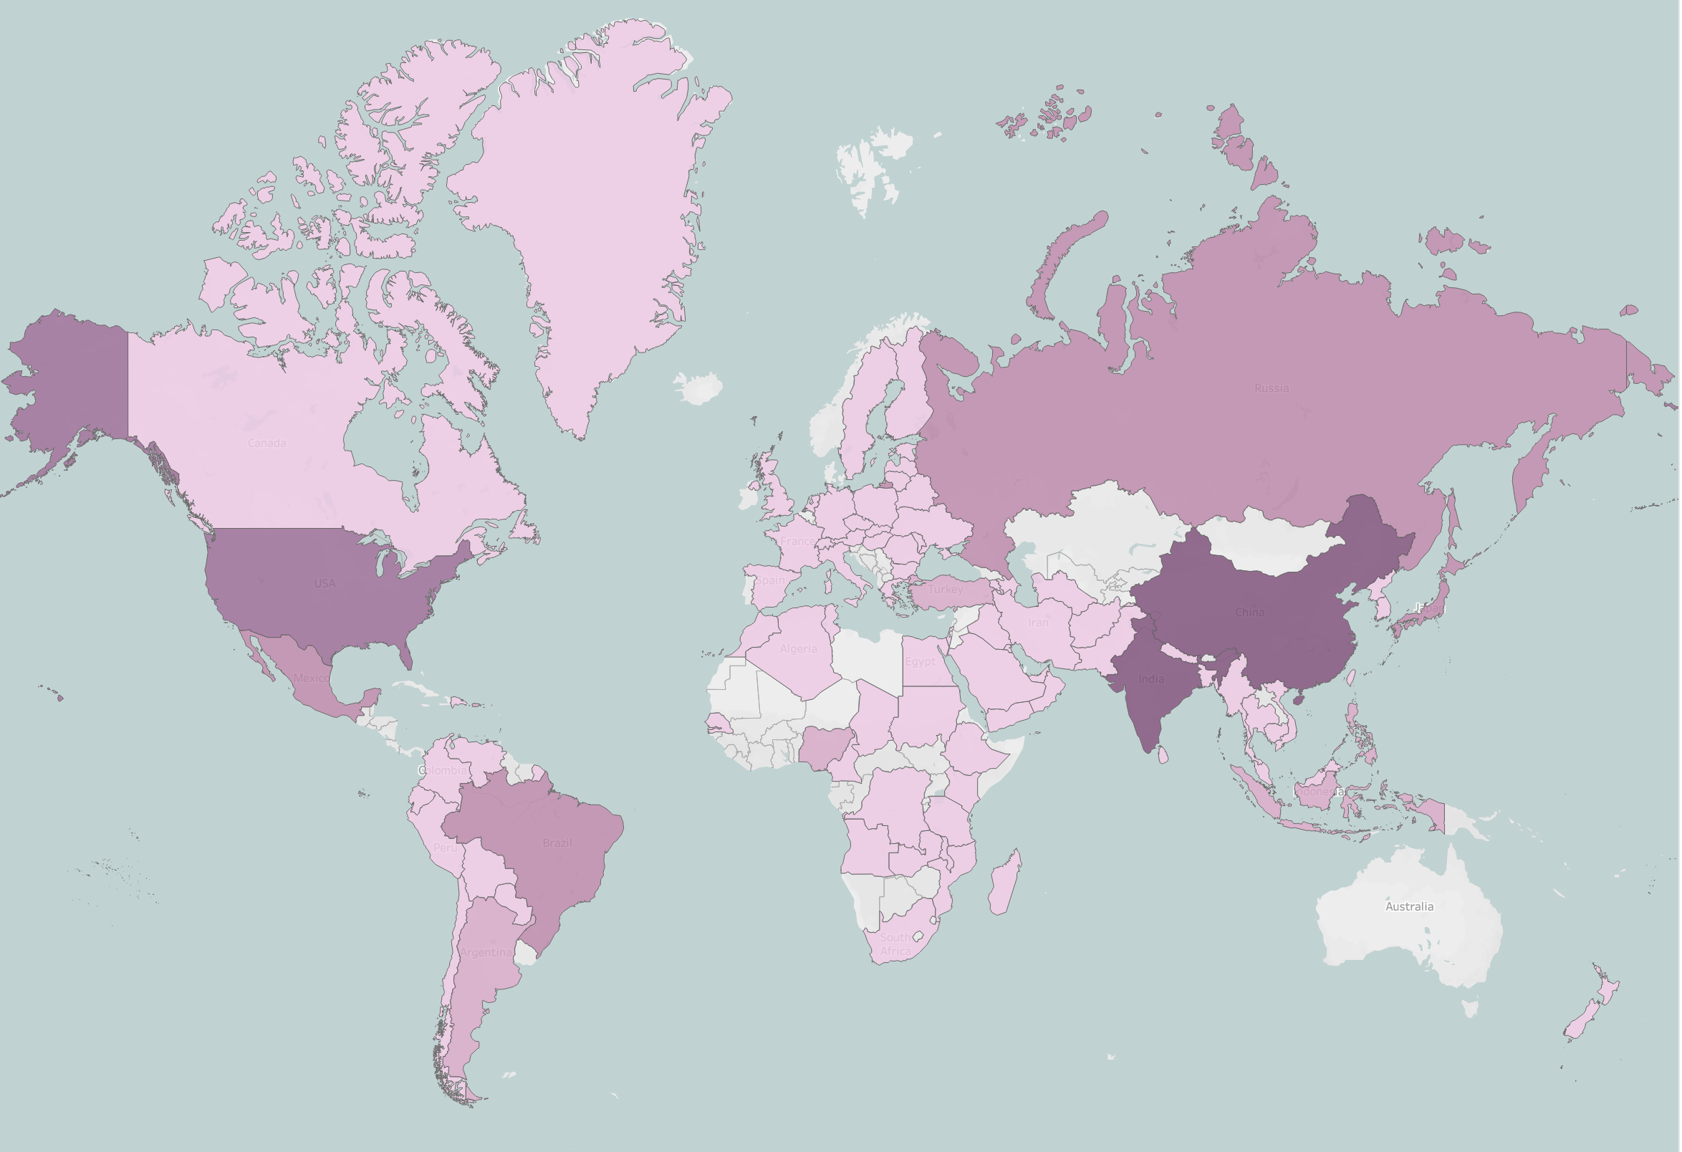
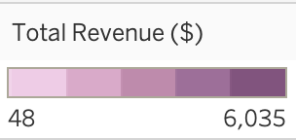
Where High-Affinity Customers Live
India, China, and the United States = ~40% of customers
Japan, Mexico, Brazil, Russia, Philippines, Turkey, and Indonesia form a growth tier with broad reach.
These are the Tier-1 launch markets
Focus early marketing, localization, and infrastructure on Tier-1 + Tier-2 rollout waves.

Slide 8
Revenue Powerhouses
India leads with over $6,000 in payments
High volume
+
High speed
=
High-value launch markets
China and the United States follow closely
These territories generate the revenue that will fund growth.

Slide 9
Rentals
What Content Pays the Bills?

Slide 10
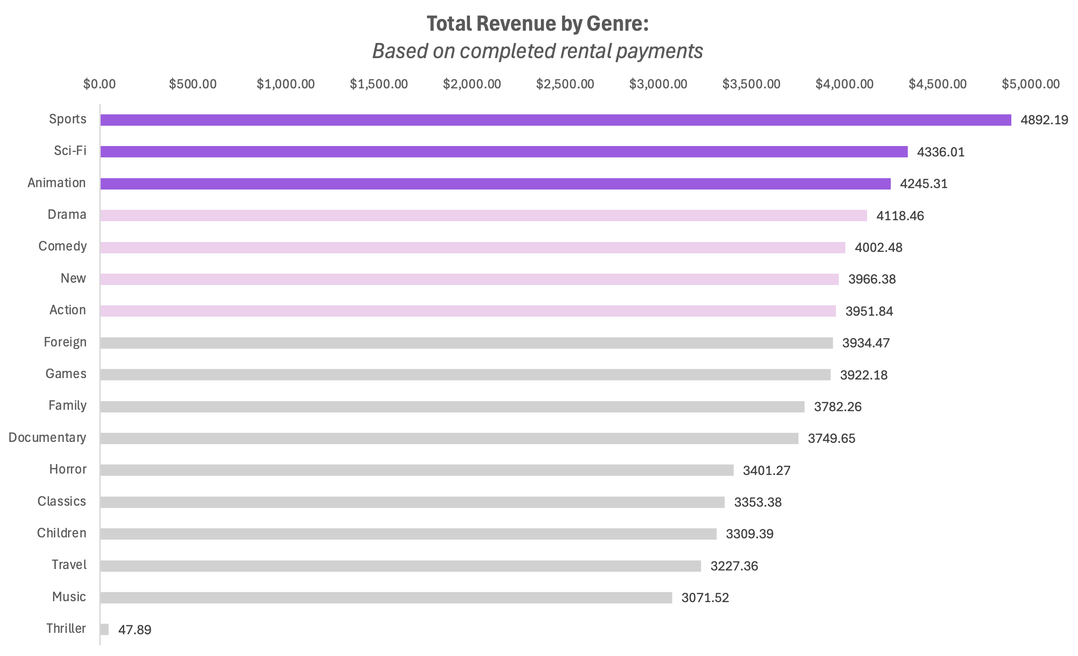
What Content Makes Money?
Drama, Comedy, and Action form the profitable middle tier.
Sports, Sci-Fi, and Animation deliver the strongest revenue performance.
Thrillers deliver low returns and is lower priority for initial streaming library.

Slide 11
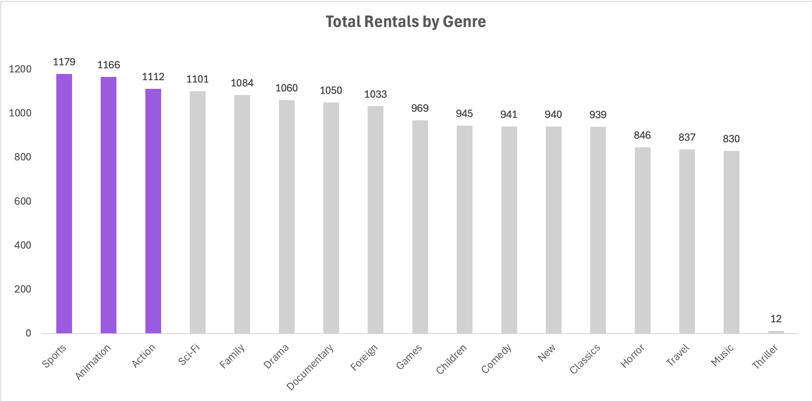
What Drives Demand?
Rental Volume by Genre
Align pricing + promotions where rentals peak
Sports and Animation: high rentals + high revenue
Some genres attract interest but don’t convert into dollars
Maximize both viewership and monetization

Slide 12

Who’s the Audience?
PG-13, NC-17, and PG lead revenue
Teen & adult focus
G-rated titles underperform, therefore family content not core to current base.
Plan launch catalogue for mature audience segments first

Slide 13
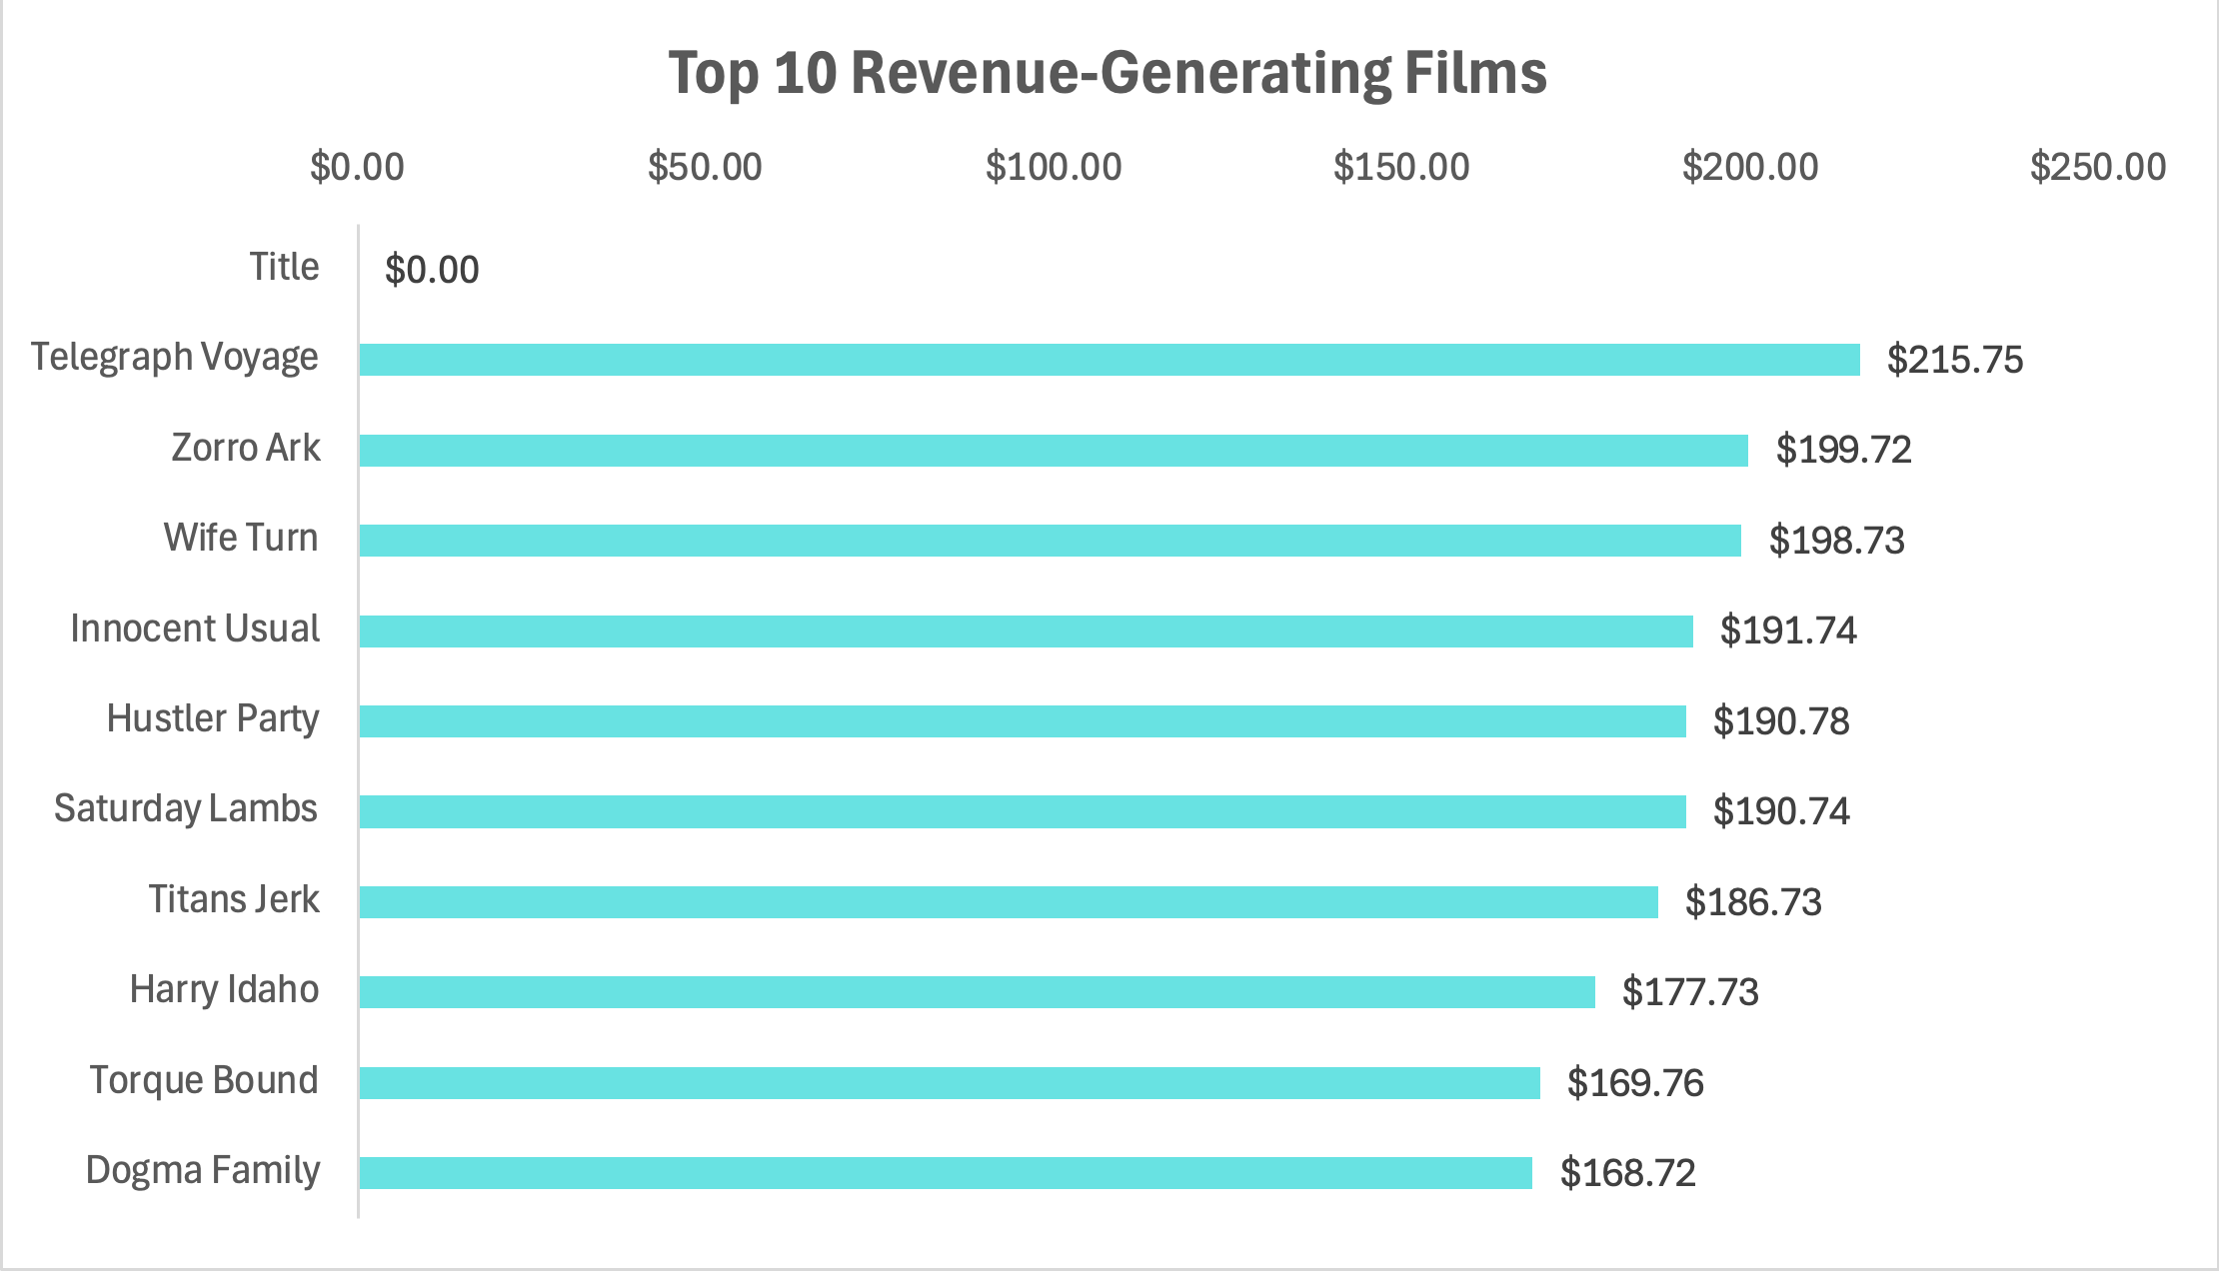
Hits Fuel the Business
Top 10 titles each generate $170-$215
Revenue is highly skewed.
Small # of films make most of money.
Bottom 10 titles generate <$8

Slide 14
Top Customer Lifetime Value
(2) Karl Seal
$208.58
United States
Top customers contribute $160-$210 each.
VIPs exist globally, not tied to single geography
These customers are first movers for premium & loyalty offerings.
(1) Eleanor Hunt
$211.55
Réunion
(3) Marion Snyder
$194.61
Brazil

Slide 15
Strategic Insight Summary
Asia-Pacific shows stronger rental pricing tolerance, making it a priority for digital expansion.
International demand is evident – increase multilingual titles to grow adoption in non-English markets.
Phase rollout: India, China, US → Japan, Mexico, Brazil, Russia as Wave 2.
Genre trends show Sports, Sci-Fi, and Animation deliver higher-value rentals; prioritize their digital availability.
Tailor pricing by region to protect margins while driving store-to-stream conversion.
Support digital rollout with continuous testing of content performance to refine catalogue and spend.

Slide 16
Remaining Questions/Next Analysis
Can we predict digital demand by leveraging rental revenue and genre trends?
What pricing tiers maximize conversion in high-potential markets like India and China?
Which cities drive strongest store-to-stream customer shifts?
How should regional infrastructure (bandwidth, delivery paths) be prioritized to reduce streaming friction?

Slide 17





Thank You
Do you have any questions?
duong.t.jess@gmail.com

