Slide 1
W03D3 – Data Preparation and Feature Engineering
Instructor: Samuel Boylan

Slide 2
Outline
Machine Learning Workflow
Data Retrieval
Data Preparation
Modeling
Model Evaluation and Tuning
Deployment and Monitoring
Data Preparation (Jupyter notebook)
Outlier Detection
Handling Missing Values
Variable Transformations
Feature Engineering (Jupyter notebook)

Slide 3
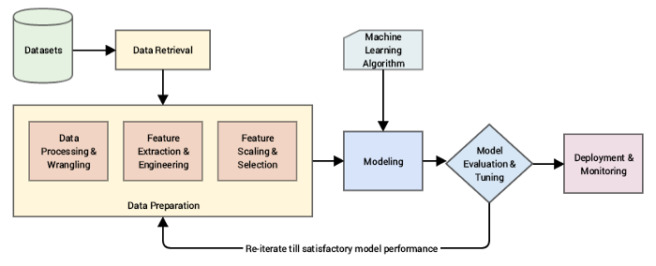
Machine Learning Workflow
Notes:
5 main stages:
Data retrieval (ingestion)
Data Prep
Modeling
Model evaluation and tuning
Deployment and monitoring
Other steps: Creating the ML question you’re trying to address. What is your target variable?
Data exploration (data prep)
Iterative process (non-linear)
In practice, much time is spent in data prep!

Slide 4
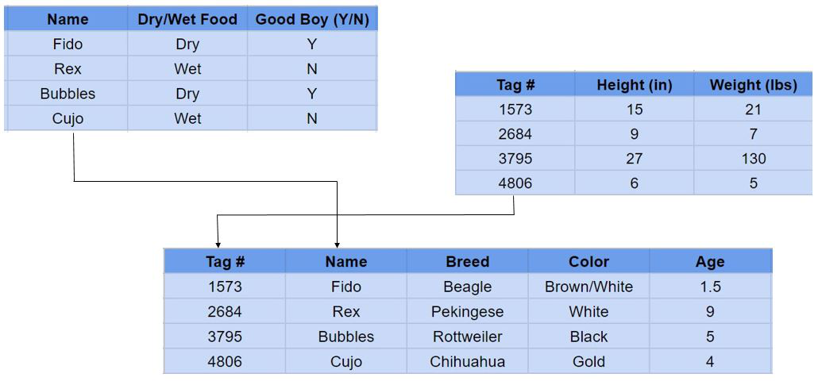
ML Workflow: Data Retrieval
Databases (SQL, NoSQL), APIs, web scraping, CSV, excel, etc…
Structured
Tabular (rows/columns)
Relational
Semi-structured
Key-value stores (JSON), graph databases
Unstructured
Audio, video, binary data
Notes:
SQL Server, MySQL, PostgreSQL, MongoDB
Data Engineer’s job to make data accessible to the data scientist
For semi-structured and unstructured typically have some structure added to them for ML (data prep step)

Slide 5
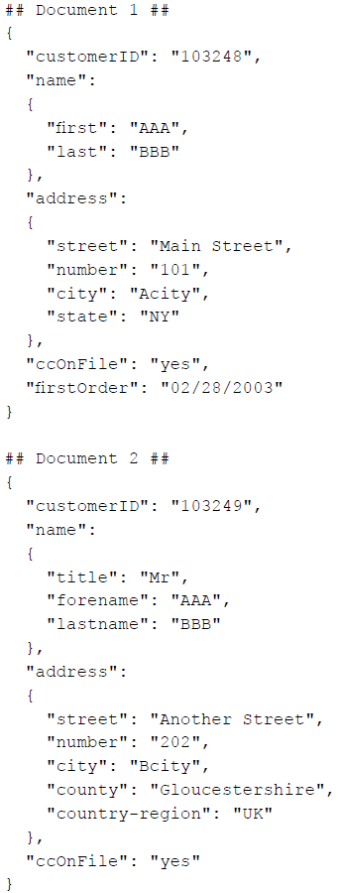
ML Workflow: Data Retrieval
Databases (SQL, NoSQL), APIs, web scraping, CSV, excel, etc…
Structured
Tabular (rows/columns)
Relational
Semi-structured
Key-value stores (JSON), graph databases
Unstructured
Audio, video, binary data
Notes:
SQL Server, MySQL, PostgreSQL, MongoDB
Data Engineer’s job to make data accessible to the data scientist
For semi-structured and unstructured typically have some structure added to them for ML (data prep step)

Slide 6




ML Workflow: Data Retrieval
Databases (SQL, NoSQL), APIs, web scraping, CSV, excel, etc…
Structured
Tabular (rows/columns)
Relational
Semi-structured
Key-value stores (JSON), graph databases
Unstructured
Audio, video, binary data
Notes:
SQL Server, MySQL, PostgreSQL, MongoDB
Data Engineer’s job to make data accessible to the data scientist
For semi-structured and unstructured typically have some structure added to them for ML (data prep step)

Slide 7
ML Workflow: Data Preparation
Exploratory Data Analysis (EDA)
Processing and wrangling
Combining data from different sources
Cleaning data
Dealing with missing data
Dealing with outliers
Feature extraction and engineering
Modifying features (e.g. date, text, categorical vs numerical)
Creating new features (feature interaction, dimensionality reduction)
Reformatting data (e.g. single column vs multiple binary columns)
Feature scaling and selection
Determining what features to use (which are useful)
Normalizing data
Notes:
Majority of time spent here.
Minimize features while maximizing prediction performance (avoid over-fitting)
Relative to the problem (self-driving cars vs predicting flower type)

Slide 8
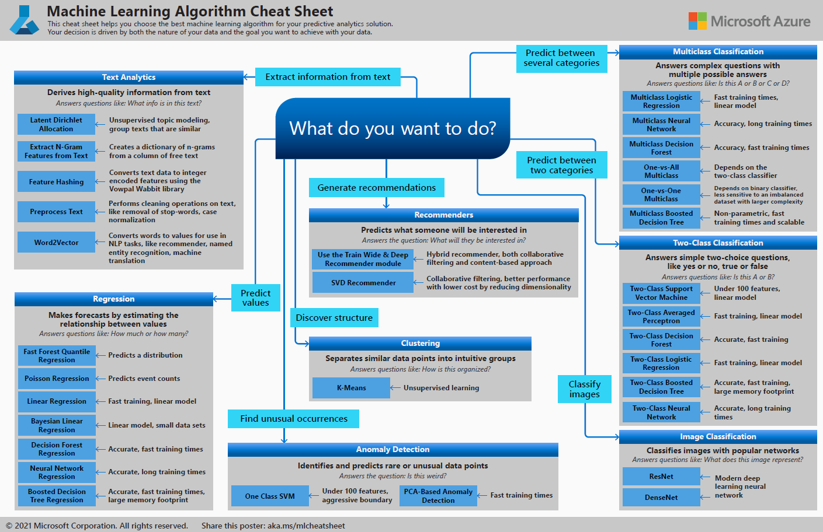
ML Workflow: Modeling
Choosing an appropriate ML model (algorithm) to apply to your data.
What are you trying to predict?
Supervised vs unsupervised
Many Python packages create these models (perform algorithms) for you.
Deep Learning (neural networks)
Many factors: accuracy, data, computational power/time/cost, linearity.
Cheat Sheet: aka.ms/mlcheatsheet
Remember: finding the “best” model is an iterative process.

Slide 9
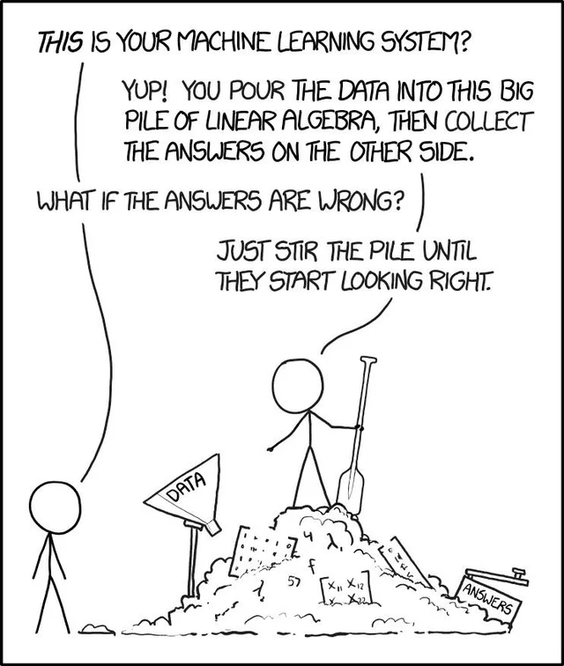
ML Workflow: Model Evaluation and Tuning
How “good” is a model? Metric examples:
Regression: MSE, RMSE, MAE
Classification: Accuracy, Precision, Recall, AUC
Clustering: Within-cluster-sum-of-squares (WCSS), silhouette score
Splitting data into training and testing sets
Prevent over-fitting
k-fold cross-validation
Tuning:
Evaluate multiple models
Tune models via hyperparameters
Lots of judgement calls and educated guesses.

Slide 10
ML Workflow: Deployment and Monitoring
After a model is trained, it can be deployed to be used by others.
API for your trained model.
User passes in input and they get their results.
Monitor model usage and problems
Evaluate model performance on additional “test” data
Input/output requirements change (pipeline)

Slide 11
Data Preparation and Feature Engineering
See Jupyter notebook!
https://colab.research.google.com/drive/1KZ2h7_gA7S0ZWUEQdQ47exokNrUZdfgL?usp=sharing

