Slide 1
W09D3 – Graph Analysis and GANs
Instructor: Jeremy Eng

Slide 2
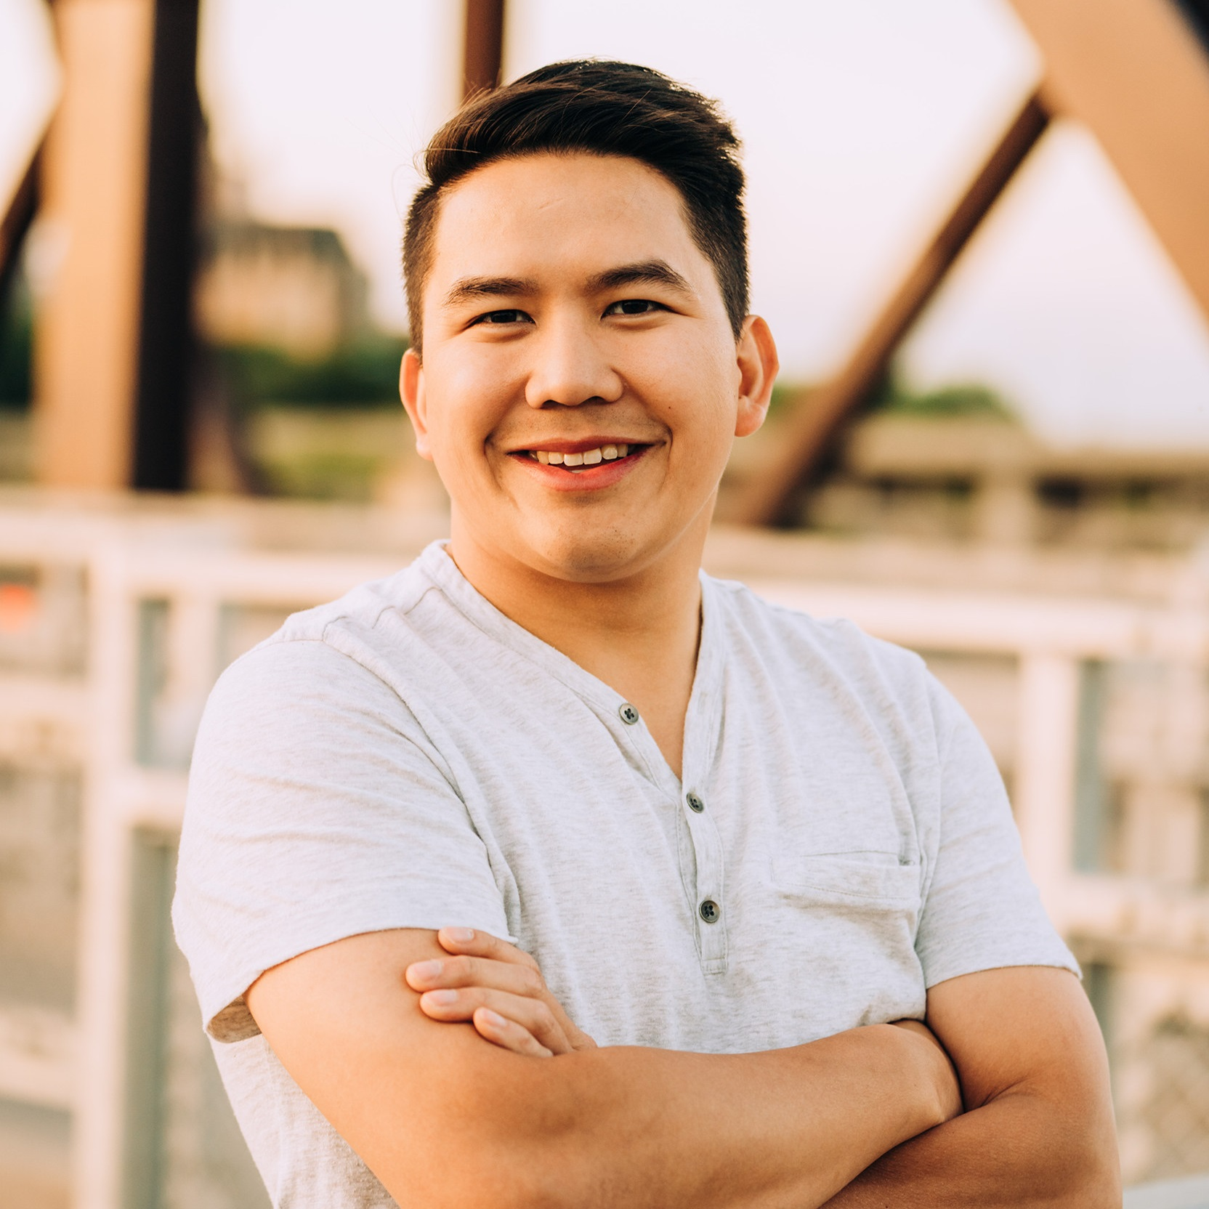
Introduction
Instructor: Dr. Jeremy Eng (engj@saskpolytech.ca)
Lead Cloud Applications and Data Instructor at Sask Polytech
Born and raised in Saskatoon, Saskatchewan
PhD in Statistics
Research Areas:
Big data simulations involving Monte Carlo techniques
Developing and applying machine learning techniques to model COVID-19 spread in Saskatchewan and Canada (PMCMC)
Microsoft Certified Trainer
LinkedIn: https://www.linkedin.com/in/jeremy-eng-sk/

Slide 3
Outline
Graphs
Definitions
Properties and metrics
Uses and Applications
Demo
GANs
GAN architecture
Applications
Demos

Slide 4
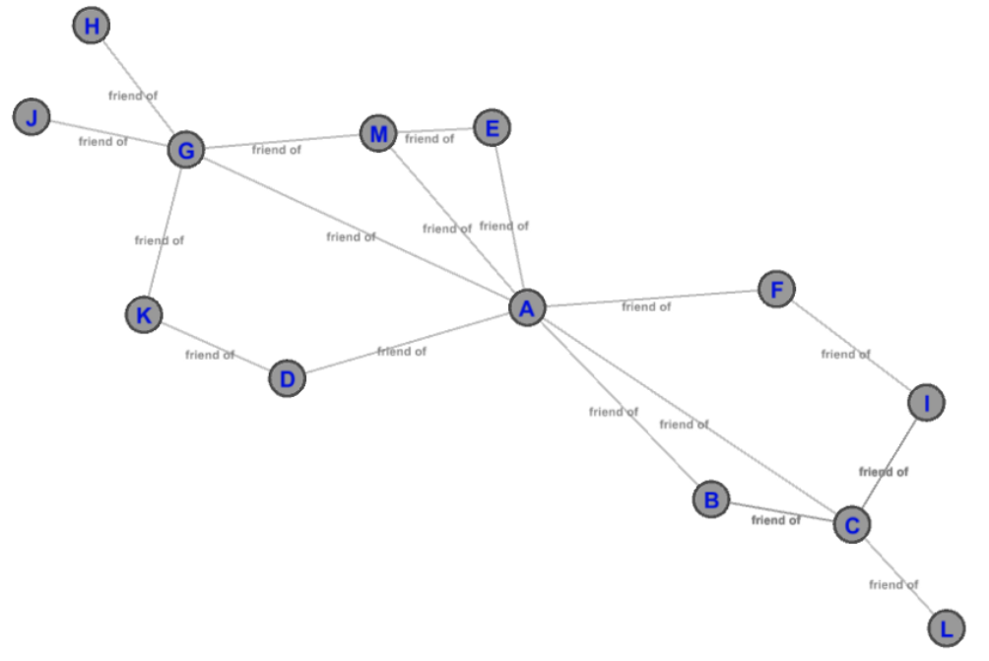
Graphs
A representation of relationships between “entities”.
E.g. Social network, company organization, maps.
Consist of nodes (vertices) and edges that connect nodes.
Nodes represent entities, edges represent relationships.

Slide 5
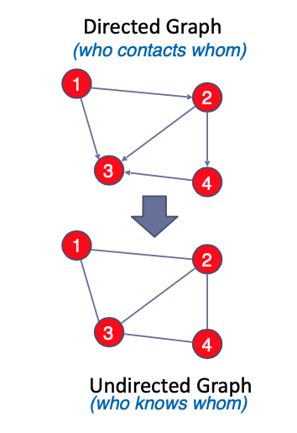
Graphs
A representation of relationships between “entities”.
E.g. Social network, company organization, maps.
Consist of nodes (vertices) and edges that connect nodes.
Nodes represent entities, edges represent relationships.
Edges can be directed or undirected

Slide 6
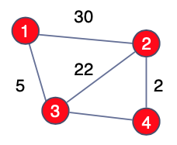
Graphs
A representation of relationships between “entities”.
E.g. Social network, company organization, maps.
Consist of nodes (vertices) and edges that connect nodes.
Nodes represent entities, edges represent relationships.
Edges can be directed or undirected
Edges can also have a weight.
Notes:
In a social network, weights could represent how the strength of “friendship” (frequency of interaction)
In a graph representing a map, weights could represent the distance between locations.

Slide 7
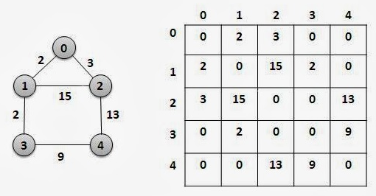
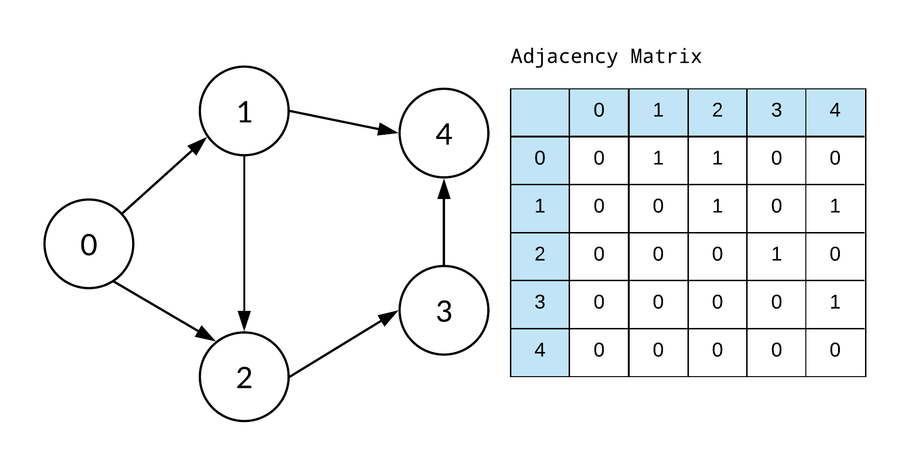
Graphs
A representation of relationships between “entities”.
E.g. Social network, company organization, maps.
Consist of nodes (vertices) and edges that connect nodes.
Nodes represent entities, edges represent relationships.
Edges can be directed or undirected
A “digraph” is a directed graph.
Edges can also have a weight.
Graphs can be represented using matrices (adjacency matrix)
Allows us to apply matrix mathematics
Notes:
Matrices are square (each row/column represents a node)
Edges are represented by the values in the matrix.
Undirected graphs will be symmetrical
Weights can be represented using values in the matrix

Slide 8
Graphs
Some general interesting questions about graphs
What are the central/important nodes? (advertising)
How “connected” is a graph? (density)
What “clusters” exist in the graph? (social network)
What is the shortest path between two nodes (maps)
Answered using graph metrics/properties (not exhaustive)
“Degree” of a node (number of edges)
How often a node lies on the shortest path
How close is a node to every other node
Average edges per node
Number of possible paths between nodes
Notes:
Note: If weighted edges, can modify/weight metrics accordingly

Slide 9
Graphs
Applications:
Recommender systems (Netflix)
Fraud detection (banking networks and transaction path)
Supply chain logistics optimization (digraphs)
Marketing (influencers and their communities)
Optimizing routes in airlines

Slide 10
Graph Demo
Create our own graphs using the Python package “networkx”
Examine interesting metrics.

Slide 11
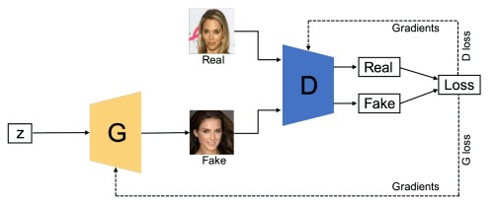
GANs
Generative Adversarial Networks (Ian Goodfellow, 2014)
Consist of two competing neural networks trying to outwit each other.
Generator and Discriminator
Generator is tasked with generating new “fake” samples of data.
Discriminator’s task is to determine if a sample is fake (was generated) or not.
Back propagation for whichever NN loses.
Weights in neural net are updated.
Notes:
Generator is rewarded when it successfully “tricks” the discriminator and penalized when it gets “caught”.
Discriminator is rewarded when it successfully identifies a “fake”.

Slide 12
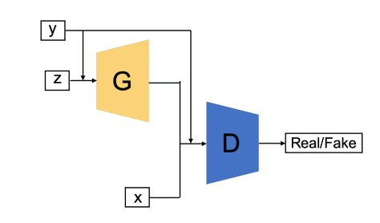
GANs
Overall goal is generation (very powerful).
Sort of unsupervised learning, where it supervises itself.
Some versions of GANs provide the generator (and discriminator) with additional data/input.
E.g. Conditional GANs
Example: Human face generation https://thispersondoesnotexist.com/

Slide 13
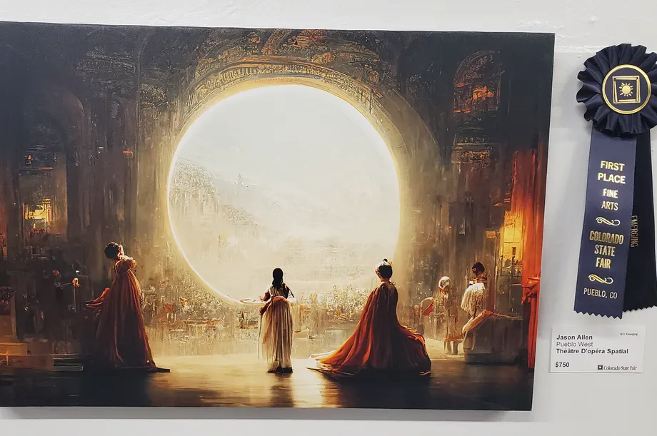
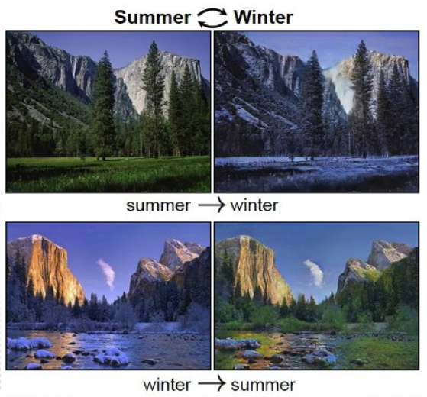
GANs
Applications of GANs:
Image/art generation
Text to Image generation
Image to image translation
Day to night, black and white to colour
Sketches to color photographs
Image improvement
Increase resolution
Restoration
Cryptography
Drug research
Notes:
CNNs are often used because images are often involved.

Slide 14
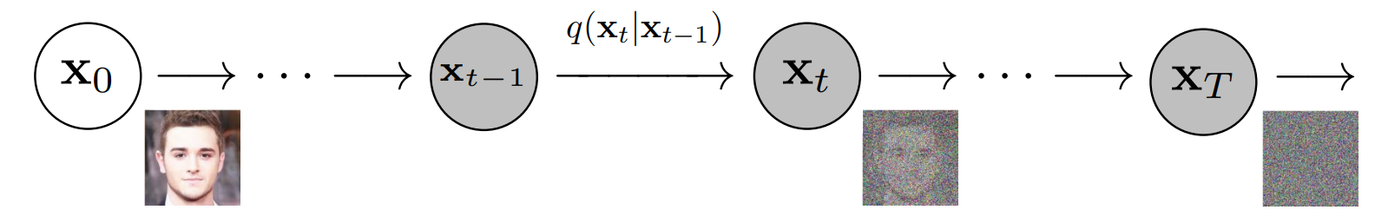
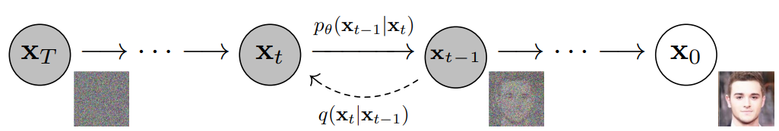
Diffusion Models
Another model used for image generation
Utilizes Markov chains
Adds noise to an image and then learns how to remove it.
Beat GANs on image synthesis (generation)
https://arxiv.org/abs/2105.05233 (May 2021)
Demo: https://deepai.org/machine-learning-model/text2img
API (cost), python examples
Intro article: https://www.assemblyai.com/blog/diffusion-models-for-machine-learning-introduction/

Slide 15
GANs Tutorial
GAN demo
GAN text to art

