Slide 1
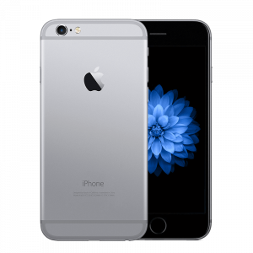
Iphone XXI
Tech.No’s most recent phone that’s been published.

