Slide 1
Goodbye Floats!
Hello CSS Flex & Grid Layouts!
"Laissez Les Bon Temps Roulez“
Let the good times roll
Kenzey B Conrad
@Webq2
KzBeck@yahoo.com

Slide 2
Float Layouts!
What is a float?
The float CSS property specifies that an element should be taken from the normal flow and placed along the left or right side of its container, where text and inline elements will wrap around it. A floating element is one where the computed value of float is not none.
https://developer.mozilla.org/en-US/docs/Web/CSS/float

Slide 3
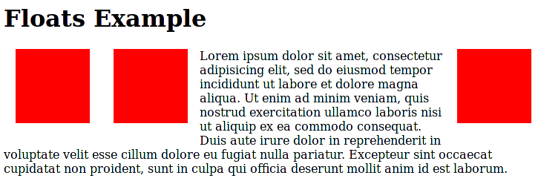
Float Layouts!
What is a float?
https://developer.mozilla.org/en-US/docs/Web/CSS/float

Slide 4
Float Layouts!
solved many problems

Slide 5
Float Layouts!
created many headaches
Notes:
Bottom line a floated element doesn’t load until everything else is loaded then it drops into place.
Think of an image…

Slide 6
Float Layouts!
required many work arounds

Slide 7

Float Layouts!
and IE . . .

Slide 8
Float Layouts!
seeking control

Slide 9
Goodbye Floats!
Hello CSS Flex & Grid Layouts!
"Laissez Les Bon Temps Roulez“
Let the good times roll
layouts tools we’ve been waiting for . . .

Slide 10
Layout Modes!
current layout methods
block - documents
inline - text
table - data in tabular form
positioning - precise placement
From W3 CSS Flexible Box Layout Module 1

Slide 11
Flex Layouts!
What are Flex Layouts?
designed for more complex applications and web pages
From W3 CSS Flexible Box Layout Module 1

Slide 12
Flex Layouts!
What are Flex Layouts?
similar to block layout
not capable of complex text or document based properties
From W3 CSS Flexible Box Layout Module 1

Slide 13
Flex Layouts!
What are Flex Layouts?
"The main idea behind the flex layout is to give the container the ability to alter its items' width, height and order to best fill the available space...“
Chris Coyier
From W3 CSS Flexible Box Layout Module 1

Slide 14
Flex Layouts!
What are Flex Layouts?
tools for distributing space and aligning content
From W3 CSS Flexible Box Layout Module 1

Slide 15
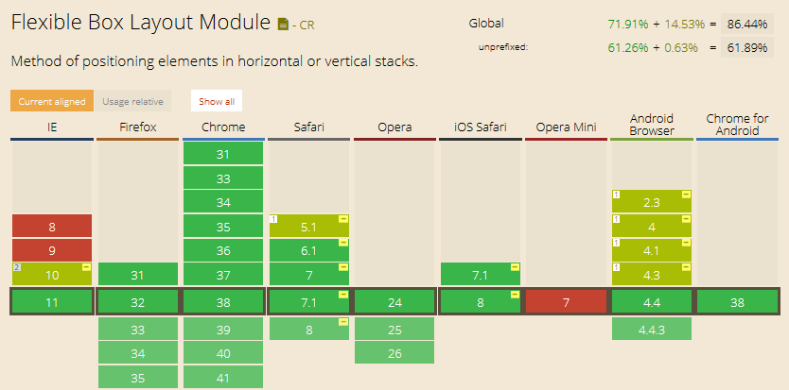
Flex Layouts!
From http://caniuse.com/

Slide 16
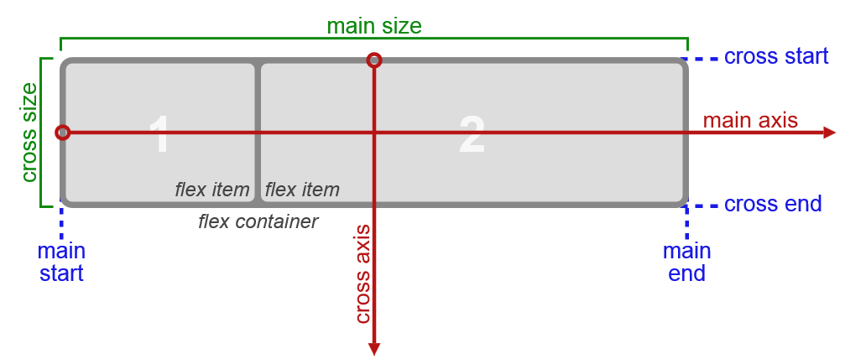
Flex Layouts!
From W3 CSS Flexible Box Layout Module 1

Slide 17
Flex Layouts!
display:flex;
now control page element
direction
alignment
spacing

Slide 18
Flex Layouts!
add flexibility to your design
layout content into columns and rows
in any direction

Slide 19
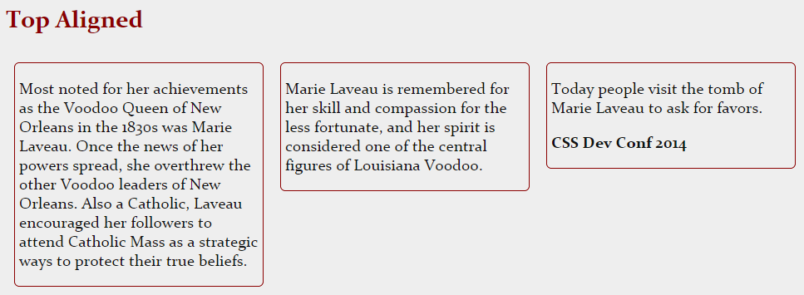
Flex Layouts!
add flexibility to your design

Slide 20

Flex Layouts!
add flexibility to your design
display: flex; causes an element to generate a block-level flex container box
note: flex containers are NOT block containers
example:
column- properties will have no effect

Slide 21
Flex Layouts!
add flexibility to your design
example:
float and clear have no effect on a flex item
the float property can still affect box generation of display computed value
vertical align has no effect

Slide 22
Flex Layouts!
add flexibility to your design
flex-wrap: wrap; wrap multiple lines
nowrap is the initial value
justify-content: space between;
items are evenly distributed in the line; first item is on the start line, last item on the end line
Helps distribute extra space leftover when all the flex items on a line are inflexible or are flexible but have reached their maximum size

Slide 23
Flex Layouts!
add flexibility to your design
align-items: flex-start;
edge of the item is placed on the cross-start line

Slide 24
Flex Layouts!
From W3 CSS Flexible Box Layout Module 1

Slide 25
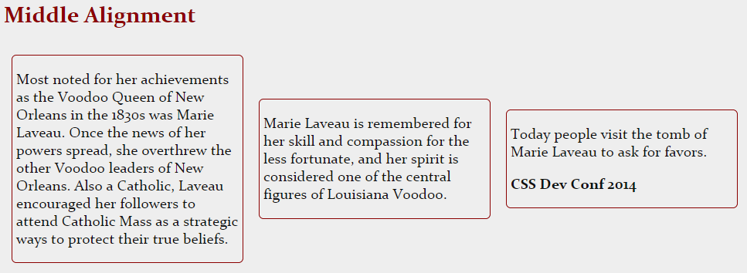
Flex Layouts!
add flexibility to your design

Slide 26
Flex Layouts!
add flexibility to your design

Slide 27
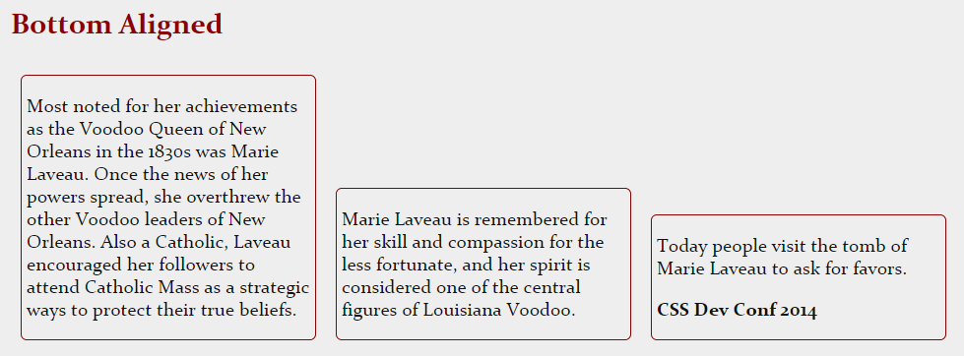
Flex Layouts!
add flexibility to your design

Slide 28
Flex Layouts!
add flexibility to your design

Slide 29
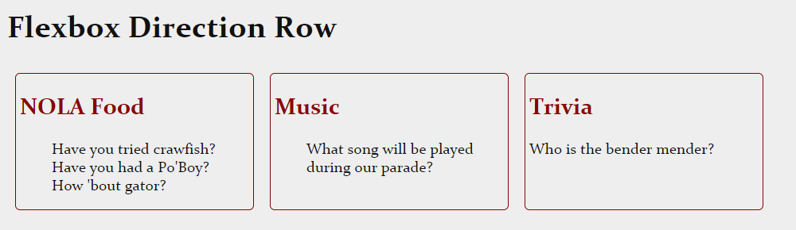
Flex Layouts!
add flexibility to your design
display order can be reversed

Slide 30

Flex Layouts!
add flexibility to your design
display order can be reversed

Slide 31
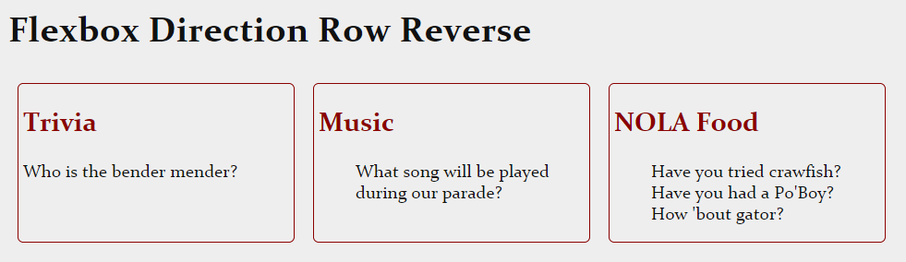
Flex Layouts!
add flexibility to your design
display order can be reversed

Slide 32

Flex Layouts!
add flexibility to your design
display order can be reversed

Slide 33
Flex Layouts!
add flexibility to your design
visual layout can be independent of
source and speech order

Slide 34
Flex Layouts!
add flexibility to your design
laid out along a single main axis
or wrapped into multiple lines along a secondary axis

Slide 35
Flex Layouts!
From W3 CSS Flexible Box Layout Module 1

Slide 36
Flex Layouts!
add flexibility to your design
can “flex” their size to respond to available space

Slide 37
Flex Layouts!
add flexibility to your design
can be aligned to their container or each other

Slide 38

Flex Layouts!
centering

Slide 39
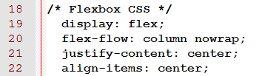
Flex Layouts!
centering

Slide 40
Flex Layouts!
centering
flex-flow: column nowrap;
default is row nowrap

Slide 41
Flex Layouts!
complex layouts
keep in mind
layout is linear in nature

Slide 42
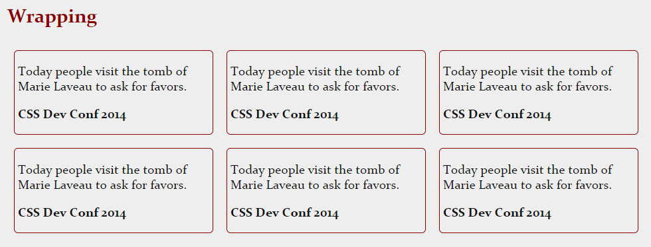
Flex Layouts!
wrapping of long lines

Slide 43
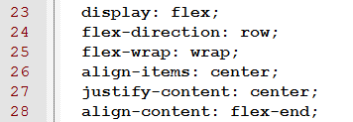
Flex Layouts!
wrapping of long lines
align-items: center; will be centered in the middle
justify-content: center; items are centered along the line

Slide 44
Flex Layouts!
wrapping of long lines
align-content: flex-end;
aligns a flex container's lines within
when there is extra space in the cross-axis
note: no effect when there is only one line of flex items

Slide 45
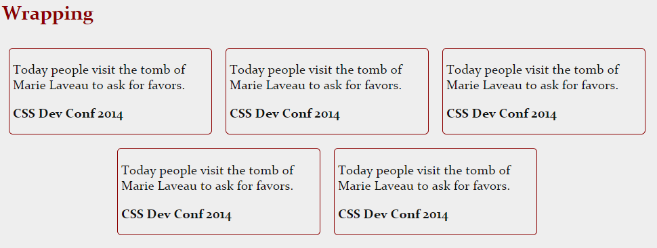
Flex Layouts!
wrapping of long lines
Notes:
Page breaks are possible in flexible boxes layout
as long as break- property allows it.
CSS3 break-after, break-before, and break-inside as well as
CSS 2.1 page-break-before, page-break-after, and page-break-inside properties are accepted
on a flex container, flex items, and inside flex items.

Slide 46
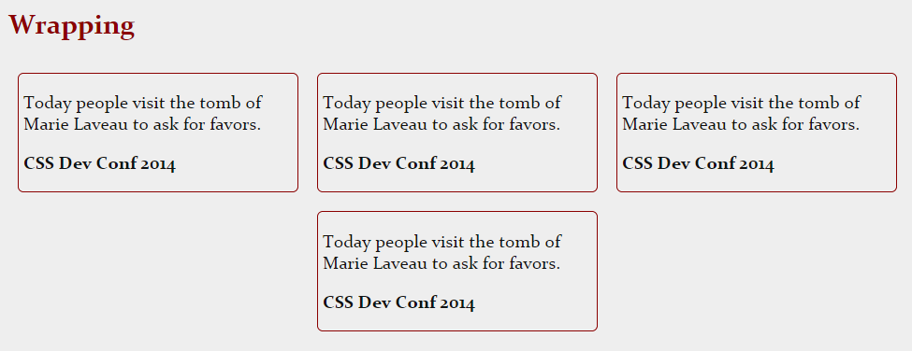
Flex Layouts!
wrapping of long lines

Slide 47
Flex Layouts! Info
wrapping of long lines
Page breaks are possible in flexible boxes

Slide 48
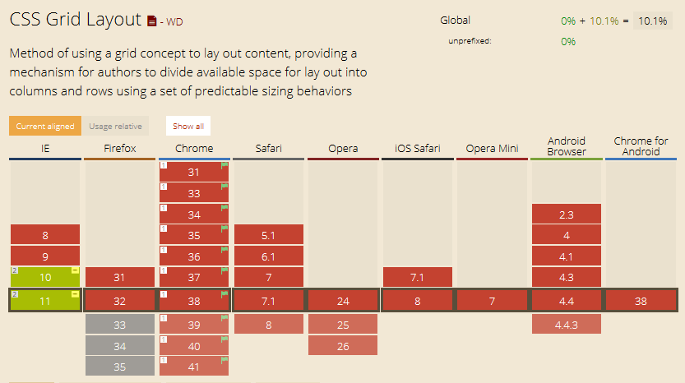
Grid Layouts!
From http://caniuse.com/

Slide 49
Grid Layouts!
What are Grid Layouts?
layout content in columns and rows
grids don’t have content structure

Slide 50
Grid Layouts!
What are Grid Layouts?
enables layouts not possible with tables

Slide 51
Grid Layouts!
What are Grid Layouts?
children of a grid container can position themselves so they overlap and layer similar to positioned elements

Slide 52
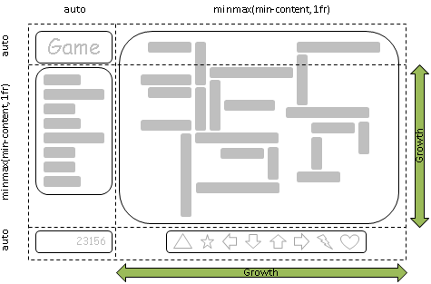
Grid Layouts!
space adaptation
easily adapt layouts for different devices
From W3 CSS Grid Layout Module 1

Slide 53
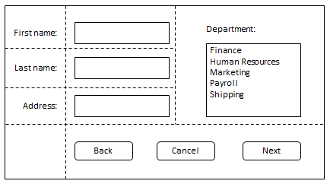
Grid Layouts!
item placement
From W3 CSS Grid Layout Module 1

Slide 54
Grid Layouts!
item placement
layout content in columns and rows

Slide 55
Grid Layouts!
getting started
enable experimental web platform features

Slide 56
Grid Layouts!
getting started Chrome
1 – enter chrome://flags
2 – scroll to enable experimental web platform features
3 – re-launch Chrome

Slide 57
Grid Layouts!
getting started
IE is enabled
Webkit enabled

Slide 58
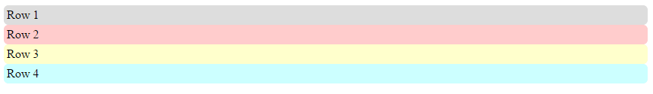
Grid Layouts!
simple grid

Slide 59
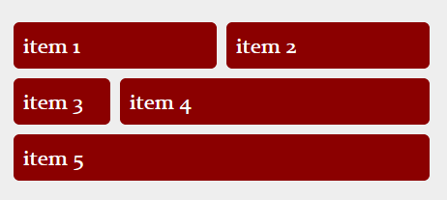
Grid Layouts!
simple grid

Slide 60
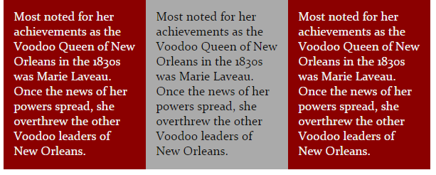
Grid Layouts!
column grid

Slide 61
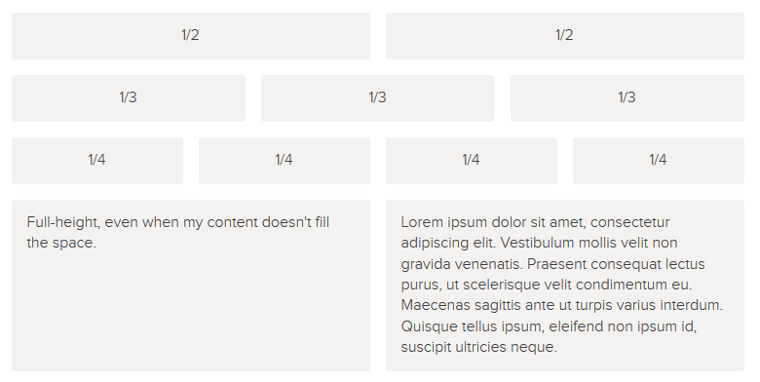
Grid Layouts!
Where do we go from here?
Philip Walton
http://philipwalton.github.io/solved-by-flexbox/demos/grids/

Slide 62
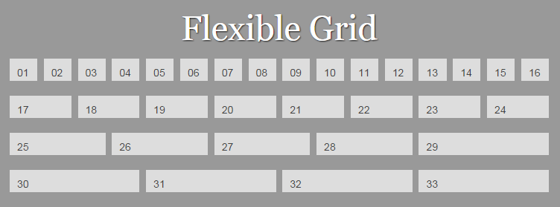
Grid Layouts!
Where do we go from here?
Rachel Andrew
http://gridbyexample.com/examples/code/layout4.html

Slide 63
Flexible Box & Grid Layouts!
FAQ
When would you use grid vs. flexbox?

Slide 64
Flexible Box & Grid Layouts!
FAQ
When would you use grid vs. flexbox?
I believe most pages will be composed of an outer grid for the overall layout, a mix of nested flexboxes and grid for the components of the page, and finally block/inline/table layout at the "leaves" of the page, where the text and content live.
~ Tab Atkins, Jr.

Slide 65
Things to know in NOLA!
"Laissez Les Bon Temps Roulez“
Let the good times roll

Slide 66
New Orleans Info
Rampart Food Store – Po’Boy’s
Ruby Slipper - brunch
Feelings Café - locals
Acme Oyster Bar
Whitney Hotel – cajun omelet

Slide 67
New Orleans Info
Bender Mender
504/301 – 1670

Slide 68
Resources Info
Tab Atkins Jr. email:
http://lists.w3.org/Archives/Public/www-style/2013May/0114.html
Joni Trythall
Visual flexbox cheat sheet:
http://jonibologna.com/flexbox-cheatsheet/
Flexy Boxes Playground
CSS-Tricks Guide to Grids
Rachel Andrew
http://gridbyexample.com/
http://philipwalton.github.io/solved-by-flexbox/demos/grids/
and MANY MANY more…

Slide 69
Goodbye Floats!
Hello CSS Flex & Grid Layouts!
Text: #
to vote for this session
"Laissez Les Bon Temps Roulez“
Let the good times roll
Kenzey B Conrad
@Webq2
KzBeck@yahoo.com

