Slide 1
The Shell Project
COP 4600
Spring 2015
Monday, March 30, 2015
Professor Sumi Helal

Slide 2
Shell Organization

Slide 3
Overall structure
Yacc
Action
Table of commands and global variables / structures
Yacc
Action
Main File
Yacc
Action

Slide 4
Make file
Lex yourlex.l lex.yy.c
yacc youryacc.y y.tab.c & y.tab.h
compile lex.yy.c object file
compile y.tab.c object file
compile main.c object file
Combining these object files produce your shell
Dependency: capture all dependencies correctly in the makefile so you can edit anything freely.
include

Slide 5
Lex.l
yacc.y
%{#include “y.tab.h”
……
%}
%%
input1 {return token1}
input2 {return token2}
%{#include “global.h”
……
%}
%%
Token1 {action1}
Token2 {action2}
shell.c
shell.h
#include “shell.h”
main(){
//set environment variables
//set main settings
while(1)
//shell loop
yyparse()
}
Table of commands
Global variables
Global structures

Slide 6
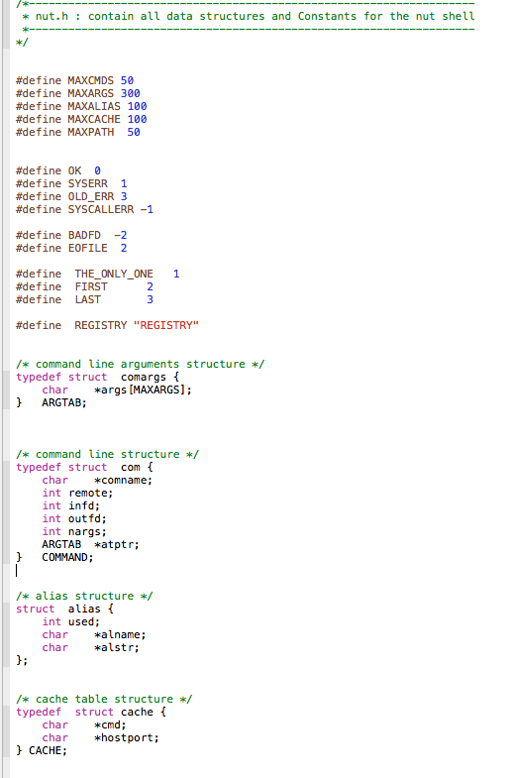
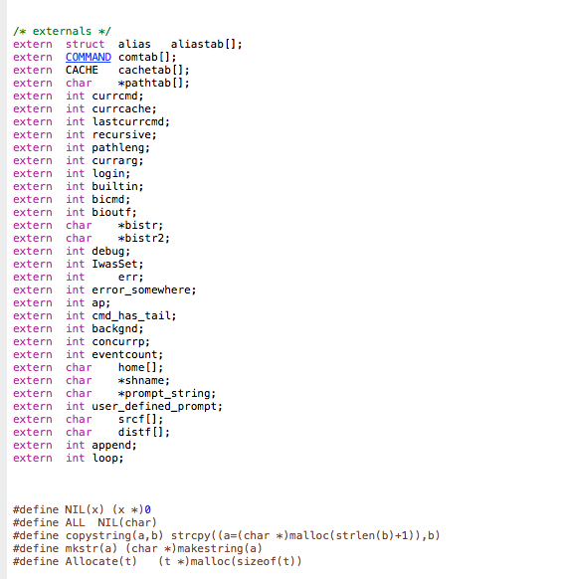
Shell header Snippets (global.h)

Slide 7
Shell Loop

Slide 8
Inside of Shell
Your shell runs as main.c.
Your shell does the following:
Print prompt
Get a command (scan and parse)
Execute the command
Handle errors or exceptions
Your shell runs in a loop, and should never die. It only exits when it receives the bye command.

Slide 9
Main Function
main()
{
shell_init();
While (1) {
printPrompt();
Switch (CMD = getCommand()) {
Case: BYE exit();
Case: ERRORS recover_from_errors();
Case: OK processCommand();
}
}
}

Slide 10
Initialization of Shell
shell_init()
{
// init all variables.
// define (allocate storage) for some var/tables
// init all tables (e.g., alias table)
// get PATH environment variable (use getenv())
// get HOME env variable (also use getenv())
// disable anything that can kill your shell.
// (the shell should never die; only can be exit)
// do anything you feel should be done as init
}

Slide 11
Shell’s Main Loop
getCommand()
{
init_scanner-and_parser();
if (yyparse())
understand_errors();
else
Return (OK);
}

Slide 12
Shell’s Main Loop
recover_from_errors()
{
// Find out if error occurs in middle of command
// That is, the command still has a “tail”
// In this case you have to recover by “eating”
// the rest of the command.
// To do this: use yylex() directly.
}

Slide 13
Shell’s Main Loop
processCommand()
{
if (builtin)
do_it(); // run built-in commands – no fork
// no exec; only your code + Unix
//system calls.
else
execute_it(); // execute general commands
//using fork and exec
}

Slide 14
Shell’s Main Loop
do_it()
{
switch (builtin) {
case ALIAS … // e.g., alias(); alias(name, word);
case CDHome … // e.g., gohome();
case CDPath … // e.g., chdir(path);
case UNALIAS …
case SETENV …
case PRINTENV …
…
}
}

Slide 15
Shell’s Main Loop
execute_it()
{
// Handle command execution, pipelining, i/o redirection, and background processing.
// Utilize a command table whose components are plugged in during parsing by yacc.
/*
* Check Command Accessability and Executability
*/
if( ! Executable() ) {
//use access() system call with X_OK
nuterr("Command not Found");
return;
}
/*
* Check io file existence in case of io-redirection.
*/
if( check_in_file()==SYSERR ) {
nuterr("Cann't read from : %s",srcf);
return;
}
if( check_out_file()==SYSERR ) {
nuterr("Cann't write to : %s",distf);
return;
}
//Build up the pipeline (create and set up pipe end points (using pipe, dup)
//Process background
}

Slide 16
Scanning & Parsing Commands (lex & yacc)

Slide 17
The Power of Yacc Actions
Embedded code within the rule.
Context sensitive code applies to exactly the circumstances that bring control to the action code.
Significant advantage in doing shell processing as yacc code. Simplifies and empowers main.c
Role of shared global data structure between yacc and main.c

Slide 18
YYParse() and YYLex()
The yyparse( ) routine returns a value of:
0 if the input it parses is valid according to the given grammar rules.
1 if parsing failed for invalid input
2 if parsing failed for memory exhaustion
yyparse( ) routine does not do its own lexical analysis and does not break the input into tokens ready for parsing.
yyparse() calls a routine called yylex( ) every time it wishes to obtain a token from the input.
yylex( ) returns a value indicating the type of token that has been obtained and yylval if the token has an actual value.
yylex( ) breaks the input into tokens and returns the tokens one by one to yyparse( ) .
A mainline routine that performs any necessary initializations, calls yyparse( ), and then performs possible cleanup actions.

Slide 19
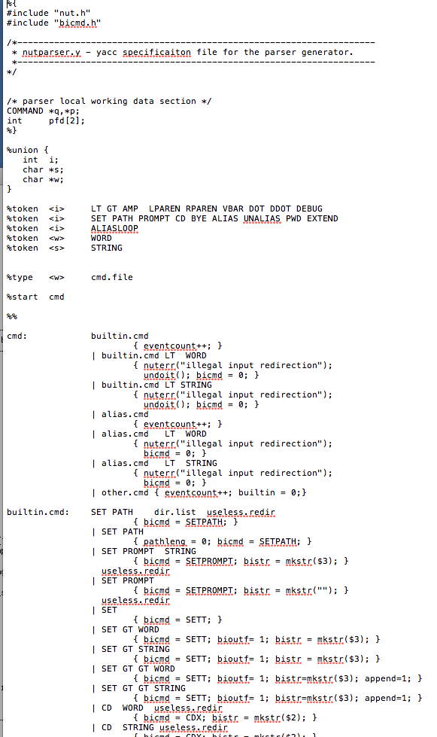
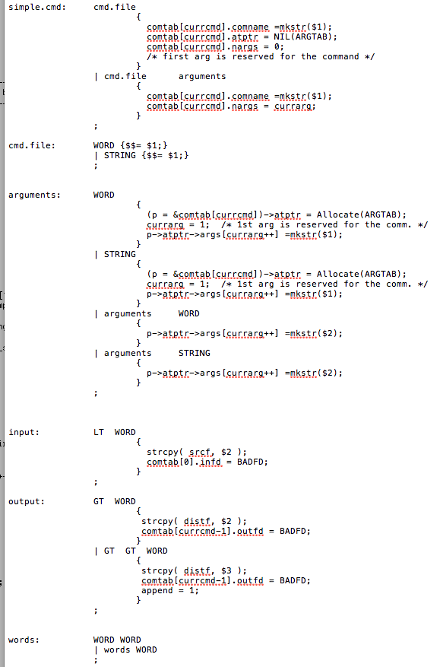
Yacc Snippets (yacc.y)

Slide 20
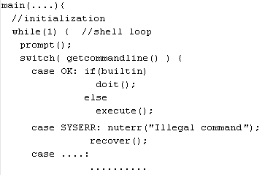
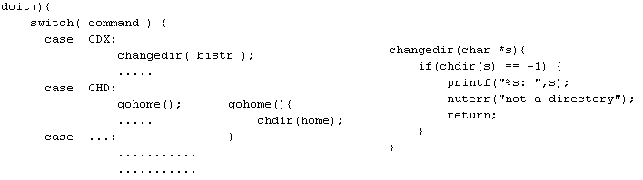
Built-in CD example

Slide 21
Alias

Slide 22
Alias
Alias in your shell substitutes a string (words) with a simple string (name).
e.g., alias mtx “mount –t vboxsf xinu /home/xinu/xinu-dev/”
Commands for Alias:
alias: listing all alias
alias name word: adding a new alias
unalias name: removing the alias
Maintaining Aliases
An alias may be added in alias table (defined as a global variable in a header file)

Slide 23
Configuring Alias
addAlias (name, word)
{
// add the alias in the name, which is not used yet
// need to check whether the alias table is full
}
removeAlias (name)
{
// remove the alias if it exists in the alias table
}
listAlias ()
{
// show all the alias in the alias table
}

Slide 24
Processing Alias
Aliases should be expanded and processed if they exist in the command line.
An alias can be nested.
e.g., alias cmd4 cmd5, alias cmd5 cmd7, alias cmd7 cmd8, ...
You need to expand aliases iteratively until the expanded command line contains no further aliases.
In your terminal
alias table
$cmd1
⇨ execute cmd2
alias cmd1 cmd2
….
alias cmd4 cmd5
alias cmd6 cmd3
alias cmd5 cmd7
….
In your terminal
$cmd4
⇨ execute cmd7

Slide 25
Processing Alias
processAlias ()
{
while (1) {
if (alias_input(cmd))
// if command has alias, check alias table // and expand it
else
break;
}
}

Slide 26
Pipeline, I/O Redirection & Background

Slide 27
Handling General Commands
To handle general commands you will need to fork() and exec() processes to run them
E.g. ls, gcc, etc.
But this is not all.
Tokens like “<“, “>”, “|” affects how commands are executed
They need to be recognized by your (lex + yacc)
… and they need to be handled by your shell

Slide 28
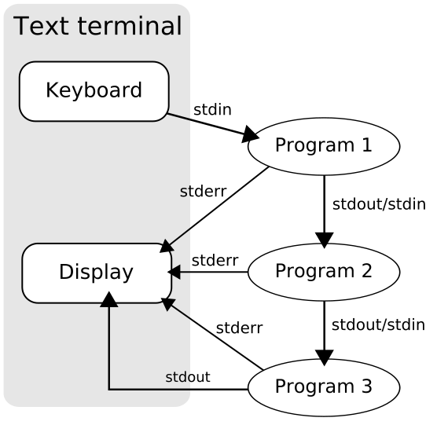
How to pipeline?

Slide 29
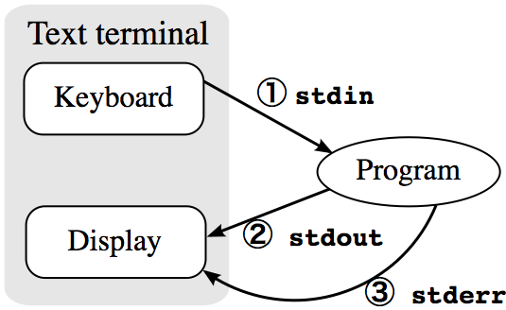
How to redirect?

Slide 30
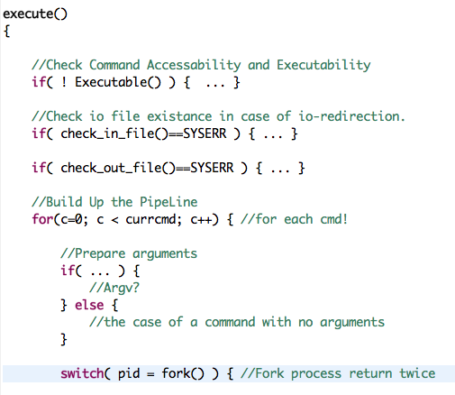
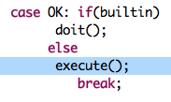
How it should look like in your shell
@main.c
Should take care of all possible cases (redirections and pipes)

Slide 31
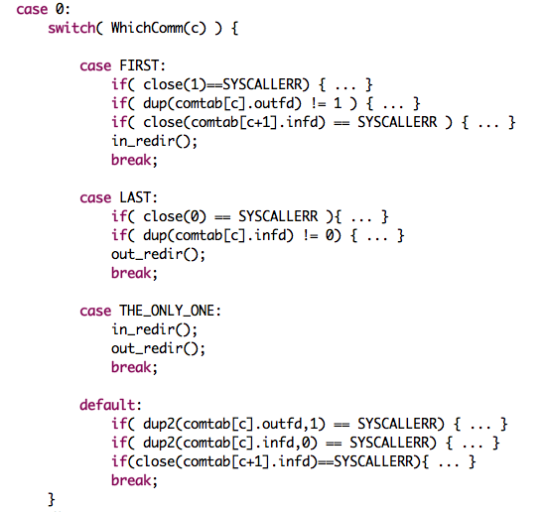
Continue

