Slide 1
The Shell Project
COP 4600
Spring 2015
Professor Sumi Helal

Slide 2
Where is your Shell?
Initially
Scanner.l
Parser.y
yyparse()
Test.c
Then …
Scanner.l
Parser.y
yyparse()
main.c
Then finally …
Scanner.l
Parser.y
yyparse()
main.c
action code
action code
…
action code

Slide 3
Initially
Assignment lists all tokens. Develop scanner.l and test in isolation. Recognize exactly all tokens. Manage low level errors as much as you can.
All grammar rules can be inferred from Assignment. Favor Left recursion. Test aggressively as you develop parser.y incrementally.
Develop a test.c to get and print commands without any processing.
If possible use Make or Ant - Compile test.c with test.o, lex.yy.o, y.tab.o and other .o’s. If you edit scanner.l you must lex to generate lex.yy.c, then must compile to generate its .o. Similarly, if you make change sin parser.y, then you should yacc parser.y, then compile y.tab.c
If you can get to this point you are already in a great shape ☺
Test by entering all sort of command types, including bogus (erroneous) commands. If you are able to recognize all different types of commands and able to handle syntax errors adequately, you have achieved 40% of your grade.

Slide 4
Then …
Now add the main loop of your shell in main.c
Main()
{
shell_init();
While (1) {
printPrompt();
Switch (CMD = getCommand()) {
Case: BYE exit();
Case: ERRORS recover_from_errors();
Case: OK processCommand();
}
}
}

Slide 5
Shell’s Main Loop
Shell_init()
{
// init all variables.
// define (allocate storage) for some var/tables
//init all tables (e.g., alias table)
//get PATH environment variable (use getenv())
//get HOME env variable (also use getenv())
//disable anything that can kill your shell.
// (the shell should never die; only can be exit)
// do anything you feel should be done as init
}

Slide 6
Shell’s Main Loop
getCommand()
{
init_scanner-and_parser();
if (yyparse())
understand_errors();
else
Return (OK);
}

Slide 7
Shell’s Main Loop
recover_from_errors()
{
//Find out if error occurs in middle of command
//That is the command still has a “tail”
//In this case you have to recover by “eating”
// the rest of the command.
// To do this: use yylex() directly.
}

Slide 8
Shell’s Main Loop
processCommand()
{
if (builtin)
do_it();
else
execute_it();
}

Slide 9
Shell’s Main Loop
Do_it()
{
switch (builtin) {
case CDHome … //gohome();
case CDPath … //chdir(path);
case ALIAS …
case UNALIAS …
case SETENV …
case PRINTENV …
…
}
}

Slide 10
Shell’s Main Loop
Execute_it()
{
// Handle command execution, pipelining, i/o redirection, and background processing.
//Utilize a command table whose components are plugged in during parsing by yacc.
/*
* Check Command Accessability and Executability
*/
if( ! Executable() ) {
//use access() system call with X_OK
nuterr("Command not Found");
return;
}
/*
* Check io file existance in case of io-redirection.
*/
if( check_in_file()==SYSERR ) {
nuterr("Cann't read from : %s",srcf);
return;
}
if( check_out_file()==SYSERR ) {
nuterr("Cann't write to : %s",distf);
return;
}
//Build up the pipeline (create and set up pipe end points (using pipe, dup)
//Process background
}

Slide 11
The Power of Yacc Actions
Embedded code within the rule.
Context sensitive code applies to exactly the circumstances that bring control to the action code.
Significant advantage in doing shell processing as yacc code. Simplifies and empowers main.c
Role of shared global data structure between yacc and main.c

Slide 12
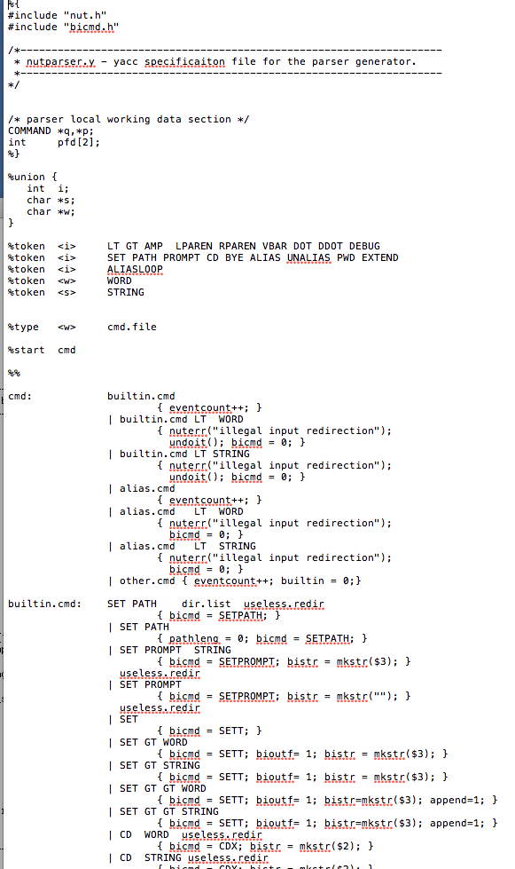
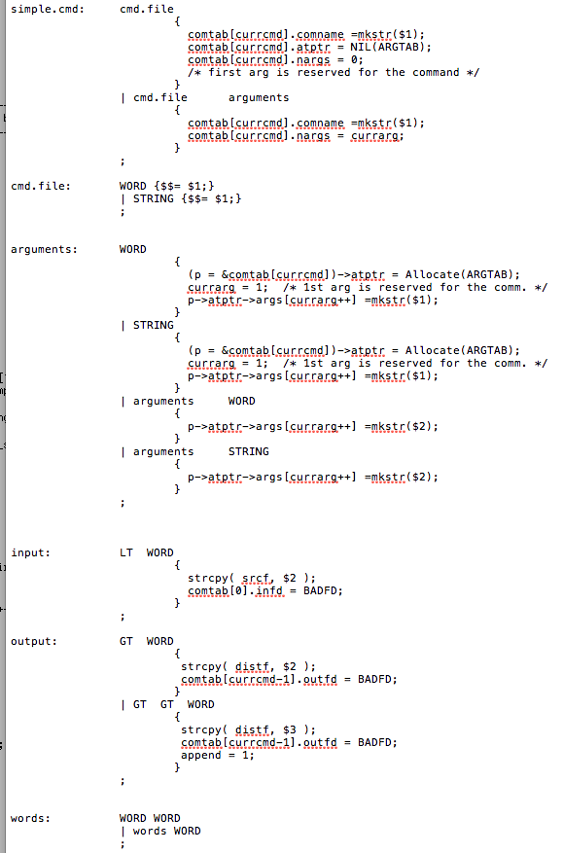
Yacc Snippits

Slide 13
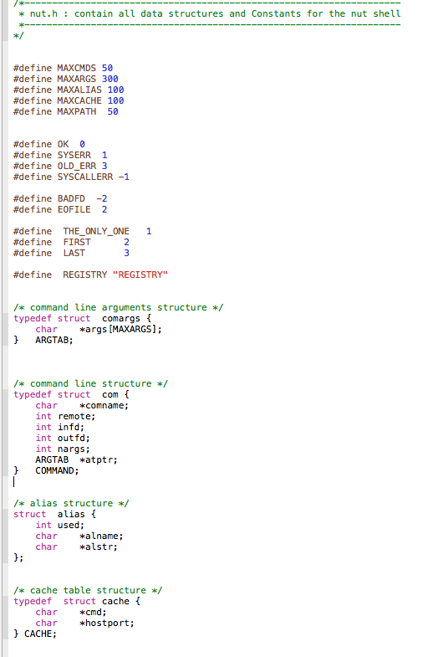
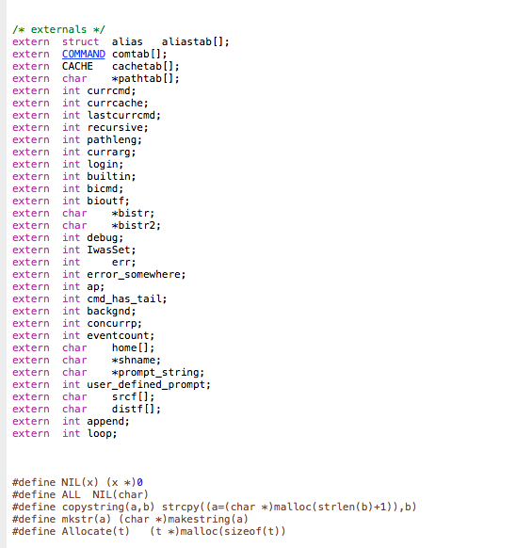
Shell header file Snippits

Slide 14
Project Management
Three Days per week, minimum.
At least two face to face meeting per week with your partner
Dedicate weekends
Divide the work
Review your partner’s work.
Cross debugging
Work incrementally, debug as you go.

