Slide 1
COP4600 - Operating System Design Spring 2015
Overview of Lex and Yacc
The Shell Project
Ahmed Khaled

Slide 2
What are Lex and Yacc?
Lex is a "Lexical Analyser“. Its main job is to break up an input stream into more usable elements called tokens.
Yacc is a “Parser“. Its job is to analyze (and verify syntactically) the structure of the input stream in terms of tokens, according to syntactic rules (grammar).
GNU has it's own, enhanced, versions of lex and yacc, called Flex and Bison.

Slide 3
Lex and Yacc cont’d
Lex and yacc provide a generalized and automated way to read input files or user commands according to syntax and patterns you specify.
The syntax and patterns are a set of tokens and structured commands defined using your Lex and yacc.
They actually compile your patterns into a state machine in C, which means that they are very fast and very type safe.

Slide 4
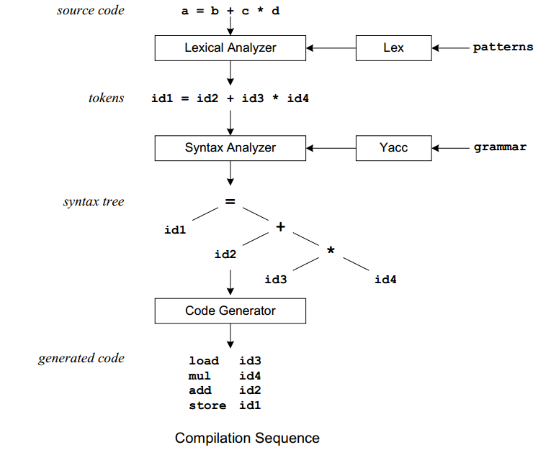
How do Lex and Yacc Work?

Slide 5
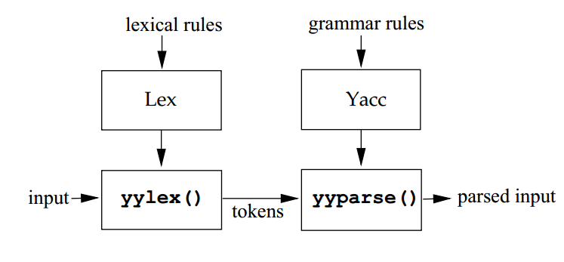
Basic flow

Slide 6
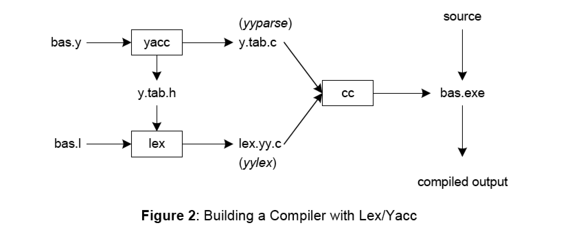
Compiling with Lex and Yacc Which function in which file?

Slide 7
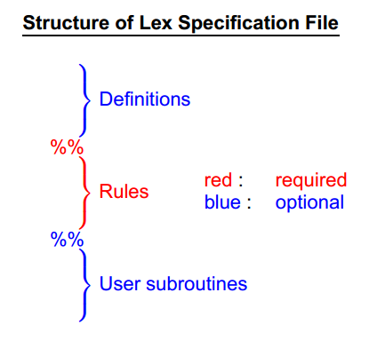
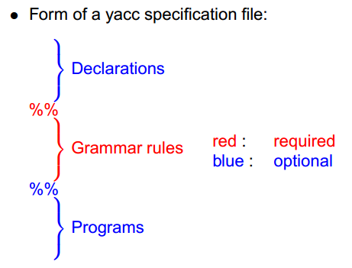
Structure of Lex & Yacc Specifications

Slide 8
“Hello World” lex and yacc Example

Slide 9
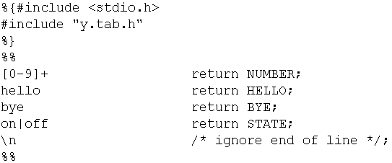
Hello.lex

Slide 10
Lex and yacc files have three sections (divided by %%). The first is sort of "control" information, the second is the actual token or grammar rule definitions, and the last is C code to be copied verbatim to the output. (The output is C code!).
Lines 1 – 3: In the control sections, you can indicate C code to be copied by enclosing it with "%{" and "%}".
Lines 5-8: They define a regular expression and an action to be executed. Action is C code that is copied into the eventual lex output.
Third section (empty for this example), is exclusively for copied C code. (Unlike the control section, there is no "%{" or "%}".).

Slide 11
Compiling the Hello.lex
Compiling with flex hello.lex produces the file lex.yy.c.
Note that hello.lex requires the header file y.tab.h generated when compiling the yacc specifications.
The generated source code is written to an output file lex.yy.c. That file contains the definition of a function called yylex() that returns 1 whenever an expression you have specified is found in the input text, 0 when end of file is encountered. Each call to yylex parses one token (assuming a return); when yylex is called again, it picks up where it left off.
These commands depend on the version of lex and yacc, so if they do not work for you search for matching commands.

Slide 12
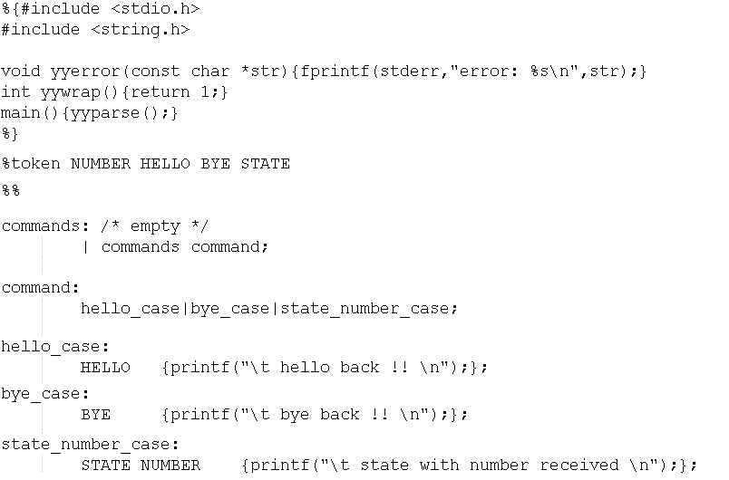
Hello.y

Slide 13
Yacc (or bison)
Yacc (or bison) defines the "terminal symbol" token types.
compiling by: bison –dy hello.y produces the files y.tab.h & y.tab.c.

Slide 14
In the YACC file, main() calls yyparse() (which is created by YACC as a function in the yacc-generated y.tab.c).
yyparse reads a stream of token/value pairs from yylex.
yylex reads characters from a FILE pointer called yyin (by default points to stdin) and outputs to yyout (by default to stdout).
Each call to yylex returns an integer value represents a token type telling YACC what kind of token it has read. The token may optionally have a value, which should be placed in the variable yylval.

Slide 15
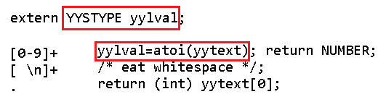
The Lexer accesses yylval by declaring in the scope of the lexer as an extern variable “extern YYSTYPE yylval;”

Slide 16
In more complex actions, the user will often want to know the actual text that matched some expression. Lex leaves this text in an external character array named yytext.
[a-z]+ printf("%s", yytext);
Sometimes it is more convenient to know the end of what has been found; hence Lex also provides a count yyleng of the number of characters matched (count both the number of words and the number of characters in words in the input).
[a-zA-Z]+ {words++; chars += yyleng;}
//Accumulates in chars the number of characters.
yytext[yyleng-1]
// Access the last character in the string matched

Slide 17
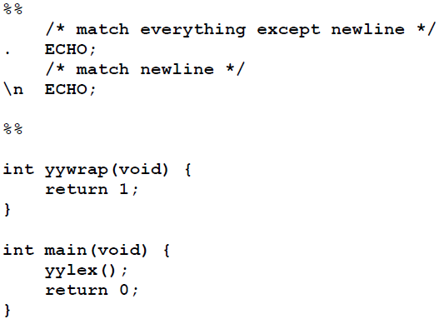
Input is copied to output one character at a time. If we don’t specify any rules then the default action is to match everything and copy it to output. Defaults for input and output are stdin and stdout, respectively. Here is the same example with defaults explicitly coded:

Slide 18
Anything not starting in column one is copied to the generated C file. We may take advantage of this behavior to specify comments in our lex file.
In this example there are two patterns, “.” and “\n”, with an ECHO action associated.
ECHO is a macro that writes code matched by the pattern, the default action for any unmatched strings. Typically defined as:
#define ECHO fwrite(yytext, yyleng, 1, yyout)
yyout is the output file and defaults to stdout.

Slide 19
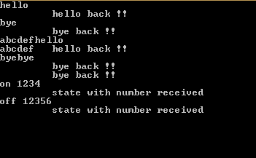
Compiling everything together
Compiling the output files using:
gcc lex.yy.c y.tab.c –o hello.exe

Slide 20
“Simple Calculator” lex and yacc Example

Slide 21
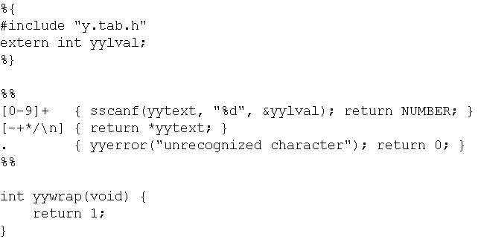
Lex file

Slide 22
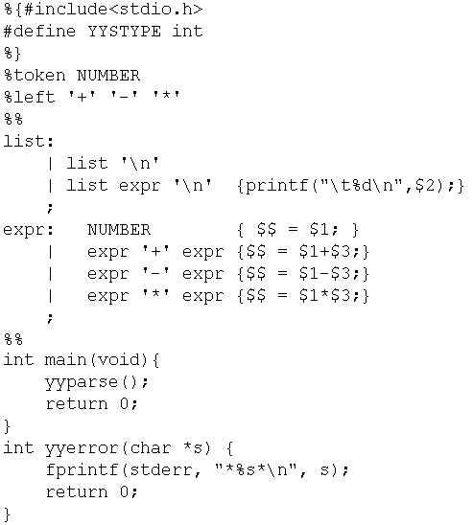
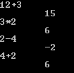
Yacc

Slide 23
References:
http://www.cs.bilkent.edu.tr/~guvenir/courses/CS315/lex-yacc/lex-yacc.pdf
http://epaperpress.com/lexandyacc/download/LexAndYaccTutorial.pdf
http://www.cs.arizona.edu/~debray/Teaching/CSc453/DOCS/tutorial-large.pdf
http://memphis.compilertools.net/interpreter.html
http://aquamentus.com/tut_lexyacc.html
https://www.ualberta.ca/dept/chemeng/AIX-43/share/man/info/C/a_doc_lib/aixprggd/genprogc/ie_prog_4lex_yacc.htm

