Slide 1
Early Support,
Not Automated Judgment
CONDITIONAL GO
Supportive decision support only
Executive view of the student dropout early-warning model
87.3%
39.8%
Dropout recall
Alert workload

Slide 2
EXECUTIVE CONTEXT
The Opportunity: Prioritize Limited Support Capacity
Student support teams need a reliable way to focus attention before dropout becomes irreversible.
Business Problem:
Some students disengage before staff can identify them manually.
AI Contribution:
Rank students by likelihood of dropout using end-of-Semester-1 signals.
Operational Goal:
Trigger earlier, supportive, human-reviewed outreach.
What value does it bring?
Better targeting of advising, counseling, and financial-support resources.
Fewer missed support opportunities than manual review alone.
Clear governance prevents harmful automated decisions.

Slide 3
USE GOVERNANCE
What the Model Does — and Does Not Do
Approved Uses
Prohibited Uses
Automatic withdrawal or dismissal.
Admission or scholarship denial.
Disciplinary action.
Automatic denial of institutional services.
Prioritize supportive student outreach.
Offer academic advising or counseling.
Offer financial-support information.
Assist human case prioritization with controls.
Principle: A high-risk score may create an opportunity for support; a low-risk score must never remove support access.

Slide 4
FINAL HOLDOUT
Performance At a Glance
0.954
0.949
0.890
87.3%
39.8%
ROC-AUC
PR-AUC
Balanced accuracy
Dropout recall
Alert rate
Holdout Outcomes Translated for Operations
Outcome
Count
Meaning
Implication: Strong screening value, but still requires a safety net and human judgment.
True positives
248
Actual dropouts correctly flagged
False negatives
36
Actual dropouts missed by the model
False positives
41
Graduates flagged for review

Slide 5
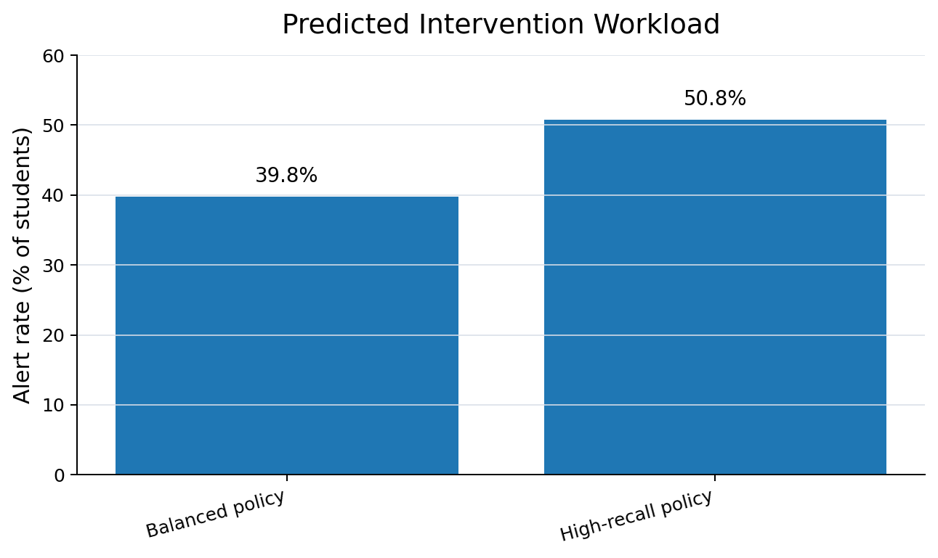
WORKLOAD
Operational Impact: Support Queue Size is Manageable
Why we choose the balanced threshold?
High-recall policy finds more dropouts but increases outreach volume.
Balanced policy keeps the alert queue under 40% of students.
This supports focused interventions without overwhelming teams.
Frozen policy: XGBoost at 0.48. Any change requires new validation.

Slide 6
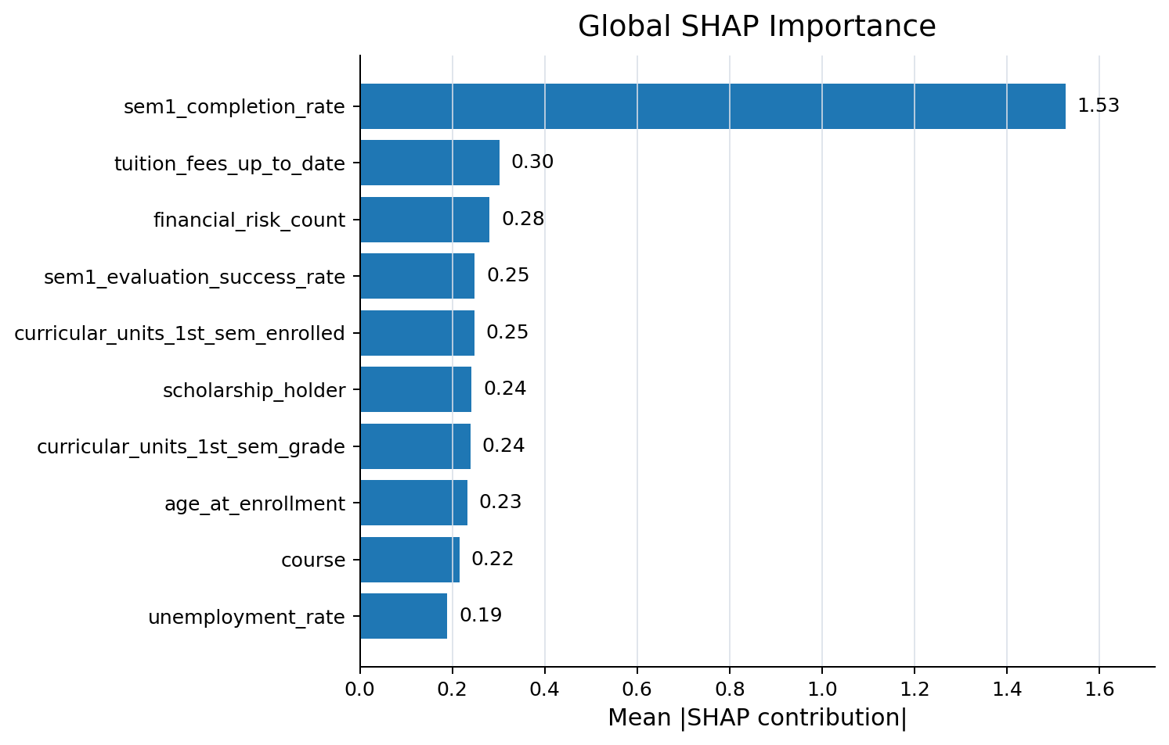
EXPLAINABILITY
What Drives Dropout Risk Predictions?
Interpretation:
The model is mostly reading early academic engagement and financial signals.
This is useful, but it may miss students whose challenges are not visible in data.
Advisor and faculty referrals must remain open.
Explainability supports trust — but it does not prove causality.

Slide 7
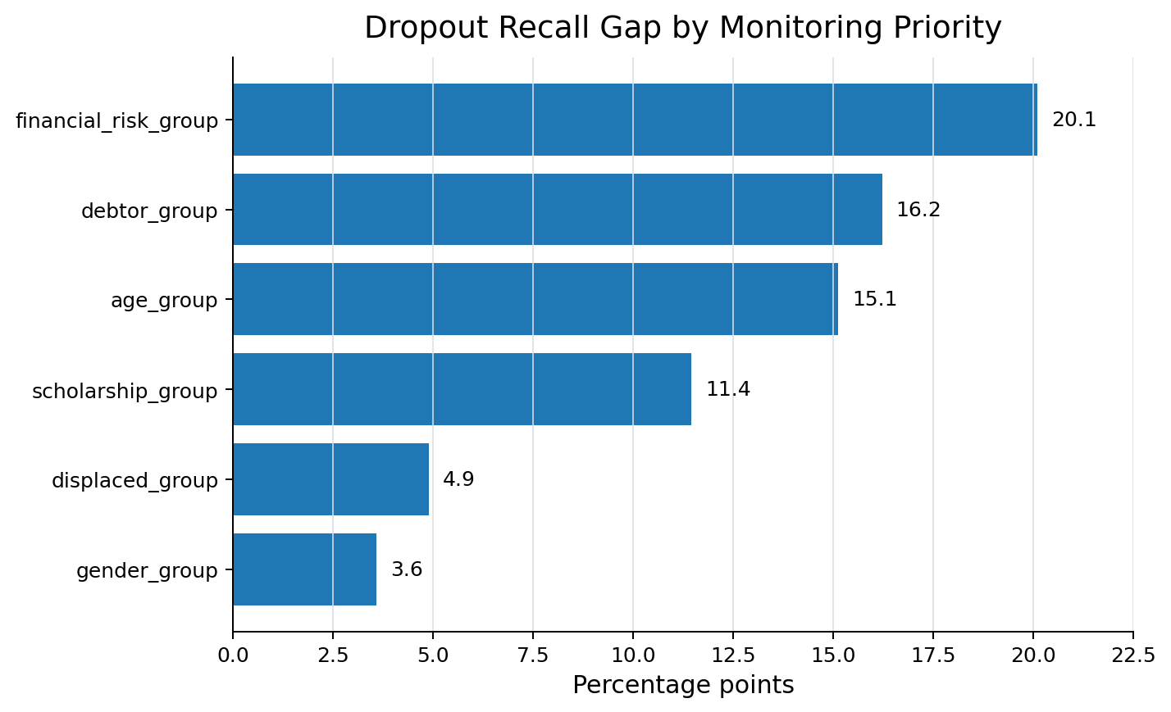
RESPONSIBLE AI
Fairness Findings: Where Monitoring Should Focus?
Highest Priorities
Financial-risk group: largest recall gap, 20.1 pp.
Debtor status: 16.2 pp recall gap.
Age: 15.1 pp recall gap and largest calibration range.
Scholarship status: 11.4 pp recall gap.
Fairness results are monitoring priorities, not proof of discrimination.

Slide 8
GOVERNANCE
Controls Required Before Operational Use
Control
Business requirement
Human oversight
Trained staff review alerts before action.
Override documentation
Record decisions, reasons, and follow-up.
No adverse automation
No dismissal, admission, scholarship, disciplinary, or service denial.
Safety net
Non-alerted students remain eligible for help.
Privacy + audit
Role-based access and model-version logging.
Governance converts a strong model into a responsible operating process.

Slide 9
OPERATIONS
Monitoring Plan After Launch
Every scoring cycle
Each completed cohort
Data quality and schema checks.
Mean risk score and score distribution.
Alert rate and workload changes.
Overall performance and calibration.
Subgroup fairness metrics.
Program-level robustness.
False-negative and override reviews.
Trigger for Action: material drift, subgroup degradation, calibration shift, or unusual override pattern.

Slide 10
EXECUTIVE ASK
Decision and Next Steps
Decision recommendation
CONDITIONAL GO — supportive decision support only
Approve with these conditions
Keep XGBoost model and 0.48 threshold frozen.
Limit use to supportive outreach and advising.
Implement the monitoring baseline and risk register.
Document human overrides and intervention outcomes.
248
36
Dropouts correctly flagged in holdout
Missed actual dropouts

