Slide 1
Motor power modulations during imagined movements
Neuromatch 2022
Brenda Qiu | Jessica Alexander Juan Pablo Botero | Kurt Lehner | Lavanya M K

Slide 2
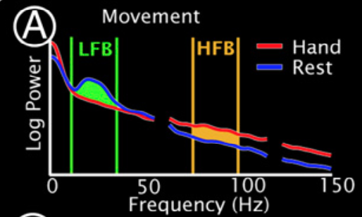
Background
relative power in beta frequency decreases within motor cortex during movement (event related desynchronization, ERD)
relative power in high gamma frequency increases during movement (event related synchronization, ERS)
Miller et al. (2010)

Slide 3
Aims
Replicate prior ERD/ERS findings
Investigate how power profiles during imagined and actual movements differ
Design and build ML pipeline to classify actual and imagined movements, with and without high gammas

Slide 4
Hypotheses
Similar ERD in beta frequency between actual and imagined
Attenuated changes in high gamma frequency for imagined movements in comparison with actual movements
Models without high gamma input will significantly underperform in the discrimination task

Slide 5
Data
ECoG recordings from subjects undergoing treatment for medically refractory epilepsy
Two interleaved tasks at rate of once per second (1 Hz), alternating between task and rest, on-screen cue:
hand (synchronous flexion/extension of all fingers)
tongue (protrusion/retraction of tongue with mouth open)
Two conditions: real movement, imagined movement
Dataglove or EMG to verify absence of movement during imagined condition

Slide 6
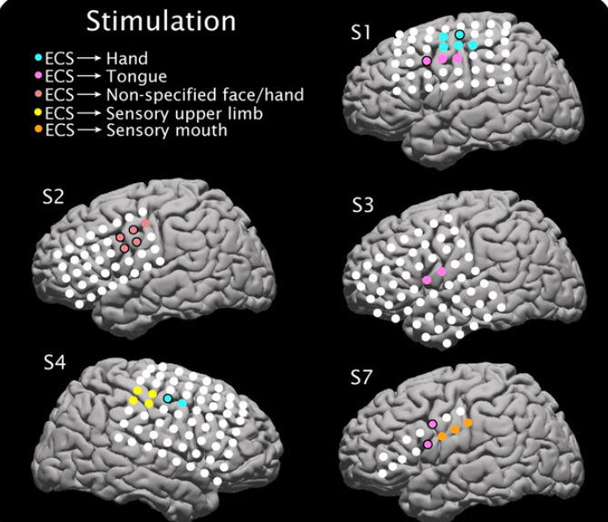
Data
Electrocortical mapping for five participants (for clinical purposes)
Provides indication of electrodes where stimulation causes movement
Analyzed S1
Miller et al. (2010)

Slide 7
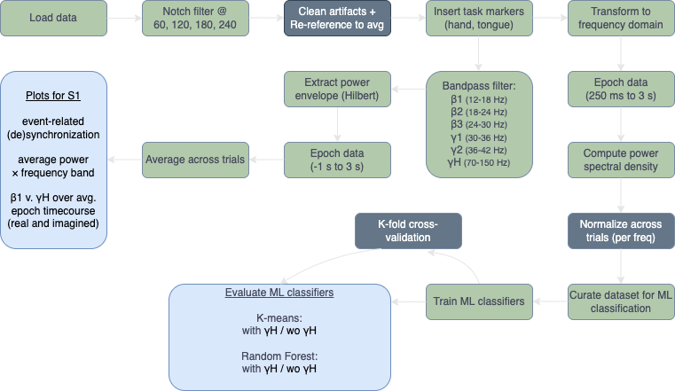
Methods
*grey boxes not completed due to project time constraints

Slide 8
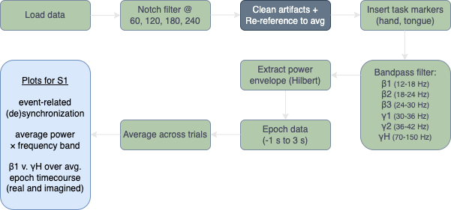
Exploratory Aims 1 and 2
*grey boxes not completed due to project time constraints

Slide 9
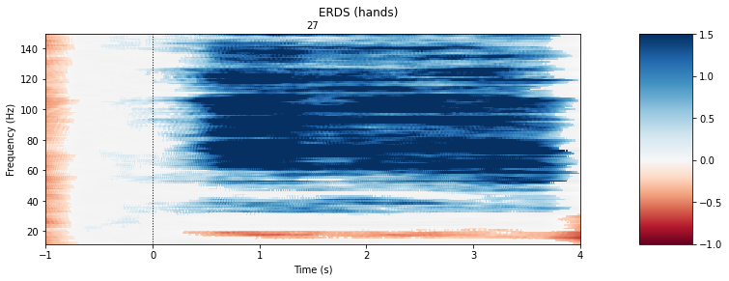
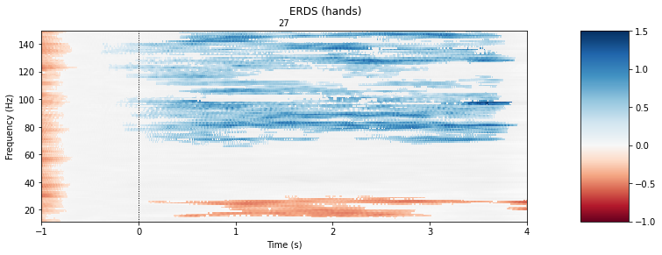
Aim 1: Replicate prior ERD/ERS findings
actual movement
imagined movement
relative change from baseline
relative change from baseline
Notes:
S1 Hand, Electrode 27

Slide 10
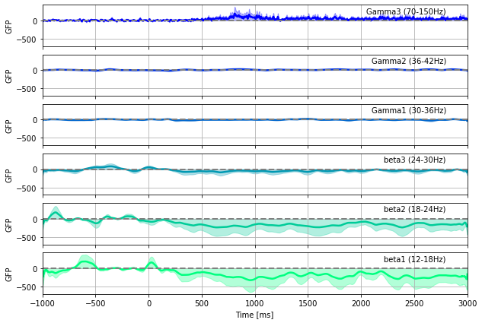
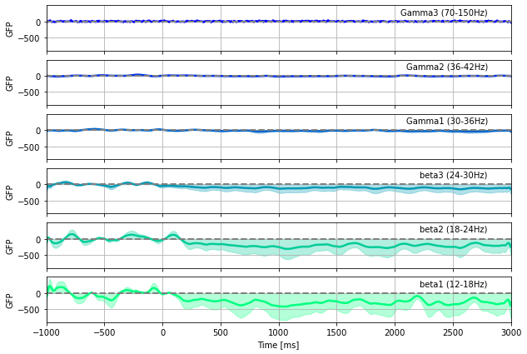
Aim 1: Replicate prior ERD/ERS findings
actual movement
imagined movement
Notes:
S1 Hand, Electrode 27

Slide 11
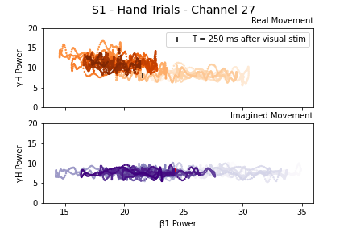
Aim 2: Investigate real v. imagined power
color (light > dark) indicates time course over epoch window (-1000 to 3000 ms)

Slide 12
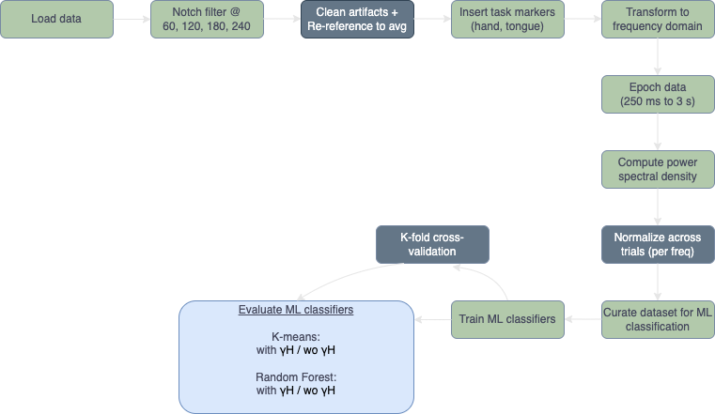
Aim 3
To what extent do lower frequency bands distinguish actual versus imagined movement?
*grey boxes not completed due to project time constraints

Slide 13
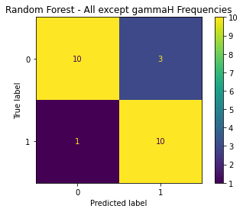
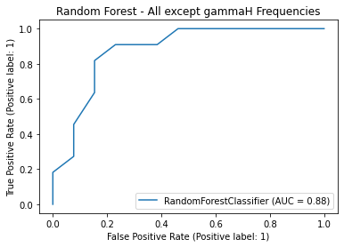
Aim 3: Classify without high gamma

Slide 14
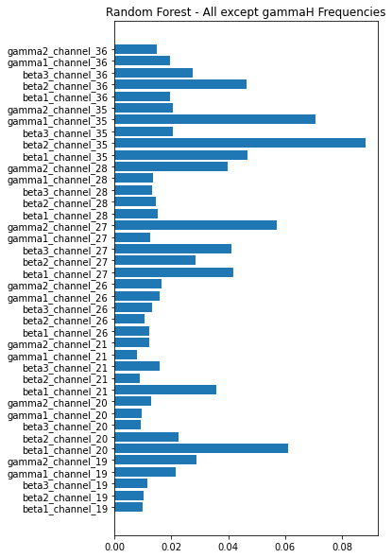
Aim 3: Classify without high gamma

Slide 15


Conclusions
Similar ERD in beta frequency between actual and imagined
Attenuated changes in high gamma frequency for imagined movements in comparison with actual movements
Low frequency only models will significantly underperform in the discrimination task
Better performance than anticipated (but models with high gamma still perform better...)

Slide 16
Limitations
specific subject population reduces generalizability of findings
project time constraints led us to simplify our preprocessing:
did not re-reference data to the average
did not perform ICA or other methods to identify and remove noisy (or epileptic) epochs in the channels we analyzed
project time constraints led us to simplify our analyses:
did not z-score across trials within bands before classification
single randomized split for training/test (no thorough cross-validation)

Slide 17
Code Availability
https://github.com/jessb0t/motorImagery

Slide 18
References
Gramfort, A., Luessi, M., Larson, E., Engemann, D. A., Strohmeier, D., Brodbeck, C., Goj, R., Jas, M., Brooks, T., Parkkonen, L., & Hämäläinen, M. S. (2013). MEG and EEG data analysis with MNE-Python. Frontiers in Neuroscience, 7(267):1–13.
Harris, C.R., Millman, K.J., van der Walt, S.J. et al. (2020). Array programming with NumPy. Nature 585, 357–362.
Hunter, J.D. (2007). Matplotlib: A 2D Graphics Environment, Computing in Science & Engineering, 9(3):90-95.
Miller, K. J., Schalk, G., Fetz, E. E., den Nijs, M., Ojemann, J. G., & Rao, R. P. N. (2010). Cortical activity during motor execution, motor imagery, and imagery-based online feedback. PNAS, 107(9), 4430–4435.
Miller KJ. A library of human electrocorticographic data and analyses. Nat Hum Behav. 2019 Nov;3(11):1225-1235.
Unterweger, J., Seeber, M., Zanos, S., Ojemann, J. G., & Scherer, R. (2020). ECoG Beta Suppression and Modulation During Finger Extension and Flexion. Frontiers in Neuroscience, 14, 35.
Code for creation of the GFP graphics based on the detailed example provided here: https://mne.tools/stable/auto_examples/time_frequency/time_frequency_global_field_power.html

Slide 19
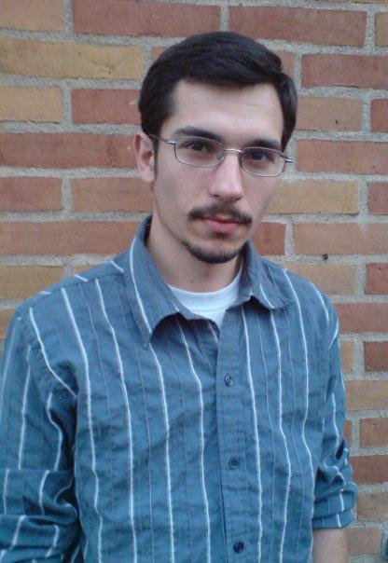



Thanks!
Dr. José Biurrun Manresa, Project TA
Anis Zahedifard, Pod TA
Neuromatch Organizers and Volunteers
Dr. Jason Ritt, Project Mentor

