Slide 1
Motor phase amplitude modulations during imagined movements
Neuromatch 2022
Brenda Liu | Jessica Alexander | Juan Pablo Botero Kurt Lehner | Lavanya Mysuru Krishnamurthy

Slide 2
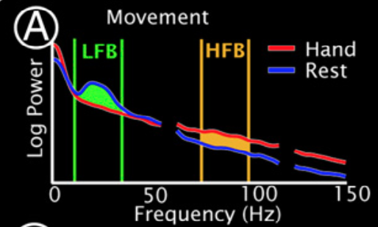
Background
relative power in beta frequency decreases within motor cortex during movement (event related desynchronization, ERD)
relative power in high gamma frequency increases during movement (event related synchronization, ERS)
Miller et al. (2010)

Slide 3
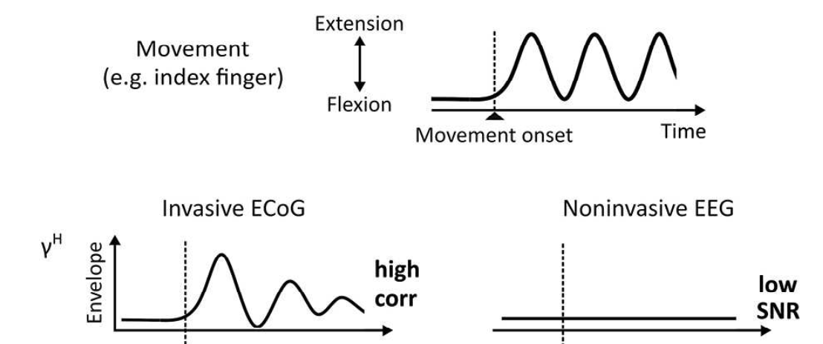
Background
power increases in high gamma correlate with dynamic movement features (movement related amplitude modulation, MAM)
Unterweger et al. (2020)

Slide 4
Aims
Replicate prior ERD/ERS findings with the Miller dataset
Investigate how power profiles across frequency bands during imagined movements differ from prior findings in actual movements
Compare ability of XXXX classifier to identify actual and imagined movements when trained on beta only, gamma only, and beta+gamma
Hypotheses
Similar ERD in beta frequency between actual and imagined
Attenuated changes in high gamma frequency for imagined movements in comparison with actual movements
Beta only models will significantly underperform in the discrimination task

Slide 5
Data
ECoG recordings from subjects undergoing treatment for medically refractory epilepsy
Two interleaved tasks at rate of once per second (1 Hz), alternating between task and rest, on-screen cue:
hand (synchronous flexion/extension of all fingers)
tongue (protrusion/retraction of tongue with mouth open)
Two conditions: real movement, imagined movement
Dataglove or EMG to verify absence of movement during imagined condition

Slide 6
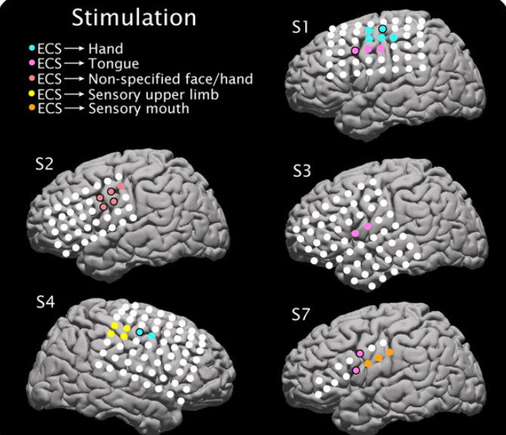
Data
Electrocortical mapping for five participants (for clinical purposes)
Provides indication of electrodes where stimulation causes movement
Analyzed S1, S3, and S4
Miller et al. (2010)

Slide 7
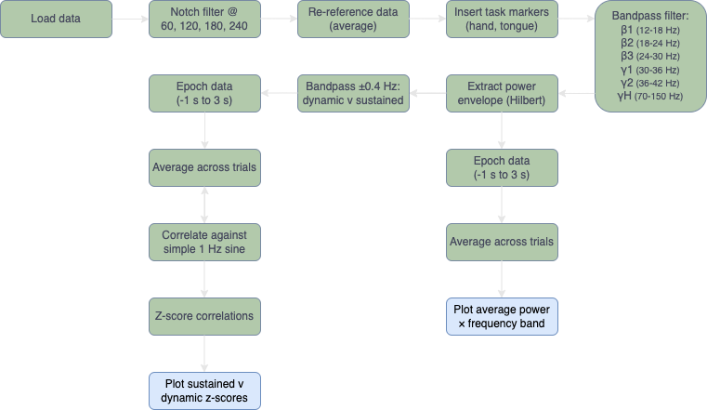
Methods
to be updated

Slide 8
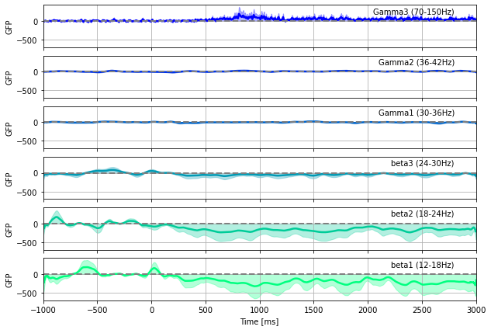
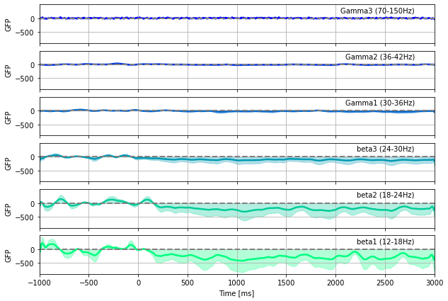
Results | ERD/ERS S1 Hand, Electrode 27
actual movement
imagined movement

Slide 9
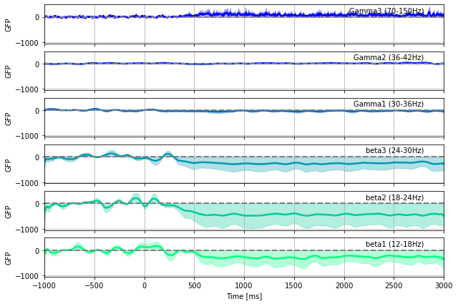
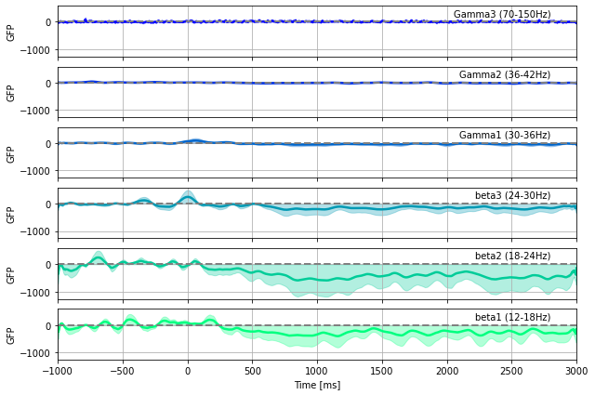
Results | ERD/ERS S1 Hand, Electrode 35
actual movement
imagined movement

Slide 10
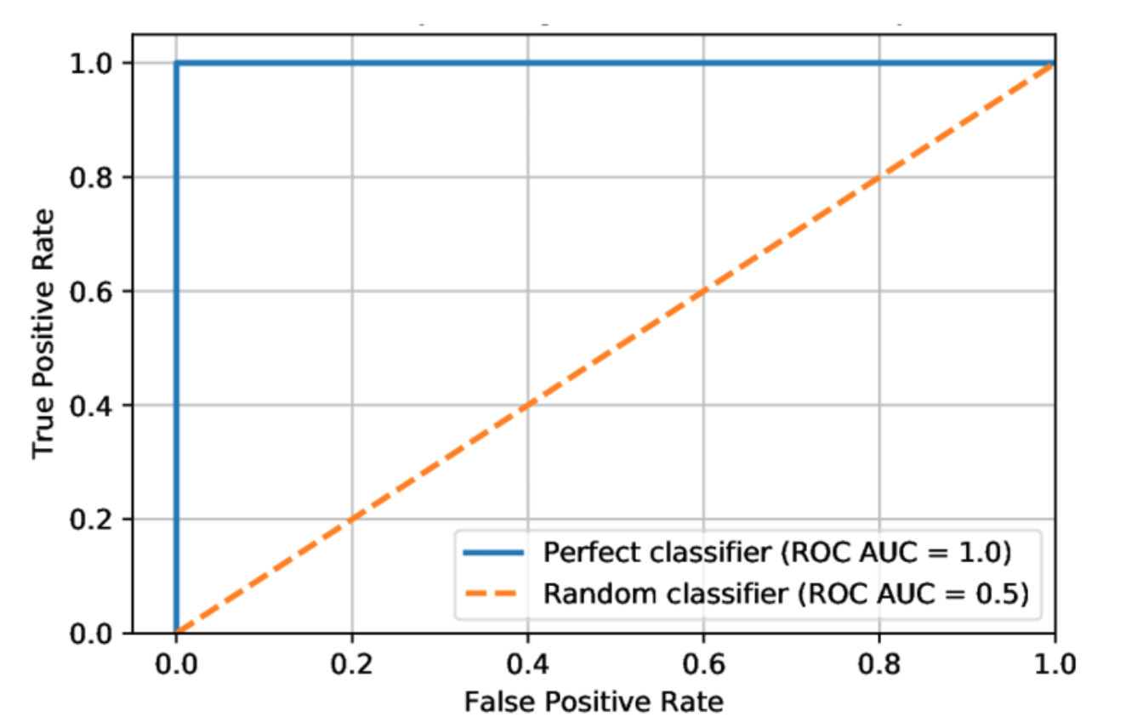
sample

Slide 11
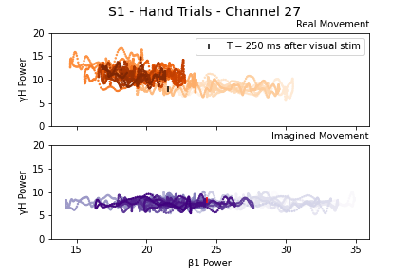
Results | ERD/ERS S1 Hand, Electrode 27
color (light -> dark) indicates time course over epoch windows (-1000 to 3000 ms)
vertical marker indicates 250 ms after onset of visual stimulus

Slide 12
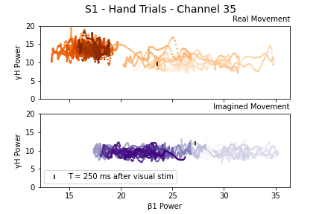
Results | ERD/ERS S1 Hand, Electrode 27
color (light -> dark) indicates time course over epoch windows (-1000 to 3000 ms)
vertical marker indicates 250 ms after onset of visual stimulus

Slide 13
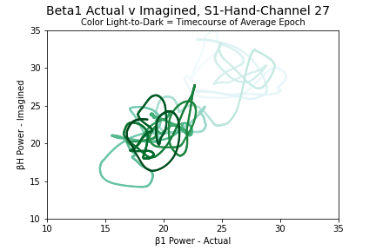
Results | ERD S1 Hand, Electrode 27

Slide 14
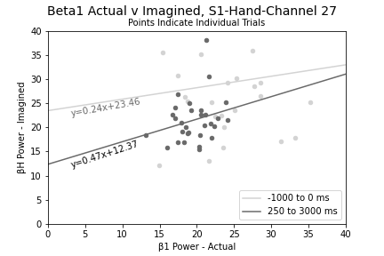
Results | ERD S1 Hand, Electrode 27

Slide 15
Conclusions
which stats to demonstrate similarity between conditions?
motor planning? Nakayashiki
to be updated

Slide 16
Limitations
specific subject population reduces generalizability of findings
project time constraints led us to simplify our preprocessing:
did not re-reference data to the average
did not perform ICA or other methods to identify and remove noisy (or epileptic) epochs in the channels we analyzed
project time constraints led us to simplify our analyses:
did not z-score across subjects before classification
single randomized split for training/test (no thorough cross-validation)

Slide 17
Future Directions
what else would we do if we had more time?

Slide 18
Code Availability
https://github.com/jessb0t/motorImagery

Slide 19
References
Gramfort, A., Luessi, M., Larson, E., Engemann, D. A., Strohmeier, D., Brodbeck, C., Goj, R., Jas, M., Brooks, T., Parkkonen, L., & Hämäläinen, M. S. (2013). MEG and EEG data analysis with MNE-Python. Frontiers in Neuroscience, 7(267):1–13.
Harris, C.R., Millman, K.J., van der Walt, S.J. et al. (2020). Array programming with NumPy. Nature 585, 357–362.
Hunter, J.D. (2007). Matplotlib: A 2D Graphics Environment, Computing in Science & Engineering, 9(3):90-95.
Miller, K. J., Schalk, G., Fetz, E. E., den Nijs, M., Ojemann, J. G., & Rao, R. P. N. (2010). Cortical activity during motor execution, motor imagery, and imagery-based online feedback. PNAS, 107(9), 4430–4435.
Miller KJ. A library of human electrocorticographic data and analyses. Nat Hum Behav. 2019 Nov;3(11):1225-1235.
Unterweger, J., Seeber, M., Zanos, S., Ojemann, J. G., & Scherer, R. (2020). ECoG Beta Suppression and Modulation During Finger Extension and Flexion. Frontiers in Neuroscience, 14, 35.
Code for creation of the GFP graphics based on the detailed example provided here: https://mne.tools/stable/auto_examples/time_frequency/time_frequency_global_field_power.html

Slide 20
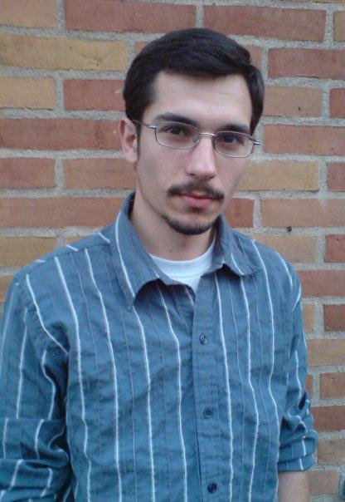



Thanks!
Dr. José Biurrun Manresa, Project TA
Anis Zahedifard, Pod TA
Neuromatch Organizers and Volunteers
Dr. Jason Ritt, Project Mentor

